Slide 1
ADS Marker Lamp
Draft Regulation: ADS marker lamp → Draft technical characteristics (1/3)
 |  | DESIGNATED MARKER LAMPS FOR AUTOMATED VEHICLES
Number |  | 1 | 2
Photometry (1) See photometry grids in the next page | Daytime (min/max) | Front: 50 / 300 cd Rear: [20 / 120 cd] Side: 20 / 120 cd
 | Nighttime (min/max) | Front: 10 / 125 Rear: 4 / 42 cd Side: 4 / 25 cd
Geometric visibility | Vertical (up/down) | Front: 15° / 15° (5° down if lower than 750mm) (5° up 30° down if higher that 3000mm) Rear: 15° / 15° (5 down if lower than 750mm) (5° up 30° down if higher that 3000mm) Side: 10° / 10° (5 down if lower than 750mm) (5° up 30° down if higher that 3000mm)
 | Horizontal (outboard / inboard) | Front: [60° / 60°] Rear: [60° / 60°] Side: 45° / 45° | Front: [60° / 20° 45°] Rear: [60° / 20° 45°] Side front: 45° forward / 30° rearward Side rear: 45° rearward / 30° forward
 | To be considered visible | Front, and rear and side: 1 0.3 cd (day) / 0.05 cd (night) Side: 3 cd (day) / 0.6 cd (night)
Mounting (Location) | Height min/max | 250 mm / -
 | Width | Front and rear: Centerline of vehicle | Front and rear: evenly spaced about vertical longitudinal plane
 | Length | Side: < 3m from the front | Side front and side rear: < 3m from the front
Activation | Other requirements | Switched ON automatically only when the vehicle is in fully automated mode and human input is not expected/required. Switched OFF automatically when the vehicle is not in fully automated mode. Manual switching ON or OFF prohibited. It should be possible to disable the automatic switching ON and OFF of ADS marker lamp (GPS/software switch) [It must not be easily accessible by the vehicle operator] Reciprocal incorporation allowed with DRL, front position lamps, side marker lamps, direction indicators, rear position lamps (only partial incorporation, remaining part of the rear position lamp shall comply with the requirements). In the case of reciprocal incorporation with direction indicator, the ADS marker lamp should switch off when direction indicator is activated on the relevant side In the case of grouped with front DI, similar requirements as UN R-48 par. 6.19.7.6. for front DI/DRL ((2) see page 3) [Shall not mask or otherwise interfere optically, physically or operationally with any one of the required lighting or light signalling functions]
Color |  | “blue-green” / “turquoise” x=0.012, y=0.495; x=0.200, y=0.400; x=0.200, y=0.320; x=0.040, y=0.320.
Symbols |  | AV1 (front), AV2 (rear), AV3 (side)
07-2025

Slide 2
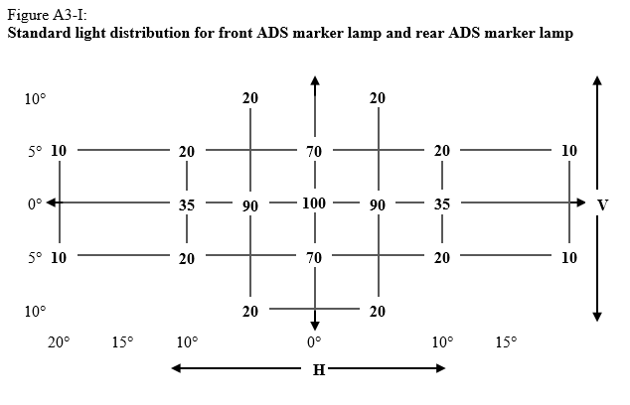
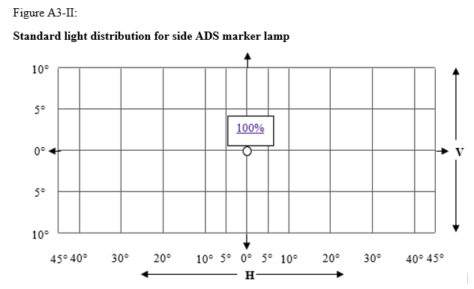
ADS Marker Lamp
Draft Regulation: ADS marker lamp → Draft technical characteristics (2/3)
Light distribution (photometry grids)
07-2025

Slide 3
ADS Marker Lamp
Draft Regulation: ADS marker lamp → Draft technical characteristics (3/3)
(2) coming from page 1:
Case of ADS-ML grouped but non reciprocally incorporated with front DI
Proposal of provision to be introduced in the new hybrid regulation ADS-ML, based on UN R-48 par. 6.19.7.6. for not reciprocally incorporated front DI & DRL.
Chosen value 125cd is the night time maximum requirement of the Front ADS-ML
X.X.X. If a front direction-indicator lamp is not reciprocally incorporated with an ADS marker lamp and the distance between the edges of the apparent surfaces in the direction of the reference axis of the front direction-indicator lamp and the ADS marker lamp is equal or less than 40 mm, the electrical connections of the ADS marker lamp shall be such that, either:
(a) The ADS marker lamp on the relevant side of the vehicle is switched OFF during the entire period (both ON and OFF cycle) of operation of the front direction-indicator lamp; or
(b) The luminous intensity of the ADS marker lamp on the relevant side of the vehicle is reduced during the entire period (both ON and OFF cycle) of operation of a front direction-indicator lamp, to attain not more than 125 cd within the angles of geometric visibility. The conformity to this requirement shall be verified at the time of the ADS marker lamp type approval and indicated in the related communication form.
If the luminous intensity of the front direction-indicator lamp in HV is at least 50% higher than the luminous intensity of the ADS marker lamp in HV, the ADS marker lamp does not need to be switched OFF as required under (a) of this paragraph nor dimmed as required under (b) of this paragraph. In this case the applicant shall demonstrate compliance with a concise description or other means acceptable to the Type Approval Authority.
Remark: activation of ADS-ML in combination with Stop lamp (grouped, reciprocally incorporated, partially reciprocally incorporated) still to be drafted by GTB
07-2025

