Slide 1
F&SC kick-off meeting
FRPC drafting team
7 July 2025

Slide 2
Mandate & operational details of drafting team
(from F&SC-05-02)
The drafting team shall write proposals for the FRPC test.
Proposals (for FPRC test drafts or other documents) are regularly submitted for approval to the meetings of the EV F&SC cluster
EV F&SC cluster drafting team has currently13 members (incl. drafting coordinator)
The drafting team can occasionally invite others to their meetings
The chair and secretariat can join as observers
Guidance from F&SC will be provided at high level on approach
Meeting frequency: at least once a month, more often if needed

Slide 3
Task 1: Outline document
Proposed to start by preparing a general concept for the test procedure, including relevant requirements and conditions to be established (e.g. family criteria, pre-conditioning, soak temperature, etc.)
Develop detailed proposals for the requirements and conditions of the test procedure, based on guidance documents
(F&SC-06-02e and 03e)
Present the outline document to the F&SC group and ask for guidance/feedback
Update the outline document up until it is adopted by the F&SC group

Slide 4
Guidance documents
Existing International standards
Drafting group
Outline
Document
F&SC
Group
Feedback

Slide 5
Drafting process
The drafting team shall draft proposals within the structure provided by the table of contents agreed in the 4th meeting
(see document F&SC-04-03e)
First draft text proposal will be a skeleton document for all sections that need to be covered e.g. family criteria, pre-conditioning, test conditions, etc. (see F&SC-05-02)
Some elements can already be drafted while outline document is being established
⇨Aim for FRPC draft test procedure is to develop a reproducible and comparable charging curve, and within this context a representative curve for real-world charging

Slide 6
Existing International standards
Drafting
Group
Draft text
proposal
F&SC
Group
Outline document & skeleton
Feedback

Slide 7
Comparison of guidance documents
F&SC-06-02 and -03
OICA guidance focuses on family criteria and fast-charging KPIs, no objections to apply ISO 12906 test procedure
NL guidance:
cover entire UBE from 0 to 100%, provide consumer metric for other charging windows (e.g. 10 to 80%)
Preference to align with existing relevant international standards (GTR 15, GTR 22, ISO 12906, HDV battery durability GRPE proposal)
EVSE and test system specifications/requirements
Data sampling and parameters
Start/stop conditions, preconditioning, soaking and preparation
Need for vehicle dyno preparation is questioned

Slide 8
Main open issues – first shot
To what extent can we use/copy/refer to other international standards?
Definition of vehicle families and parent vehicle selection
Are on-board parameters accepted as reliable or should they be measured?
Is the full recharge curve measured (0-100%) or a limited one (e.g. 20-80%)?
Is the UBE from the WLTP test procedure applied (UN R154) or is this established as part of the FRPC?
How should the SOC be determined (as indicated by the vehicle or determined objectively by the FRPC)?
Is the use of a chassis dynamometer required?

Slide 9
Next steps
Kick-off drafting team meeting on 7 July 2025, next meetings will be scheduled
Identify fundamental issues where guidance from F&SC is needed for, as input for the outline document
⇨ Volunteers?
Prepare first outline document ahead of next F&SC meeting on 18 September
F&SC to respond to outline document and develop KPIs for FRPC
Timeline for FRPC: first draft text proposal by December 2025(!)

Slide 10
QUESTIONS & DISCUSSION

Slide 11
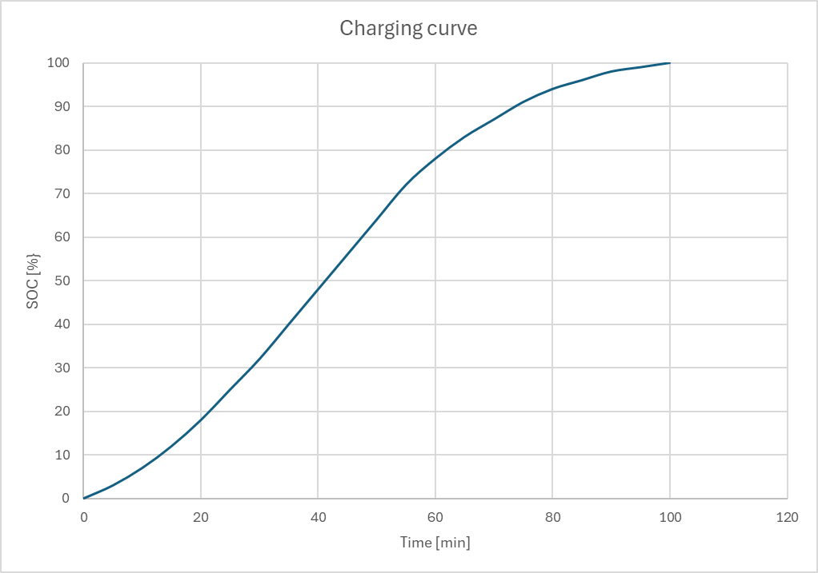
Average power from 20-80% SOC
Time from 20-80% SOC
Start condition: SOC = 0%
End condition: SOC = 100%

