Slide 1
Multicircuit preliminary results
Reminder: ETRTO decided to examine the vehicle method on different circuits.
Tests (1 convoy 3 3PMSF tyres, 1 convoy 3 Normal tyres) have been organized with “low” and “high” temperatures by 2 new service providers in south of Germany and North of France
Results now available, showing similar and different abrasion rate index.
TFTA 37th session (part 2) 26 August 2025

Slide 2
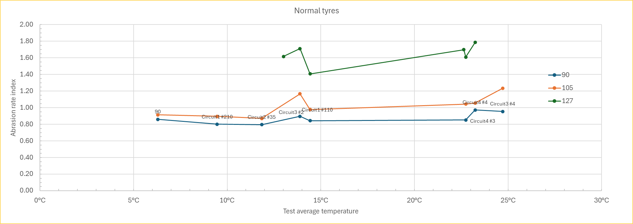
Summer tyres results
3 tyres of the correlation/validation plan has been tested, with same vehicles.
Consistent results: 8/8 for 1 tyre, 6/8 for 1 tyre, 5/6 for 1 tyre
Shifted results:1 measure Circuit 4, 1 measure Circuit 3 , 1 measure Circuit 2

Slide 3
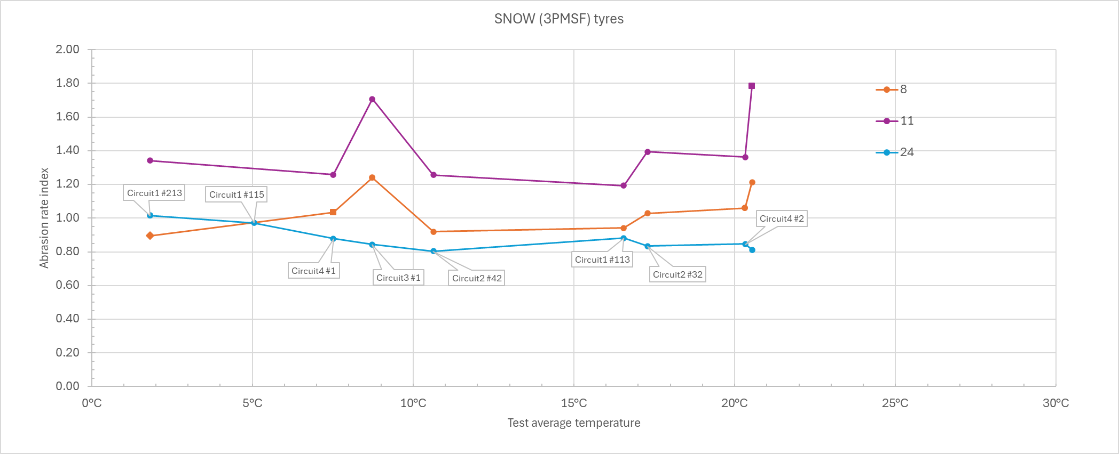
Winter tyres results
3 tyres of the correlation/validation plan has been tested, with same vehicles.
Consistent results: 9/9 for 1 tyre, 6/8 for 2 tyres
Shifted results: 2 measures x 2 tyres on Circuit 3

Slide 4
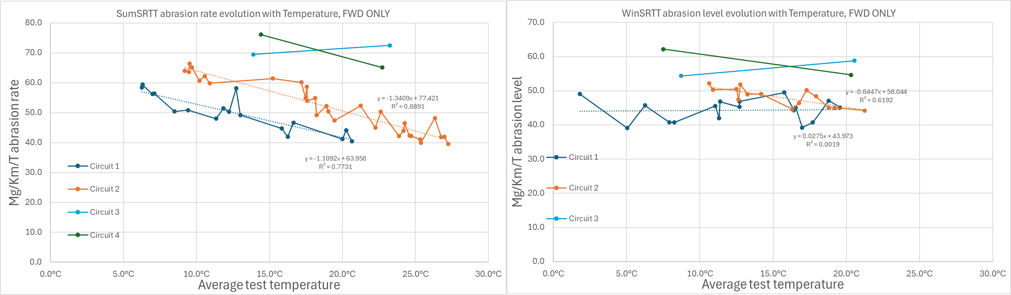
SRTT abrasion level
New circuits are more severe than existing circuits, still in vehicle method specifications.

Slide 5
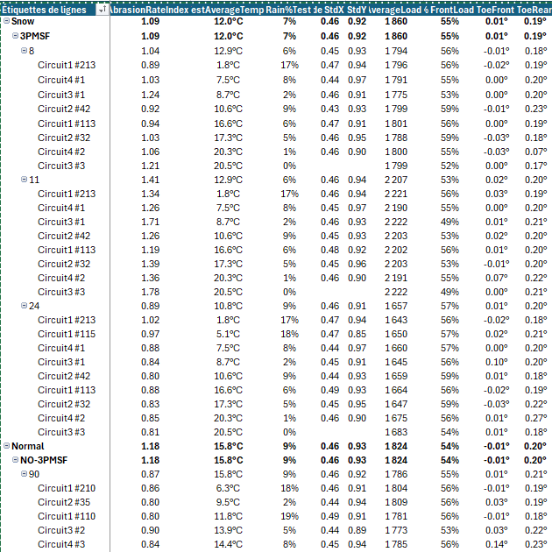
Analyze to perform
Deep analyze needed, target being to understand if:
  Parameters in line with method
  Difference of conditions (temp, rain, accelerations, load distribution, axles tuning…) between tests may explain or not the difference of results
  Possible different conditions candidate/reference also to be analyzed.
May drive to method improvements, including:
  Smaller tolerances for parameters,
  Restriction of differences between candidate tyres and reference tyres conditions (load, load distribution, tuning… )
  Correction based on test condition

Slide 6
Conclusion and next steps
Current status:
  Tests are finished,
  Data are under assessment
Perform deep analyze by ETRTO and Test Centers to check:
  Coherence of data with uncertainties range,
  Understand the deviation root causes, including the contribution of test suppliers to this analysis.
Propose possible improvements decreasing residual uncertainties.

Slide 7
Thanks for your attention

