Slide 1
XL tyres allowance
Target: confirm the allowance of 0.1 for AI of XL tyres vs. SL tyres.
To this end, ETRTO realized tests with WinSRTT at IFV and SumSRTT at DEKRA
The same SRTT tyre models have been used in SL and XL condition
SL conditions: pressure 250 kPa, load ~1650 kg
XL conditions: pressure 290 kPa, load ~1785 kg

Slide 2
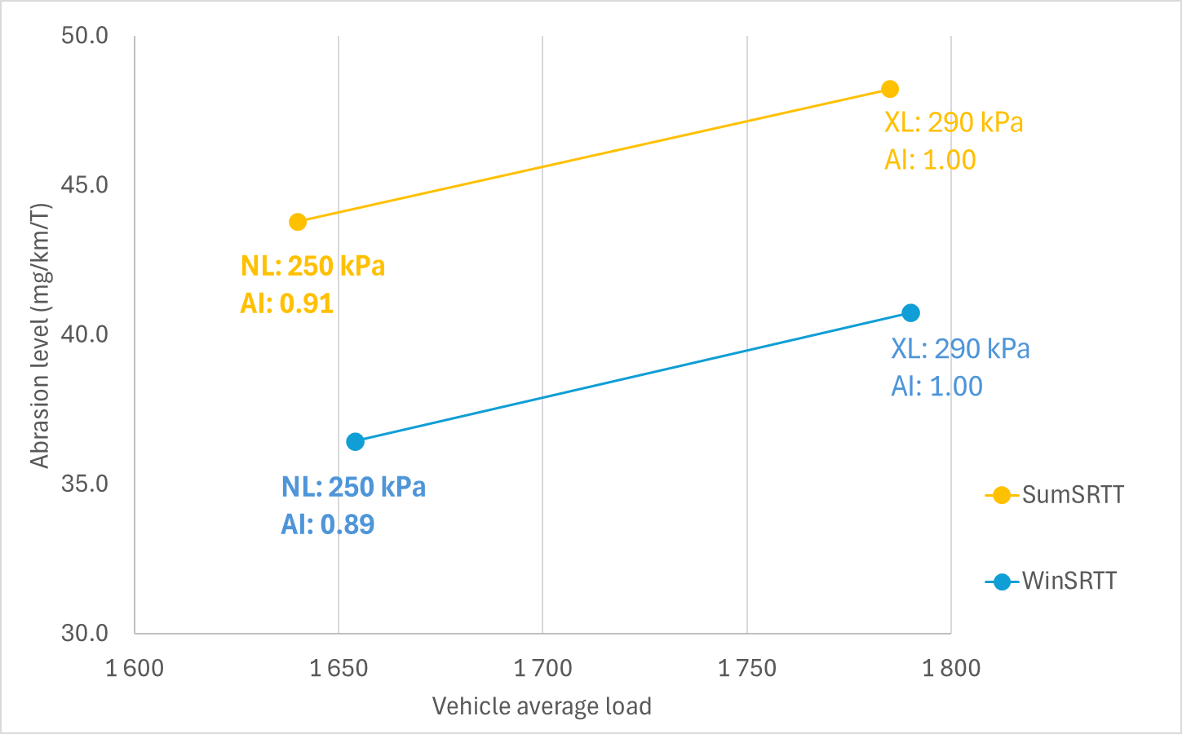
ETRTO test results illustrating XL vs SL tyres abrasion index
Test performed: compare same physical tyres (WinSRTT and SumSRTT) @
  SumSRTT test
    SL: 250 kPa and ~ 1650 kg
    XL: 290 kPa and ~ 1785 kg
  WinSRTT test
    SL: 250 kPa and ~ 1650 kg
    XL: 290 kPa and ~ 1785 kg
  Detailed tests parameters:
Conclusion: both tyre models (XL) have demonstrated a difference of about -0.1 for their abrasion rate index when tested in SL conditions
Maintaining an allowance of 0.1 over time for abrasion index for XL tyres is essential to preserve consistency with validated test conditions.

Slide 3
Thanks for your attention

