Slide 1
UK and EU top ten selling cars and reverse detection systems
11 September 2025
NOT GOVERNMENT POLICY
VRU-Proxi TF_REV_DETECT-01-02

Slide 2
Background
To help understand what reverse detecting equipment is currently fitted to new car models, analysis of the top 10 selling models of 2024 in the UK and EU was performed.
Each car was assessed on whether they are fitted with parking sensors or a reversing camera or both, and how this changes for different trim levels. Full analysis can be viewed on slide 4.
All information used is from open source.
All vehicle specifications were checked via UK dealer websites. What is available in the EU might be different and country specific.

Slide 3
Findings
All but one (Volvo XC40) of the models assessed were fitted with either a reversing camera or parking sensors on the base model. It was possible to fit both or either, as optional extras to the Volvo XC40.
60% of the UK models were fitted with both systems at the base trim level, compared to only 10% of the EU models.
All but one (Volvo XC40) of the UK models had both systems fitted one trim level up from basic. In the EU both systems were only fitted higher up the trim levels.
It is possible to get both systems fitted on all models if you go high enough up the trim levels except for the Toyota Yaris, where it is not possible to have parking sensors.

Slide 4
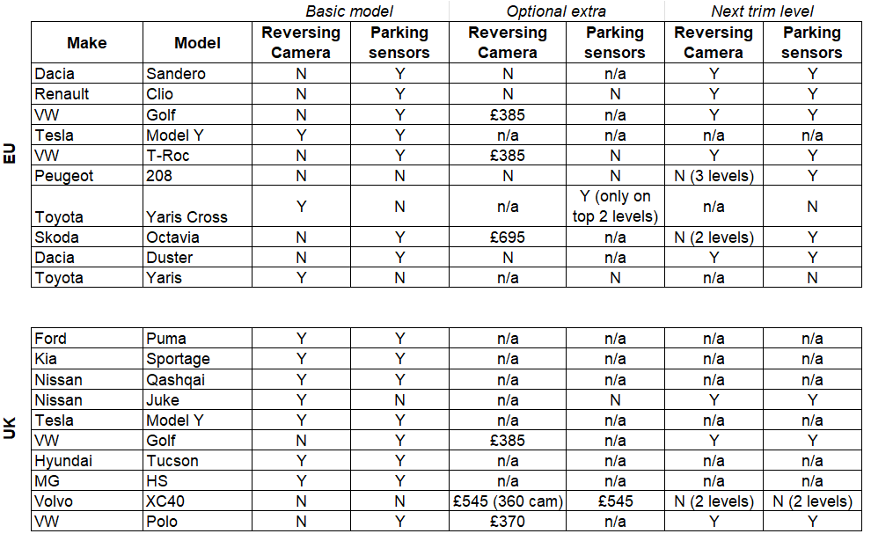
Analysis

