Slide 1
OICA Input to SLR-74
Topic: “Prohibited if not allowed”
SLR-74-07
3rd September 2025

Slide 2
Working document reflecting the outcome of SLR-73
5. General specifications
The fitting of any lighting and light-signalling device or function, other than those mentioned in paragraph 6, is prohibited for the purposes of granting a type-approval according to this Regulation
except for:
any special warning lamp approved in conformity with UN Regulation No. 65;
[approved reflecting plates according to Regs. 70 and 150 as well as green lamps used on ADR vehicles] → NEW, proposed by OICA
[light-emitting rear registration plates, the service-door-lighting system according to the provisions of UN Regulation No. 107 on vehicles of categories M₂ and M₃ and external status indicator] → NEW, considered during SLR-73 (text moved from Par. 2.1.5.)
“Core” part to be added
Exceptions for further discussion
2.1.5. "Lamp" means a device designed to illuminate the road or to emit a light signal to other road users. Rear registration plate lamps and retro-reflectors are likewise to be regarded as lamps. [For the purpose of this Regulation, light-emitting rear registration plates, the service-door-lighting system according to the provisions of UN Regulation No. 107 on vehicles of categories M₂ and M₃ and external status indicator as defined in this Regulation are not considered as lamps.]
5.22. With the exception of retro-reflectors, a lamp even bearing an approval mark is deemed not to be present when it cannot be made to operate by the sole installation of a light source and/or a fuse.

Slide 3
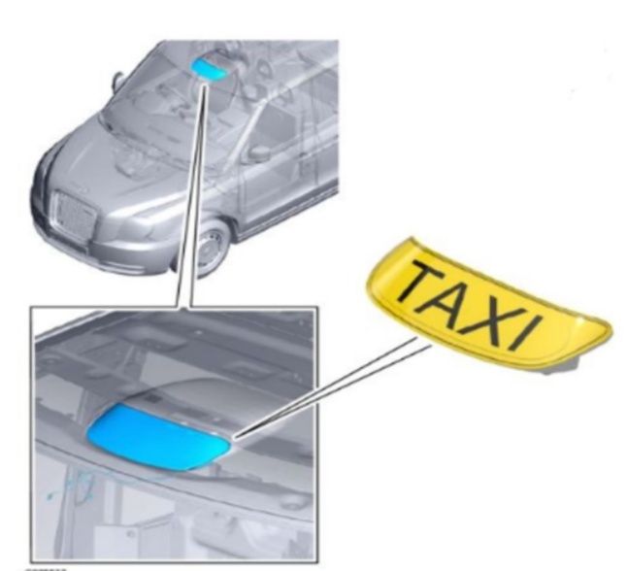
Problem
Example 1: UK Taxi lamp permitted under the UK Road Vehicle Lighting Regulations (RVLR)
The SLR group is discussing a proposal to add new requirements under paragraph 5. ‘General specifications’:
5. General specifications
The fitting of any lighting and light-signalling device or function, other than those mentioned in paragraph 6, is prohibited for the purposes of granting a type-approval according to this Regulation, except for…
For the purpose of discussion, the exemption in paragraph 5.22. of UN Regulation No. 48 permits a taxi lamp to be installed but remain non-operational provided it is deactivated by means other than a light source and/or a fuse. The lamp could later be re-activated when it is configured for the relevant market. UN R156 prevents re-activation via software.
OICA questions how the SLR proposal achieves the original objective of Simplification?
OICA believes that the 1958 Agreement is not the appropriate mechanism for prohibiting the installation of non-type-approved lamps.
Image: Copyright free. Supplied with permission from LEVC.
Example 2: Tail lift illumination in §53 under Straßenverkehrs-Zulassungs-Ordnung (StVZO)
Image: Copyright free. Supplied by Torsten Schwarz, Audi.

Slide 4
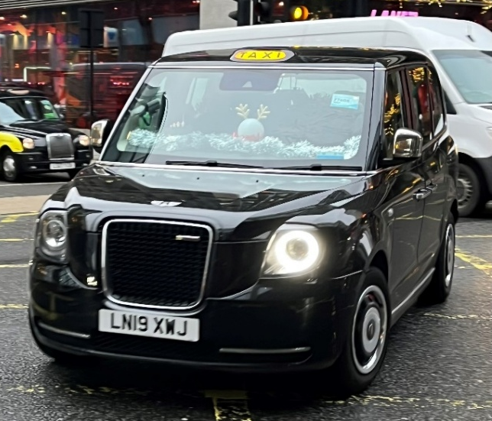
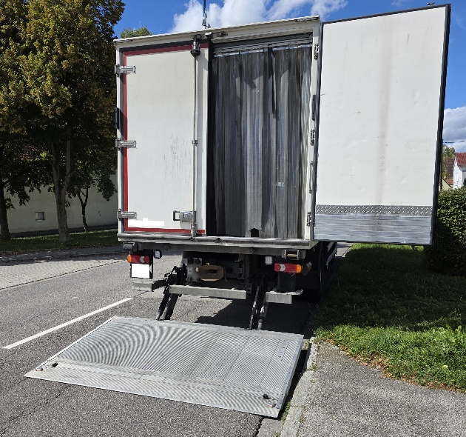
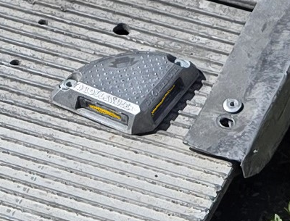
Problem
The proposed text forces vehicle manufacturers to implement additional solutions only for the purpose of type approval. This adds unnecessary complexity and cost to de-activate and re-activate lamps permitted to be installed at a national level.
Otherwise, lamps only allowed at a national level would have to be installed post-registration to avoid invalidating type approvals. In the case of nationally required lamps (see Example 2), this is not possible.
Considering the above options, how does this prevent the installation of lamps that are not desirable to contracting parties?
This installation problem can only be managed at a national level by national enforcement.
The 1958 Agreement aims to harmonize technical standards, promote innovation, and enable mutual recognition of approvals to eliminate technical barriers to trade. In line with these objectives, it provides a framework for assessing functions and technologies that can be internationally agreed upon. It is not intended to prohibit the installation of devices or functions that are not yet mutually accepted, particularly when such devices are permitted under national regulations.
Photo: Copyright free, photo taken by Mark Grainger, SMMT.
Example 2: Tail lift illumination
Photo’s: Copyright free, photos taken by Torsten Schwarz, Audi.

