Slide 1
Proposals for GTR-24
26th September 2025

Slide 2
Proposals for GTR-24
Brake Dust Filter – Active Version (evacuation by electric blower)
Brake Dust Filter – Passive Version (filter close to the brake disc)

Slide 3
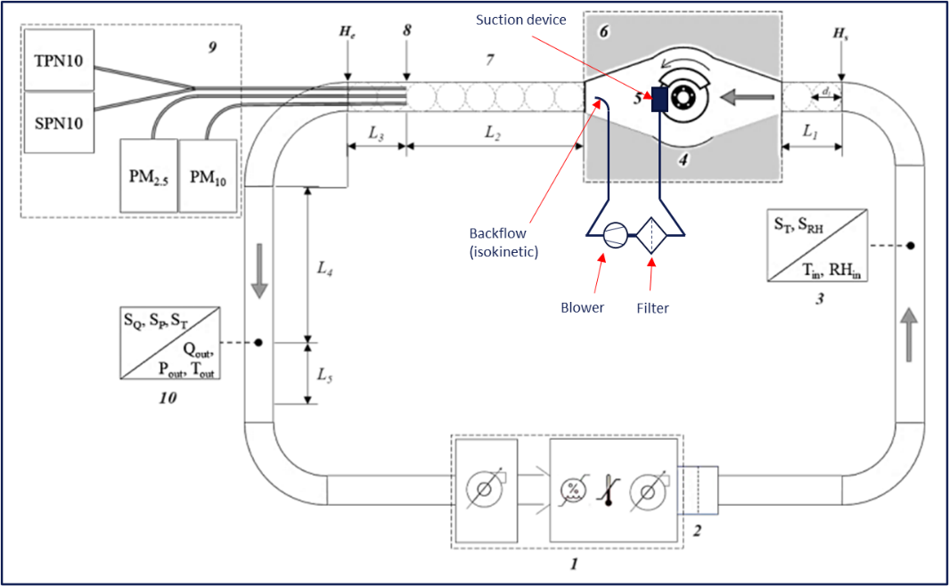
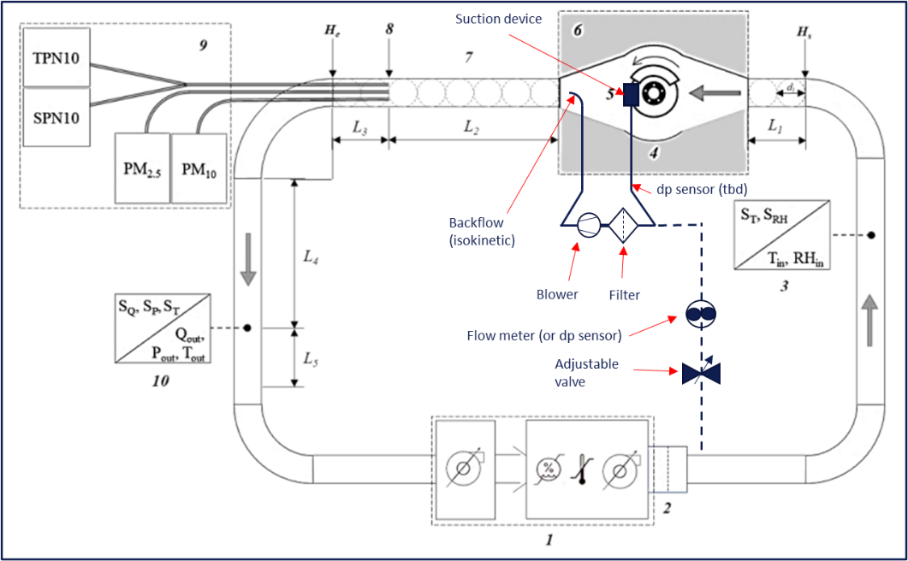
Brake Dust Filter
Active Version (evacuation by electric blower)
Parts of the systems may be installed outside the enclosure as long as they do not impact the brake filter system particle collection efficiency. Any extracted flow from the enclosure shall be returned at the inlet of the tunnel, approximately in the center of the cross-section.
If an active system is designed to use one or several filter(s) and one blower for more than one brake, the additional volume flow needed to compensate the volume flow of the other brake(s) shall be extracted by the tunnel upstream of the enclosure (and downstream of the volume flow measurement

Slide 4
Brake Dust Filter
Active Version (evacuation by electric blower)
Proposal for GTR-24: Modulation of the active filtering function shall reflect the same conditions that activate and modulate the blower under real vehicle operating conditions.
Current Wording:
9.2.3 - In case of active brake filtering devices, the testing facility shall use the “Brake Pressure” and “Linear Speed” signals to activate the filtering function at the brake event start time as defined in paragraph 13.1. In such a case, the active filtering function may be deactivated up to maximum 5 seconds after the brake event end time as defined in paragraph 13.1.
The possibility to modulate the blower is not explicitly mentioned
Amendment proposal:
9.2.3 - In case of active brake filtering devices, the testing facility shall use the “Brake Pressure” and “Linear Speed” signals to activate the filtering function at the brake event start time as defined in paragraph 13.1. In such a case, the active filtering function may be deactivated up to maximum 5 seconds after the brake event end time as defined in paragraph 13.1. The modulation of the active filtering function, including blower operation, shall reflect the logic of the vehicle and be triggered by the same conditions that activate and modulate the blower under real vehicle operating conditions. A brake signal (digital or analog e.g. 0-5V) and a speed signal (digital or analog e.g. 0-5V) have to be made available by the testing facility in order to activate the filtering system .

Slide 5

Brake Dust Filter
Active Version (evacuation by electric blower)
Proposal for GTR-24: Modulation of the active filtering function shall reflect the same conditions that activate and modulate the blower under real vehicle operating conditions.
v
T
p_{brake}
Perf._{blower}
Brake disc temperature T
Δt
Velocity_{car} v
Speed and Brake Signal needs to be made available by the testing facility
Performance_{blower} = f(t,v,p)
Brake boost pressure p_{brake}
1
2
3
4
5
t

Slide 6
Brake Dust Filter
Passive Version (filter close to the brake disc)
Current Wording:
8.4.2 - The testing facility shall position the calliper to minimise potential interference with the incoming cooling air. Install the calliper above the disc with the centre of the calliper in a 12-o’clock position as illustrated in Figure 8.6. irrespective of the mounting position at the vehicle. Other calliper orientations (e.g. vehicle’s mounting position) or configurations are not allowed and shall invalidate the test. The parking brake shall not be dismounted for carrying out a brake emissions test.
Effectiveness of the passive filtration is not maximised at 12 o’clock position and it does not reflect the mounting position in the vehicle
Amendment proposal:
8.4.2 - The testing facility shall position the calliper to minimise potential interference with the incoming cooling air. Install the calliper above the disc with the centre of the calliper in a 12-o’clock position as illustrated in Figure 8.6. irrespective of the mounting position at the vehicle. Other calliper orientations (e.g. vehicle’s mounting position) or configurations are not allowed and shall invalidate the test. The parking brake shall not be dismounted for carrying out a brake emissions test. By way of exception, when a passive filter is installed, the orientation of the calliper and the filter shall be adjusted to reflect the actual mounting conditions in the vehicle, provided that interference with the incoming cooling air is minimised.

Slide 7
Brake Dust Filter
Passive Version (filter close to the brake disc)
SOTA for GTR-24 (8.4.2): currently the brake calliper needs to be mounted on 12 o‘clock position, whether without a filter or with a filter
with filter
air flow
air flow
Proposals for passive filter use only:
the position can be discussed between the OEM and the service provider for a result closer to real drive emission
brake calliper and mounted filter can be aligned between 10 o‘clock brake calliper and 2 o‘clock brake calliper + filter position
air flow

Slide 8
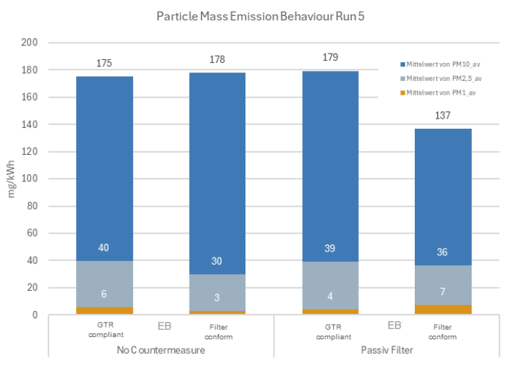
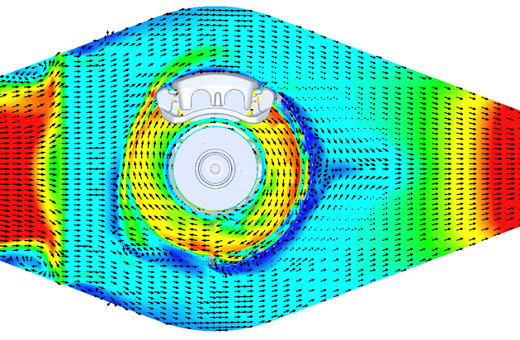
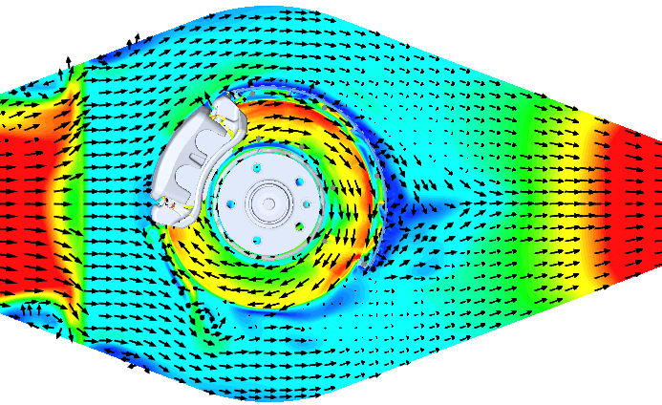
Brake Dust Filter
Passive Version (filter close to the brake disc)
Simulation GTR-LD test bench
SMP test bench HD results
GTR-similar test bench LD results
12 clock position
Clock Pos. | Flow (m³/h) | Test bench | Eff.
12 | 1300 | external | X%
12 | 1400 | internal | X%±3%
10 | 1400 | internal | X%+14%
10:30 clock position
12:00
08:00
12:00
08:00
w/o passive filter
with passive filter
→clock position has high impact on efficiency of passive filtering systems. For a technology-open dyno layout it is crucial to have a flexibility window of the position of the braking system.

Slide 9
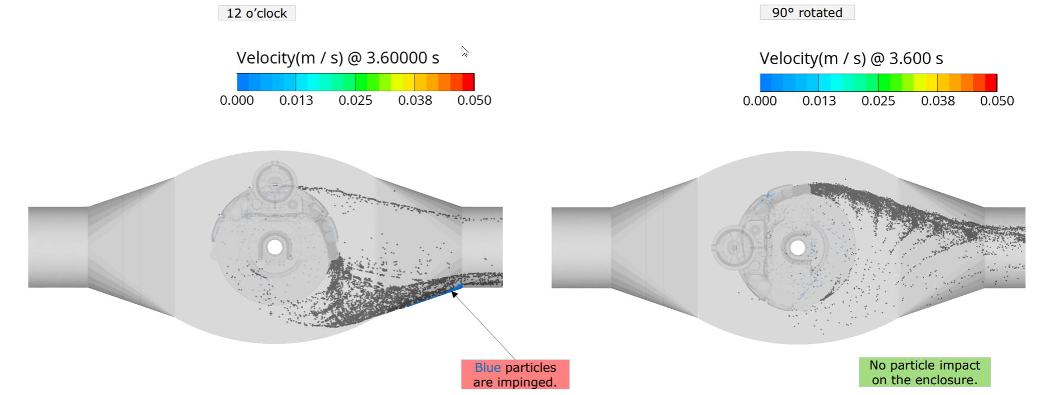
Brake Dust Filter
Passive Version (filter close to the brake disc)
Particle accumulation and impact (AVL simulation results for HD)
→clock position has high impact on efficiency of passive filtering systems

