Slide 1
PMP status update
26 Sep 2025
Sustainable, Safe, and Smart Mobility Unit, Joint Research Centre

Slide 2
Agenda
1. Review Meeting Minutes last PMP meeting 10.7.2025
2. Overview of amendments to LD brakes GTR 24
  a. ILS3 updates
  b. OICA’s proposals
  c. CLEPA on brake dust filters
  d. AUMOVIO: Update on c-factor calculation & electromechanical brakes
  e. ZF-AIP multifilter holders
3. TF5 updates (GTR HD brakes)
  a. SG1: Layout
  b. SG2: Cycles
4. Any other Business

Slide 3
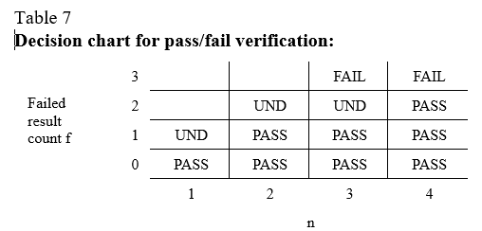

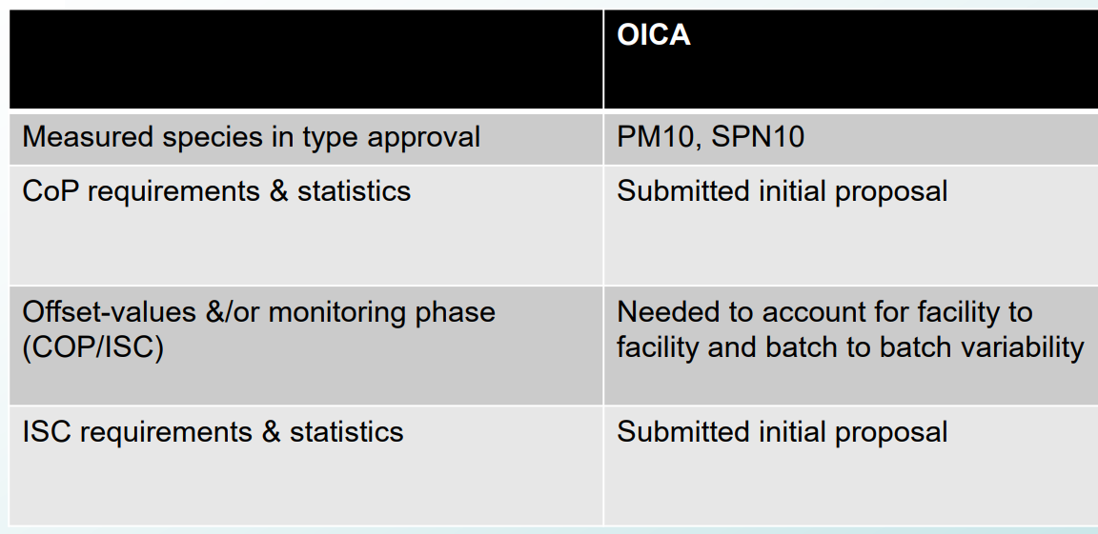
UNR on LDV brakes
EC comments
+PM2.5, TPN10 at type approval
Start n=3 (not 1)
No offset (uncertainty included in the limit)
No strong disagreement
From OICA presentation at AGVES 24/9/2025
ECE-TRANS-WP29-GRPE-2025-18e

Slide 4
PMP, GTR, UNR, Euro 7 timelines (LD)

Slide 5
PMP, GTR, UNR, Euro 7 timelines (HD)

Slide 6
GTR 24, 3rd amendment changes
Since 2nd amendment (no negative comments received)
Language improvements
Definitions improvements
Addition of rounding criteria, addition of decimals requirement in tables
Removal of 3-probe option
Filter holder temperature upper limit removed
Addition of requirement of keep soaking data
To confirm that changes have been implemented correctly

Slide 7
GTR 24, 3rd amendment changes
Since July
Brake “corner” addition
Improvement and clarifications for temperature and pressure measurement for flow normalisation
Signal filtering requirements
Brake runout (BRO) measurement procedure clarification for drum brakes

Slide 8
GTR 24, 3rd amendment changes
Since July
Improved figures for PN and PN setup
Decimal corrections in tables
WLTP temperature 23 +/-5°C (instead of 2°C or 3°C)
Torque symbol in Eq 13.1 and definitions

Slide 9
Not implemented
Additional 5 s sampling for PN signal (agreed)
Residual torque during setup preparation (under discussion)
Multifilter holders (under discussion)
Dyno quality criteria (under discussion)
Brake replacement parts testing couple (to be discussed)
Passive and active filters additions (to be discussed)
Other topics of today’s meeting (to be discussed)

Slide 10
Thank you
Notes:
Update/add/delete parts of the copy right notice where appropriate.
More information in the Reuse guidelines: eceuropaeu.sharepoint.com/sites/intellectual-property/SiteAssets/Forms/AllItems.aspx?id=%2Fsites%2Fintellectual-property%2FSiteAssets%2FSitePages%2FGuides-and-Manuals%2F2019_Reuse-guidelines%28CC-BY%29_Jan2022%2Epdf&parent=%2Fsites%2Fintellectual-property%2FSiteAssets%2FSitePages%2FGuides-and-Manuals

