Slide 1


Research for Impact Analysis: Children Left In Vehicles
Presented by Krisha Vardarajan/ Brisbane 12th Session Meeting 2025

Slide 2
The Questions
What is the policy problem you are trying to solve and what data is available?
What are the objectives, why is government intervention needed to achieve them, and how will success be measured?
What policy options are you considering?
What is the likely net benefit of each option?
Who did you consult and how did you incorporate their feedback?
What is the best option from those you have considered and how will it be implemented?
How will you evaluate your chosen option against the success metrics?
Notes:
This is an issue that is both tragic and preventable yet continues to affect Australian families every single year.
Each year, thousands of children are left in cars — sometimes unknowingly, sometimes knowingly — and while many are rescued in time, too often the result is severe injury or death. On the screen there are 7 questions, when completeing an Impact analysis we are required to answer these questions.
My aim in this presentation is to provide a comprehensive overview of the issue, grounded in data, medical evidence, psychology, and policy. I’ll cover:
The scale of the problem nationally and by state
The dynamics of heat risk and why cars become deadly so quickly
The psychological mechanisms behind Forgotten Baby Syndrome
Real Australian case studies that illustrate the risks
The injuries sustained by survivors, which are often overlooked
Why under-reporting means the issue is even bigger than statistics suggest
The current legal framework and how courts approach these cases
And finally, the policy options available to reduce and ultimately eliminate these tragedies
By the end, I hope to leave you with both the urgency of the problem and a clear sense of what Australia can do next.

Slide 3
RECAP: GLOBAL STATISTICS
Notes:
There are 3.9 million children aged 0-14 in Australia making them 20 percent of the population. With far too many children dying or getting injured as a result of being left in vehicles, and numbers rising every year, the problem of CLIV is more important than ever. The three different scenarios regarding CLIV that was agreed upon by the IWG are: unknowingly left in the vehicle, knowingly left in the vehicle and gained access to the vehicle. Globally, more than 1,010 children have died of heatstroke around the world, because they were left or became trapped in a hot car over the past 25 years.
These are the key global statistics that were included in the background research f the Global technical Regulation. We can clearly see that globally there has not ben a dip in pediatric Vehicular Deaths and unfortunately it is the same case in Australia. Within these statistics, it has been identified that in most cases the child was unknowingly left in the vehicle. Therefore, I will also be expanding upon the topic of Forgotten Baby Syndrome especially in Australia.

Slide 4
SUMMARY: CLIV IN AUSTRALIA
On average, two children are locked in a vehicle every day in Queensland.
Around 30 children have died in hot cars in Australia over the past 25 years.
Vehicle interiors heat: 75% of the rise in temperature occurs within 5 minutes.
Policy goal: Reduce fatalities and serious injuries through education, service regulation, and in-vehicle technologies.
Policy aim: eliminate fatalities via education, childcare reforms, vehicle technology
Policy aim: eliminate fatalities via education, childcare reforms, vehicle technology
Notes:
“The key messages I want you to remember from this analysis are:
Scale: Each year, more than 5,000 children are rescued from vehicles across Australia. That’s about 15 children every day.
Fatalities: Since the mid-1990s, there have been around 30 confirmed child deaths due to hot cars. In the past five years alone, there have been 10 fatalities. That is not a rare accident, that’s one or two children dying every single year.
Heat risk: Vehicles heat rapidly. Within 10 minutes
Cause: this IWG have identifies three different causes that I will expand on later.
Policy aim: The objective must be to eliminate fatalities and reduce incidents through education, childcare transport reforms, and in-vehicle technology that is already being adopted overseas.

Slide 5
National Statistics
5,000+ rescues annually (Kidsafe, RACQ, NRMA)
The Royal Automobile Club of Queensland, an organisation in Queensland, that provides a range of services to its members, including roadside assistance, insurance, banking, and travel products.
The NRMA (trading name of National Roads and Motorists' Association) is an Australian organisation offering roadside assistance
10 deaths nationally in last 5 years
1–2 fatalities per year on average
Emergency rescues treated as life-threatening incidents
Notes:
Nationally, the numbers are striking.
Rescues: Over 5,000 children are rescued every year by RACQ, NRMA, police, and ambulance services. That’s not an outlier year, that’s consistent across the past decade. RACQ is The Royal Automobile Club of Queensland. They provide road assistance services to their members however, in terms of children left in vehicles they answer these call outs no matter if the person calling is a member or not.
Fatalities: On average, we lose 1–2 children every year. The numbers may sound small, but each of those represents a preventable death, and the true tragedy is that these incidents have continued steadily over decades.
Recent trends: In just the last five years, there have been 10 deaths nationally. That’s as many as the previous 20 years combined, showing the issue is not going away.
Emergency response: Roadside assistance providers treat these calls as life-threatening emergencies. They are dispatched ahead of regular roadside jobs, in recognition of the danger.
These figures show that CLIV is a daily emergency in Australia, not just an occasional tragedy.
These figures show that CLIV is a daily emergency in Australia, not just an occasional tragedy.

Slide 6
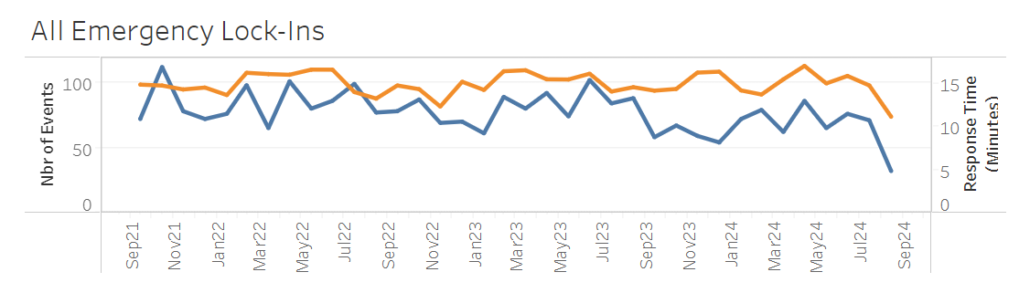
Queensland Statistics
14 deaths in Queensland between 2004 – 2024.
  7 children gained access
  7 were left in by caregivers
41 children left on buses in Queensland over 5 years prior to 2022 reforms
Daily RACQ callouts for children accidentally locked in cars
Cost per job across the network is ~$AU110.00 (~$US72.50) – two vehicle are deployed per job
(RACQ, 2024)
Notes:
The RACQ have provided us with these statistics on the state you are currently in. It is important to note that when RACQ gets a call about a child being left in a vehicle, it is treated as an emergency, therefore, they will answer the call no matter if the person calling is a member or not. It is a service that they provide in kind to the community. Because of this, there is a cost to them of about 110 aud per callout. Not to mention that every time one of these callouts happen, there are two trucks sent out; one to help with the rescue and one to manage any bystanders or families in distress.

Slide 7
State-Level Insights
Queensland: 800–1,000 rescues annually; 14 deaths since 2004
NSW: 4,265 callouts in 2022; 1,800+ in 2023
Victoria: 1,587 rescues in 2017–18; 225 in Dec 2015 alone
Other states: dozens to hundreds annually, seasonal spikes
Notes:
When we break it down by state, we see both common trends and regional differences.
In Queensland, RACQ responds to between 800 and 1,000 child lock-ins every year - that’s 2-3 per day. Since 2004, there have been 14 child deaths in Queensland linked to hot cars.
In New South Wales, NRMA recorded 4,265 callouts in 2022 - the highest in a decade. That averages 11 a day. The number fell to about 1,800 in 2023, but that’s still 5 per day.
In Victoria, Ambulance Victoria reported 1,587 rescues in 2017-18, and in December 2015 alone, there were 225 rescues in one month - 7 per day during that summer.
In South Australia, the MFS has recorded over 300 rescues in a single year.
Western Australia, Tasmania, and the Northern Territory report lower totals, but still dozens to hundreds annually.
The key insight: this problem is national, with Queensland and Victoria consistently the hardest hit, but no jurisdiction immune.

Slide 8
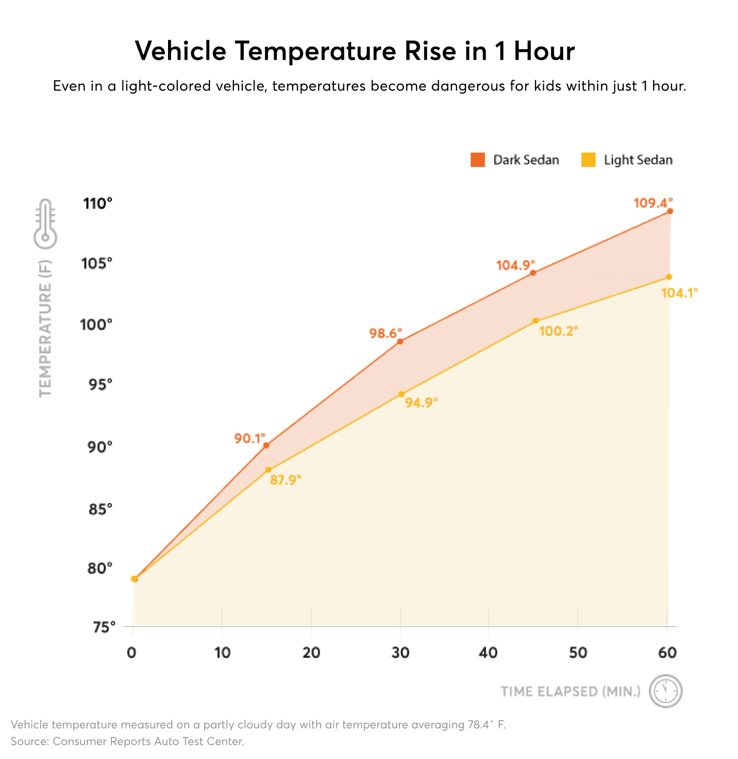
Heat Risk Dynamics
Within 5 minutes: Cabin temperature rises by 75% of the total increase.
Within 10 minutes: Interior is approximately 10 degrees Celsius hotter than outside.
Within 30 mins: Vehicle reaches approximately 40 degrees Celsius even on a mild day.
Average response time for RACQ is 15 mins.
(Thomas, 2025)
Notes:
This chart illustrates why vehicles are so dangerous.
Within 5 minutes, a car’s interior can rise by 5–10 degrees.
Within 10 minutes, it is usually about 10°C hotter than outside.
Within 30 minutes, even on a mild day, the interior can exceed 40–45°C.
For context, a child’s organs begin to shut down once their core body temperature reaches 40°C. At 41–42°C, survival is unlikely without immediate intervention.
The image on the screen is shown in farenheit but it is just to give a visual representation of the progression of heat in a car.
Myths:
Cracking the windows has little effect - only a few degrees difference.
Parking in shade, driving a larger car, or having tinted windows does not prevent rapid heat rise.
The scientific reality is that no child is safe in a parked vehicle, not even for a few minutes.

Slide 9
Who is Affected?
Figure shows that most victims are under 6 years old.
Three main scenarios:
  Unknowingly left – caregiver forgets due to stress/fatigue/change in routine
  Knowingly left – caregiver underestimates risk.
  Child gains access – vehicle unlocked or keys accessible
Notes:
Age: The majority are under six years old. Infants and toddlers are the most common victims because they cannot free themselves and have immature thermoregulation.
Scenarios:
Unknowingly left - the caregiver forgets, often after a change in routine. This accounts for over half of fatalities.
Knowingly left - the caregiver underestimates the risk, thinking they’ll be gone ‘just a minute’.
Child gains access - the child climbs into an unlocked vehicle and cannot get out.
Vulnerable groups: Families under financial or social stress are overrepresented. In Queensland, half of all fatal cases involved children who had prior contact with the child protection system.
The common thread is vulnerability - these children cannot protect themselves, and they depend entirely on adult systems to keep them safe.”

Slide 10
Forgotten Baby Syndrome
Stress
Sleep Deprivation
Definition:
Forgotten baby syndrome, is a neurological phenomenon where a parent or caregiver inadvertently leaves a baby or young child in a vehicle, often leading to heatstroke and death.
It is not a sign of neglect but results from a temporary memory overload caused by a combination of stress, fatigue, or a change in routine, leading to a conflict between habit memory (automatic actions) and prospective memory (future actions).
Routine Changes
False Memories
Notes:
One of the most misunderstood elements is Forgotten Baby Syndrome.
This is not about bad parenting - it is about the limits of human memory.
When we are under stress, tired, or distracted, the brain’s habit memory overrides our prospective memory. We operate on autopilot. That’s why a parent can genuinely believe they dropped their child at daycare when in fact the child is still in the car.
Often, caregivers form false memories. They can remember unbuckling the car seat or saying goodbye, even though those actions never occurred.
The triggers are common parenting conditions:
Sleep deprivation
Stress and distraction
Changes in routine
Associate Professor Matthew Mundy in Victoria has explained this phenomenon to coroners, showing how even diligent parents are vulnerable. International expert Dr David Diamond calls it “fatal distraction” - a failure of memory that can strike anyone.
Understanding FBS helps shift the conversation from blame to systemic prevention.

Slide 11
Australian Cases of FBS
Baby Noah (VIC, 2015): mother sleep-deprived and ill
Sydney 2023 (Arikh) and 2025 (Olivia): fathers assumed drop-off done
Baby Bella (Bendigo, 2012): mother acquitted, memory failure
Shows FBS is real and recurring in Australia
Notes:
Several Australian cases highlight this:
Victoria, 2015: Baby Noah died after his mother, severely sleep-deprived and ill, mistakenly believed she had dropped him at daycare. The coroner called it a ‘catastrophic lapse’.
Bendigo, 2012: Baby Bella died in similar circumstances. Her mother was acquitted of manslaughter after expert testimony confirmed it was an involuntary memory failure.
Sydney, 2023 and 2025: Two toddlers died in back-to-back years when their fathers assumed the daycare drop-off had been completed. In both cases, the error was only discovered at pickup time.
These stories are heartbreaking, but they underscore the reality: FBS is not theoretical. It is happening here in Australia, today.

Slide 12
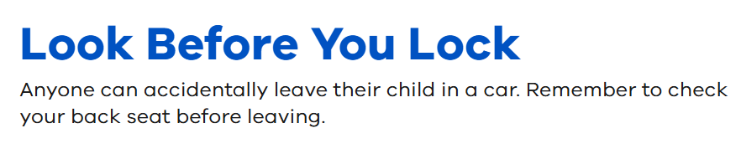
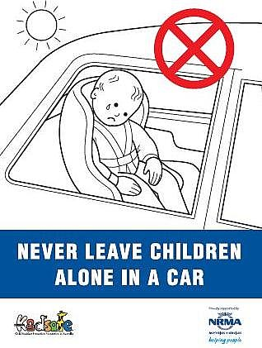
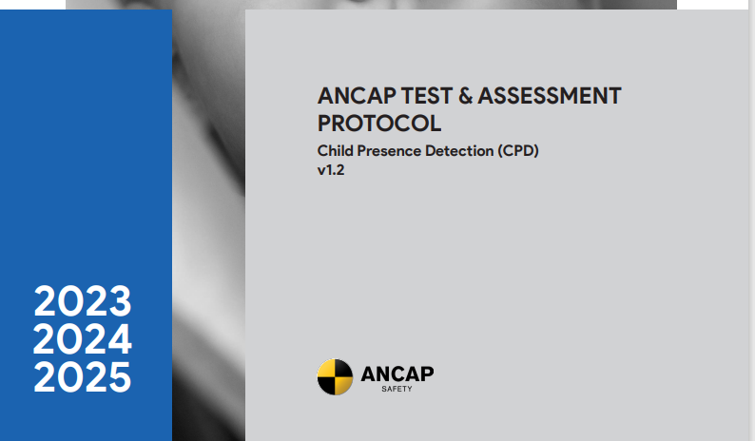
Current CLIV Initiatives in Australia
(Queensland Government, 2025)
(Kidsafe, n.d)
(ANCAP, n.d)
Notes:
We have state government campaigns and in Australia we have ANCAP
ANCAP stands for the Australasian New Car Assessment Program, an independent organization that provides safety information for new vehicles sold in Australia and New Zealand. Through independent physical crash tests and the assessment of collision avoidance technologies, ANCAP awards star ratings from 0 to 5 to indicate a vehicle's relative safety performance. In 2023 ANCAP introduced another technical assessment protocol for Child Presence Detection. This means that vehicles that are fitted with any type of technology that detects and alerts when a child has been left in a car correctly, they will be awarded points that go towards the star rating that ANCAP gives to vehicles. It is important to note that they are a non-regulatory organisation, therefore, they cannot compel a company to go through testing, this is where the Australian Design rules come in to play.

Slide 13
Policy Options
Option 1 – Status Quo: existing campaigns, criminal liability
Option 2 – Non-regulatory uplift: national campaigns
Option 3 – Targeted service regulation: bus sweeps, logbooks, penalties
Option 4 – Vehicle regulation: mandate detection tech via ADRs
Notes:
Our policy objectives must be ambitious but clear:
Reduce fatalities from CLIV in Australia.
Reduce incidents: bring down the more than 5,000 rescues each year.
Strengthen childcare and transport safeguards: ensure no child is ever left on a bus or service vehicle.
Align with international standards: prepare for vehicle technology mandates already being introduced globally.
These objectives align with Australia’s child safety commitments and broader road safety strategy.
We have four main pathways:
Status quo - continue current campaigns and criminal liability. But evidence and injury statistics shows this isn’t enough.
Non-regulatory uplift - launch a coordinated national campaign, partner with auto clubs for monitoring, and use retail prompts.
Targeted regulation for services - mandate bus sweeps, compliance logbooks, and penalties for breaches.
Vehicle regulation - mandate in-vehicle child detection technology through the Australian Design Rules, phasing in over several years.
Each option carries different costs, timelines, and levels of effectiveness, but together they form a layered approach.

Slide 14
Benefits
Save 1-2 children’s lives annually
Prevent hospitalisations and lifelong disability
Reduce thousands of emergency rescues
Avoid coronial/legal cases
Reduce social, economic, and family trauma costs
Notes:
The benefits are significant.
Lives saved: Preventing 1–2 deaths each year. In monetary terms, that’s $5–10 million annually in Value of a Statistical Life.
Injury prevention: Fewer cases of heatstroke and permanent disability.
Reduced emergency demand: Fewer RACQ and NRMA callouts, easing pressure on services.
Reduced legal and coronial burden: Fewer inquests and prosecutions.
Family well-being: Preventing unimaginable grief and trauma.
This is a rare public policy area where benefits are both human and economic, and overwhelmingly outweigh the costs.

Slide 15
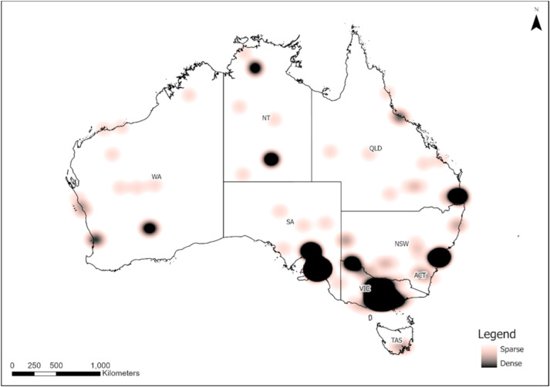
Injuries and Non-Fatal Outcomes
Survivors may suffer serious harm:
Heat exhaustion, heatstroke
Brain injury, developmental delay
Organ damage (kidneys, liver, heart)
Psychological trauma
Injuries carry lifelong health and social costs
Heatstroke incident locations 2001-2008
(Coates, 2022)
Notes:
Not all children die - but many suffer serious injuries.
Heat exhaustion and heatstroke can leave permanent harm even if the child survives.
Brain injury: prolonged overheating can cause irreversible neurological damage, leading to developmental delays or disability.
Organ damage: kidneys, liver, and heart are highly vulnerable to heat injury.
Psychological trauma: older children may carry long-term anxiety from the event.
These outcomes impose enormous personal, social, and economic costs. A single heatstroke event can leave a child requiring a lifetime of care.
So the benefit of prevention is not only about lives saved, but also about protecting children from lifelong harm.
Heatwave fatalities in Australia, 2001–2018: An analysis of coronial records - ScienceDirect

Slide 16
Why Many Incidents Go Unreported
Not all cases involve emergency services
Parents/bystanders often resolve before RACQ/NRMA arrive
Fear of stigma or legal consequences
Near-misses rarely documented
No centralised national database for non-fatal CLIV incidents
Notes:
Official numbers almost certainly underestimate the true scale.
Not all incidents involve emergency services. Many are resolved by caregivers or bystanders before RACQ or police are called.
Fear of stigma and punishment: parents may be reluctant to admit a mistake.
Near misses go undocumented: cases where a child is distressed but not hospitalised rarely appear in any database.
No national database: we rely on coroners for deaths and auto clubs for rescues, but non-fatal data is fragmented.
This means the 5,000 rescues we cite annually may only be the tip of the iceberg. The real number of at-risk children could be much higher, reinforcing the need for systemic safeguards.

Slide 17
Legal Consequences of CLIV in Australia
Criminal offence in all states/territories
Charges: child endangerment, negligence, manslaughter
Penalties: fines to imprisonment (up to 5 years+)
Courts weigh intent vs. Forgotten Baby Syndrome
Coroners focus on systemic prevention and reforms
Notes:
Leaving a child unattended in a car is a criminal offence nationwide.
In Victoria, penalties include fines and up to 6 months’ imprisonment.
In New South Wales, it can attract up to 5 years’ imprisonment under reckless endangerment.
In Queensland, cases where a child dies can lead to manslaughter charges, with maximum penalties as high as life imprisonment.
Other states have similar laws under child neglect and endangerment statutes.
When a child dies, charges escalate to manslaughter or criminal negligence.
But courts recognise the distinction between deliberate neglect and memory failure.
In deliberate cases, parents have been convicted and jailed.
In cases of Forgotten Baby Syndrome, courts have shown leniency, sometimes leading to acquittals.
Coronial inquests often focus less on punishment and more on recommendations for reform. They call for campaigns, childcare transport safeguards, and exploration of detection technologies.
Ultimately, legal deterrence alone has not stopped these incidents. Punishments exist, but children continue to die. That means prevention must go beyond criminal law, toward systemic solutions.

Slide 18
Costs
Government: campaigns, compliance, audits
Services: training, sweeps, compliance tools
Manufacturers: detection systems ($150–$250/vehicle)
Consumers: small price increase offset by safety benefits
Notes:
Interventions do carry costs, but they are modest compared to the benefits.
Government: funding education campaigns, compliance audits, and monitoring.
Services: staff training, sweeps, and low-cost tools like glass-break hammers.
Manufacturers: detection technology, estimated at $150–$250 per new vehicle.
Consumers: a small price rise in car costs, offset by a major safety benefit.
In cost-benefit analysis, this intervention is overwhelmingly positive.

Slide 19
Risk & Equity
Under-6s most at risk
Childcare transport repeatedly weak point
Families under stress/child protection more affected
Remote/regional areas: hotter climate, slower emergency response
A study conducted by the Journal of Transport & Health revealed that in Australia:
  ”Male, younger, and lower-educated parents were more likely to leave children unattended.”
Notes:
As mentioned before, statistics have shown that children who have been through the child protection system before are unequally represented in the CLIV data and through forgotten baby syndrome we have seen that families that are under undue stress are more likely to see their children left in a car. Therefore, this is an even bigger issue.
Even more, in Australia we have the unique position of having expansive remote areas, RACQ have said that the response time would be slower in those regions. A study conducted by the Journal of Transport & Health revealed that in Australia: “Male, younger and lower-educated parents were more likely to leave their children unattended”.
Unattended children in vehicles: Exploring risks, attitudes, and technology adoption among Australian parents/caregivers - ScienceDirect

Slide 20
Implementation
Services
Education
Vehicles
Enforcement
Expand ‘Look Before You Lock’ nationally
Sweeps, staff training, compliance audits
Vehicles: mandate detection systems via ADRs
Audits, penalties, monitoring.
Notes:
How do we implement?
Education: expand ‘Look Before You Lock’ into a national, permanent campaign.
Services: mandate sweeps, train staff, and enforce compliance audits.
Vehicles: introduce an ADR pathway to mandate child-presence detection in new cars.
Enforcement: conduct regular audits and apply penalties for breaches.
Implementation must be phased but firm — because every year we delay, more children are at risk.

Slide 21
Evaluation & Monitoring
KPIs:
Fatalities and hospitalisations
RACQ/NRMA rescues
Bus/childcare compliance failures
Uptake of detection technology
Reviews at 12, 24, 36 months
Notes:
Finally, evaluation.
We need clear KPIs:
Annual fatalities and hospitalisations
RACQ and NRMA rescue callouts
Childcare transport compliance
Uptake of detection technology
Regular reviews at 12, 24, and 36 months will ensure accountability and allow adjustments.
Success is simple to measure: fewer rescues, fewer injuries, and fewer fatalities.”

Slide 22
thank you
Department of Infrastructure, Transport,
Regional Development, Communications, Sport and the Arts
Notes:
“To conclude:
This issue is urgent, preventable, and national.
The statistics show thousands of incidents and steady fatalities.
The science shows cars heat to deadly levels in minutes.
The psychology shows even loving parents can forget.
The law shows penalties exist, but deterrence hasn’t been enough.
And the policy solutions are within our reach.
By combining education, regulation, and technology, we can prevent these tragedies and ensure no Australian child dies this way again.
Thank you.”

