Slide 1
IWG-EMC-49-08
Proposal by CLEPA & emc Test NRW:
Revisiting Requirements on Harmonics in IEC 61000-3-12^{*)} for UN-R10.08
^{*)} IEC 61000-3-12:2011+AMD1:2021

Slide 2
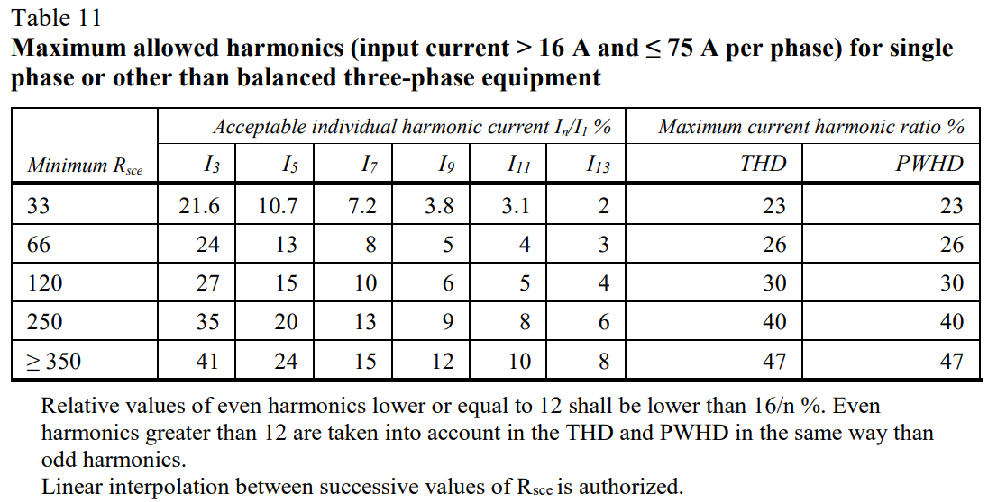
IWG-EMC-49-08
Juxtaposing IEC 61000-3-12 and UN-R10 for other than balanced equipment
UN-R10 as given in E/ECE/324/Add.9/Rev.6
Requirements for other than balanced three-phase equipment are identical* in UN-R10 and IEC 61000-3-12.
→ Information in UN-R10 is complete
*Note that acc. to IWG-EMC-46-06e, the reference fundamental current I₁ of IEC 61000-3-12 (Ed.1) is replaced by the reference current I_{ref} of IEC 61000-3-12 (Ed. 2.1) for the calculation of emission limits. However, the limits have remained the same.

Slide 3
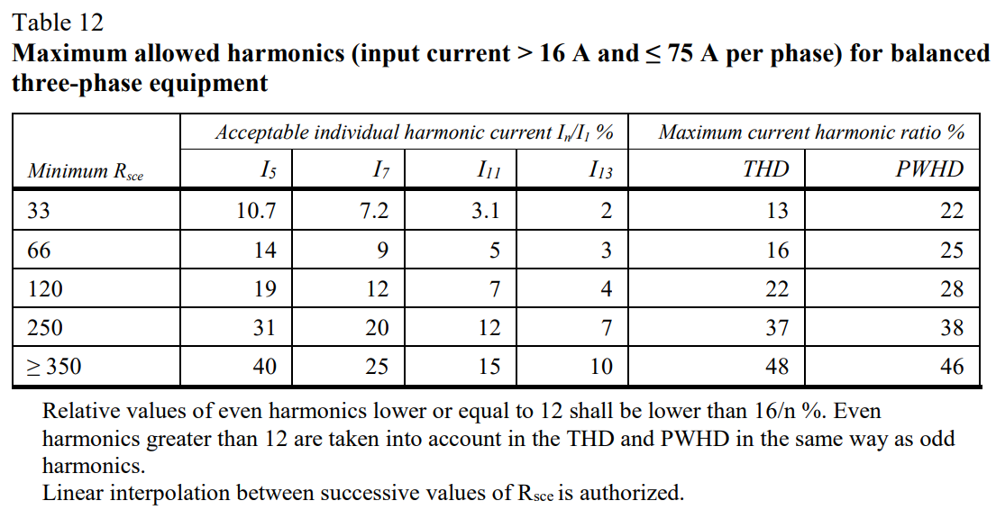
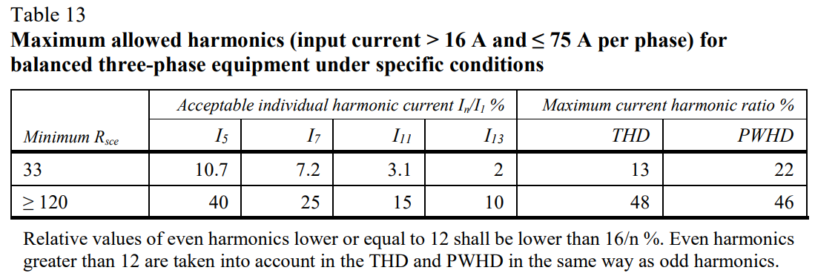
IWG-EMC-49-08
Juxtaposing IEC 61000-3-12 and UN-R10 for balanced equipment
UN-R10 as given in E/ECE/324/Add.9/Rev.6
General requirements for balanced three-phase equipment are identical* in UN-R10 and IEC 61000-3-12.
→ Information in UN-R10 is complete
Specific requirements for balanced three-phase equipment are partially identical* in UN-R10 and IEC 61000-3-12.
However, UN-R10 does not consider every specific case (incomplete).
*Note that acc. to IWG-EMC-46-06e, the reference fundamental current I₁ of IEC 61000-3-12 (Ed.1) is replaced by the reference current I_{ref} of IEC 61000-3-12 (Ed. 2.1) for the calculation of emission limits. However, the limits have remained the same.

Slide 4
IWG-EMC-49-08
What is missing acc. to IEC 61000-3-12 in UN-R 10?
IEC 61000-3-12 defines requirements for balanced three-phase equipment under specific conditions
  In UN-R 10, only requirements for the special case a, b, c are taken on
  Requirements for special cases d, e, f are not considered
  The definitions of the special cases a - c (and eventually a – f) are not explained in UN-R 10.
IEC 61000-3-12 contains requirements for the operating manual depending on the short-circuit ratio
  See IEC 61000-3-12, Clause 6
  In UN-R 10, no entries into the operating manual of the vehicle are required
  Potential precautionary measures for Rsce values other than 33 are not made aware of

Slide 5
IWG-EMC-49-08
Proposal & Rationale
In order to ensure that information in UN-R10 is complete and unambiguous for application, the following information from IEC 61000-3-12 should be added to UN-R10:
Table 5 on harmonics limits for special cases d,e,f
Explanation of the special cases a-f
Note that no new or harsher requirements are introduced by these proposals. The proposals serve to align UN-R10 with the state of the art standard on harmonics testing and avoid ambiguity by providing complete information.
IEC 61000-3-12 is a generic standard that is applicable to equipment connected to mains.
Therefore, it contains different options and limits, depending on the load (balanced/unbalanced), specific or general conditions and short circuit-ratio.
Requirements in UN-R10 should be in line with IEC 61000-3-12 to facilitate product development open to technological advancements whilst ensuring conformity through unambiguous and clear requirements. Offering different options for harmonics limits is not contradictory to this goal as the Technical Services are knowledgeable and skilled to apply the appropriate requirements on a case-by-case basis.

Slide 6
IWG-EMC-49-08
For discussion
Independent of the short-circuit ratio applied, IEC 61000-3-12 requires a statement in the operating manual.
As ESAs are typically delivered without a manual, the information can only be provided in the operating manual of the vehicle for which the vehicle manufacturer is in charge.
As of now, no statements on harmonics testing are required in the operating manual of the vehicle.
Question to GRE IWG EMC:
Should UN-R 10 require additional information in the operating manual to be fully compliant to IEC 61000-3-12?
The author and the speaker of this presentation confirm that they have authorization to use all content including photos and visual elements.
The material is either copyright-free or the author/speaker hold the necessary copyright or permission.
The UNECE will remove any material from its events and supporting websites if there is unlawful use of copyrighted material.
The author/speaker takes responsibility for any infringement on copyright and holds the UNECE harmless to this effect.

