Slide 1
OICA TF EMC:
Simulation and virtual testing
IWG-EMC-49-10
Proposal simulation and virtual testing in R10.08

Slide 2
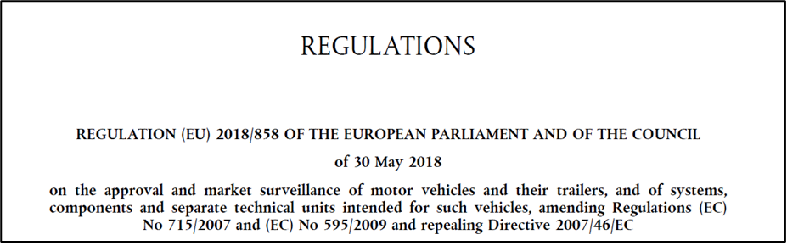
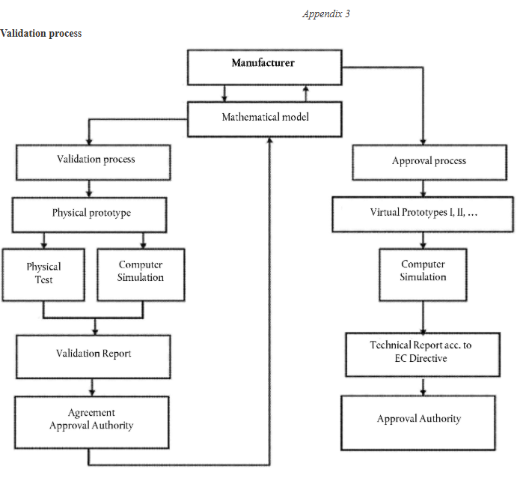
State of the art and motivation
IWG-EMC-49-10
virtual testing accepted in the homologation?
VT and Type-approval: article 30
Annex VIII:
Conditions for the use of virtual testing methods by a manufacturer or a technical service
The following scheme shall be used as basis structure for describing and conducting virtual testing:
(a) purpose; (b) structure model; (c) boundary conditions; (d) load assumptions; (e) calculation; (f) assessment; (g) documentation.
7. At the request of the manufacturer, and subject to the agreement of the approval authority, virtual testing methods may be used in accordance with Annex VIII as alternatives to the tests referred to in paragraph 1
8. The Commission is empowered to adopt delegated acts in accordance with Article 82, amending Annex VIII to take into account technical and regulatory developments by updating the list of regulatory acts in respect of which virtual testing methods may be used by a manufacturer or a technical service and the specific conditions under which those virtual testing methods are to be used.
Validation process

Slide 3
State of the art and motivation
IWG-EMC-49-10
UN-ECE-R139
UN-ECE-R13/H
UN-ECE-R16
UN-ECE-R140
UN-ECE-R29
UN-ECE-R141
UN-ECE-R10
EMC is not included in the list of regulations which can use virtual testing now and hence a change would be required.

Slide 4
Overview of SVT EMC homologation
IWG-EMC-49-10
HW changes
Platform project
N vehicle variants
Upgrade from vehicle A
Virtual Testing Integration
Goal: virtual approval ECE R10
Parameter studies
Design optimization
Model validation
Worst case analysis
Virtual integration analysis and concept validation
Evaluation and approval of variants using certified simulation models

Slide 5
Overview of SVT EMC process
IWG-EMC-49-10
Preparation and validation of virtual process
Model validation in main project
Approval process
Manufacturer
Validation process
Approval process
Main Project Vehicle
Definition of the R10 physical tests
Case-1
Case-2
Real tests
Virtual test
Mathematical models
Virtual Modell: CE, RE, RS
Virtual Modell: CE, RE, RS
Model adjustment
Physical model
Simulation model
Computer simulation
Model validation
Validation report
Technical report
acc. to EC directive
Validation report
Agreement approval authority
Approval authority

Slide 6

Status of SVT OICA EMC TF
IWG-EMC-49-10
SVT Subgroup
Technical working group for virtual testing (SVT)
Goal of the working group is to develop a technical draft for OICA EMC TF
Annex Overview SVT
SVT Scope
Scope
Preparation of approval process
4.4 As alternative to physical test procedures (SVT ECE R10), virtual testing can be used as complementary technical means to demonstrate compliances to specific electromagnetic compatibility requirements.
4.4.1 Information about virtual testing procedure is shown in Annex (SVT part)
Procedure of V&V
Definition of simulation cases
Procedure of certification
SVT ECE R10 items
Acceptation and SVT-Report
Approval

Slide 7
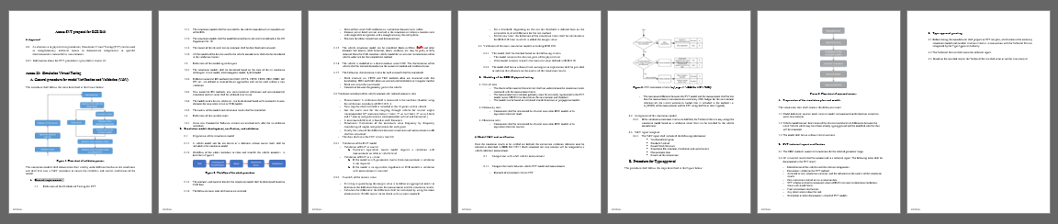
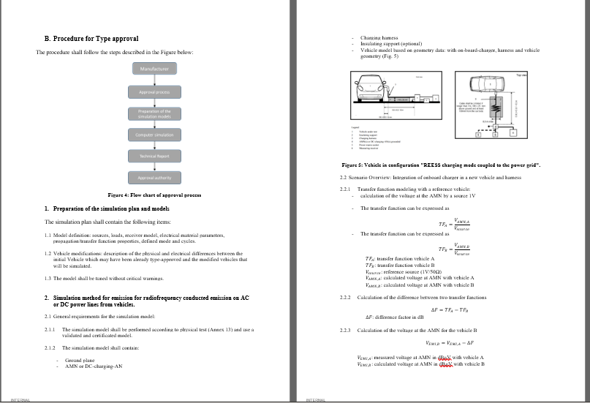
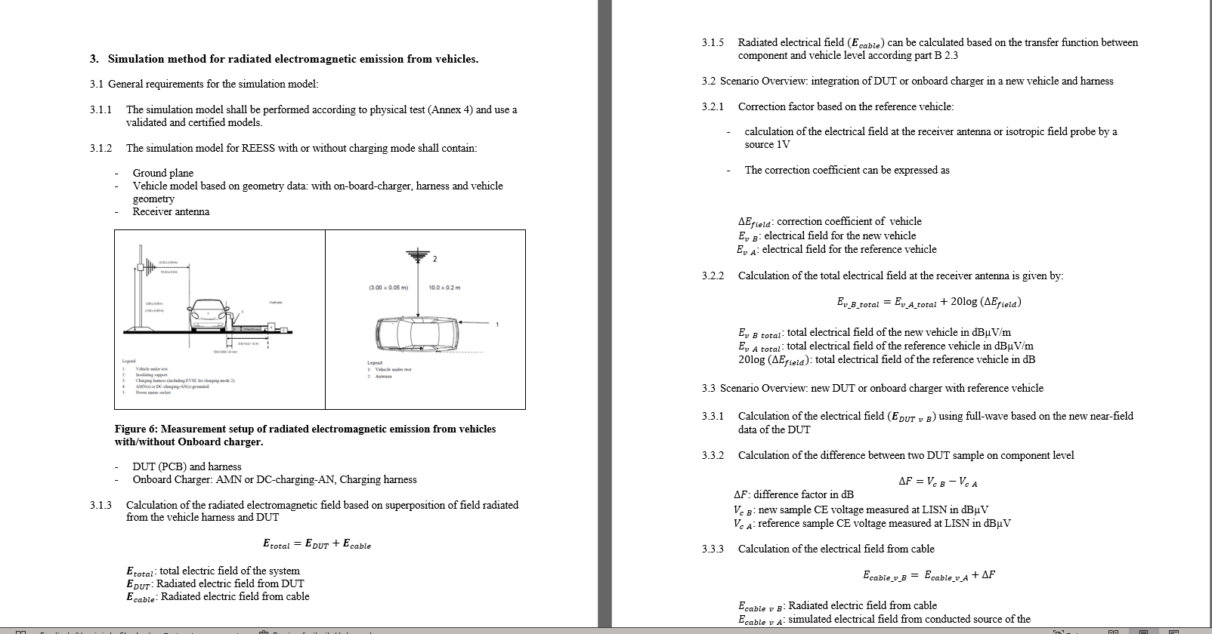
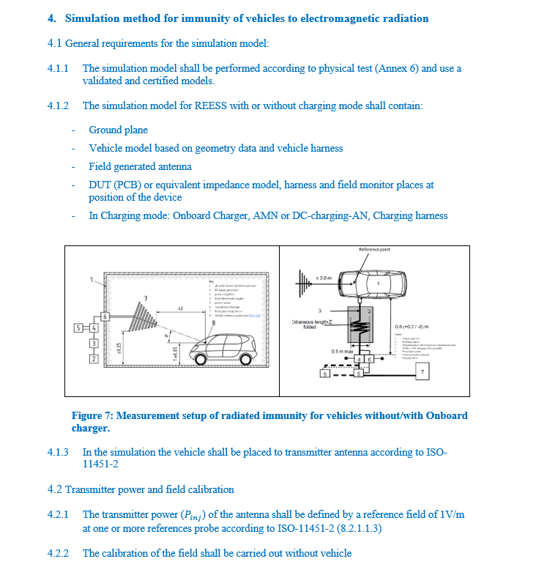
EMC TF SVT: proposal
IWG-EMC-49-10
General part: EMC SVT draft
General requirements for SVT
Technical part: EMC SVT draft
RF-Immunity
RE
CE-Onboard charger

Slide 8

EMC TF SVT: Roadmap
IWG-EMC-49-10
SVT TF
SVT TF
SVT TF
SVT TF
Working on general part of the draft
Working on CE onboard Charger topic
Preparation of Radiated emission topic
Preparation of Radiated immunity topic
Jun-23
Apr-24
Nov-24
May-25
OICA EMC TF
OICA EMC TF
IWG
Presentation of the SVT draft
Share the SVT proposal with OICA TF
Working on feedback items from the OICA TF
ECE R10 r8
May-25
Oct-25
Oct-25

Slide 9
Status from ISO/TC22/SC32/WG3
Documents shared in WG
Resolution 851: Virtual testing
Japan proposal about virtual testing one pager (N 3397)
German proposal about Virtual testing for ISO (N 3520)
Remind previous meeting documents
German NC one pager about Virtual testing (N 3384)
French NC contribution about Virtual testing (N 3409)
Decision was made to establish a STF to prepare a 1 pager explaining the intention of the WG3 experts and to ask to CISPR/D and IEC/TC47/SC47A/WG2 if they wish to participate on a Joint Task Force (JTF) with ISO/TC22/SC32/WG3 for working on Virtual Testing in Automotive EMC.
STF
SFT
CISPR/D
WG2/WG3
Kick-off and prepare the one pager
technical discussion and prepare of SVT roadmap
Share the one pager with WGs
…
Oct-25
Feb-26
Mar-26

Slide 10
EMC TF SVT: Q&A
IWG-EMC-49-10
Responsibilities
Practical Aspects of Simulation
Impacts of changes in physical cables are visible.
Calculation of a worst case and surveillance tests.
Analysis of the impact of the physical test setup
Certification support
The manufacturer could be responsible for the implementation of the Simulation methods, validation and documentation
Q&A
Role of Technical Services
Benefits
Involved early to validate the procedure
Qualified the SVT validation and approval process
Supervise the simulation and reports
Reduce the number of porotypes
Reduce the number of measurements
Using the simulation for the integration of EE components
Calculation of worst-case parameters

Slide 11
IWG-EMC-49-10
The author and the speaker of this presentation confirm that they have authorization to use all content including photos and visual elements.
The material is either copyright-free or the author/speaker hold the necessary copyright or permission.
The UNECE will remove any material from its events and supporting websites if there is unlawful use of copyrighted material.
The author/speaker takes responsibility for any infringement on copyright and holds the UNECE harmless to this effect.

