Slide 1
Amendment of
GRBP/2025/29 and GRBP-82-08
Working Document for 83rd GRBP
IWG RD-ASEP
Munich, 21-23 October 2025

Slide 2
GRBP Starting Situation defined by decision in 82nd GRBP
Amend Working Document GRBP/2025/29 and submit it to 83rd GRBP for adoption
take GRBP-82-08 as a base for amendments
consider only these three agreed items as amendments:
  Define Default mode respectively R138 range only
  in combination with a driver-only activation of EES.
  Add Transitional provisions for extensions of existing Type Approvals.
  Validate Limit Curve with available data of CP’s and OICA based on a
  transparent explanation of the calculation.
Update Document for Reference GRB-68-03 and submit it latest to 84th GRBP for adoption
Describe acceptable sound in a new part B for EVs
  based on R.E. 3 Annex 2 paragraph 4
  for speed ranges outside the control range of GRBP/2025/29
Source: GRBP-82-39e

Slide 3
GRBP Starting Situation
Detailed Planning
Today
1st preparation
online (2h)
2nd preparation
online (2h)
3rd preparation
online (2h)
4th preparation
online (2h)
5th preparation
online (2h)
Subgroup
Munich (1,5d)
Deadline
WD for 83rd GRBP
12.09.
19.09.
25.09.
07.10
13.10.
22./23.10.
18.11.
Default mode
Transitional Provisions
14.10.
validate Limit Curve & explain Calculation
Text proposal with 3
agreed items
23.10.
Find consensus in Subgroup & finalize document
Text finalized with last improvements
Source: GRBP-82-39e
Current State of Work
Preparation Group provided text proposal for
Subgroup meeting
Transitional Provisions have been worked out
Calculation has been explained
Default mode has been exchanged by prohibition of EES outside the control range
Driver-only activation has been enhanced to unneeded HMI requirements
Limit curve validation has exchanged by unjustified limit reductions
Besides the three agreed items, additional requirements have been added

Slide 4
Finding a Consensus
Define Default mode respectively R138 range only in combination with a driver-only activation of EES (1)
00
01
02
GRBP-82-08
OICA‘s Proposal
Improved Text for WD
"Enhanced Exterior Sound (EES)" means any sound generated by an active system installed on a vehicle enhancing the vehicle’s audibility.
This includes sound generated by actuators either integrated into an exhaust silencing system or mounted as an individual unit.
For the purpose of this Regulation, any sound that is subject to applicable mandatory requirements under other UN Regulations shall not be considered to be an EES. This includes, but is not limited to:
a) audible warning according to UN Regulation No. 28,
b) alarm according to UN Regulation No. 116,
c) minimum sound according to UN Regulation No. 138, in the mandatory speed range, or
d) reverse warning according to UN Regulation No. 165."
"Enhanced Exterior Sound (EES)" means sound
generated by active systems installed on a vehicle enhancing the vehicle’s sound emission and
that is not subject to requirements of other UN Regulations.¹
_____________
¹ For example, audible warning signals (according to UN Regulation No. 28), alarms (according to UN Regulation No. 116), safety sound (according to UN Regulation No. 138) and reverse warning signals (according to UN Regulation No. 165) are not EES.

Slide 5
Finding a Consensus
Define Default mode respectively R138 range only in combination with a driver-only activation of EES (2)
00
01
02
GRBP-82-08
OICA‘s Proposal
Improved Text for WD
  No definition available
"Predominant sound mode" for the purpose of this Regulation means a distinct sound condition that is automatically activated when the vehicle is switched on by the vehicle master control switch defined in paragraph xx.
"Vehicle Master Control Switch" means the device by which the vehicle’s on-board electronics system is brought, from being switched off, as in the case where a vehicle is parked without the driver being present, to normal operation mode (i.e. the vehicle status is "ready to drive").
"Predominant sound mode“ not needed!
"Vehicle Master Control Switch" means the device by which the vehicle’s on-board electronics system is brought, from being switched off, as in the case where a vehicle is parked without the driver being present, to normal operation mode (i.e. the vehicle status is "ready to drive").

Slide 6
Finding a Consensus
Define Default mode respectively R138 range only in combination with a driver-only activation of EES (3)
00
01
02
GRBP-82-08
OICA‘s Proposal
Improved Text for WD
  No requirements for start up condition.
Specifications for predominant sound modes
The specifications of this paragraph are only applicable for electrically propelled vehicles.
A predominant sound mode shall only generate sound in a speed range from 0 km/h to 50 km/h in regard to the specifications of UN-Regulation No. 138 paragraph 6.
The vehicle may have more than one predominant sound mode, provided each of these modes satisfies the provisions of the paragraph above.
A predominant sound mode can only be changed to another driver-selectable mode by an intentional action of the driver.
Specifications for EVs and HEVs, when electrically propelled
Any EES shall comply with the requirements of UN-Regulation No. 138 paragraph 6 in the speed range equal and lower than 20 km/h including standstill.
When the vehicle is switched on by the vehicle master control switch, no enhanced sound by an EES is provided in the speed range greater than 50 km/h.
Any activation of EES shall require an intentional action of the driver¹.
_______________________
¹ For example: changing a mode or operating a switch.

Slide 7
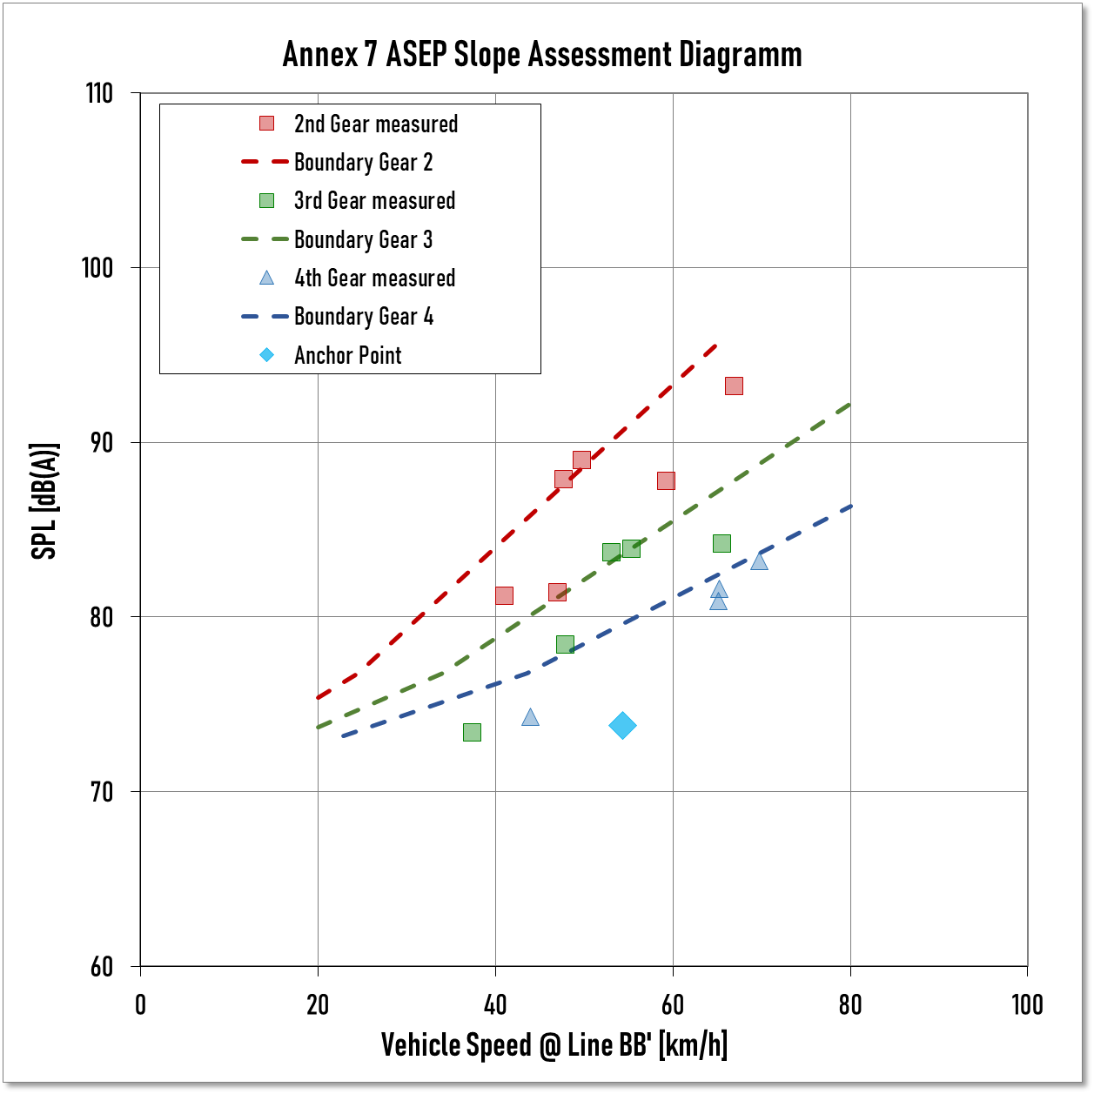
Finding a Consensus
Validate Limit Curve with available data of CP’s and OICA: ΔL_{ASEP}
Phase 3 ICE-Vehicle¹ with PMR 244 kW/t:
  Full Load ASEP Limits (dotted lines) for 2nd gear (red) with high acceleration, 3rd gear (green) with medium acceleration and 4th gear (blue) with moderate acceleration.
  Phase 3 BE-Vehicle² with EES and PMR 245 kW/t:
  EV-ASEP Limit (grey solid line) without ΔL_{ASEP}
  EV-ASEP Limit with added ΔL_{ASEP} for maximum acceleration of 5 m/s² for 2,1-4,4 s* (grey dotted line)
ASEP Limits versus Exit Speed v_{bb}
Benefit of EVs:
While accelerating they are at least 10 dB³ quieter than ICE.
Impact of temporary ΔL_{ASEP} :
Temporary Limit of BEV is still lower than ICE-V‘s 4th gear limit.
➔ There‘s no need and no justification for stricter limits than
the OICA proposed limits.
Source: HMG Akustiklabor, Vehicle ID-337 from RD-ASEP Database
Source: HMG Akustiklabor, Vehicle ID-2441 from ACEA/OICA EV Database 2024
For comparison: Difference between Limit values of phase 1 and 3 is up to 4dB
*) accelerating with 5 m/s² up to 100 km/h

Slide 8
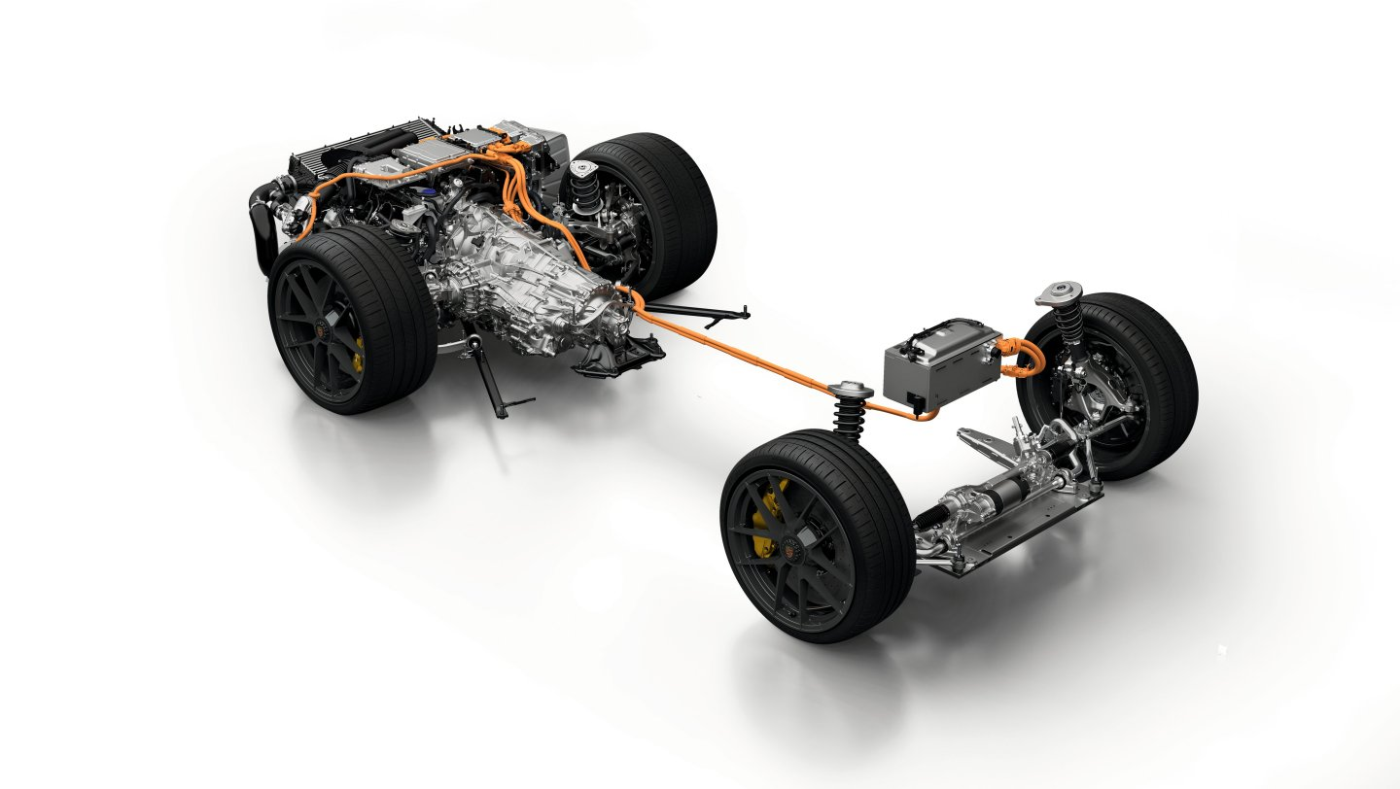
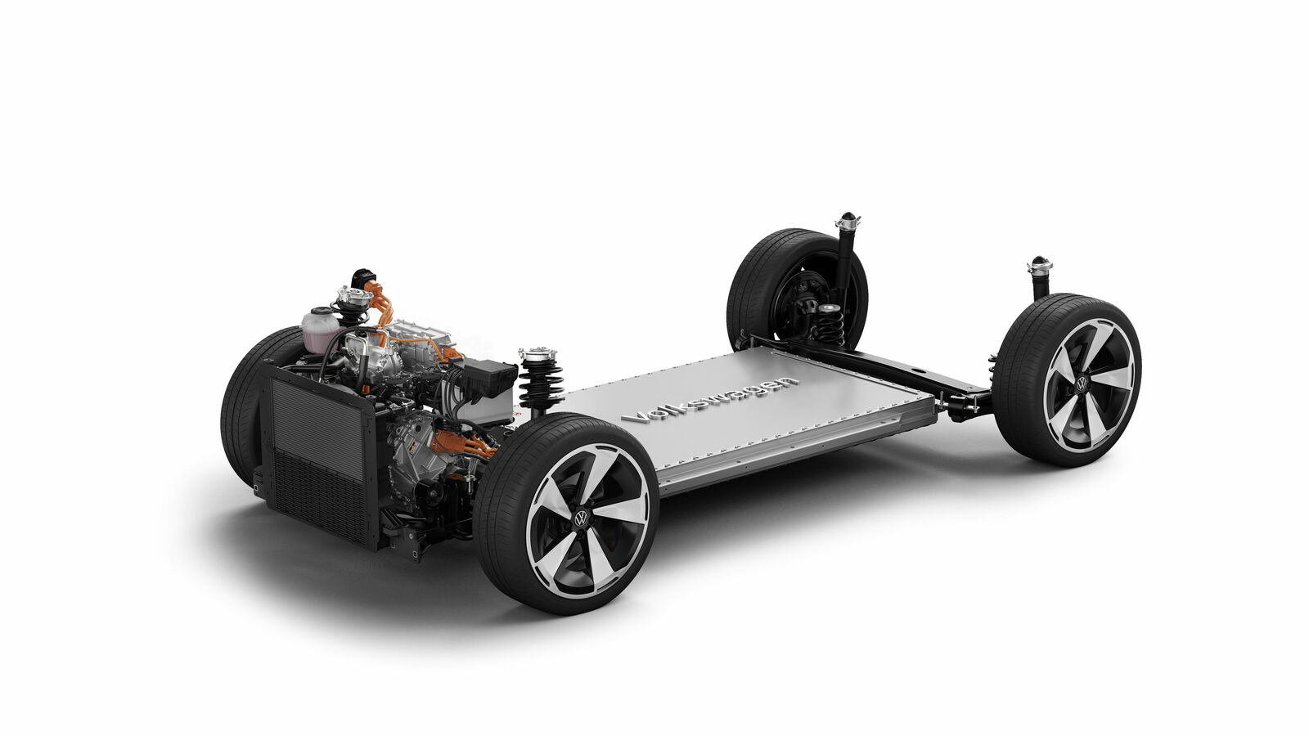
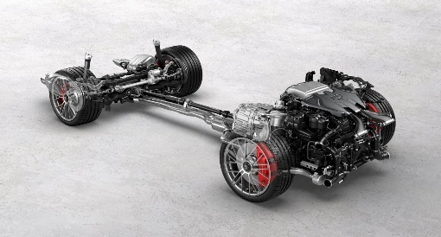

Finding a Consensus
Validate Limit Curve with available data of CP’s and OICA: x-Margin
Various Propulsion Concepts
ICE-V
EV
Multiple Electric Propulsion Sources
Single Drivetrain
[Engine - Gear Box* - Final Drive]
Single Drivetrain
[Converter - Motor - Final Drive]
The extension of the margin from 2 dB to 3 dB for EVs with AWD drivetrains is justified, since at least two electrical motors plus its converters are installed.
These are additional and independent sound sources and should not be mixed-up with a classical 4WD.
ICE-V 4WD
EV AWD
Single Drivetrain
[Engine - Gear Box* - 1st Final Drive]
in addition „only“ 2nd Final Drive
1st Drivetrain [Converter - Motor - Final Drive]
in addition
2nd Drivetrain [Converter - Motor – Final Drive]
*) gearbox with lockable gears
Source: Pictures of Drivetrains by Volkswagen and Porsche

Slide 9
Finding a Consensus
Validate Limit Curve with available data of CP’s and OICA: x-Margin
If even L_{crs} fails the ASEP requirements with a 2 dB margin, there is no justification to limit this margin!
L_{crs_rep} is louder than L_{wot_rep} in Annex 3 Tests
The extension of the margin from 2 dB to 3 dB for EVs with non-linear sound-load-behaviour is justified, since the low L_{wot_rep} defines the ASEP anchor point for all load conditions for Evs including L_{crs_rep}.
Basically, even the OICA proposed 3 dB is too stringent for a simple supplement.
Making almost the quietest vehicles borderline cannot be the target of the regulation.
max. sound pressure level [dB(A)]
vehicle speed v_{BB‘} [km/h]
UN-Regulation No. 51/03 Annex 3
3.1.3.3. Validation of individual test runs
If a sound peak obviously out of character with the general sound pressure level is observed, the measurement shall be discarded. At least four measurements for each test condition shall be made on each side of the vehicle and for each gear ratio. …The first four valid consecutive measurement results, within
2 dB(A), allowing for the deletion of non-valid results …, shall be used for the further calculations below.
* based on VEHICLE ID-07 (CP-Data) with PMR: 72 kW/t, a_{max}= 3 m/s² and L_{urban}: 68,6 dB(A) Phase 2
** accepted difference between consecutive test runs of one (!) test condition see UN-R51/03 Annex 3 Paragraph 3.1.3.3.

Slide 10
Finding a Consensus
Transitional provisions for extensions of existing Type Approvals
00
01
02
GRBP-82-08
OICA‘s Proposal
Improved Text for WD
Supplement [11] does not apply to existing UN type approvals and their extensions, granted prior to the date of entry into force of Supplement [11].
Supplement [11] does not apply to existing UN type approvals and their extensions, granted prior to the date of entry into force of Supplement [11].
As from the official date of entry into force of Supplement [11] to the 03 series of amendments to this Regulation, no Contracting Party applying this UN Regulation shall refuse to grant or refuse to accept UN type approvals according to Supplement [11] to the 03 series of amendments to this UN Regulation.
Until 24 months after the date of entry into force of the Supplement [11] to the 03 series of amendments to this UN Regulation, Contracting Parties applying this UN Regulation can continue to grant extensions to existing UN type approvals to the 03 series of amendments to this UN Regulation, granted prior to the date of entry into force of Supplement [11] without taking into account the provisions of Paragraph 6.2.3.3. of Supplement [11]
  While supporting the new specifications for EVs and HEVs when electrically propelled, industry needs transitional provisions introducing them for the extension of existing types since this changes may need adoptions in vehicle’s software architecture.

Slide 11
Conclusion & OICA’s Position
OICA’s Proposal Meets all Requirements to be Addressed in a Supplement.
Based on CP collected data OICA’s validation confirms industry’s proposal as reasonable and effective.
EVs are the most silent vehicles! The subgroup’s discussion discredits EVs as noisy vehicles, which is simply not true.
OICA suggested wording (GRBP-2026-xx) is based on WD GRBP2025-29 & GRB 82-08, and meets the request of GRBP to solve the remaining three items:
  After start-up no EES in the speed range greater than 50 km/h (default mode).
  Activation of additional sound only by an intentional decision of the driver.
  24 months transitional provisions for extensions of existing Type Approvals only regarding these new specifications.
  In addition, AVAS requirements introduced for any additional sound below 20 km/h and standstill
  (not in scope of Annex 7 ASEP)!
In 82nd GRBP we had a common understanding to have an interim solution, focusing completely new requirements to a 04 series of amendments to UN Regulation 51 based on RD-ASEP (further development of Annex 7 ASEP).
Since a supplement can only be based on a sensed consensus line between CPs and industry, completely new requirements in a supplement cannot be supported without industry’s support.
Further postponement of this Supplement is not supported by industry, as the short time in force until the introduction of RD-ASEP (see GRBP-82-09) does not justifies this high effort on an almost superseded measurement method.

Slide 12
Thank You!
Copyright Disclaimer:
The author and the speaker of this document/presentation confirm that they have authorization to use all content including photos and visual elements.
The material is either copyright-free or the author/speaker hold the necessary copyright or permission.
The UNECE will remove any material from its events and supporting websites if there is unlawful use of copyrighted material.
The author/speaker takes responsibility for any infringement on copyright and holds the UNECE harmless to this effect.

