Slide 1
A-LCA
SG7 : drafting
Presentation of the draft
26 th of november 2025

Slide 2
What have been done by SG7
SG1 :
  Provide draft for multi-output allocation (follow ISO, recommend economic ratio of 5 + 3 years of price average, if database diverge, it should be mentioned in the report) → Niikuni-san send the updated draft with EC, JP, JRC, CLEPA comments taken – DONE (US ok)
    Can we confirm the previous section on multi-output should be fully removed ? OK to remove
    Wait for ansgar confirmation → « refered product » - check within full document
JP :
  Check definition 3.5.2 → OK with US definition
SG4 :
  Check definition 3.5.2 → take the first definition agreed by the US
  Provide Discrepancy + deterioration definitions → deterioration will be put as [ reserved ] – SG4 will provide the new update including the definition of discrepancy
  Adress FU + Service life + methane leakage + battery replacement & FC during Friday meeting and send new input to SG7 co-leaders + IWG leading team → text on FU was provided (US still need to confirm) + idem for Service Life + methane leakage updated OK + battery replacement (US will confirm) + restructure (agreed) – will be Included by SG7
RV :
  Organize a meeting with CPs regarding [reserved] or consensus + ask US to propose a counter proposal regarding “cluster” → George/Sam provided yesterday the update draft – will be Included by SG7
SG2/SG3 :
  Finetune Table 2 on primary data and send proposal to SG7 co-leaders + IWG leading team → provided by Ansgar (change of the order of the sections + table 2 was completely removed and replace by text) - DONE
  Primary data share : provide new inputs after the meeting with EC → provided by Ansgar (we still need to decide for which stages and for which level PDS/PADS is mandatory = mandatory for production and optional) → include in the compiled document in [ ] - DONE
SG7 :
  Restructuration of Chapter 2, 7 and 8 (cf. previous slides) : DONE
  Check cross reference, numbers etc. – mostly done
  Check definition based on JP comments - DONE
  Change “guideline” into “Resolution” if needed → DONE (when appropriate, guideline was kept or replaced by Resolution or methodology)
  Ask US to provide regulation for II.3 → DONE wo answer
  Remove III 5 & 6 on Future review and langage → DONE
  Ask US to provide conter proposal for definition 3.10 → DONE wo answer
  Add ESG abbreviation & keep PEV (+ respond to US) → DONE
  Table 1 : add “mainly primary data”
  Add “traction” battery in 8.2.1.3 (US comment)
  Update Table 22 based on JP comments – will be done asap
  Close verification section
  Restructure SG6 draft → DONE
  Change the title of RV : Determination of CFP
  Add the general formula at the beginning of the draft :
    CV(ehicle) = CM(aterial) + CP(roduction) + CUSE + CEoL
    In section → (TBD) 7.9.7. RV: Total carbon footprint
    / ! \ in SG3 : C_{VP} = means carbon emissions due to material production, component and vehicle manufacturing in kilogram of carbon dioxide equivalent [kg CO2eq]
    In RV : 𝐶𝑃, 𝑖 means the production stage carbon emission of the declared vehicle, [kgCO2eq];
    SG7 proposal → harmonize in RV section and use C_{VP inly} → add addition equation CVP = CM + Cpart/manufacturing + change CVP in Production section and in the total carbon footprint
  Add in the Annex a section In which we will provide an simple extract but refers to the tool+ Ask again François if we can provide a tool (an excel file) and not a simple table
  Second life : Add a sentence in Chapter 7 System boundaries + make the changes proposed by SG5 → SG5 will provide the updated draft SG7 will intergrate it - DONE
  SG7 will check the reference of ISO, and if we need to copy/paste to have the self standing report – will be done asap

Slide 3
What have been done by SG7 : SG6 focus
SG7 :
  Land use change : updated text provided by Nori-san on the 17th/1 → DONE
  Q : energy modelling of maintenance ? → check in the text (SG4 : maintenance should be compliant with production – agreed in SG4) → check
 | List of Topic | CLEPA | OICA | SG leader decisions & SG7 action
 | Energy modelling at production stage | Remove in the title « at production stage » |  | OK
 | Fuel modelling at production stage
 | Electricity modelling at production stage
 | Electricity from the grid via a contractual instrument | (d) → be procude for the same year | OICA would like to mention again, that for practicality reasons, a mixed modelling approach should be accepted. If the decsision is postponed to a later stage in the UNECE process, it has to be made sure that, in the transition time to second stage, the provisions of the UNECE standard do not prescribe one approach in favor over another. Either implement "mixed modelling approach" as suggested by SG7, or Delete section "There is no double counting with grid electricity (the LCI data for grid electricity uses the residual mix, excluding the value of the electricity certificate. If no residual mix is available, the fossil generation mix for the respective grid shall be used);" | → Be procuded Within a year
 | Electricity from a directly connected supplier
 | Electricity from on site production
 | . Electricity from the grid without contractual instrument
 | Energy modelling at Use stage and EoL stage | Remove Dispatch modelling Note | As discussed in the SG6 emergency meeting OICA suggests: - as EU COM requested, government-published mixes and factors may be dynamic or static (up to governments to decide) - consistency across technologies is enabled, i.e. dynamic has to be used for both electricity and fuel mix. Since fuel mix pathways are not available as IEA STEPS scenario, a comparable scenario has to be developed for preference 2 of the hierarchy. For level 3 and 4 reporting, comparability is key. Therefore, preference 3 in the hierarchy should be not applicable for level 3 & 4, as also supported by ICCT. → Add [static or dynamic] in the 1. + add [[A comparable scenario for fuel mix has to be established] + For levels 3 and 4, point 3 in the hierarchy is not suitable for comparability reasons, as the purpose of mandatory declaration and OEM comparison necessitates a consistent reference. Hence 3 (dispatch modelling) shall not be used for level 3 and 4, but may only be used only for level 1 and 2. | OK keep dispatch modeeling note + keep the actual text + [energy modelling per level] only to secure the possibility to specify the methodology per level later on (phase 2)
 | Energy Modelling at material production stage
 | Energy modelling at production stage
 | Energy modelling at use stage
 | Energy modelling at EoL stage
 | Additional table | Provide a similar table in the chapter on energy |  | [energy modelling per level] only to secure the possibility to specify the methodology per level later on (phase 2)

Slide 4
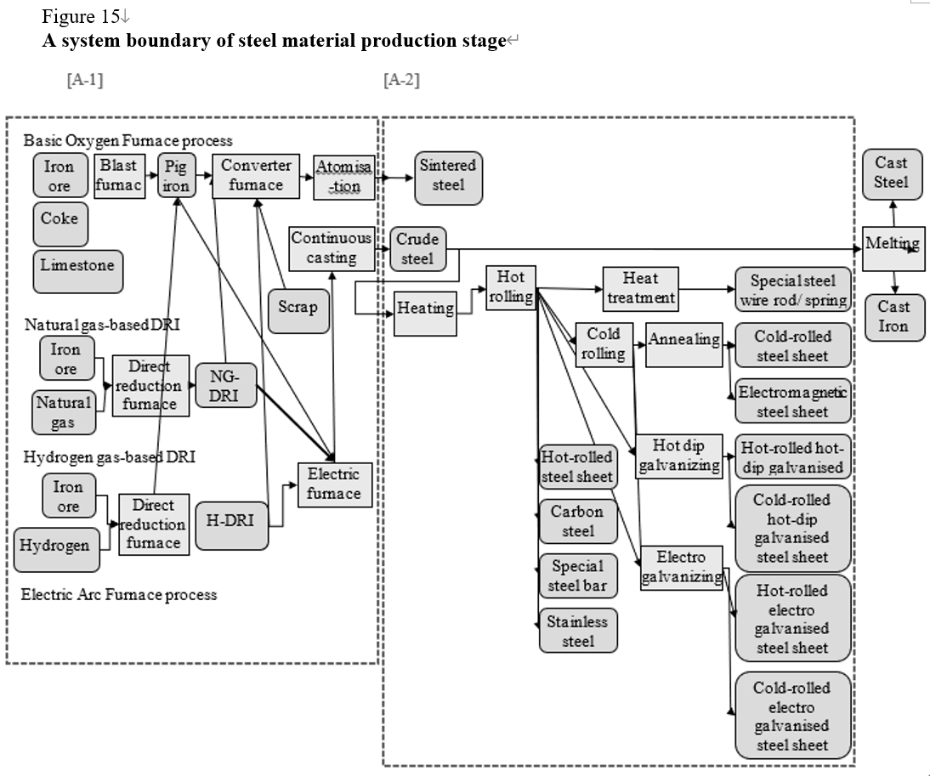
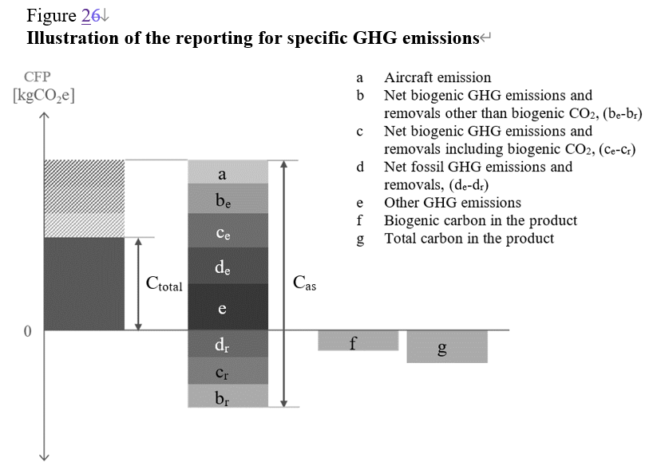
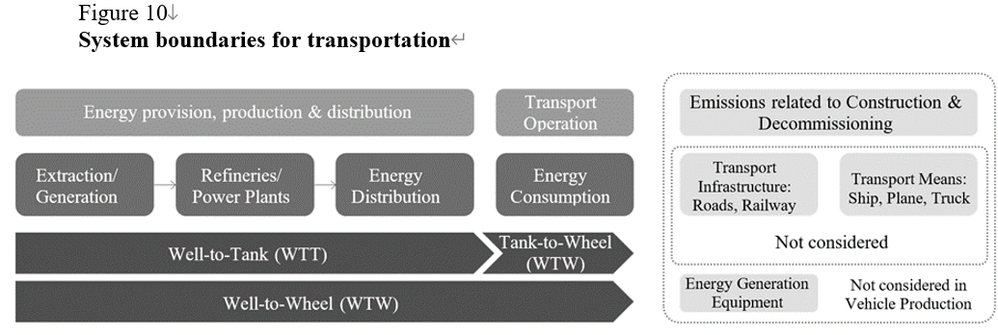
Figures issues – coherency
Figure 2 (previous Figure 6)
Values "Ctotal" and "Cas" is not explained in this figure nor this chapter. They should be explained.
→ SG3?
Figure 15
Diagrams of "Electric Arc Furnace process" are vanished. They should be added.
& some minor issues
- A legend for this figure is needed
- Finetuning is needed (some arrows are not connected, etc.)
→ SG2
Figure 10 (previous Figure 13)
The description “Energy Generation Equipment” on the right is misleading because only "vehicle production" is mentioned. It should be modified or deleted.
→ SG3?
Deadline for revisions: Dec. 1st ?

Slide 5
Figures issues – editorial (minor)
Deadline for revisions: Dec. 1st ? → SG7 will send the figure document + Kawamoto-san & SG2 will organize a short meeting + figure EoL part → SG5 will provide ppt

Slide 6
Next steps
SG7 :
incorporate SG6 draft + SG4 + « Deterlmination of CFP »
Check CR
Send the draft to IWG Tomorrow (Caroline will do)

Slide 7
Thank you
Caroline MIR caroline.mir@ademe.fr
Samarendra Tripathy samarendra.tripathy@renault.com
Kawamoto Ryuji kawamoto.r@mazda.co.jp

