Slide 1

Feedback on the draft GTR (KOREA)
Korea Automobile Testing and Research Institute (KATRI)
Chief researcher Kil ho MAENG
(helper@kotsa.or.kr)

Slide 2
Contents
1. Comparative Review of Deactivation Requirements
2. Cases of Vehicles for Carrying Children
* South Korea and the United States

Slide 3
Comparative Review of Deactivation Requirements

Slide 4
Comparative Review of Deactivation Requirements
○ Background
- At the last meeting, the IWG CLIV discussed test procedures for “Deactivation”.
- Deactivation is not a main function of the system (same with the switching-off of the device).
- To simplify test procedure of CLIV, deactivation of other devices have been reviewed.
○ Reviewed UN Regulations
- 16. Safety-belts (Seatbelt reminder)
- 130. Lane Departure Warning system
- 151. Blind Spot Information System for the Detection of Bicycles
- 158. Devices for means of rear visibility or detection
- 159. Moving Off Information System
Page 1

Slide 5
Comparative Review of Deactivation Requirements
○ UN R 16. Seatbelts (Seatbelt reminder)
8.4.2.6. The safety-belt reminder may be designed to allow deactivation
8.4.2.6.1. In the case a short term deactivation is provided, it shall be more difficult to deactivate the safety-belt reminder than buckling the safety-belt on and off. When the ignition is switched off for more than 30 minutes and switched on again, a short-term deactivated safety-belt reminder must reactivate.
8.4.2.6.2. In the case that a facility for a long term deactivation is provided, it shall require a sequence of operations to deactivate, that are detailed only in the manufacturer’s technical manual and/or which requires the use of tools(mechanical, electrical, digital, etc.) that are not provided with the vehicle.
There is no additional test after deactivation.
There is no specific requirements for long term deactivation. The regulation only prohibits long term deactivation done by drivers or owners of the vehicle.
Page 2

Slide 6
Comparative Review of Deactivation Requirements
○ UN R 130. Lane Departure Warning System (LDWS)
5. Specifications
5.2.3. The LDWS shall be active at least at vehicle speeds above 60 km/h, unless manually deactivated as per paragraph 5.3. below.
5.3. If a vehicle is equipped with a means to deactivate the LDWS function, the following conditions shall apply as appropriate:
5.3.1. The LDWS function shall be automatically reinstated at the initiation of each new ignition "on" (run) cycle.
5.3.2. A constant optical warning signal shall inform the driver that the LDWS function has been deactivated. The yellow warning signal specified in paragraph 5.4.2. below may be used for this purpose.
6. test procedure
6.7. Deactivation Test
6.7.1 If the vehicle is equipped with means to deactivate the LDWS, turn the ignition (start) switch to the "on" (run) position and deactivate the LDWS. The warning signal mentioned in paragraph 5.3.2. above shall be activated. Turn the ignition (start) switch to the "off" position. Again, turn the ignition (start) switch to the "on" (run) position and verify that the previously activated warning signal is not reactivated, thereby indicating that the LDWS has been reinstated as specified in paragraph 5.3.1. above. If the ignition system is activated by means of a "key", the above requirement shall be fulfilled without removing the key.
There is no additional test after deactivation. It only checks operational condition.
The test procedure only checks the yellow warning signal, which may be used.
Page 3

Slide 7
Comparative Review of Deactivation Requirements
○ UN R 151. Blind Spot Information System for the Detection of Bicycles (BSIS)
5.3.1.2. The warning signal shall meet the requirements of paragraph 5.5. below. It may be deactivated manually. In the case of a manual deactivation, it shall be reactivated upon each activation of the vehicle master control switch.
The BSIS shall automatically deactivate if it cannot operate properly due to its sensoring devices being contaminated by ice, snow, mud, dirt or similar material or due to ambient light conditions below those specified in paragraph.
5.3.1.3. This shall be indicated as specified in paragraph 5.6.2. It shall automatically reactivate when the contamination disappears and normal function has been verified. This shall be tested in accordance with the provisions of paragraph 6.9. below
6. test procedure
6.9. Automatic deactivation test
6.9.1. Contaminate any of the system's sensing devices completely with a substance comparable to snow, ice or mud (e.g. based on water). The BSIS shall automatically deactivate, indicating this condition as specified in paragraph 5.6.2.
6.9.2. Remove any contamination from the system's sensing devices completely and
perform a reactivation of the vehicle master control switch. The BSIS shall automatically reactivate after a driving time not exceeding 60 seconds.
The regulation mentions: if contaminated, automatically deactivated.
There is requirement only for testing automatic deactivation performance.
The regulation only mentions that deactivation “shall be indicated”.
Page 4

Slide 8
Comparative Review of Deactivation Requirements
○ UN R 158. Devices for means of rear visibility or detection
16.1.1.3. Deactivation
The rear-view image shall remain visible during the backing event until either, the driver modifies the view, or the vehicle direction selector is no longer in the reverse position.
Modifying the view means to switch to any other camera views.
The view can be manually switched off when the vehicle is not moving rearward.
The system may be switched off when the vehicle detects a coupling by means of coupling device.
17. Requirements for detection system
17.1 The system shall be activated when the backing events starts. If proper functioning cannot be effected, either the system shall automatically shut off or the driver shall be able to deactivate the system manually.
The detection system shall remain active as long as the vehicle direction selector is in the reverse position.
In case the vehicle can detect coupling with a coupling device, the system may be switched off.
Deactivation condition is little unclear: ex) what if vehicle direction selector is in R position but not moving rearward?
There is requirement, but no additional test for checking performance and condition.
The regulation only says that the system shall be activated at every backing event.
Page 5

Slide 9
Comparative Review of Deactivation Requirements
○ UN R 159. Moving Off Information System (MOIS)
5. Specifications
5.3. Automatic Deactivation
5.3.1.The MOIS shall automatically deactivate if it malfunctions or cannot operate properly due to its sensor devices becoming contaminated by ice, snow, mud, dirt or similar material. The MOIS may also automatically deactivate due to ambient light conditions below that specified in paragraph 5.2.1.
5.3.2. Automatic deactivation shall be indicated by the failure warning signal specified in paragraph 5.8.
5.3.3. The MOIS shall automatically reactivate when the normal function of the sensors is verified. This shall be tested in accordance with the provisions of paragraphs 6.8 (failure detection test) and 6.9. (automatic deactivation test).
5.4. Manual deactivation
5.4.1. It may be possible to manually deactivate the MOIS.
5.4.2.Manual deactivation shall be through a sequence of intentional actions to be carried out by the driver, for example by requiring a single input exceeding a certain threshold of time or a double press, or two separate but simultaneous
inputs. 5.4.3. It shall not be possible to manually deactivate any other system at the same time as the MOIS or through the same sequence of actions. 5.4.4. When manually deactivated, it shall be possible for the driver to easily manually reactivate the MOIS.
5.4.5. When manually deactivated, the MOIS shall automatically reactivate when the vehicle master control switch is activated.
5.7.5.The collision warning signal may be deactivated manually. In the case of a manual deactivation, it shall be reactivated on each activation of the vehicle master control switch.
6. Test procedure
6.9. Automatic deactivation test
6.9.1. With the MOIS system active, contaminate any of the MOIS sensing devices completely with a substance comparable to snow, ice or mud (e.g. based on water). The MOIS shall automatically deactivate, indicating this condition as specified in paragraph 5.8.
Similar with BSIS
There is additional test after the automatic deactivation.
Page 6

Slide 10
Comparative Review of Deactivation Requirements
○ Conclusion
- Most regulations do not require to repeat performance test after deactivation. There are only test procedures for checking proper operation after deactivation.
- Some indicators are mentioned as “may used” for showing the status of device deactivation.
(UN R121 is not checked yet)
○ For consideration
- Conducting performance test after short/long term deactivation would be deemed stringent.
- The purpose of CLIV Indicator/tell-tale is not clear.
⇒ Deactivation/Activation
Page 7

Slide 11
Cases of vehicles for carrying children
* South Korea and the United States

Slide 12

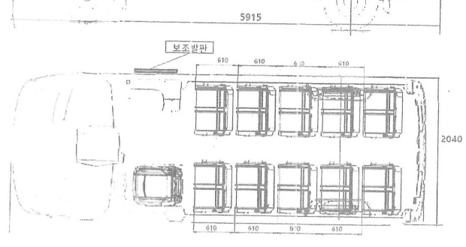
Cases of vehicles for carrying children
○ Vehicle specification in KOREA
- Maker: Korea bodybuilder
- Seating capacity of children: 20
- L,W,H: 5,915/2,040/2,760 mm
- Alarm
1) Additional device (Not horn) (70~80db)
2) After 3 minutes
Page 9

Slide 13
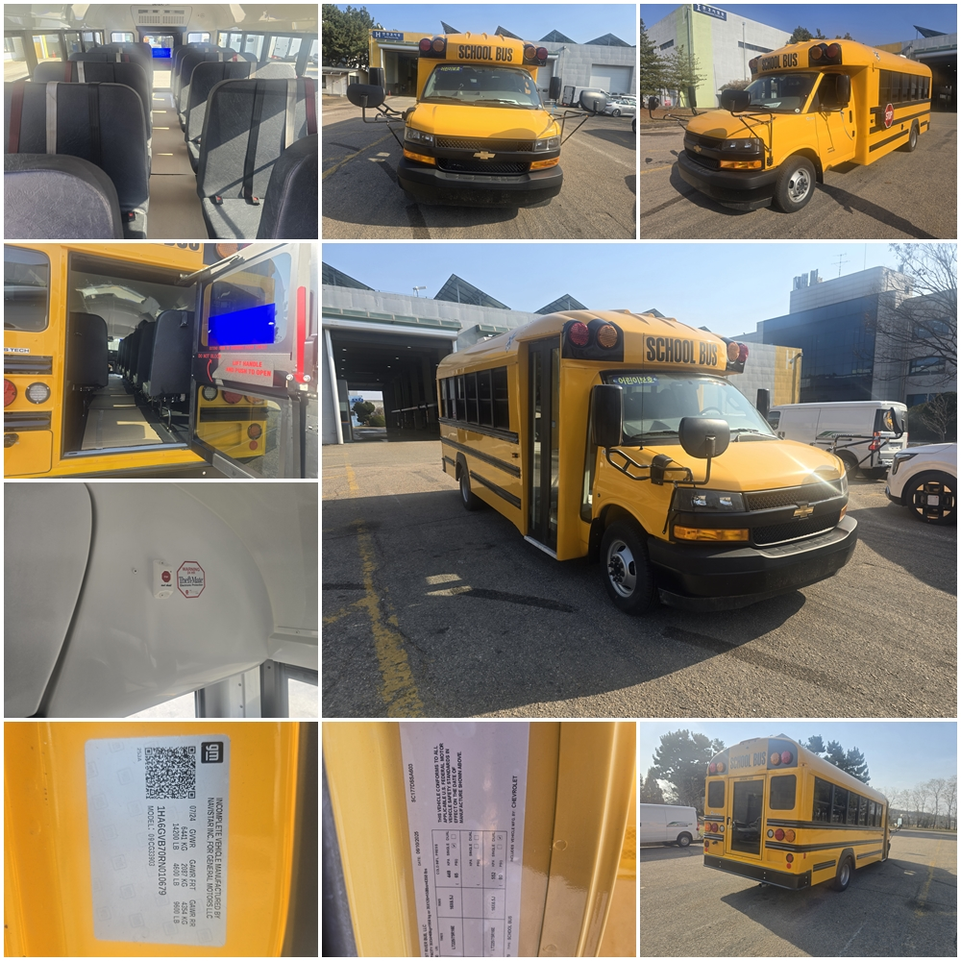
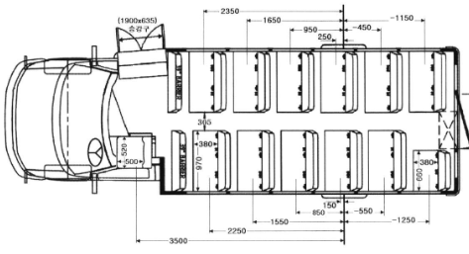
Cases of vehicles for carrying children
○ Vehicle specification in the U.S
- Maker: TRANS TECH HSST (US)
- Seating capacity of children: 35
- L,W,H : 7,410/2,470/2,750 mm
- Alarm
1) Horn (90↑db)
2) End of journey → Check → Push
Button → Vehicle master switch off
* If vehicle master switch off without
pushing button, Alarm starts within
10 seconds.
Page 9

Slide 14
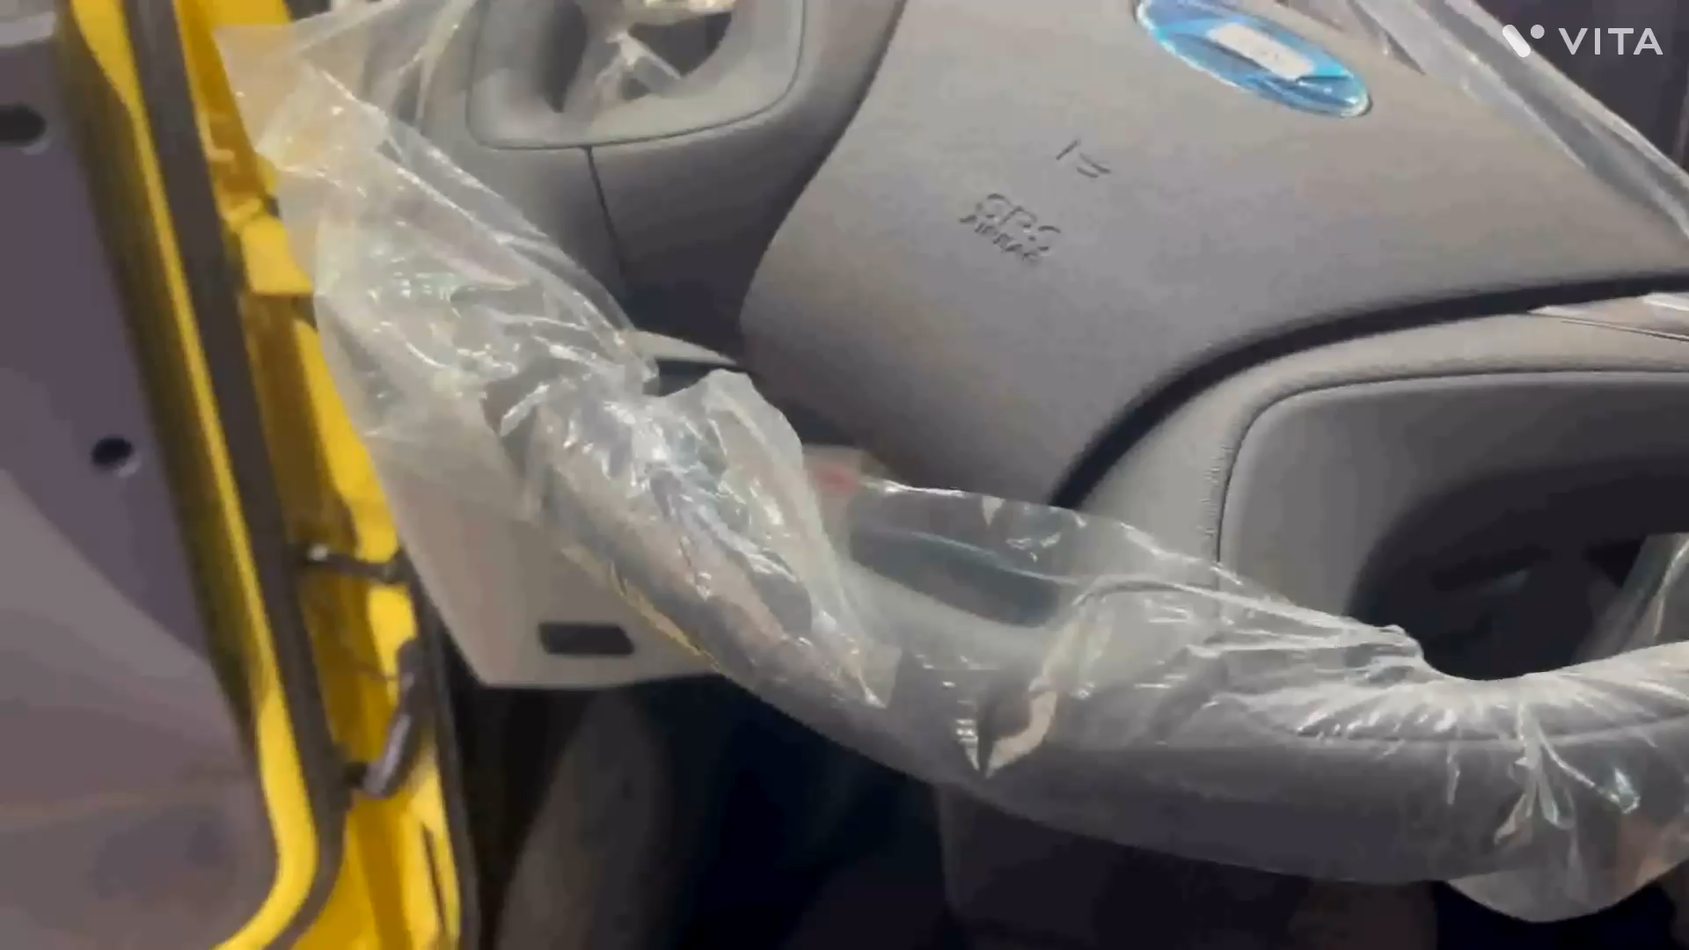
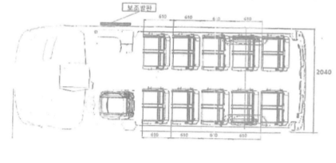
Cases of vehicles for carrying children
○ Checking children left in vehicle: Case 1 (KOR), Walking distance: apprx. 11m
Page 10

Slide 15
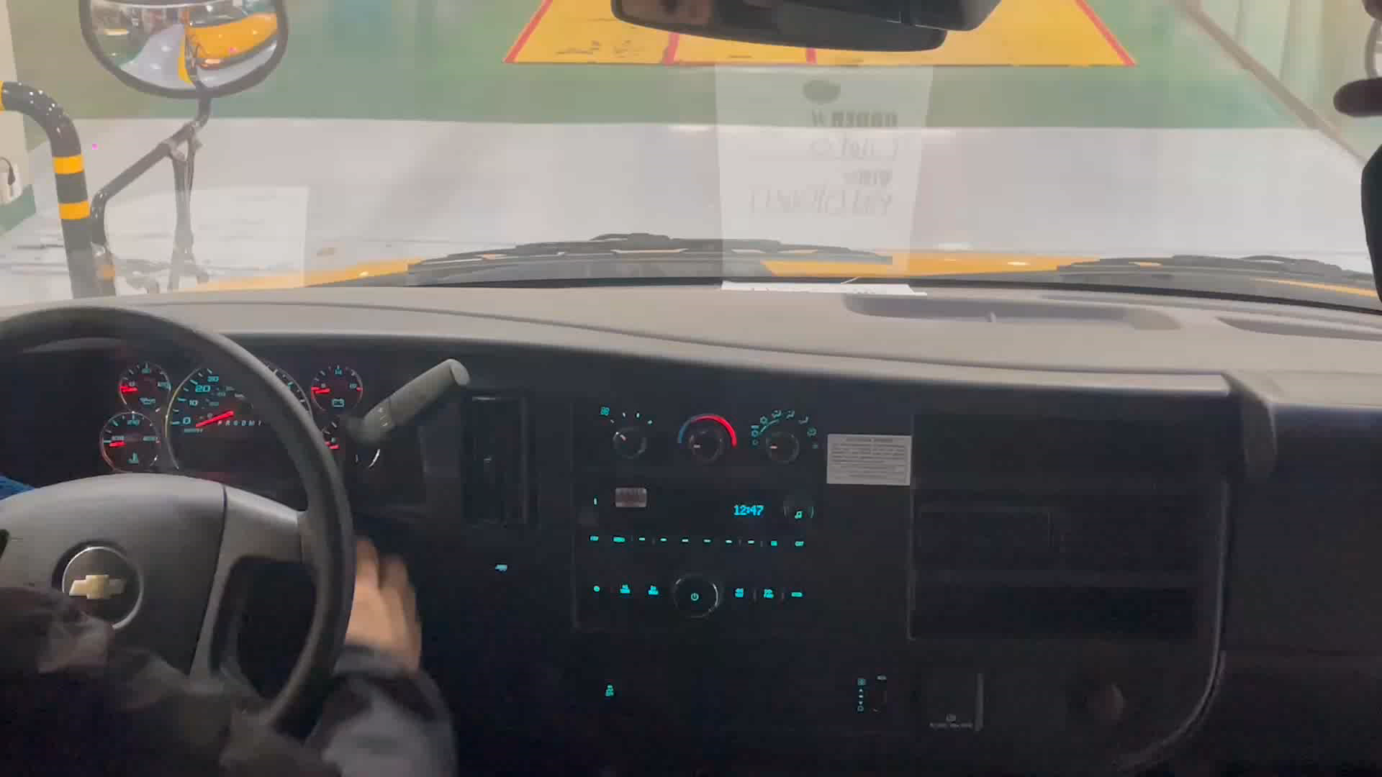
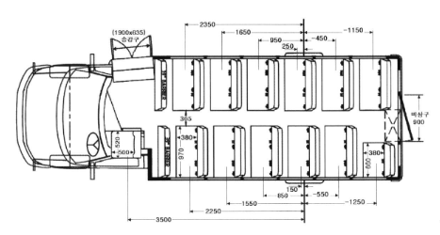
Cases of vehicles for carrying children
○ Checking children left in vehicle: Case 2 (U.S), Walking distance: apprx. 5m
Page 11

Slide 16
Thank you
Chief researcher Kil ho MAENG
(helper@kotsa.or.kr)

