Slide 1
Guidance document: initial view
Submitted by the expert from the United Kingdom
Informal document AI-03-04
3rd session of the IWG on AI, Nov 13 2025
Provisional agenda item 5(a)

Slide 2
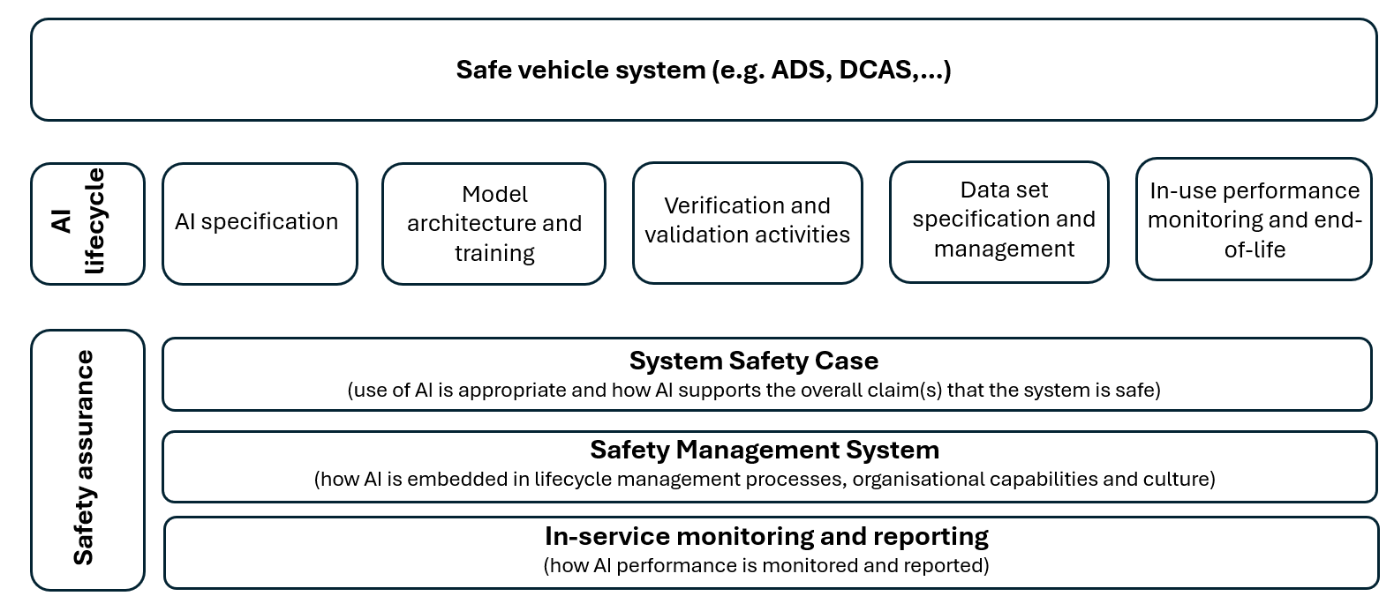
Technical topics: potential areas for guidance
Guidance: using AI within vehicle safety systems (e.g. appropriate use / identifying and describing the role AI plays)
Guidance: Best practice for each stage of the ‘lifecycle’.
Guidance: What to include within a system safety case, safety management system and ISMR.

Slide 3
Example layout
1. Introduction
2. Scope
3. Definitions and Terminology (relevant items taken from the T&D document)
4. General considerations on the use of AI
5. AI Lifecycle: best practice
AI specification
Model architecture and training
Verification and validation activities
Data-set specification and management
In-use performance monitoring
End of life
6. Safety Assurance when using AI: best practice
Safety case
Safety management system
Other considerations:
Worked Examples (extract use-cases from the use case document and present a high-level worked through example in accordance with section 5, this could be an annex)
Future Work (where/how do we record other aspects not considered so far)
NOTE: guidance can be built/developed over time.
Notes:
Worked example:
How use cases identified in task 6b could be used as examples in theguidance

Slide 4
Next steps
Agree approach to contributing to the guidance document
UK would like to contribute, and can draw on existing thinking/research conducted domestically
Alignment of potential guidelines with ADS Regulation, e.g. safety case and safety management system

