Slide 1
A-LCA
SG7 : drafting
Presentation of the draft
5th of december 2025 – IWG 32nd

Slide 2


Summary of achievements
All Contracting Parties (US, EU, Korea & Japan) provided comments and most of the time concrete proposals
More than 200 comments and modifications received on the latest version
Focus is more on content and coherency
Ongoing process of :
  Redundancy check
  Cross reference
  Figures update
Request IWG to allow further simplification of text (with out changing content and not to touch some sensitive sections) as we still need to improve readability
A huge Thanks to IWG leading team, SG leaders, CPs and SG !
<3

Slide 3
What have been done : focus on [open topics]
 | List of Topic | Status
 | List of Topic | Concept | Methodology | Draft status | New inputs from SG leaders/CPs | SG7 actions | IWG decision
II. 3. | Existing regulationa and standards | CLOSED | CLOSED | CLOSED? | US provided reference | SG7 added the reference and propose to close the issue
 | Table 1 | CLOSED | CLOSED | OPEN | CPS provided feedback and a general coherency check is ongoing
III 3. | Definitions | CLOSED | CLOSED | OPEN – still XX [ ] reserved for Phase 2 | Traction abttery definition added (US) Japan proposed to remove some definitions (which is not used or which are used once) | SG7 Propose to remove definitions which are not usedbut keep the definitions which are used even one time
5.1.3 | Land use change | CLOSED | CLOSED | OPEN | Input provided by CPs | SG7 propose to have a conclusion
5.5.1.2 | Electricity modeling | CLOSED | CLOSED | OPEN | EU propose that ‘Contracting Parties shall establish, within their respective territories, how electricity modelling is to be defined. ‘ | SG7 integrated the proposal
Notes:
L

Slide 4
What have been done : focus on [open topics]
 | List of Topic | Status
 | List of Topic | Concept | Methodology | Draft status | New inputs from SG leaders | SG7 actions | IWG decision
 | Functional Unit and reference flow | CLOSED | CLOSED | OPEN | US provided concrete proposal | SG7 updated the draft Final decision required before 5th dec
 | Determination of vehicle CFP (RV) | CLOSED | CLOSED | OPEN | EU still need some clarifications | SG7 included the al CP comments
 | Primary data share | CLOSED | CLOSED | OPEN? | EU and Japan have concerns | Final decision required before 5th dec
 | Multi-output allocation | CLOSED | CLOSED | OPEN? | Not much comments from stake holders | SG7 propose to close the issue

Slide 5
What have been done : focus on [open topics]
 | List of Topic | Status
 | List of Topic | Concept | Methodology | Draft status | New inputs from SG leaders | SG7 actions | IWG decision
8.2.1.3 8.2.1.1 | Parts production and vehicle assembly stage | CLOSED | CLOSED | CLOSED | SG2 and SG3 provided revised equations | SG7 integrated this new inputs
8.3.1.1 | Service life | CLOSED | CLOSED | CLOSED ? | Comments provided by CPs | Final agreement from IWG expected
8.3.3 | Duel energy ( PHEV) | CLOSED | CLOSED | OPEN : ? | OICA provided a counter proposal (not included in the draft) | SG7 integrated inputs in [ ] Decision required from SG4
8.3.3.2 | Deterioration factor | Open | Open | OPEN : ? | Input provided by CPs | SG7 integrated inputs in [ ] Decision required from SG4 Can move to next phase with [RESERVED] ?
8.3.6.2.5 | Battery replacement | CLOSED | CLOSED | OPEN : ? | US EPA provided concrete proposal | SG7 integrated inputs in [ ] Decision required from SG4 Can move to next phase with [RESERVED] ?
8.3.6.2.6 | Fuel cell replacement | CLOSED | Open | OPEN? | US EPA provided concrete proposal | SG7 integrated inputs in [ ] Decision required from SG4 Can move to next phase with [RESERVED]?
III 9. | Reporting | CLOSED | CLOSED | CLOSED | SG1 provided : 251014 GRPE-2025-30 Draft Informal Document - for GRPE submission Reporting update 251027 | SG7 included the new input sent by Niikuni-san
III 10. | Verification process | CLOSED | CLOSED | CLOSED | EU provided | SG7 included Latest draft : 201024_GRPE-93-43e_clean_verification + removed [ ]

Slide 6
Next steps
For CPs
Key Dates
Provide feedback on the latest draft to SG7 co-leaders – before the 8th of December
  Please send your comments directly in the clean version (word) and limit your comments to concrete counter proposal
  Send your comments to the IWG leading team + in cc Caroline + Sam + Kawamoto-san
05 December: 32nd A LCA IWG
8/11 December: Potential meetings with leading team and François san
12 December: Submission of working document
For SG leaders
Dedicated meetings on pending issues
Recheck coherency of equations, figures and tables
Decision on topics to move for next phase

Slide 7
Thank you
Caroline MIR caroline.mir@ademe.fr
Samarendra Tripathy samarendra.tripathy@renault.com
Kawamoto Ryuji kawamoto.r@mazda.co.jp

Slide 8
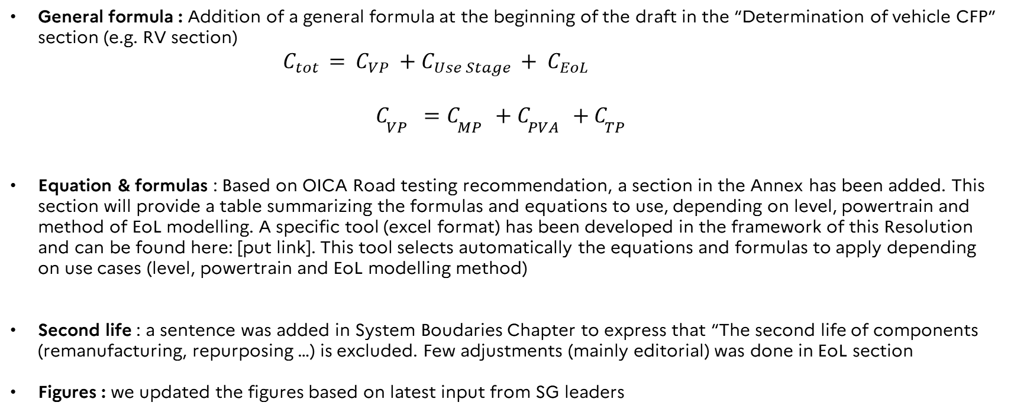
What have been done : Harmonization & Coherency
  General formula : Addition of a general formula at the beginning of the draft in the “Determination of vehicle CFP” section (e.g. RV section)
${C_{tot} = C}_{VP} {+ C_{Use Stage }+ C}_{EoL}$
$C_{VP}=C_{MP}+C_{PVA}+C_{TP}$
  Equation & formulas : Based on OICA Road testing recommendation, a section in the Annex has been added. This section will provide a table summarizing the formulas and equations to use, depending on level, powertrain and method of EoL modelling. A specific tool (excel format) has been developed in the framework of this Resolution and can be found here: [put link]. This tool selects automatically the equations and formulas to apply depending on use cases (level, powertrain and EoL modelling method)
  Second life : a sentence was added in System Boudaries Chapter to express that “The second life of components (remanufacturing, repurposing …) is excluded. Few adjustments (mainly editorial) was done in EoL section
  Figures : we updated the figures based on latest input from SG leaders

