Slide 1
TFGP-05-06
GTB Task Force “Glare Control”
The glare phenomenon, its causes and relevance ranking of glare events
2025-12-09
- GTB/TF-GC -

Slide 2
To better understand the glare phenomenon during night-time driving, the GTB Task Force «Glare Control» examined the results of a lot of studies and researches conducted in the time period from 1996 to the current year in different countries, trying to better identify these reasons.
The activity resulted in a preliminary classification of glare type, in relation to their potential reason.
…more on that later. First, some questions.

Slide 3
GLARE (as we intend it)
Excessive amount of light directed into the eyes of drivers of oncoming vehicles or, through the rear-view mirrors, preceding vehicles

Slide 4
ILLUMINATION
Emitting light into the traffic area in such a way as to allow the driver:
to see the road ahead of the vehicle
to recognize obstacles on the road and in its immediate vicinity
detect an obstacle with sufficient time to stop the vehicle / to avoid collision

Slide 5
This amount of light (“too much”) can only be determined as an average, due to the wide range of a driver’s visual performance.
How much light is "too much"?
The perception of both illumination and glare depends on the individual driver’s visual performance (e.g. adaptation capability of the eye) and to ambient conditions.
At what level does the amount of light become "excessive"?
In other words: there will always be someone who will feel dazzled.

Slide 6
More importantly:
Glare is a phenomenon that
cannot be totally eliminated.
Target is to mitigate a significant amount of strong glare events.

Slide 7
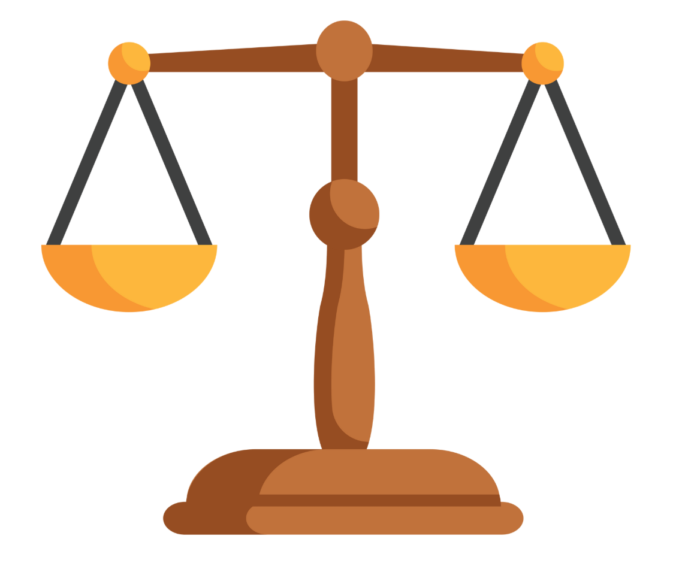
VISIBILITY
GLARE
(discomfort & disability)
ROAD ILLUMINATION

Slide 8
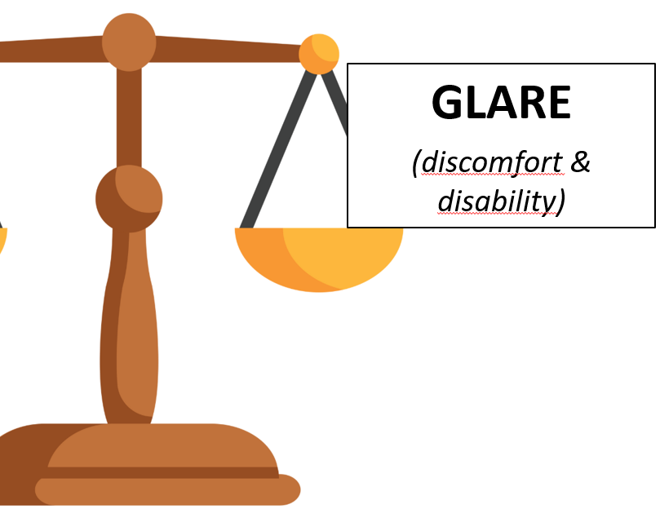
Glare Relevance Level is depending on:
Intensity I
(glare illuminance level at driver‘s eye)
Exposure time E
(length of glare peak)
Occurance frequency F
(how often the glare event takes place)
1
2
3
Glare Relevance Level = Intensity x Exposure Time x Occurance Frequency

Slide 9
Glare Relevance Level = Intensity x Exposure Time x Occurance Frequency
Ranking of glare effects: (see table in doc TFGP-05-07)
Red (very high), Orange (high), Yellow (mid), Green (low)
Basis for future proposal of effective countermeasures for glare reduction

Slide 10
FUTURE inputs from GTB
First ideas for countermeasures to glare events
Quantification of the effectiveness of proposed countermeasures.

