Slide 1
A-LCA
SG7 : drafting
FOCUS on SG6
12-13 & 17-18 & 19 th of november 2025

Slide 2
SG7 : proposal of restructuration
Current structure :
7.14.1. Fuel modelling –
7.14.2. Electricity modelling –
7.14.2.1. Electricity from the grid via a contractual instrument
7.14.2.2. Electricity from a directly connected supplier
7.14.2.3. On-site generated electricity
7.14.2.4. Grid Mix and On-Site Electricity Production:
7.14.3. Future Changes in Energy Mix
8.3.5.1. Future Changes in Energy Mix
7.14 Energy modelling
7.14.1. Energy modelling at production stage [and for maintenance?]
7.14.1.1. Fuel modelling at production stage
7.14.1.2. Electricity modelling at production stage
→ the three option are described here : location, 100% market & mixed
7.14.1.2.1. Electricity from the grid via a contractual instrument
7.14.1.2.2. Electricity from a directly connected supplier
7.14.1.2.3. Electricity from on site production
7.14.1.2.4. Electricity from the grid without contractual instrument
7.14.2 Energy modelling at Use stage and EoL stage
→ hierarchy approach is described here
8.1.6. Energy Modelling at material production stage
8.2.4. Energy modelling at production stage
8.3.5. Energy modelling at use stage
8.3.5.1. Application of the energy modelling schemes for dynamic scenario
→ calculation : arithmetic or year specific
8.3.5.2. Application of the energy modelling schemes for static scenario
8.4.7. Energy modelling at EoL stage
SG7 suggestions :
Reorganize the section 7.14 into 1/ production stage and 2/ Use stage and EoL stage – WO changes in the text.
Merge the two sections on one-site generated electricity
Adress dynamic/static modeling in the general Chap7 and not in Chap8 Use stage
Remove redundancy within the minimum criteria regarding contractual

Slide 3
SG7 : fuel modelling – small changes proposal
SG7 suggestion : refer to section 7.6 on infrastruture
7.14.1.1. Fuel modelling at production stage
The definition of emission factors for fuels follows the methodology outlined in the EU Renewable Energy Directive 2018/2001 and other systems such as the U.S. EPA Renewable Fuel Standard and shall include:
(a) Upstream processes referring to the extraction or cultivation of raw materials.
(b) Processes related to the fuel’s processing.
(c) Transport and distribution processes at each life cycle stage.
(d) Emissions from the fuel in-use.
(Infrastructure and capital goods for the production of fuel should be included by default only within the system boundary for the vehicle use stage. Refer to Section 7.6 Infrastructure and Capital Goods.)
Additionally, concerning fuels originated from bio-materials, the following conditions shall be considered;
(a) Additional emissions related to changes from soil carbon stock caused by land use change.(e.g. wetlands conversion, some specific forest areas, etc.). See Section 7.8 on Land Use.
(b) Emission savings from soil carbon accumulation via improved agricultural management (e.g. shifting to reduced or zero-tillage, using cover crops, etc.), CO2 capture and geological sequestration, and CO2 capture and replacement. Refer to section 7.10. Inclusion of specific GHG emissions and removals for reporting of such emissions.
In the case of one or more other products (co-products, e.g. sugar beet pulps, Distillers Dried Grains with Solubles), allocation shall be determined based on Section 7.15.2 Multi Output allocation. in proportion to the energy content of the products, determined by lower heating value in the case of co-products other than electricity and heat, or other allocation methods using the allocation method hierarchy in ISO 14040:2006; or developed for national programs, for example the U.S. Renewable Fuels Standards (RFS). The co-product method used in a study should be transparently presented in the study report, and sensitivity analysis should be conducted with alternative allocation methods for impacts of allocation method choices.
Refer to Section 7.8 on Lan Use
Refer to 7.10 Inclusion of specific GHG emissions and removals for reporting of such emissions.
Refer to section 7.15.2 Multi output allocation and put the following section about « proportion to energy content of the products should be determined by lower hearting value in the Section 7.15.2

Slide 4
SG7 : Energy modelling at production stage – additional option of the mixed approach
7.14.1.2 Electricity modelling at production stage
Three main approaches exist for modelling electricity consumption by a product system: the location-based approach, the 100% market-based approach and a mixed-method approach.
(a)The location-based approach is a method of allocating electricity impacts among end-users based on geographical representativeness (economic area, country, bidding zone , etc.); this approach is currently the most commonly used by LCA practitioners, with main LCA databases offering detailed models at a relatively fine geographic scale. The same average profile per kWh is applied to all electricity consumers within a single grid. The GHG Protocol defines it as follows: “A location-based method reflects the average emissions intensity of grids on which energy consumption occurs (using mostly grid-average emission factor data).” [In this approach subnational consumption grid mix (i.e. for the USA California grid mix) or a national consumption grid mix (i.e., country-specific), or a supra-national consumption grid mix (i.e., EU grid mix, Africa grid mix, North America) can be used based on Section 7.11.1.2. Geographical representativity]
(b)The 100% market-based approach allocates electricity impacts among end-users based on a principle of individual contractual instruments, which can be claimed by different consumers. This approach seeks a more precise accounting of the environmental impacts of energy choices made by companies and consumers. The GHG Protocol defines it as follows: “A market-based method reflects emissions from electricity that companies have purposefully chosen (or their lack of choice). It derives emission factors from contractual instruments, which include any type of contract between two parties for the sale and purchase of energy bundled with attributes about the energy generation, or for unbundled attribute claims.” [In this approach, every electricity consumption process is modelled using either:
  Processes that reflect the electricity mix purchased via specific contractual instruments related to the considered process and including losses during transmission and distribution of the purchased electricity
  Or, if no contract exists for the given process, a residual consumption mix related to it, which can be derived either at a national level, a sub-national level or supranational level. If no residual mix is available, the fossil generation mix for the respective grid shall be used.
  The contractual instruments that are used shall comply with the specific requirements as stated in the following sections 7. 7.14.1.2.1.
Further, this approach should only be used if the entity has enough data (i.e. secondary databases and datasets using residual consumption mixes for every process in the upstream value chain of the product).]
(c)[When industries do not have either enough adequate data (processes covering needed residual mixes and processes using them) or the time to develop those, they may use the following mixed-method approach. The mixed method approach uses available location-based electricity mixes consumption processes from the LCA databases as generic default while using specific processes that reflect the electricity mix purchased via specific contractual instruments from suppliers and / or the electricity mix produced within the factories and including losses during transmission and distribution of the purchased electricity. [This approach should be carefully applied as risk of double counting of inventories and impacts can happen.]
[Specific recommendations regarding the best approach to use per level and per life cycle stages is provided in chapter 8.]
For some geographical region of interest already prescribing official guidelines for such modelling, practitioners shall rely on such specific regulations, e.g. EU RED, most recent U.S. EPA Power Sector Reference Case. Furthermore, temporal and geographical consistency should be ensured.
Development of electricity emission factors shall be based on ISO 14067:2018 and shall include upstream processes and production of electricity generation infrastructure for the electricity supply system (e.g. mining of fuels, transport of fuels to power plants, growing and processing of biomass fuel feedstock, and production of equipment generating renewable energy, such as photovoltaic installations).
SG7 suggestion :To add a 3rd option which is the mixed method approach
Provide a sentence explaining the level of geographical granularity which can be used
Explain that residual mix should be used. If no residual mix available the fossil generation mix for the respective grid shall be used (taken from the SG6 draft but TBD within SG6)
3rd option : the mixed method approach + [highlighting the risk of double counting]

Slide 5
SG7 : Electricity from the grid via a contractual instrument : removing redundancy
SG7 suggestion :removing redundancy and gather all criteria together
7.14.1.2.1. Electricity from the grid via a contractual instrument
Electricity data from electricity certificates for a specific generator site or supplier documented by energy certificates may be used in the calculation of emission factors for electricity supplied from the grid if it can be ensured that all the following conditions are met. The contractual arrangement should:
(a)convey the information associated with the unit of electricity delivered;
(b)assure with a unique claim, to avoid double counting of GHG emissions and GHG removals within the boundary of the subject;
(c)be tracked and redeemed, retired or cancelled by, or on behalf of, the reporting entity.
(d)be produced [as close as possible to the period to which the contractual instrument is applied and comprises a corresponding timespan;] OR [For the same year that electricity was produced within the country, or within the market boundaries where consumption occurs and to which the grid is interconnected.]
(e)be produced within the country, or within the market boundaries where consumption occurs if the grid is interconnected.
(f)The environmental value of electricity certificates must not be biased;
(g)There is no double counting with grid electricity (the LCI data for grid electricity uses the residual mix, excluding the value of the electricity certificate. If no residual mix is available, the fossil generation mix for the respective grid shall be used);
Information about the electricity certificate should be clearly stated in
the LCA report:
      Name and location of the generating facility;
      Method of generation;
      Amount of electricity generated and amount of electricity certificates issued;
      If available, tracking number assigned by the electricity certificate system.
Detailed conditions shall be based on ISO 14068 -1:2023.
In ISO 14067:2018, there are examples of certificates that can be used by contractual instruments, such as European Guarantee of Origin (GOs) and US Renewable Energy Certificates (RECs) which meet the above conditions. Electricity certificates that do not guarantee compliance with the above conditions shall not be used. Contractual instruments may include utility tariffs, power purchase agreements (PPAs) or energy attribute certificates (EACs) themselves.
If processes within the subject are located in Small Island Developing States (SIDS)[3)] , the carbon footprint may additionally be quantified using contractual instruments for such processes, irrespective of grid interconnectivity.
Notes on handling power certificates
Note 1 Contractual instruments are any type of contract between two parties for the sale and purchase of energy bundled with attributes about the energy generation, or for unbundled attribute claims. This can include energy attribute certificates (EACs), renewable energy certificates (RECs), guarantees of origin (GOs), power purchase agreements (PPAs), green energy certificates or supplier-specific emission rates.
Note 2 The market-based approach is a method to quantify the indirect emissions from energy of a reporting organisation based on GHG emissions emitted by the generators from which the reporting organisation contractually purchases electricity bundled with contractual instruments, or contractual instruments on their own.
Note 3 The location-based approach is a method to quantify indirect emissions from energy based on physical delivery of energy, using average energy generation emission factors for defined geographic locations at a national or sub-national level.
Note 4 Using biofuels or other bio-based materials based on contractual instruments can result in GHG emissions reductions.
mistake
Removing the criteria “Mixing location-based and market-based modelling shall be avoided within one life cycle stage of an LCA;” → because it ia already address in Section 7.14.1.2 Electricity modelling at production stage as 3rd option
One option should be choisen by SG6. I put here both option.
Removing the section « To promote the development of additional renewable energy capacity, entities should apply the following sourcing hierarchy:
(a) self-generation or physical power purchase agreements with direct line connections;
(b) financial power purchase agreements from renewable sources;
(c) contractual instruments from a generation facility no older than 15 years.”
I suggest to remove these notes as it is already explained in 7.14.1.2Electricity modelling at production stage

Slide 6
SG7 : Electricity from directly connected supplier, on site production and grid: small changes
7.14.1.2.2. Electricity from a directly connected supplier
Site-specific electricity data may be used in the calculation of emission factors for electricity supplied directly from electricity generators via dedicated transmission lines to facilities manufacturing the respective products and consumed in the manufacture of such products, if no contractual instruments have been sold to a third party.
7.14.1.2.3. Electricity from On-Site Production
On-site electricity production can only be accounted for under the following conditions:
(a) The production asset is owned by the same entity as the factory, or the asset has a direct connection to the factory and is not connected to the grid.
(b) Only the fraction of electricity that is used on-site and not sourced from the grid shall be accounted for.
(c) No credits can be claimed for electricity produced in excess and sent to the grid.
(d) No contractual instruments have been sold to a third party
Any deviation, along with detailed explanations of the calculation methods or models used to revise emission factors, must be reported in the LCA report
7.14.1.2.4. Electricity from the grid without contractual instrument
The emission factors of average consumption electricity grid mix shall be calculated based on:
(a) The consumption per country of the different electricity sources (coal, natural gas, nuclear, hydropower, wind, solar PV) [Imports should be modelled as the average production mix of the country from which the electricity is imported. The consumption mix and the exported mix are the same.]
(b) The emission factors per country of each electricity source (coal, natural gaz, nuclear, hydropower, wind, solar PV), provided by a same database (EcoInvent, Sphera ..). These emissions factors should include
Upstream processes referring to the extraction of raw materials,
Processes and direct emission during electricity production
Transportation, distribution, and losses
(Infrastructure and capital goods for the production of electricity should be included by default only within the system boundary for the vehicle use stage. Refer to Section 7.6 Infrastructure and Capital Goods.)
SG7 suggestion : merge previous sections : 7.14.2.3. On-site generated electricity and 7.14.2.4. Grid Mix and On-Site Electricity Production → they are talking about the same topic
this (d) is based on previous draft : «Site-specific electricity data may be used in the calculation of emissions factors for on-site electricity generated and consumed on the premises where the respective product is produced, if no contractual instruments have been sold to a third party. “
Suggestion TBD :we could specify here some requirement about location-based modelling (e.g. what should be included in the scope (infra, losses etc. – as we did for fuel)]

Slide 7
SG7 : Energy modelling at use stage and EoL stage : inclusion of static modelling + level condition
7.14.2. Energy modelling at use stage and EoL stage
Practitioners shall also account for any potential changes in the fuel or electricity production pathways during the lifetime of the vehicle. To model energy at use stage and EoL stage, a consistent approach between fuel and electricity modelling is required, and only location-based approach shall be used. .
The energy mix change considered for the use stage and the EoL stage shall be based on the latest available dynamic scenario, in order of preference:
1. Official, government-published dynamic scenario on energy mix or emission factors (where these are consistent with the defined scope) based on currently implemented policy for a country or geographical region of interest
2. If the above government-published energy mix or emissions factors are not available, use the Stated Policies Scenario (STEPS) from the most recent IEA WEO report, with the inclusion of the Sustainable Development Scenario (SDS) as a sensitivity (or equivalent scenario taking into account international commitments under the UNFCCC)
3. For regions without official government-published energy consumption or emission factors, or for which IEA WEO data is unavailable, dispatch modelling or the use of peer-reviewed published data based upon dispatch modeling may be used if it reflects implement policy. Any such analysis should comprise a sensitivity consistent with the goals of IEA WEO SDS.
4. Official, government-published static scenario on energy mix or emission factors (where these are consistent with the defined scope) based on currently implemented policy for a country or geographical region of interest. In this case reference year shall be reported.
For levels 3 and 4, preferences 2 and 3 might not be suitable, as the purpose of mandatory declaration and OEM comparison necessitates a single reference. Hence preference 2 and 3 should be used only for level 1 and 2.
The selected scenario should be communicated and justified. The detailed calculations of the fuel or grid mix composition and average representative fuel or grid mix composition over the full service life of the vehicle should be communicated.
(Note) Dispatch modelling: An electric power sector dispatch model is a mathematical representation of how sources of electricity generation are chosen and scheduled (i.e., “dispatched”) to meet a given electricity demand. It essentially models the decision-making process of electricity system operators and is capable of making projections of future generation and future emissions given cost constraints, environmental policy and emissions constraints, and constraints related to resource adequacy. Dispatch models also include representations of individual electricity generation units (EGU) and regional interconnection of EGUs as part of regional, national, and international electricity grids.
For any prospective LCA, secondary data will be needed. Secondary LCI data should be sourced from data sets provided directly by government or relevant authorities. If such data is not available, region-specific secondary data from IEA should be used.
The scenario and trajectories shall be explained in the final report. Details must be referred to in the “Reporting” section.
SG7 suggestion : If static approach can be used, this section should be removed
We need to specify that market based should not be used for the use phase.
TBD : proposal from SG7 to find comprise, and should be discussed and revised with IWG/SG leaders
SG7 : remove this paragraph, as the hierarchy approach already inform about the type of data to use.

Slide 8
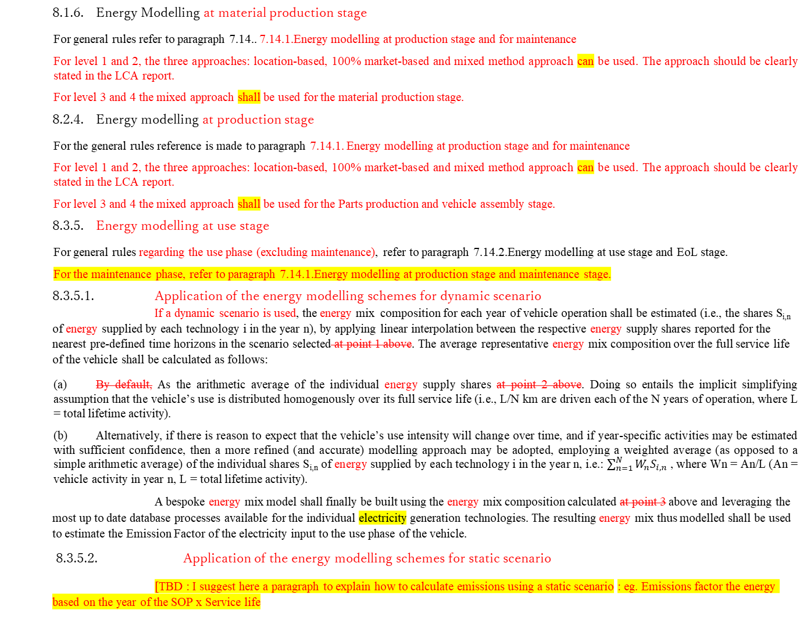
SG7 : Energy modelling in Chapter 8 – need for additional draft
8.1.6. Energy Modelling at material production stage
For general rules refer to paragraph 7.14.. 7.14.1.Energy modelling at production stage and for maintenance
For level 1 and 2, the three approaches: location-based, 100% market-based and mixed method approach can be used. The approach should be clearly stated in the LCA report.
For level 3 and 4 the mixed approach shall be used for the material production stage.
8.2.4. Energy modelling at production stage
For the general rules reference is made to paragraph 7.14.1. Energy modelling at production stage and for maintenance
For level 1 and 2, the three approaches: location-based, 100% market-based and mixed method approach can be used. The approach should be clearly stated in the LCA report.
For level 3 and 4 the mixed approach shall be used for the Parts production and vehicle assembly stage.
8.3.5. Energy modelling at use stage
For general rules regarding the use phase (excluding maintenance), refer to paragraph 7.14.2.Energy modelling at use stage and EoL stage.
For the maintenance phase, refer to paragraph 7.14.1.Energy modelling at production stage and maintenance stage.
8.3.5.1. Application of the energy modelling schemes for dynamic scenario
If a dynamic scenario is used, the energy mix composition for each year of vehicle operation shall be estimated (i.e., the shares S_{i,n} of energy supplied by each technology i in the year n), by applying linear interpolation between the respective energy supply shares reported for the nearest pre-defined time horizons in the scenario selected at point 1 above. The average representative energy mix composition over the full service life of the vehicle shall be calculated as follows:
(a) By default, As the arithmetic average of the individual energy supply shares at point 2 above. Doing so entails the implicit simplifying assumption that the vehicle’s use is distributed homogenously over its full service life (i.e., L/N km are driven each of the N years of operation, where L = total lifetime activity).
(b) Alternatively, if there is reason to expect that the vehicle’s use intensity will change over time, and if year-specific activities may be estimated with sufficient confidence, then a more refined (and accurate) modelling approach may be adopted, employing a weighted average (as opposed to a simple arithmetic average) of the individual shares S_{i,n} of energy supplied by each technology i in the year n, i.e.: $\sum_{n=1}^{N}{W_{n}S_{i,n}}$ , where Wn = An/L (An = vehicle activity in year n, L = total lifetime activity).
A bespoke energy mix model shall finally be built using the energy mix composition calculated at point 3 above and leveraging the most up to date database processes available for the individual electricity generation technologies. The resulting energy mix thus modelled shall be used to estimate the Emission Factor of the electricity input to the use phase of the vehicle.
8.3.5.2. Application of the energy modelling schemes for static scenario
[TBD : I suggest here a paragraph to explain how to calculate emissions using a static scenario : eg. Emissions factor the energy based on the year of the SOP x Service life
We need here a paragraph here to explain which approach is recommended per level (location-based vs 100% market based vs mixed approach]
SG7 suggestion : explain how to calculate the emission from use phase using dynamic scenario
SG7 proposal : replace «grid» and «electricity» per «energy», so we have 1 paragraph for all type of energy (electricity and fuels)
SG7 suggestion : explain how to calculate the emission from use phase using static scenario

Slide 9
SG7 : Energy modelling in Chapter 8 – EoL
8.4.7. Energy modelling at EoL stage
For general rules refer to paragraph 7.14.2. Energy modelling at use stage and EoL stage.
8.4.7.1. Future Changes in Energy Mix
Practitioners shall also account for any expected changes in the fuel or electricity production pathways during the lifetime of the vehicle. (detailed methodology shall be considered)
Specifically, the following recommendations are made on how to model energy inputs to the EoL phase:
8.4.7.2. EoL phase electricity
1. The same scenario for the expected future evolution of the energy mix in the geographical region of interest shall be adopted, as previously selected for the dynamic modelling of the use phase (cf. hierarchical approach in Section 7.14.2.Energy modelling at use stage and EoL stage) electricity input in paragraph [x.x.x]..
2. The grid mix composition for the specific year of vehicle decommissioning (i.e., year of vehicle registration + expected lifetime) shall be estimated (i.e., the shares S_{i,N} of energy supplied by each technology i in the year N), by applying linear interpolation between the respective energy supply shares reported for the two nearest pre-defined time horizons in the scenario selected at point 1 above
3. A bespoke grid mix model shall be built using the grid mix composition calculated at point 2 above and leveraging the most up to date database processes available for the individual energy generation technologies. The resulting energy mix thus modelled shall be used to estimate the Emission Factor of the energy input to the EoL phase of the vehicle.
For dynamically evolving fuel mixes (e.g., “green”/”grey” hydrogen; bio/fossil diesel blends; etc.), a similar approach to the one described above for electricity should be employed, whereby the respective fuel mix models for the use phase and EoL phase are arrived at by considering the existing future scenarios. "
In case of the process in the EoL phase is not a hotspot, the static energy modelling may be applied.
.
I suggest here to remove the section, as a static scenario could be used eventually.
I suggest here to remove the term dynamic, as a static scenario could be used in the use phase. Thus here we say that the same approach should be taken for use phase and EoL.
I suggest to replace «electricity» by «energy» so we have a common rule for both type of energy

Slide 10
SG7 : Energy modelling table summary
 | Material production stage | Part & assembly stage | Use stage (excluding maintenance) | Maintenance only | EoL stage
Level 1 | Location-based Or 100% Market-based Or Mixed method | Location-based Or 100% Market-based Or Mixed method | Location based + Hierarchy : 1, 2, 3, 4 | Location-based Or 100% Market-based Or Mixed method + static? | = Use stage but if a process is not a hotspot is may be static
Level 2 | Location-based Or 100% Market-based Or Mixed method | Location-based Or 100% Market-based Or Mixed method | Location based + Hierarchy : 1, 2, 3, 4 | Location-based Or 100% Market-based Or Mixed method + static? | = Use stage but if a process is not a hotspot is may be static
Level 3 | Mixed method | Mixed method | Location based + Hierarchy : 1, 4 | Mixed method + static? | = Use stage but if a process is not a hotspot is may be static
Level 4 | Mixed method | Mixed method | Location based + Hierarchy : 1, 4 | Mixed method + static? | = Use stage but if a process is not a hotspot is may be static

Slide 11
Thank you
Caroline MIR caroline.mir@ademe.fr
Samarendra Tripathy samarendra.tripathy@renault.com
Kawamoto Ryuji kawamoto.r@mazda.co.jp

