Slide 1
SLR-75-09
TRANSITIONAL PROVISIONS
Stop reproducing the old TPs in the new series of amendments
IWG-IWVTA amendments to “Aide-mémoire”

Slide 2
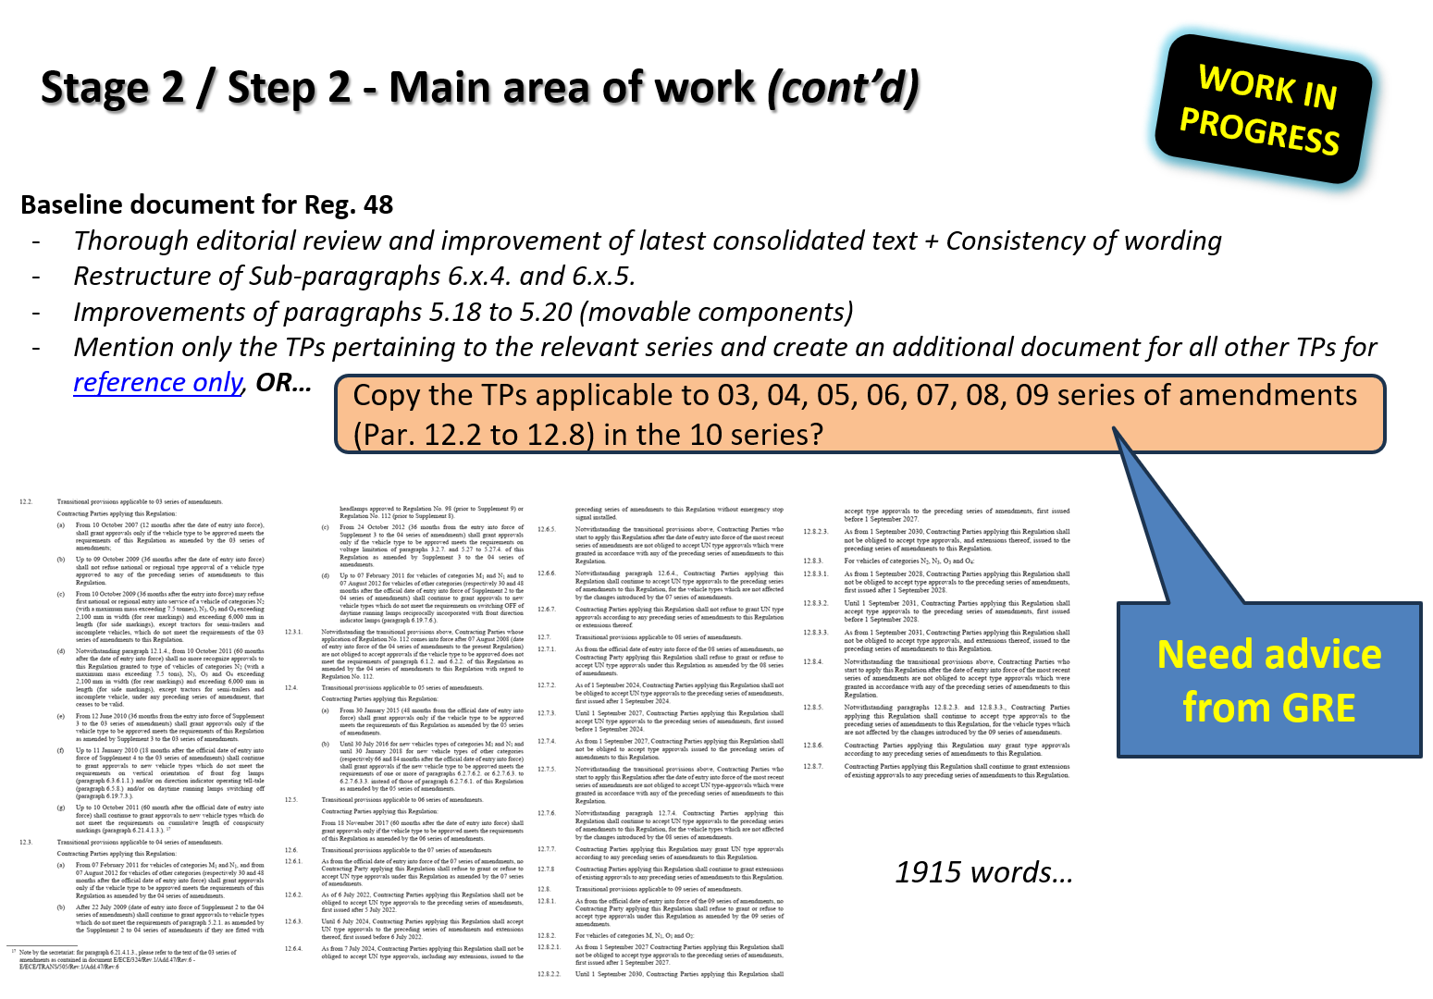
Excerpt of SLR report to GRE-93 (doc. GRE-93-05)

Slide 3
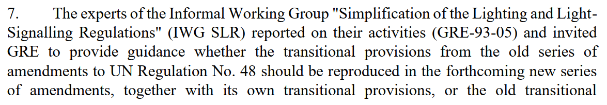
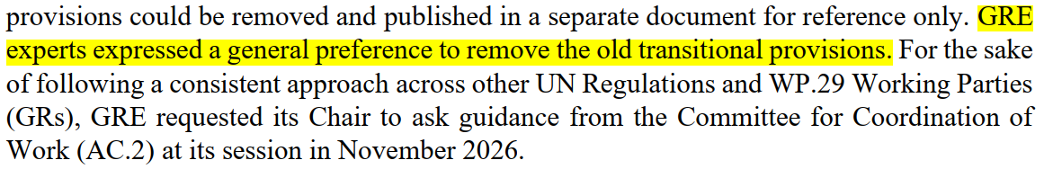
Excerpt of GRE-93 Report (doc. ECE/TRANS/WP.29/GRE/93)

Slide 4
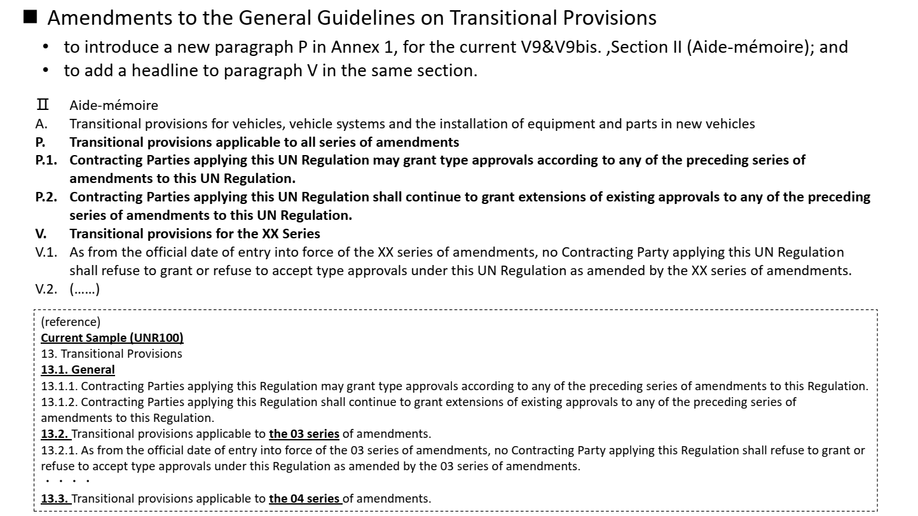
Excerpt of IWVTA report to 197th WP.29 (doc. WP.29-197-23)

Slide 5
ECE-TRANS-WP29-1044-Rev3 amended by WP.29-197-23
12. Transitional provisions
12.1. (P.) General Transitional provisions applicable to all series of amendments
12.1.1. As from the official date of entry into force of the most recent series of amendments, no Contracting Party applying this Regulation shall refuse to grant approval under this Regulation as amended by this most recent series of amendments.
12.1.2. As from the official date of entry into force of the most recent series of amendments, no Contracting Party applying this Regulation shall refuse national or regional type-approval to a vehicle type approved under this Regulation as amended by this most recent series of amendments.
12.1.3. During the time period from the official date of entry into force of the most recent series of amendments and its mandatory application to new type-approvals, Contracting Parties applying this Regulation shall continue to grant approvals to those types of vehicles which comply with the requirements of this Regulation as amended by all the applicable preceding series of amendments.
12.2. (V.) Transitional provisions applicable to 10 series of amendments
12.2.1. (V.1) As from the official date of entry into force of the 10 series of amendments, no Contracting Party applying this Regulation shall refuse to grant or refuse to accept UN type-approvals under this Regulation as amended by the 10 series of amendments.
12.2.2. (V.2) As of 1 September 20xx, Contracting Parties applying this Regulation shall not be obliged to accept UN type-approvals to the preceding series of amendments, first issued after 1 September 20xx.
12.2.3. (V.3) Until 1 September 20xx, Contracting Parties applying this Regulation shall accept UN type-approvals to the preceding series of amendments, first issued before 1 September 20xx.
12.2.4. (V.4) As from 1 September 20xx, Contracting Parties applying this Regulation shall not be obliged to accept type-approvals issued to the preceding series of amendments to this Regulation.
12.2.5. (V.5) Notwithstanding the transitional provisions above, Contracting Parties who start to apply this Regulation after the date of entry into force of the most recent series of amendments are not obliged to accept UN type-approvals which were granted in accordance with any of the preceding series of amendments to this Regulation.
12.2.6. (V.7) Notwithstanding paragraph 12.2.4. Contracting Parties applying this Regulation shall continue to accept UN type-approvals to the preceding series of amendments to this Regulation, for the vehicle types which are not affected by the changes introduced by the 10 series of amendments.
12.2.7. (V.9) Contracting Parties applying this Regulation may grant UN type-approvals according to any preceding series of amendments to this Regulation.
12.2.8. (V.9bis) Contracting Parties applying this Regulation shall continue to grant extensions of existing approvals to any preceding series of amendments to this Regulation.
Draft example of TPs for R48-10 (based on 08 series)
https://unece.org/transport/vehicle-regulations/guidelines-transitional-provisions

