Slide 1
Rear DI/Stop Signal Visibility
SLR-75-11
3rd December 2025
<< Images contained in this document are free of copyright >>

Slide 2
Reminder of last proposal from Germany
SLR-73-08 rev 1
1 - UN-R48 § 5.7.1.3.3.
2 - UN-R148 § 5.6.3.
STOP
DI apparent surface > 30cm²
25 mm
DI
≤ 25% of the apparent surface
3 - UN-R48 § 6.5.4.1.
This part of DI shall fulffil the photometric requirements
DI
a
If a >200mm, then a ≤ b
OR
DI Intensity > 30% more than Stop Intensity
STOP
b
Outer edge of the vehicle

Slide 3
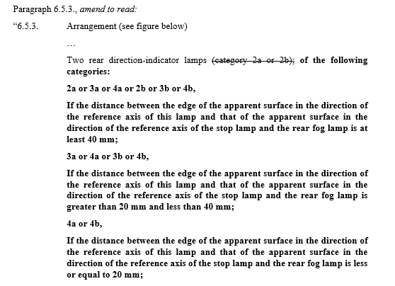
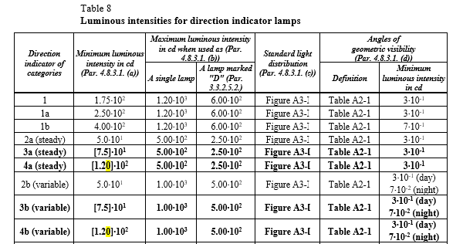
Reminder of previous proposal from Germany
SLR-66-08/Rev.1
UN-R48
UN-R148

Slide 4
Lamps with complaint from Germany

Slide 5
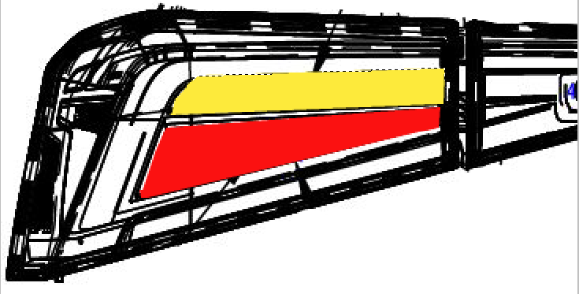
OICA Data
DI photometry provided by areas outside 25mm distance from stop = No
75% of DI area outside 25mm from stop = No
Area of Direction Indicator = <30 cm²

Slide 6
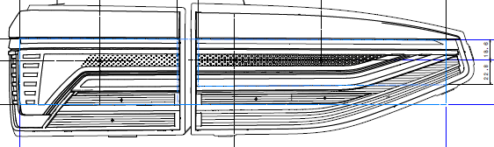
OICA Data
DI photometry provided by areas outside 25mm distance from stop = No
75% of DI area outside 25mm from stop = No
Area of Direction Indicator = <30 cm²

Slide 7
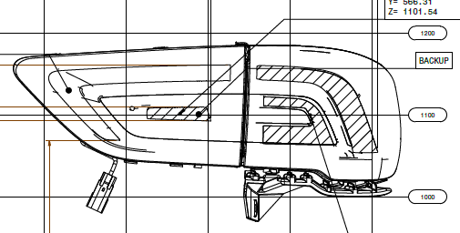
DI photometry provided by areas outside 25mm distance from stop = No
75% of DI area outside 25mm from stop = No
Area of Direction Indicator = <30 cm²

Slide 8
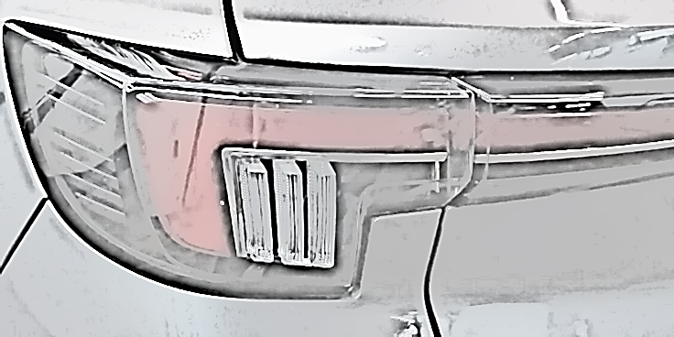
DI photometry provided by areas outside 25mm distance from stop = No
75% of DI area outside 25mm from stop = No
Area of Direction Indicator = <30 cm²

Slide 9
Lamps without complaint from Germany

Slide 10
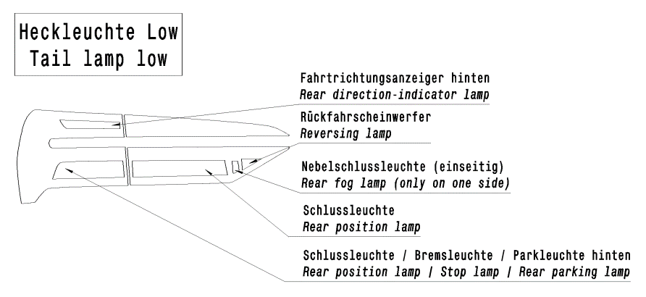
OICA Data
DI photometry provided by areas outside 25mm distance from stop = Yes
75% of DI area outside 25mm from stop = Yes
Area of Direction Indicator = < 30 cm²

Slide 11
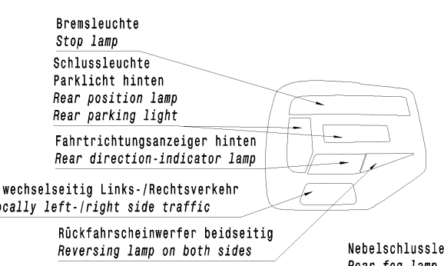
OICA Data
DI photometry provided by areas outside 25mm distance from stop = Yes
75% of DI area outside 25mm from stop = Yes
Area of Direction Indicator = < 30 cm²

Slide 12
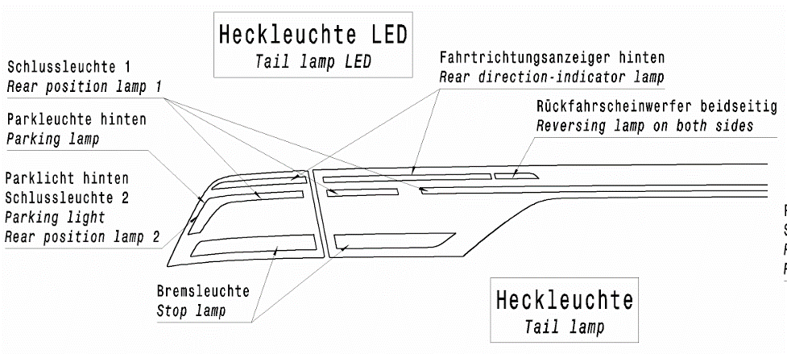
OICA Data
DI photometry provided by areas outside 25mm distance from stop = Yes
75% of DI area outside 25mm from stop = Yes
Area of Direction Indicator = <30 cm² (Part 1 for open Trunk)

Slide 13
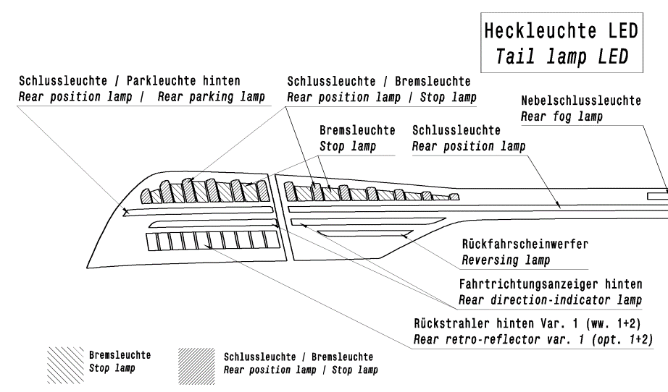
OICA Data
DI photometry provided by areas outside 25mm distance from stop = Yes
75% of DI area outside 25mm from stop = Yes
Area of Direction Indicator = <30 cm²

Slide 14
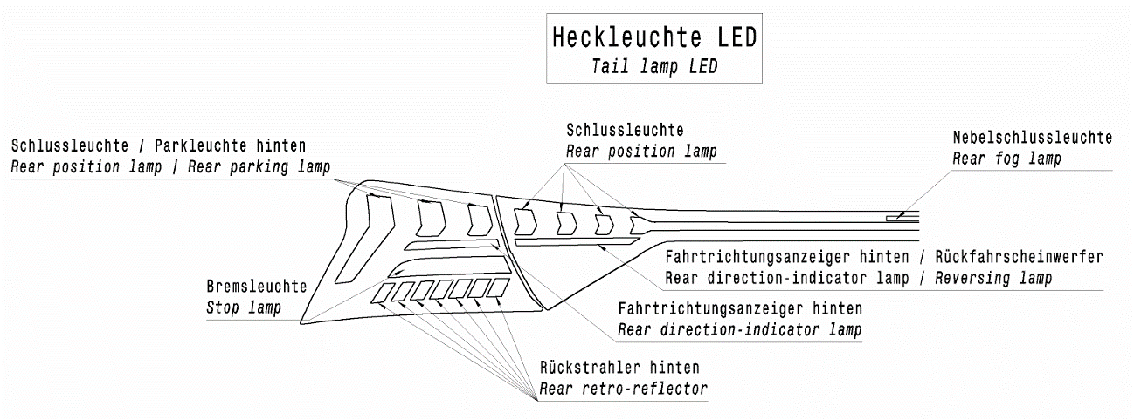
OICA Data
DI photometry provided by areas outside 25mm distance from stop = No
75% of DI area outside 25mm from stop = No
Area of Direction = < 30 cm² (Part 1)

Slide 15
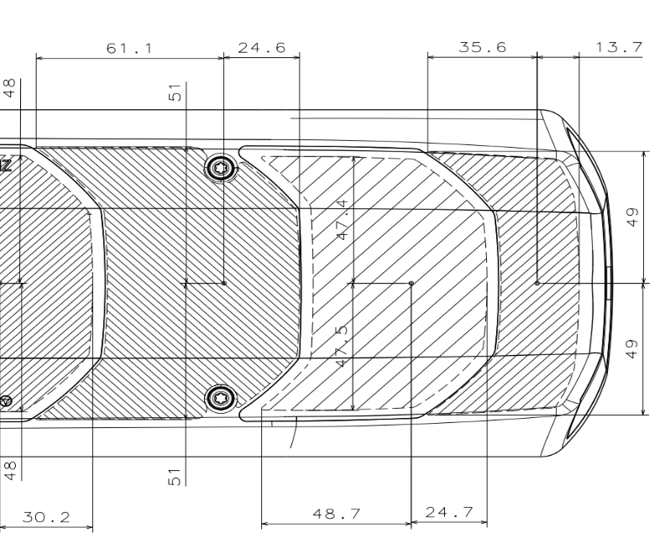
OICA Data
Direction indicator
Stop lamp
25 mm
DI photometry provided by areas outside 25mm distance from stop = No
75% of DI area outside 25mm from stop = No
Area of Direction Indicator = >30 cm²

Slide 16
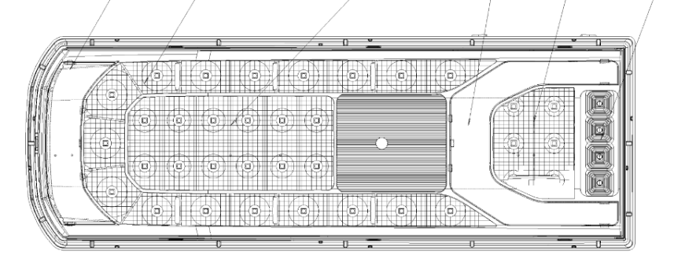
OICA Data
Direction indicator (only sequential activation)
25 mm
25 mm
25 mm
Stop lamp
25 mm
DI photometry provided by areas outside 25mm distance from stop = No
75% of DI area outside 25mm from stop = No
Area of Direction Indicator = >30 cm²

Slide 17
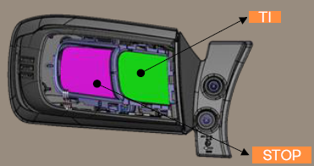
OICA Data
DI photometry provided by areas outside 25mm distance from stop = No
75% of DI area outside 25mm from stop = No
Area of Direction Indicator = <30 cm²

Slide 18
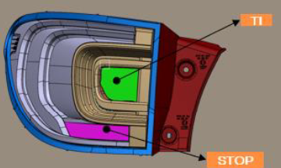
OICA Data
DI photometry provided by areas outside 25mm distance from stop = Yes
75% of DI area outside 25mm from stop = Yes
Area of Direction Indicator = <30 cm²

Slide 19
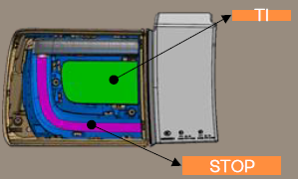
OICA Data
DI photometry provided by areas outside 25mm distance from stop = No
75% of DI area outside 25mm from stop = Yes
Area of Direction Indicator = >30 cm²

Slide 20
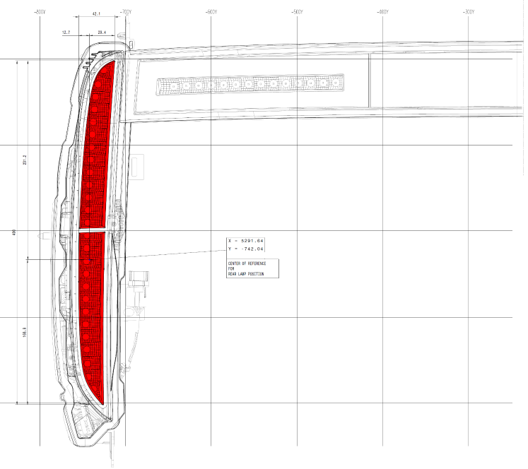
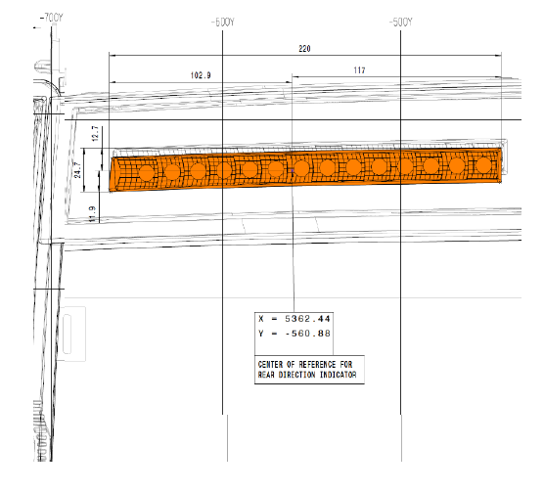
OICA Data
Check | Result
DI further outboard than Stop | No
DI photometry provided by areas outside 25mm distance from Stop? | Yes
75% of DI area outside 25mm from Stop? | Yes
DI equal to or larger than 30 cm²? | Yes
DI equal to or larger than Stop lamp? | No
DI separated by at least 20mm from Stop lamp? | Yes
DI 25% higher intensity in HV than stop lamp? | No

Slide 21
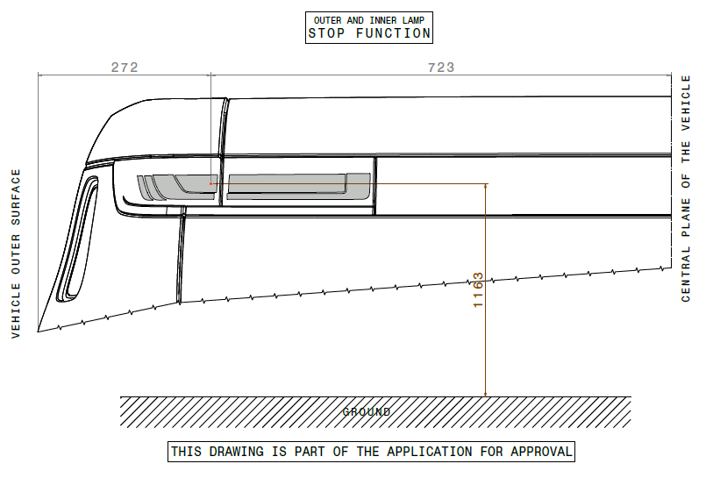
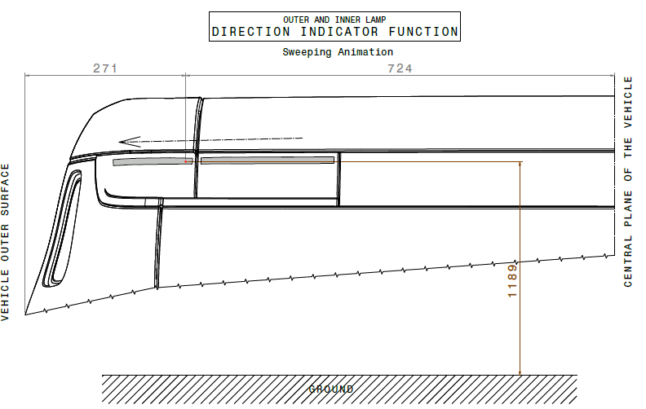
OICA Data
Check | Result
DI further outboard than Stop | Yes
DI photometry provided by areas outside 25mm distance from Stop? | No
75% of DI area outside 25mm from Stop? | No
DI equal to or larger than 30 cm²? | Yes
DI equal to or larger than Stop lamp? | No
DI separated by at least 20mm from Stop lamp? | No
DI 25% higher intensity in HV than stop lamp? | No

Slide 22
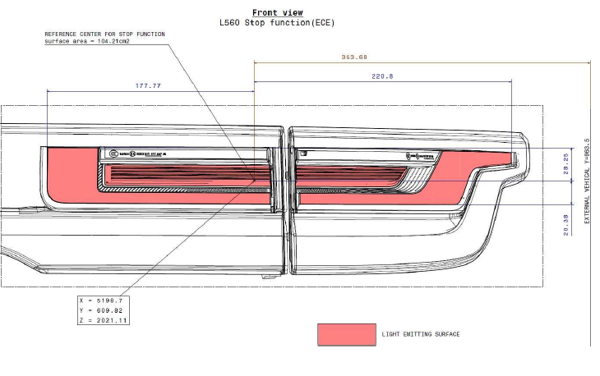
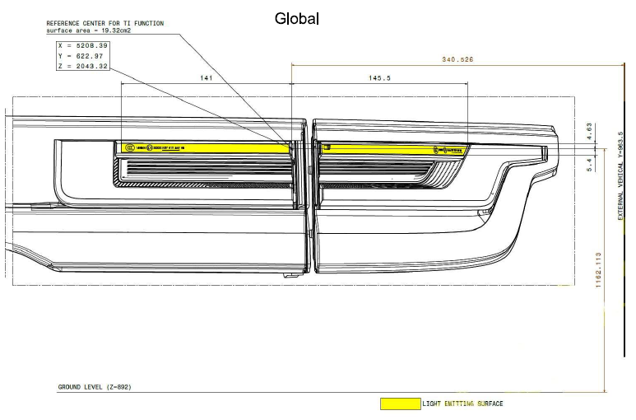
OICA Data
Check | Result
DI further outboard than Stop | No
DI photometry provided by areas outside 25mm distance from Stop? | No
75% of DI area outside 25mm from Stop? | No
DI equal to or larger than 30 cm²? | No
DI equal to or larger than Stop lamp? | No
DI separated by at least 20mm from Stop lamp? | No
DI 25% higher intensity in HV than stop lamp? | No

Slide 23
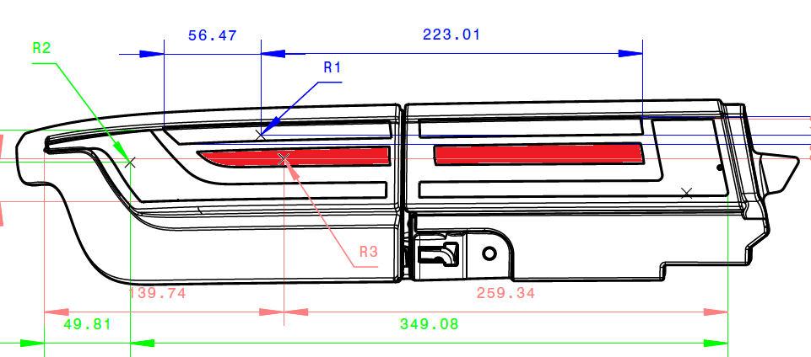
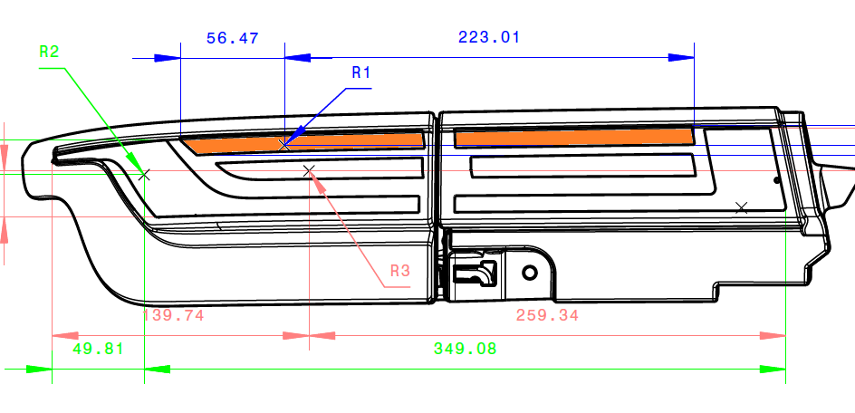
OICA Data
Check | Result
DI further outboard than Stop | Yes
DI photometry provided by areas outside 25mm distance from Stop? | No
75% of DI area outside 25mm from Stop? | No
DI equal to or larger than 30 cm²?
DI equal to or larger than Stop lamp?
DI separated by at least 20mm from Stop lamp? | No
DI 25% higher intensity in HV than stop lamp? | No

Slide 24
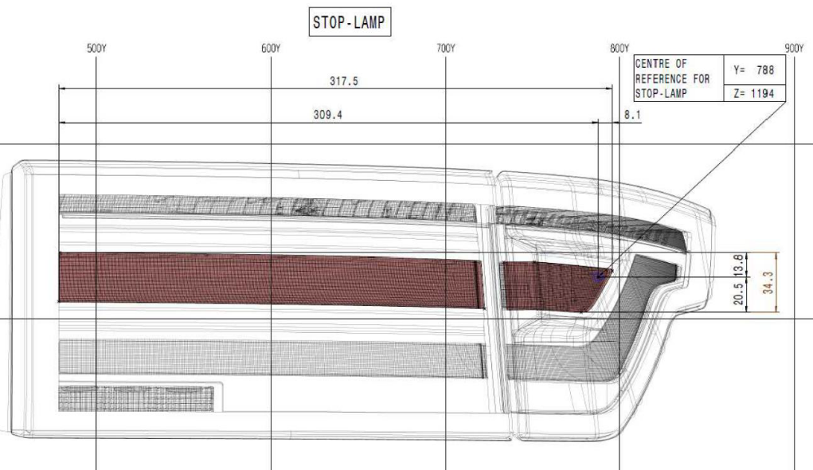
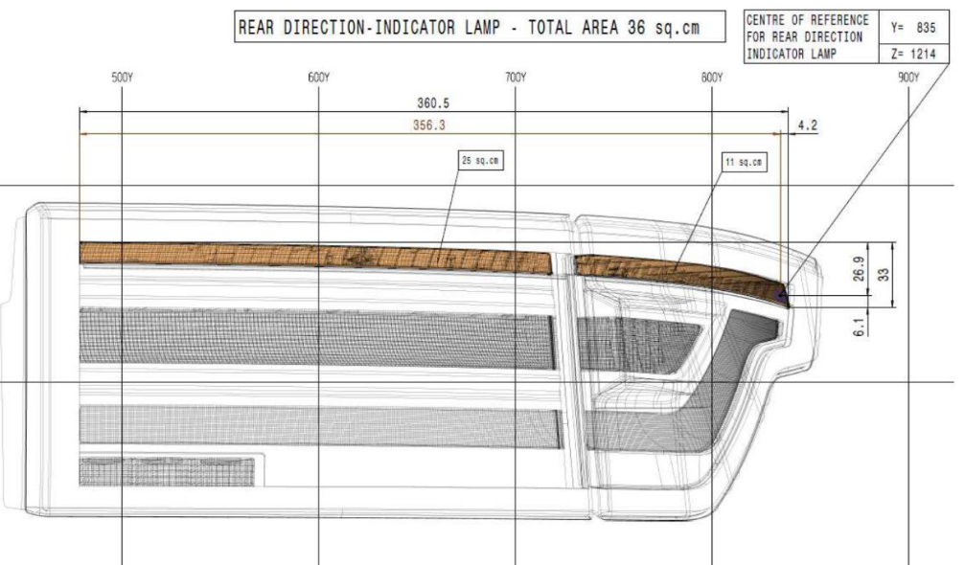
OICA Data
Check | Result
DI further outboard than Stop | Yes
DI photometry provided by areas outside 25mm distance from Stop? | No
75% of DI area outside 25mm from Stop? | No
DI equal to or larger than 30 cm²? | Yes
DI equal to or larger than Stop lamp? | No
DI separated by at least 20mm from Stop lamp? | No
DI 25% higher intensity in HV than stop lamp? | Yes

Slide 25
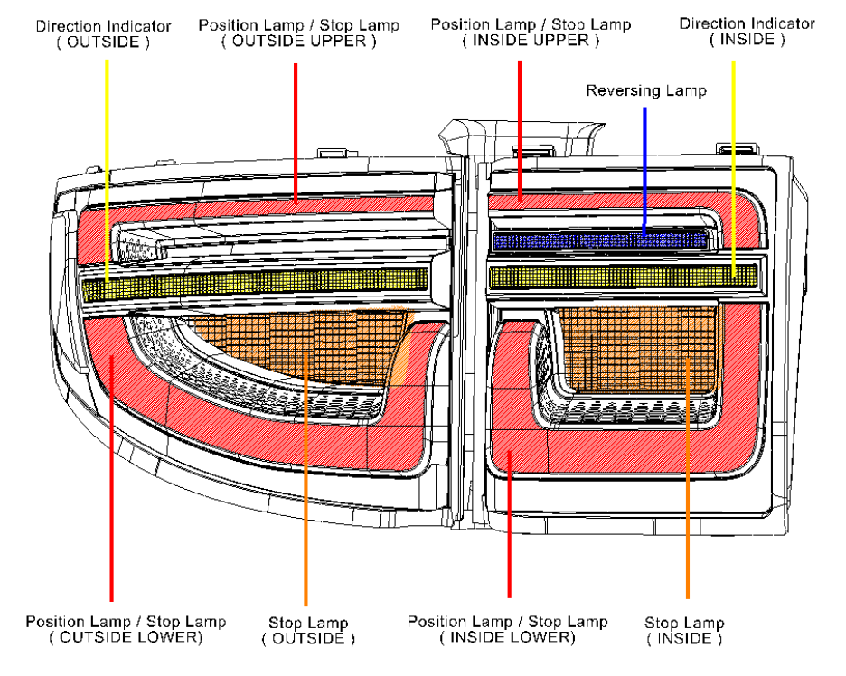
OICA Data
Check | Result
DI further outboard than Stop | No
DI photometry provided by areas outside 25mm distance from Stop? | No
75% of DI area outside 25mm from Stop? | No
DI equal to or larger than 30 cm²? | No
DI equal to or larger than Stop lamp? | No
DI separated by at least 20mm from Stop lamp? | No
DI 25% higher intensity in HV than stop lamp? | No

Slide 26
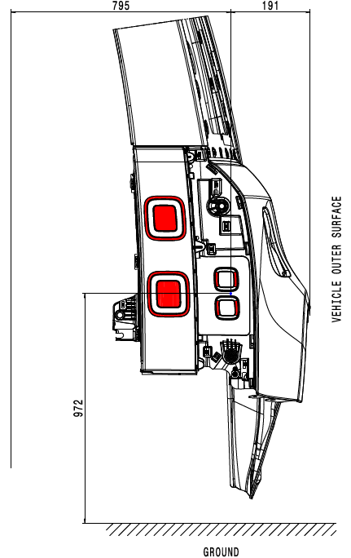
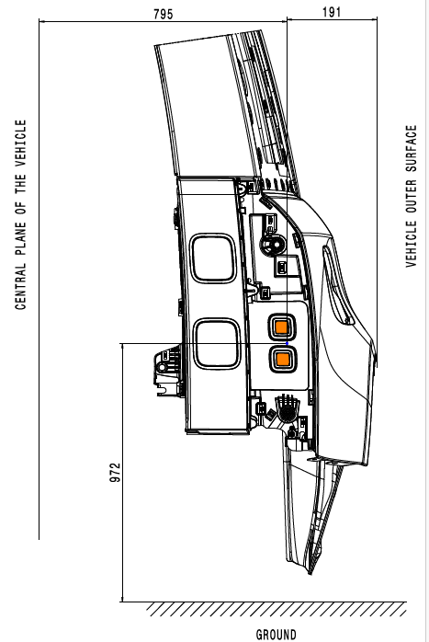
OICA Data
Check | Result
DI further outboard than Stop | No
DI photometry provided by areas outside 25mm distance from Stop? | No
75% of DI area outside 25mm from Stop? | No
DI equal to or larger than 30 cm²? | No
DI equal to or larger than Stop lamp? | No
DI separated by at least 20mm from Stop lamp? | No
DI 25% higher intensity in HV than stop lamp? | No

Slide 27
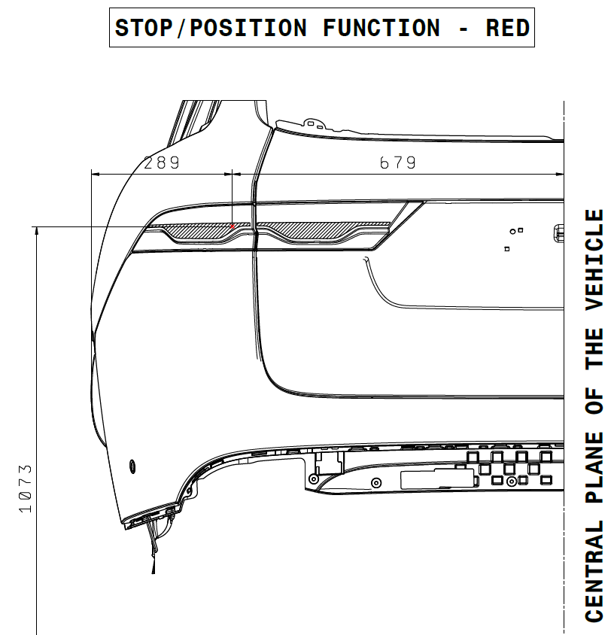
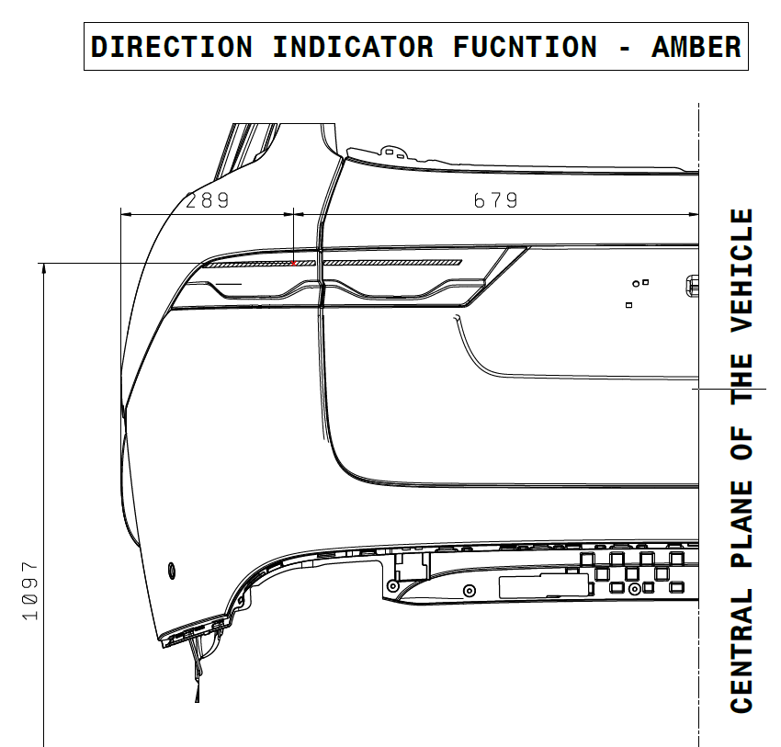
OICA Data
Check | Result
DI further outboard than Stop | No
DI photometry provided by areas outside 25mm distance from Stop? | No
75% of DI area outside 25mm from Stop? | No
DI equal to or larger than 30 cm²? | No
DI equal to or larger than Stop lamp? | No
DI separated by at least 20mm from Stop lamp? | No
DI 25% higher intensity in HV than stop lamp? | No

Slide 28
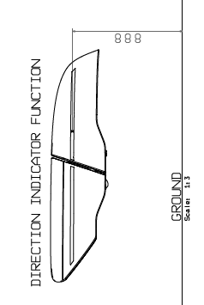
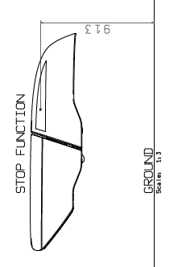
OICA Data
Check | Result
DI further outboard than Stop | Yes
DI photometry provided by areas outside 25mm distance from Stop? | No
75% of DI area outside 25mm from Stop? | No
DI equal to or larger than 30 cm²? | Yes
DI equal to or larger than Stop lamp? | Yes
DI separated by at least 20mm from Stop lamp? | No
DI 25% higher intensity in HV than stop lamp? | Yes

Slide 29
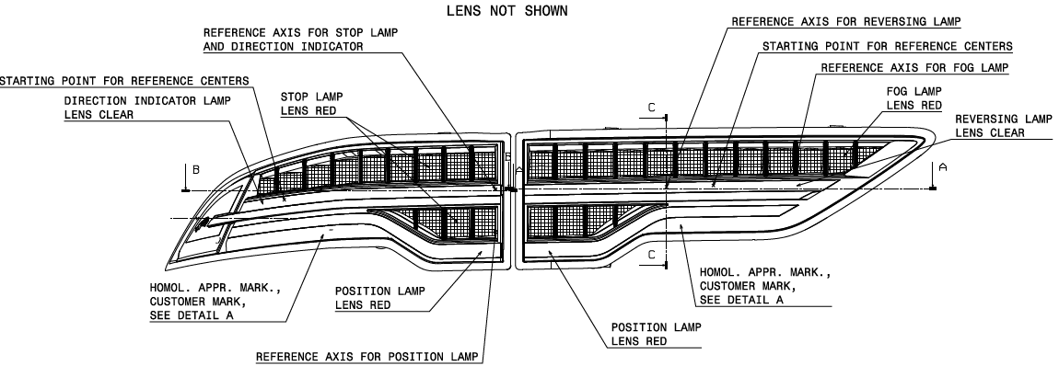
OICA Data
Check | Result
DI further outboard than Stop | Yes
DI photometry provided by areas outside 25mm distance from Stop? | No
75% of DI area outside 25mm from Stop? | No
DI equal to or larger than 30 cm²? | No
DI equal to or larger than Stop lamp? | No
DI separated by at least 20mm from Stop lamp? | No
DI 25% higher intensity in HV than stop lamp? | No

Slide 30
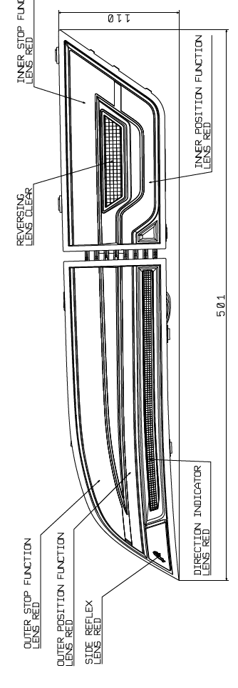
OICA Data
Check | Result
DI further outboard than Stop | No
DI photometry provided by areas outside 25mm distance from Stop? | No
75% of DI area outside 25mm from Stop? | Yes
DI equal to or larger than 30 cm²? | Yes
DI equal to or larger than Stop lamp? | No
DI separated by at least 20mm from Stop lamp? | No
DI 25% higher intensity in HV than stop lamp? | No

Slide 31
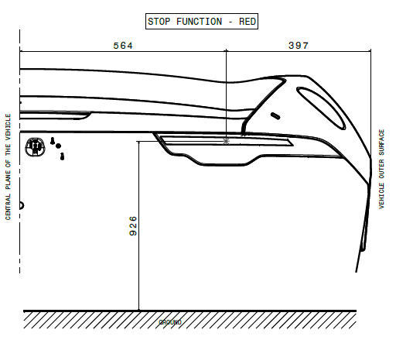
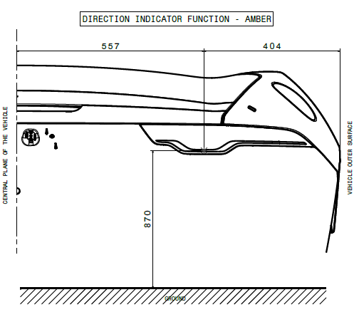
OICA Data
Check | Result
DI further outboard than Stop | No
DI photometry provided by areas outside 25mm distance from Stop? | No
75% of DI area outside 25mm from Stop? | No
DI equal to or larger than 30 cm²? | Yes
DI equal to or larger than Stop lamp? | No
DI separated by at least 20mm from Stop lamp? | No
DI 25% higher intensity in HV than stop lamp? | No

Slide 32
OICA Position for discussion only
There cannot be a problem when direction indicators meet one of the following:
The apparent surface is equal to or greater than the apparent surface of the stop lamp.
The intensity at HV is a minimum of 25% greater than the intensity at HV of the stop lamp.
The separation distance in either the vertical or horizontal direction from the stop lamp is equal to or greater than 20 mm.
The apparent surface is equal to or greater than 30 cm².

