Slide 1
AVSR-28-03
Automated Driving Systems Marker Lamp
(ADS ML)
Based on document GTB WGSL 699 revision1
GTB
November 2025

Slide 2
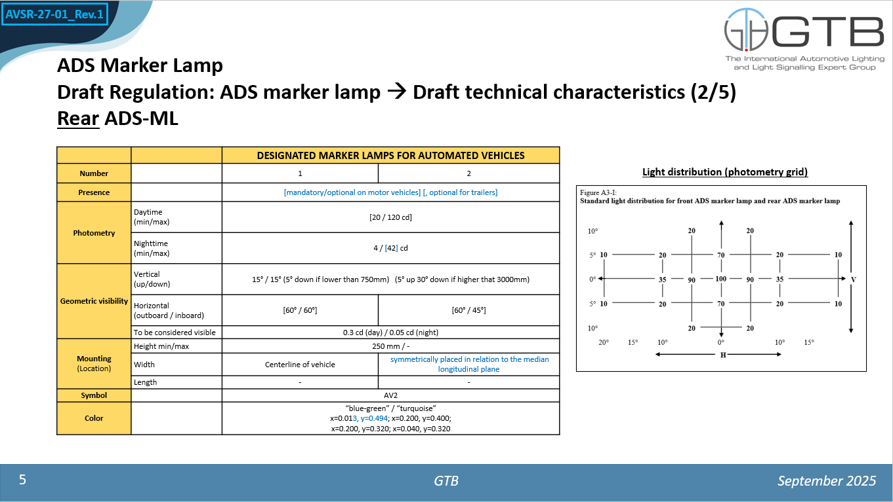
AVSR-28-03
Rear ADS Marker Lamp
AVSR-27: maximum “nighttime value under discussion”
→ keep 42 cd
GTB
November 2025

Slide 3
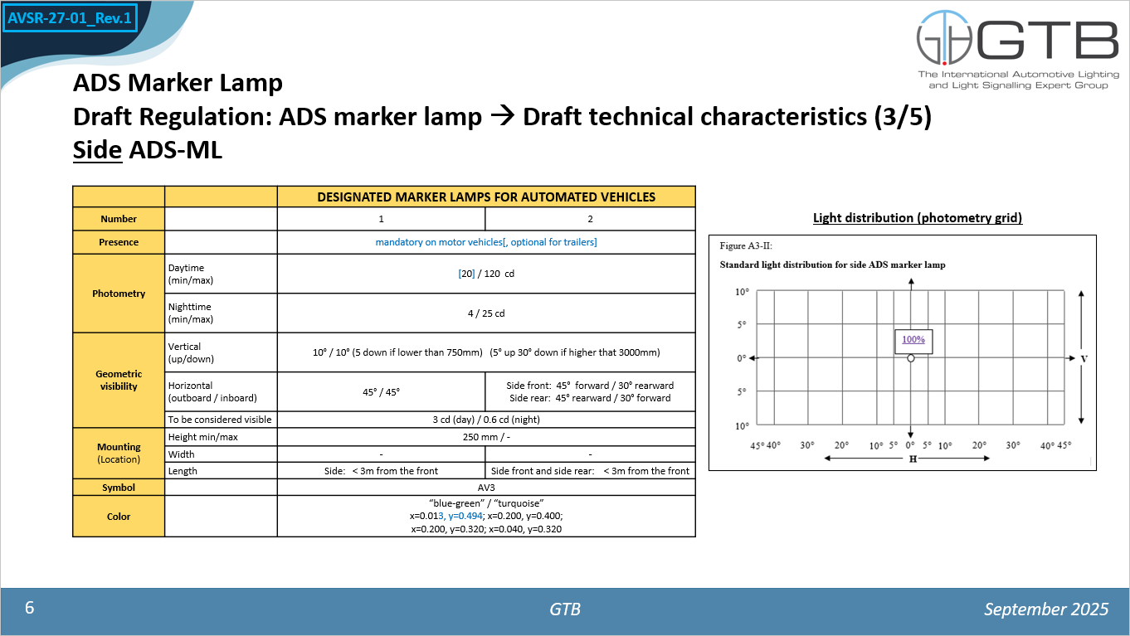
AVSR-28-03
Side ADS Marker Lamp
AVSR-27: minimum “daytime value under discussion”
GTB
November 2025

Slide 4
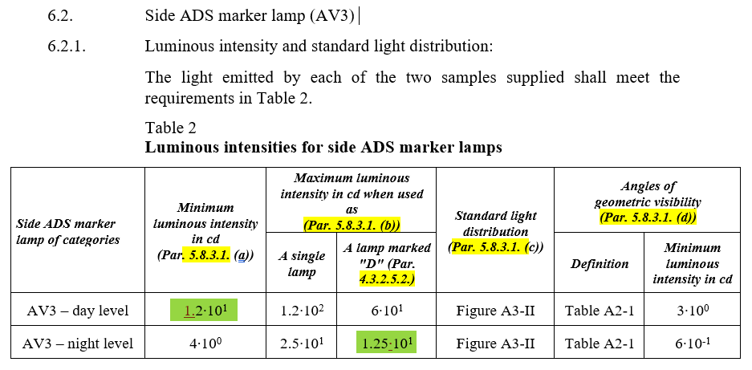
AVSR-28-03
Side ADS Marker Lamp
Minimum value for day level has been lowered to 12 cd & multiplication sign added.
GTB
November 2025

