Slide 1


Hands-off detection warning time for B1-systems
31.08.2016
Submitted by the experts of OICA
Informal Document: ACSF-08-09
International Organization of Motor Vehicle Manufacturers
Organisation Internationale des Constructeurs d'Automobiles

Slide 2
Hands-off detection warning time for B1-systems
Following issues should be considered:
Technology neutrality
Steering input are difficult to measure/identify
  on road segments in very good conditions
  at low speeds
  if drivers will have a relaxed attitude on holding the steering wheel
The balance for the detection:
  „Hands-off-the steering wheel“ interpreted as „hands-on“
  => avoiding due to safety aspects
  „Hands-on-the-steering-wheel“ interpreted as „hands-off“.
  => avoiding to attain a high acceptance of the systems

Slide 3
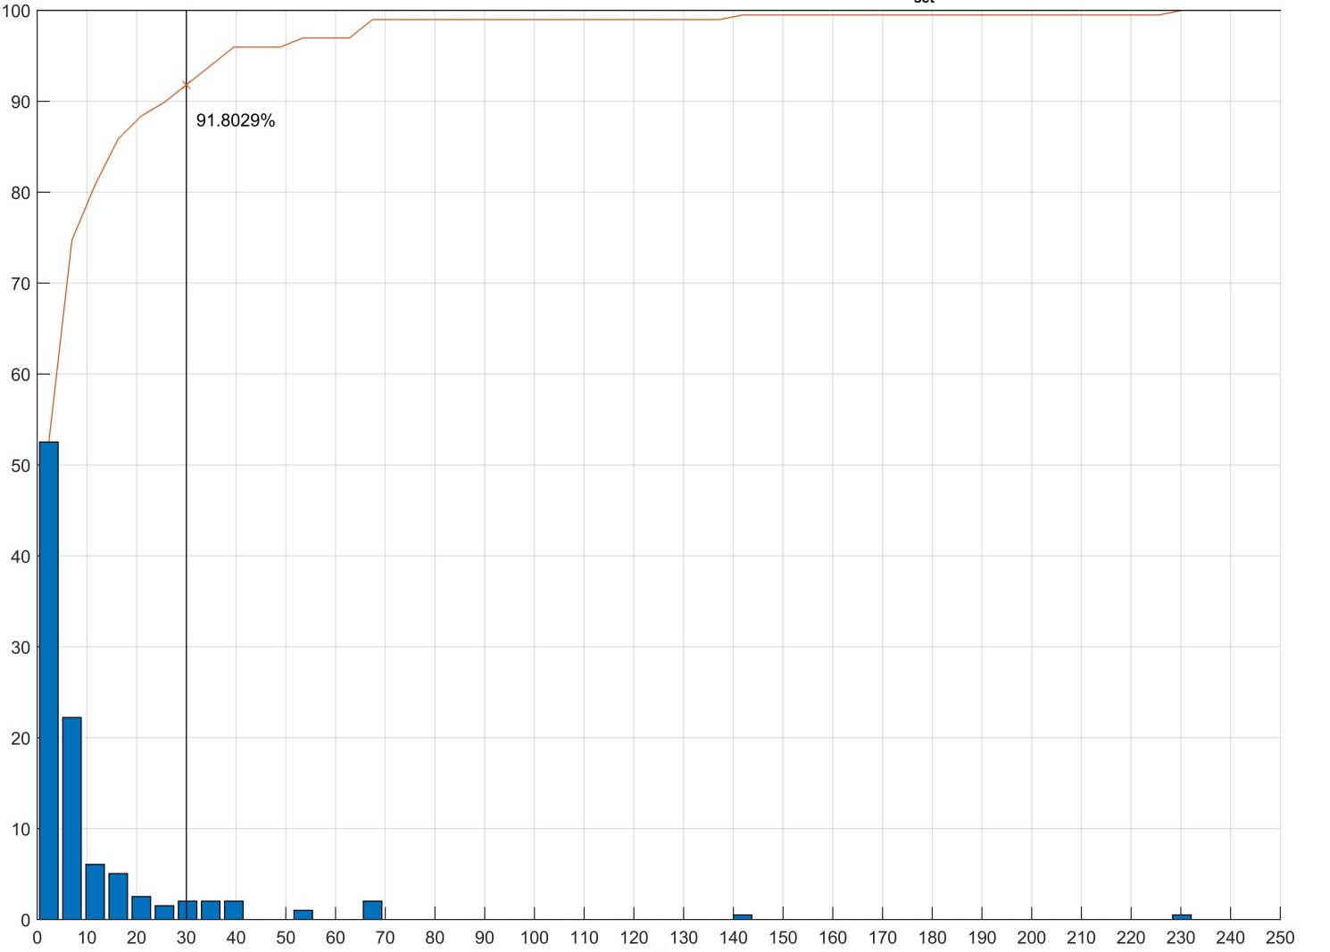
Hands-off detection warning time for B1-systems
Brown Line:
Summary of the detected “hands-on”
situations by time sequence
percent of hands-on detection in x seconds (%)
Vset = 85 km/h
highway with good surface and low traffic situation
Tractor-trailer combination
(s)

Slide 4
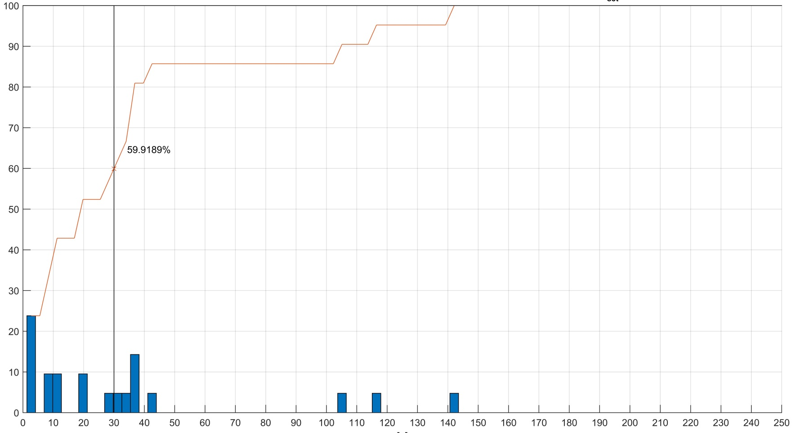
Hands-off detection warning time for B1-systems
Brown Line:
Summary of the detected “hands-on”
situations by time sequence
percent of hands-on detection in x seconds (%)
90%
Vset = 35 km/h
highway with good surface and high traffic situation (stop-and-go)
Tractor-trailer combination
(s)

Slide 5
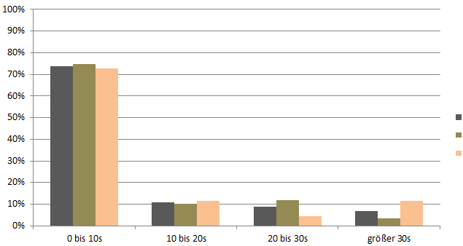
Hands-off detection warning time for B1-systems
positive „hands-on“ detection
proportion of all routes
Proportion (%)
All roads
ORK: Oval round course
(long, straight road in high quality)
DLK: Endurance course
(long, straight road with small part of curves, average quality)
Time span until the next detection

Slide 6

Hands-off detection warning time for B1-systems
positive „hands-on“ detection
proportion on straight routes
Proportion (%)
ORK: Oval round course
(long, straight road in high quality)
DLK: Endurance course
(long, straight road with small part of curves, average quality)
Time span until the next detection

Slide 7
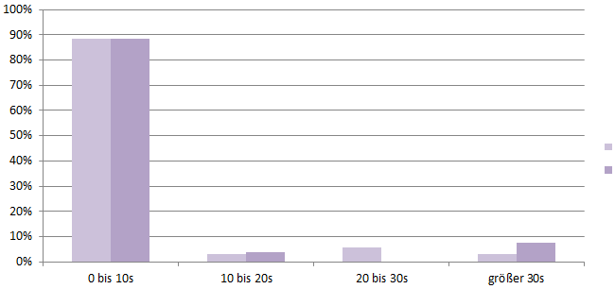
Hands-off detection warning time for B1-systems
positive „hands-on“ detection
proportion on curves
Proportion (%)
ORK: Oval round course
(long, straight road in high quality)
DLK: Endurance course
(long, straight road with small part of curves, average quality)
Time span until the next detection

Slide 8
Conclusions
  Summary of technical rationales:
  110s at 35 km/h gives the same reliability of the hands-off detection as 30s at 85km/h (slides 3 & 4)
  The distribution of timespan between two positive hands-on detection is very much influenced by the profile of the road:
      on a straight road: ~57% of measured timespan are below 10s
      in curves: ~90% of measured timespan are below 10s
  Recommendation:
  A detection time higher than 30s is recommended at lower speed, in order to avoid too frequent false warnings, leading to low driver acceptance, while preserving the same level of safety

Slide 9
Backup

Slide 10
