Slide 1
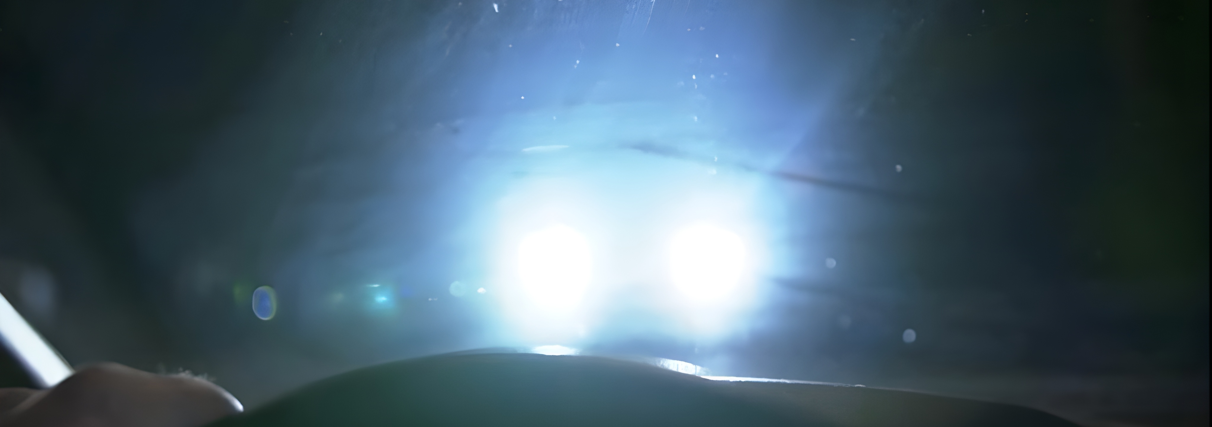

TFGP-07-02
Glaring Issues (HWT-PTI)
UNECE GRE TF-GP, HWT-PTI
March 2026

Slide 2
Glaring Issues (HWT-PTI)
1) Aiming
In short | Complete Issue
The “initial aiming” procedure in TA leads to indistinct H-V point. | The aiming of a road illumination device can be found visually, with several possibilities where the kink point may be. This leads to the situation that in PTI it is difficult to inspect headlamp aim using suitably low thresholds. We also need a common understanding which is the right aiming (and which is wrong).
The definition of cut-off line and kink point is insufficient and indistinct. | The shape of the cut-off line and the kink point (elbow point) is insufficiently defined/described. The interconnection between R149 (component) and R48 (installation in the vehicle) should be revised because in PTI we inspect complete vehicles. The definitions are not sufficiently clear; the kink point is allowed in an huge area.
It is not clear that these definitions must apply to complete vehicles.
The left rising part of cut-off leads to glare. | Left rising part of the cut-off line necessarily leads to (at least some) glaring of the opposite traffic on straight lines, and especially on right bends.
On wet roads, the reflex zone in front of a vehicle leads to glare. | With today´s light distribution, the reflex zone leads to glare on wet roads.

Slide 3
Glaring Issues (HWT-PTI)
2) Changes to requirements on construction
In short | Complete Issue
Highly mounted headlamps have a higher tendency to glare lower vehicles in front. | Highly mounted headlamps have a higher tendency to glare lower vehicles in front. There is a trend for M1 to have higher mounted headlamps. (on average ~1,5 cm higher mounted per year).Higher mounted headlamps have advantages in range.
Cleaning hardware are not as efficient as they could be. | The requirements for cleaning hardware for headlamps are insufficient to remove soiling (e.g. too small water reservoirs).
Cleaning hardware is not mandatory for all vehicles. | Only M1/N1 with bright headlamps are required to have cleaning hardware. Studies clearly show that soiled non-bright headlamps lead to strong glare.
Auto-levelling is not as efficient as it could be. | The newly mandatory auto-levelling is a step forward, but its performance requirements could be improved to avoid glare better.

Slide 4
Glaring Issues (HWT-PTI)
3) provisions for PTI
In short | Complete Issue
PTI lacks information for an efficient and effective PTI. | There should be a new chapter "provisions for PTI", instead of a paragraph (R48 6.22.9.2.3, amended in Se7 Am6 to 6.22.9.3.3).

Slide 5
Glaring Issues (HWT-PTI)
4) Measurements
In short | Complete Issue
The requirement “measure with 75 kg on driver´s seat“ is unrealistic. | It is not practical for PTI and garages to measure headlamp aiming with "75 kg on driver´s seat". The filling of the tank, and other conditions may have a significant influence on the measured downward inclination.
It is not mandated to measure alignment EOL. | Currently, the OEM must ensure that the headlamp aiming requirements are fulfilled also when installed in the vehicle. The measure how to fulfil the requirement is not sufficiently defined.
The alignment degrades between EOL and handover to costumer. | For transport the vehicle is put into transport mode (e.g. via diagnosis, via suspension travel limiter, ...). Studies show that the headlamp is very often misaligned at the point of vehicle handover, mostly due to the transport and setting of suspension parts. This is also the case for other sensors/actuators.
The passing beams class C is not always easy to switch on for PTI. | There are solutions in the market, where the neutral state (passing beam class C) cannot be switched on in PTI in a defined way. This requirement is not sufficiently clear. In PTI, the headlamp alignment is inspected in this state.
There are no generally accepted requirements for head lamp testers. | There are no general (mandatory) requirements on tools for inspection of headlamp aiming in PTI (and in garages). Manufacturers usually use German and French requirements instead.

