Slide 1
Content
Submitted by the experts of OICA and CLEPA
Informal Document: ACSF-10-08
ESF definition
Description of use cases
Taxonomy of collision avoidance functions
Description of functions
Tests

Slide 2
ESF Definition
2.3.4.3 “Emergency Steering Function (ESF)" means a control function within an electronic control system whereby, for a limited duration, changes to the steering angle of one or more wheels may result from the automatic evaluation of signals initiated on-board the vehicle, in order to assist the driver in avoiding [or mitigating] a collision with:
      another vehicle driving in an adjacent lane,
        drifting towards the path of the subject vehicle and/or,
        into which path the subject vehicle is drifting and/or,
        into which lane the driver initiates a lane change manoeuver.
      an obstacle obstructing the path of the subject vehicle or when the obstruction of the subject vehicle’s path is deemed imminent.
      ESF shall cover one or several use cases from the list above.

Slide 3

Use Cases
i.a
i.b
i.c
ii.
Function is expected to intervene around this point

Slide 4
Taxonomy of collision avoidance functions
Collision Avoidance Functions
Avoidance Manoeuver manually performed by driver (by turning steering wheel) with system support
Avoidance Manoeuver automatically initiated by system
Within or outside
the lane (driver’s decision)
Within
the lane
Within or outside
the lane (system’s decision)
Use cases
Functions #
ii.
i.a
i.b
i.c
ii.
i.a
ii.
1
2
3
4
5
6
7
On the market - Close to market / IN SCOPE
of discussions - Regulatory step 1
Future / OUT OF SCOPE
Regulatory step 2

Slide 5
Use Case i.a
“Another vehicle drifts towards the subject vehicle”
Function type
1
2
3
4
5
6
7
2
2
Description:
The function automatically intervenes by steering when detecting another vehicle is drifting towards its path.
Function :
  On the market
  Avoidance within the lane.
  Forward and side looking sensors.
  Detection of lane marking / boundaries.
  The system is able to work on a road without lane marking (provided road boundaries are detected).
  Warning during intervention
  Blind spot detection may separately provide a warning prior ESF intervention
Function :
  Future evolution
  Function able to cross lane markings.
2
6
No intervention Intervention

Slide 6
Use Case i.b
“The subject vehicle drifts towards the adjacent lane”
Function type
1
2
3
4
5
6
7
No risk of collision
➔ No intervention
Description:
On the market
The function automatically intervenes by steering when detecting:
  a vehicle in the blind spot or
  an oncoming vehicle at higher speed.
The manoeuver ends:
  after the subject vehicle is back in the “center” of the original lane, or
  after “stopping the drift”,
  as specified by VM
  Avoidance within the lane.
  Forward and side looking sensors.
  Detection of lane marking / boundaries.
  The system is able to work on a road without lane marking (provided road boundaries are detected).
  Warning during intervention
  Blind spot detection may separately provide a warning prior ESF intervention
No intervention Intervention

Slide 7
Use Case i.c
“The driver of the subject vehicle performs a lane change”
Function type
1
2
3
4
5
6
7
Description:
On the market
The function automatically intervenes by steering when detecting:
  a vehicle in the blind spot or
  an oncoming vehicle at higher speed.
The manoeuver ends:
  after the subject vehicle is back in the “center” of the original lane, or
  after aborting the LC
  Avoidance within the lane.
  Forward and side looking sensors.
  Detection of lane marking / boundaries.
  The system is able to work on a road without lane marking (provided road boundaries are detected).
  Warning during intervention
  Blind spot detection may separately provide a warning prior ESF intervention
No intervention Intervention

Slide 8

Use Case ii.
Function type
“An obstacle obstructs the path”
“Obstruction of the path is imminent”
1
2
3
4
5
6
7
Description:
On the market.
The driver performs the evasive manoeuver
The system assists the driver to avoid collision
The driver decides to cross the lane marking, not the system
Lane markings not required
Only forward looking sensors needed
The system does not check side or rear traffic
more details on next slide
No intervention Intervention

Slide 9
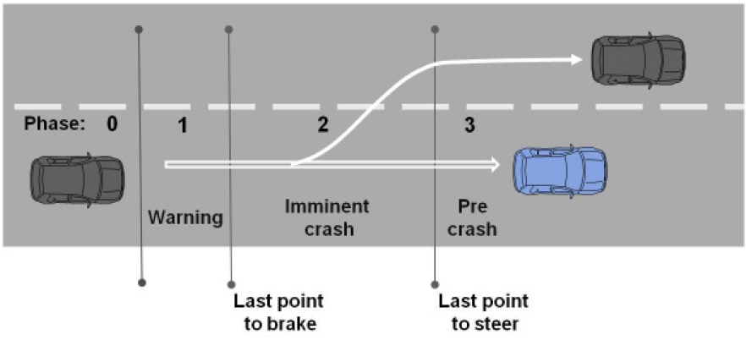
Use Case ii.
Function type
“An obstacle obstructs the path”
“Obstruction of the path is imminent”
1
2
3
4
5
6
7
Description:
When the driver performs an evasive manoeuvre (red path) by turning the steering wheel, the system provides assistance by adding precisely calculated steering torque (i.e. amplifying driver’s torque) to support the movement of the steering wheel and avoid the collision. Given the added torque is limited and the driver is hands-on, the driver is free to follow the steering recommendation given by the system or to override the system recommendation.
If the driver does not perform any evasive manoeuver, the function does not intervene.
If the driver performs a second steering actuation to the right (green path), the system will assist the same way as during the red actuation, to follow the intended path.
If the driver does not performs a second steering actuation to the right, the system may provide a steering recommendation to the right, which again the driver is free to follow or not. This is very similar to what a CSF function of type (c) is doing to prevent lane departure.

Slide 10
Use Case ii.
Function type
“An obstacle obstructs the path”
“Obstruction of the path is imminent”
1
2
3
4
5
6
7
Description:
On the market / close to market.
The system performs automatic avoidance within the lane
Only forward looking sensors required
The system does not check side or rear traffic
No intervention Intervention

Slide 11
Use Case ii.
Function type
“An obstacle obstructs the path”
“Obstruction of the path is imminent”
1
2
3
4
5
6
7
Description:
Future evolution, out of scope
Lane markings not required
Forward, side and rearward looking sensors required.
The system checks if there is enough space to perform the avoidance manoeuver
No intervention Intervention

Slide 12
ESF Tests
Since Osaka ACSF-09 meeting, industry explored the possibility to define performance and tests for ESF.
This approach led us to a dead-end, and revealed the definition of performance and tests are not required to achieve the main objective, which is to avoid misusing ESF as a B1 system.
Industry proposal is to follow the same approach as for CSF (while making it more stringent):
  Acoustic and optical warning at every avoidance manoeuver automatically initiated by system
  Acoustic and/or optical warning when avoidance manoeuver manually performed by driver
  Describes the conditions for collision risk detection and demonstrates them
  50N max overriding test (to be tested)
Rationales in next slides

Slide 13
Rationale #1
CSF
CSF
LKAS
Stability…
Collision avoid.
Lane departure avoid.
ACSF B1
LKAS
Objectives
Avoid misuse → hands-off detection
Minimum performance and tests, to ensure a “safe” coupling with ACSF C/D
CSF
LKAS
Stability…
Collision avoid.
Lane departure avoid.
Objectives:
Avoid misuse → acoustic warning if too long or too frequent intervention
ESF
Collision avoid.
Objectives
Avoid misuse → acoustic warning at every intervention (unless avoidance performed by the driver)
Minimum performance and tests
Industry explored the possibility to define ESF performance and tests (with e.g. TTC) but this revealed to be impractical, while not strictly required to reach the objectives.
See next slides.

Slide 14
Rationale #2
Time to Collision (TTC) - AEBS vs ESF
AEBS for LCV
ESF
Assumptions:
3s TTC at 80km/h
(= 67m)
Stationary target
1 vehicle is moving in 1 dimension *
2 vehicles are moving in 2 dimensions
67m
67m
Drift rate = [0.5m/s]
(note: in R130, rate of departure between 0.1 and 0.8 m/s)
80km/h
67m
Test complexity
is not
Comparable
!!
80km/h
3 m
* With a moving target at 67km/h, 2 vehicles are moving but the distance become 11 m…

Slide 15
Conclusions
ESF
Such a test is impractical: TTC not measurable, due to high tolerances on drift rate, leading to variation in the collision point.
In many cases, a TTC is not relevant for collision risk detection; there are other potential criteria (safety distance, speed, vehicle type, road conditions, use case etc.).
Industry proposal is to stick to the CSF approach and provide a warning at every intervention of ESF.
In addition, the manufacturer should describe the conditions for collision risk detection and demonstrate them with documentation, test results, virtual or physical tests etc.
50N max overriding test (to be tested)
This will ensure no misuse and easy overriding.
2 vehicles are moving in 2 dimensions
Drift rate = [0.5m/s]
(note: in R130, rate of departure between 0.1 and 0.8 m/s)
67m
80km/h
3 m

