Slide 1
PMP CPC Round ROBIN
Additional evaluations at AVL

Slide 2
CONTENT
Charging efficiencies
Effect of calibration material
Instrumentation effects (DMA, electrometers)
10 nm calibrations with miniCAST

Slide 3
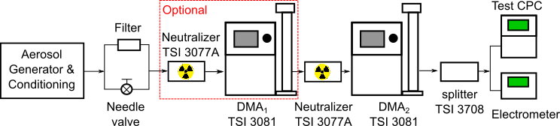
Calibration setup
Electrospray (Emery Oil / Dioctyl Sebacate), RR APG, miniCAST (evaporating tube or catalytic stripper), PALAS DNP3000
Tandem DMA → Charging efficiencies
Two different types of electrometers were also available

Slide 4
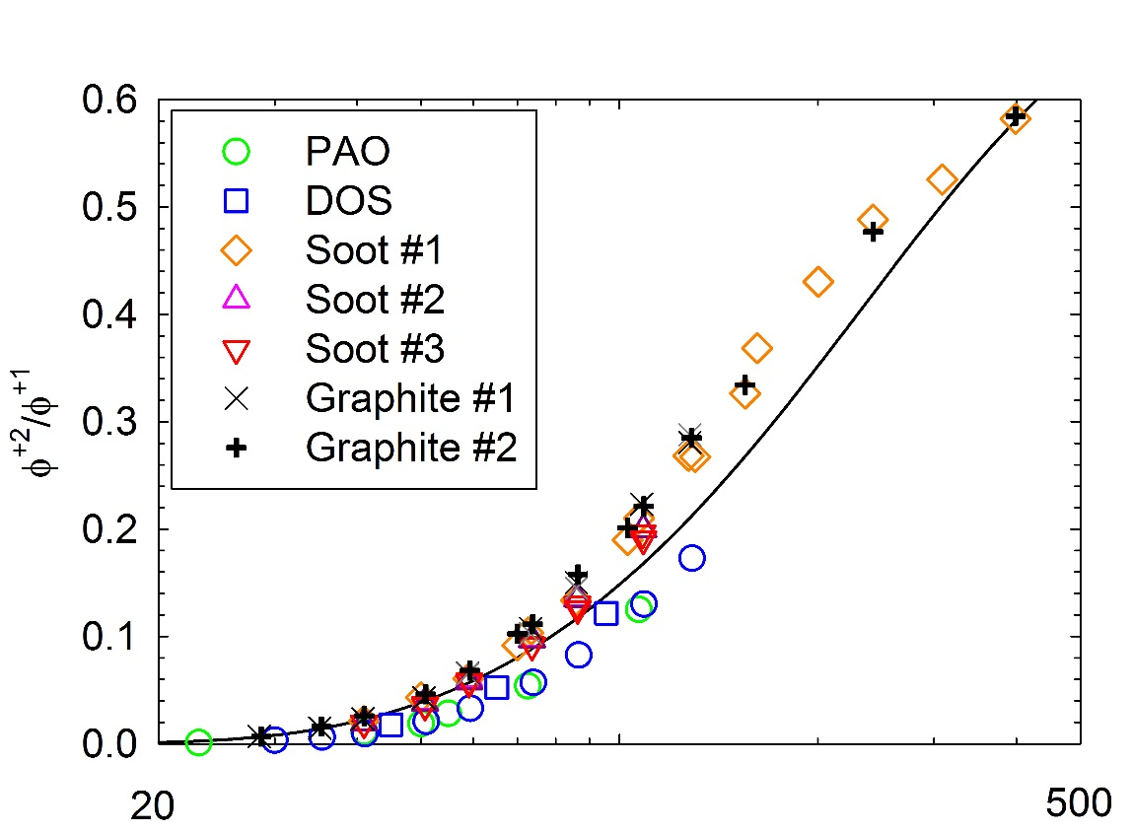
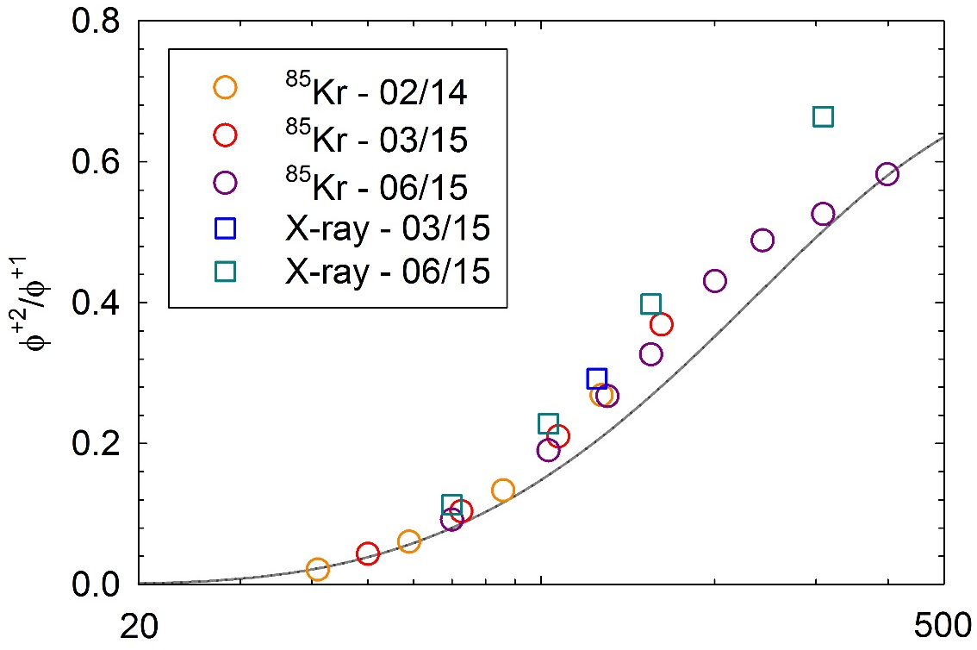
Charging efficiencies
ISO15900
The tandem DMA setup allows for the quantification of double to single charge fractions
  Charging efficiencies differ for soot/graphite and oil droplets
  ISO15900 recommendation was found to lie in between
  Soft X-ray neutralizers yield systematically higher fractions of multiply charges
⁸⁵Kr
Soot
Mamakos, Aerosol Science & Technology 50:363-372

Slide 5
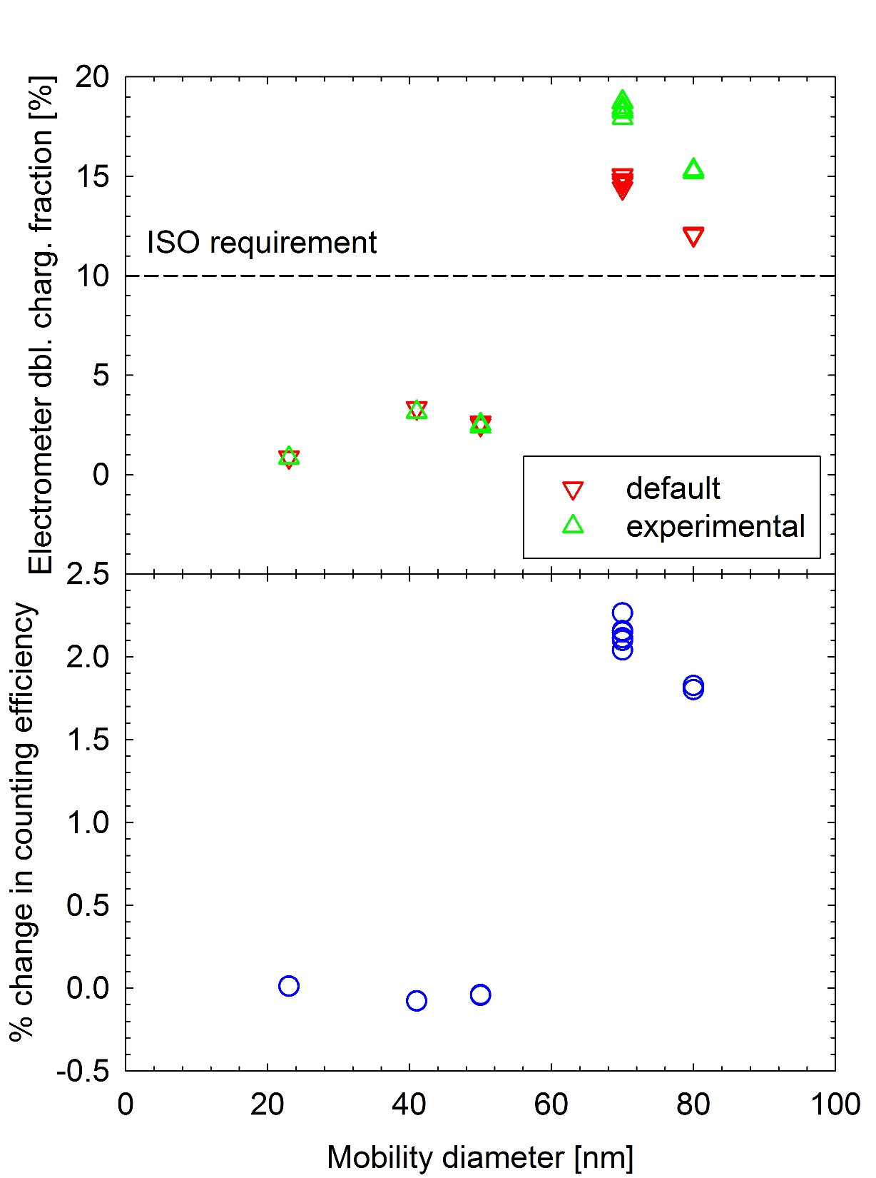
Charging Efficiencies Effect
Default settings of RR APG led to rather high double charge fractions above 60 nm (>10% of ISO15900 requirement) for calibrations against electrometer
The use of default charging efficiencies was calculated to result in ~ 2% underestimation at sizes above 60 nm
⁸⁵Kr

Slide 6
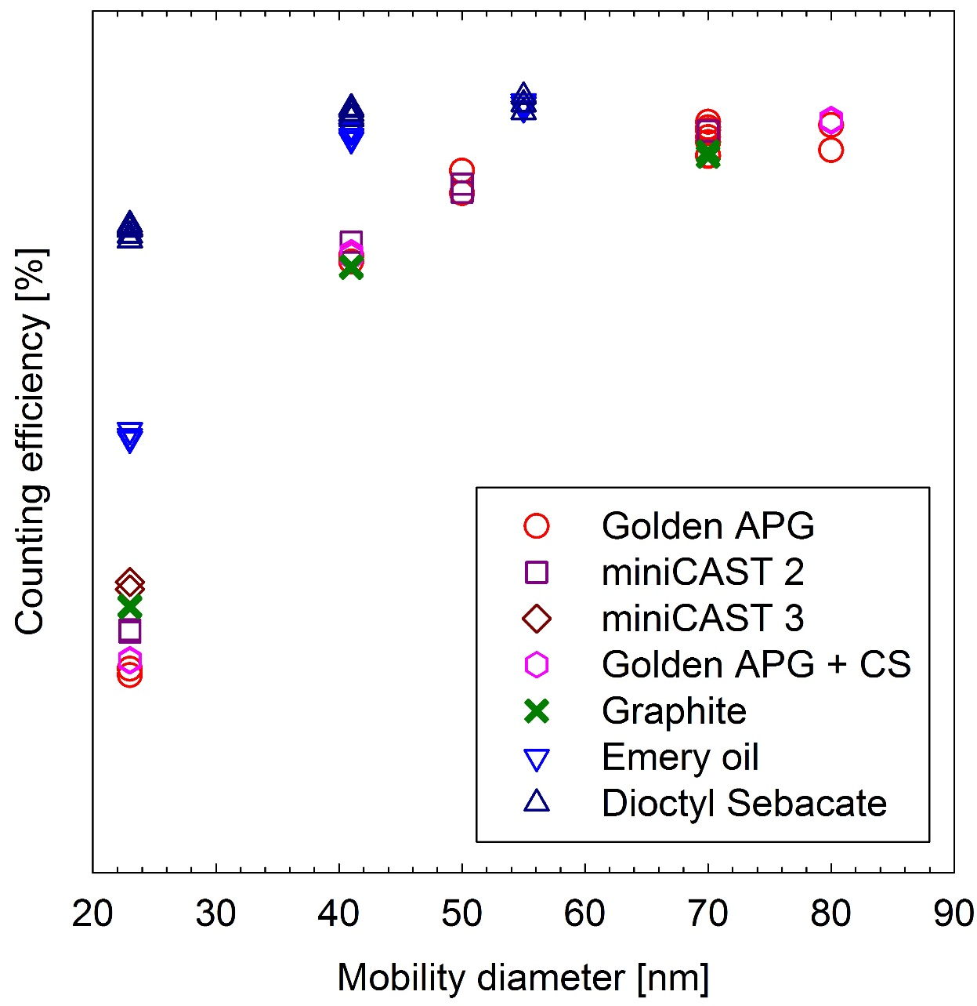
Calibration material effect
Response for soot and graphite particles distinctly different than for emery oil
Efficiency for dioctyl sebacate much higher than any activation theory suggests → Chemical effect

Slide 7
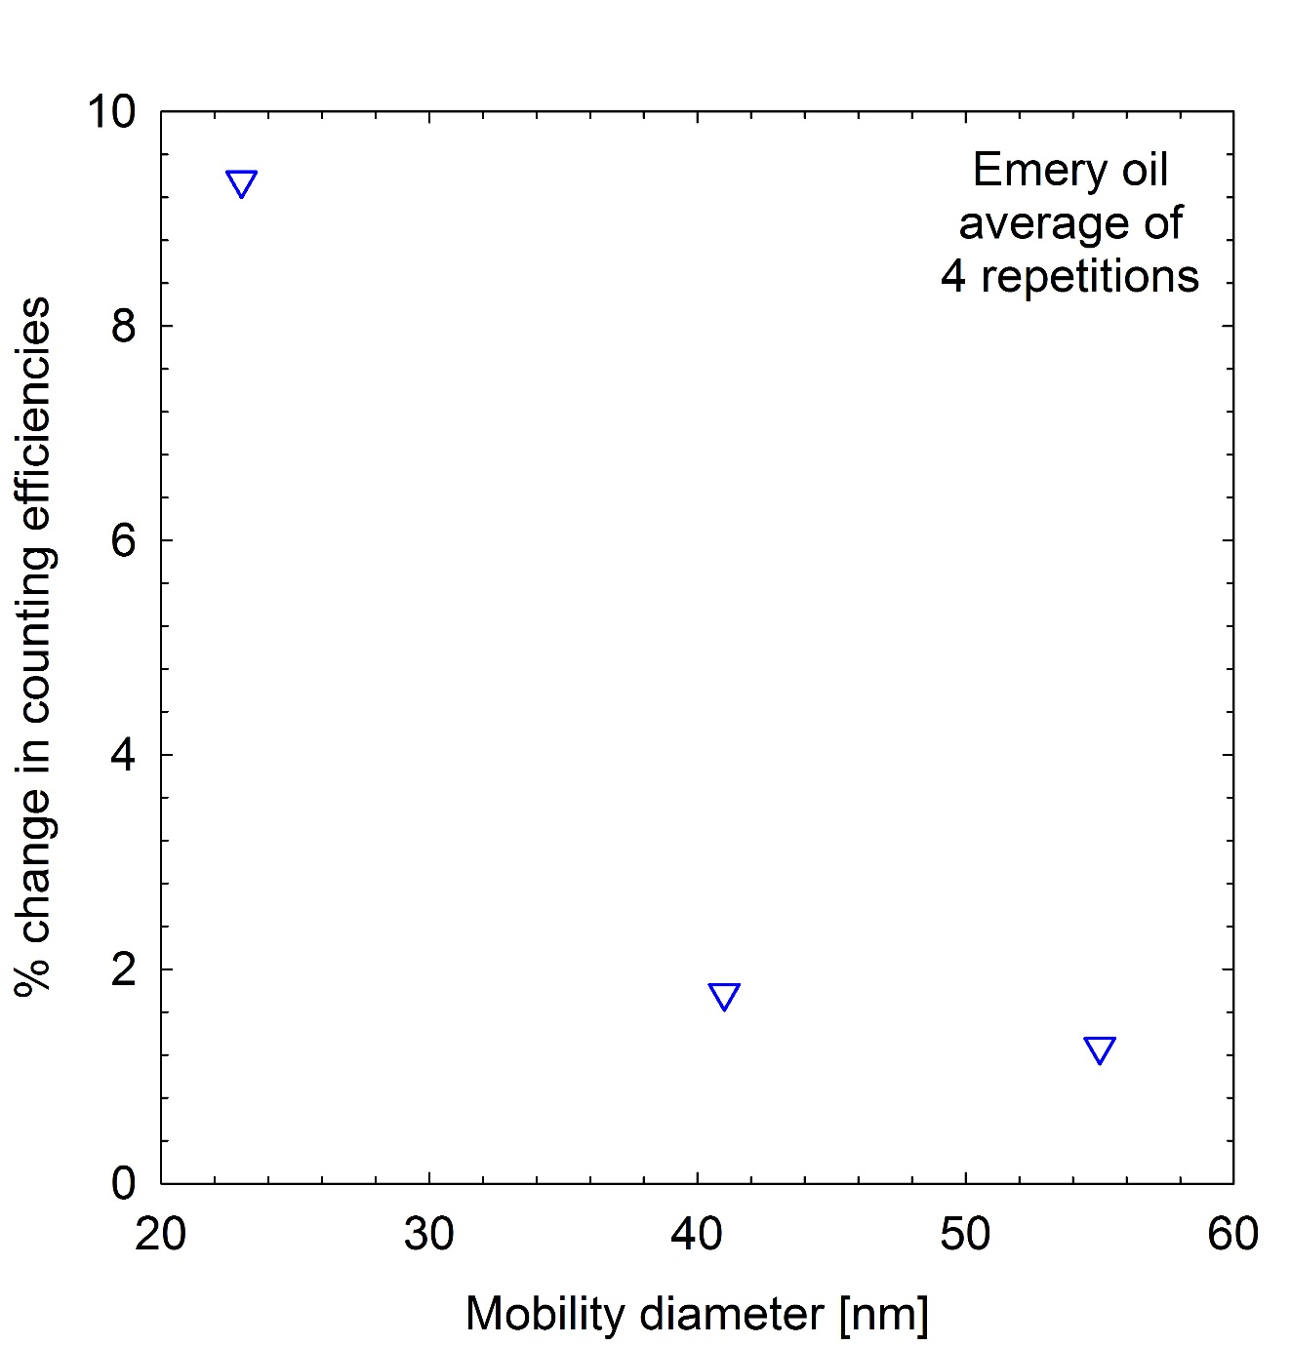
Instrumentation Effects - DMA
Repetition of emery oil tests with different DMA/classifier yielded systematic differences
Effect is more prominent at 23 nm, where the counting efficiency curve is steep

Slide 8
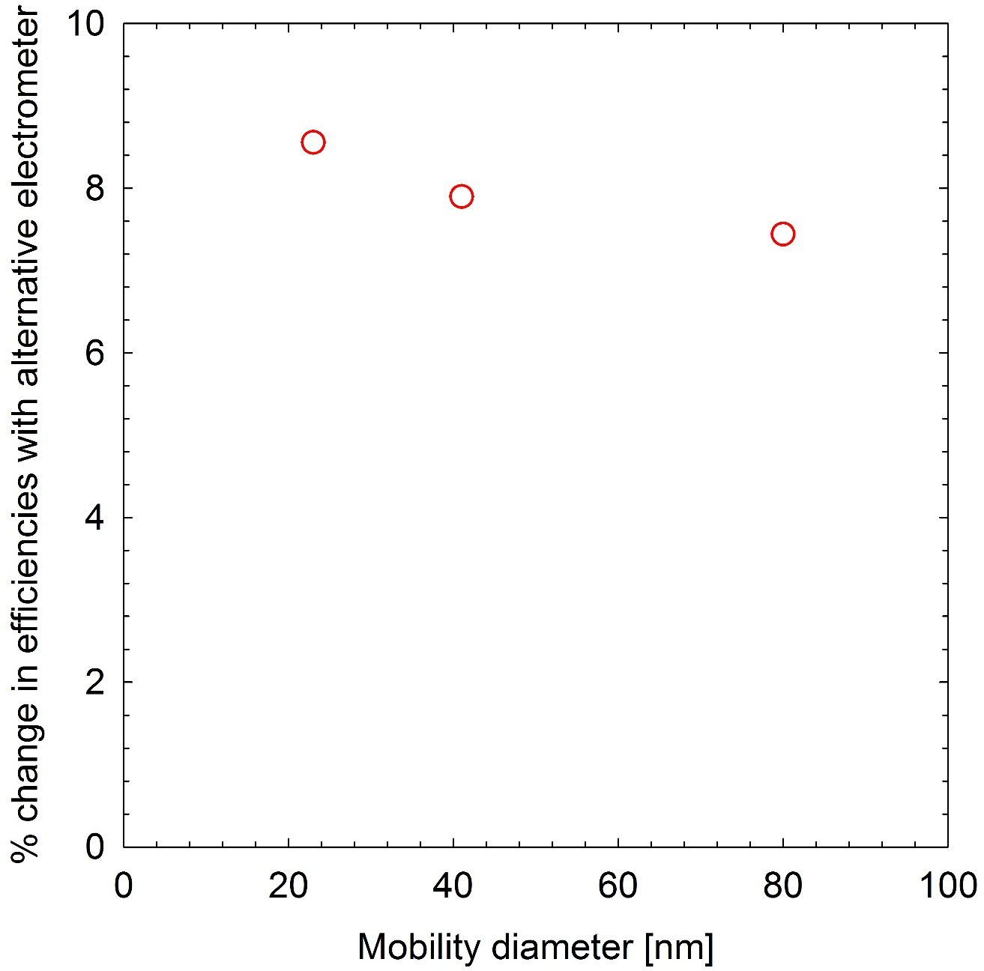
Instrumentation Effects - Electrometer
We received a different type of electrometer during the campaign
A systematic difference of 8% was observed, which was rather independent of size even if flows were properly controlled

Slide 9
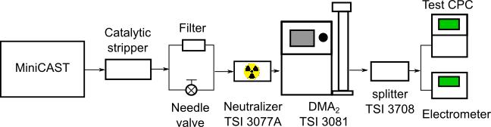
10 nm measurements
Setup:
  miniCAST burner settings to produced size distribution peaking below 10 nm
  Thermal treatment with Catalytic Stripper to avoid additional dilution
  Concentrations at 10 nm registered by the electrometer were ~15000 #/cm³
  Not optimal settings due to setup (i.e. use of long DMA) and time limitations

Slide 10
CONclusion
Care is required in dealing with multiple charge fractions especially when an electrometer is employed as a reference
Importance of traceable calibration of reference instrumentation: DMAs & Electrometers
Organic liquid particles show distinctly higher counting efficiency, and there is a clear strong chemistry effect → Chemical composition needs to be defined in conjunction with the type of working fluid employed

