Slide 1
FIA MOBILITY & TOURISM
Gerd Preuss,
FIA Representative at
UNECE, WP 29
Data Protection and Cyber Security in Automated Driving
ITS-AD Meeting,
November 2016
Submitted by FIA Document No. ITS/AD-10-06
(10th ITS/AD, 16 November 2016, agenda item 3-1-2)

Slide 2
Data Protection and Cyber Security in Automated Driving
Summary
Basic Principles of Data Protection
Functional Safety vs Cyber Security
Cyber Security in Vehicles

Slide 3
Data Protection and Cyber Security in Automated Driving
Summary
FIA welcomes, that Data Protection and Cyber Security are regarded as topics of high importance in ITS-AD as a general technical requirement
Both topics are also relevant for partly automated systems like the ones described in Regulation 79 (ACSF)
Data Protection and Cyber Security must be implemented in the technical design of a vehicle and the infrastructure (V2V; V2I)
Vehicle Owner/Driver has the right to decide about what date is being sent/received from/to his vehicle, unless legal requirements like in the case of Automated Emergency Call System (AECS) are in place
Certain data are per se primarily of a technical nature, it may be associated with the vehicle owner or driver via VIN and consequently constitutes personal data to which the Data Protection rules apply

Slide 4



Data Privacy and Cyber Security in Automated Driving
Basic Principles for Data Protection
Transparency
Vehicle owners and/or operators are entitled to know what data is collected, transmitted, stored and received in their vehicles
Data minimization and earmarking
The principles of data minimization and earmarking data for specific uses should be mandatory requirements in the development of the applications
Freedom of Choice
The vehicle owner/driver must be able to decide, with whom he shares or does not share his vehicle related data and from who he obtains data related services

Slide 5
Data Privacy and Cyber Security in Automated Driving
Basic Principles for Data Protection
Privacy by Design through Pseudonymisation of Data
Even though certain data (e.g. actuation of the turn indicator) is per se primarily of a technical nature, it may be associated with the vehicle owner or driver via the Vehicle Identification Number and consequently constitutes personal data to which the Data Protection rules apply
Personal Data
Company Data of others than the VM
VIN
Location
enable the VM to record profiles of drivers
These data shall be pseudonymised in any data transfer from / to the vehicle to ensure non monitoring by one party e.g. VM

Slide 6
Data Privacy and Cyber Security in Automated Driving
Functional Safety vs Cyber Security
Functional Safety vs Cyber Security
Current vehicles are designed to fulfill highly sophisticated functional safety,
e.g. ABS, ESP, ACSF
In contrast to this, cyber security in vehicles is not up to date. The Vehicle Manufacturers prefer to develop their own IT security systems, while IT experts (BSI) support the method of the Common Criteria
FIA member ADAC proved, that mileage fraud of odometers and theft of vehicles with keyless go systems is easily possible, due to the fact, that these systems are functional safe, but not cyber secured.
The consequences hereof are to the detriment of the consumer.

Slide 7
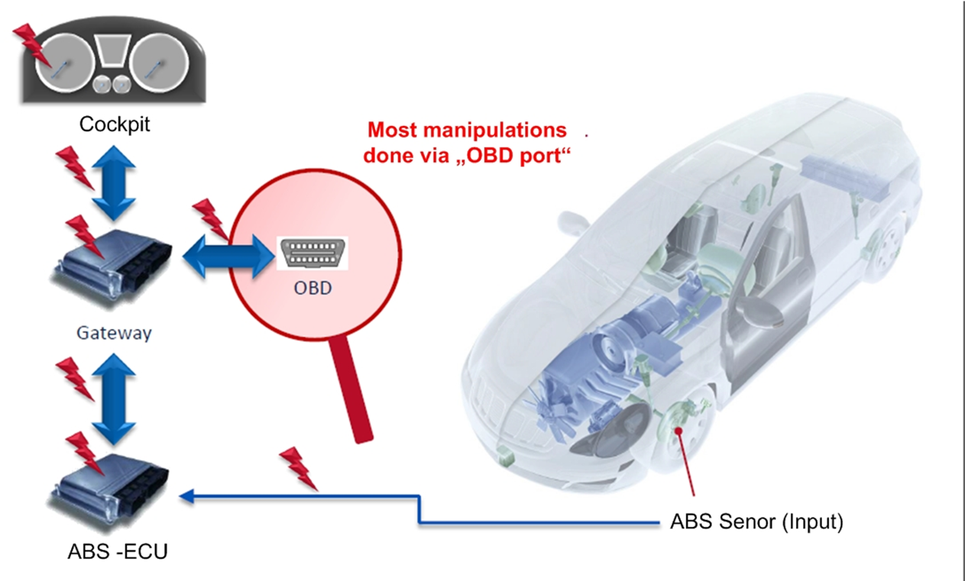
Data Privacy and Cyber Security in Automated Driving
Functional Safety vs Cyber Security
Mileage Fraud
Functional Safety of the odometer is ok; but
lacking cyber security leads to manipulation

Slide 8
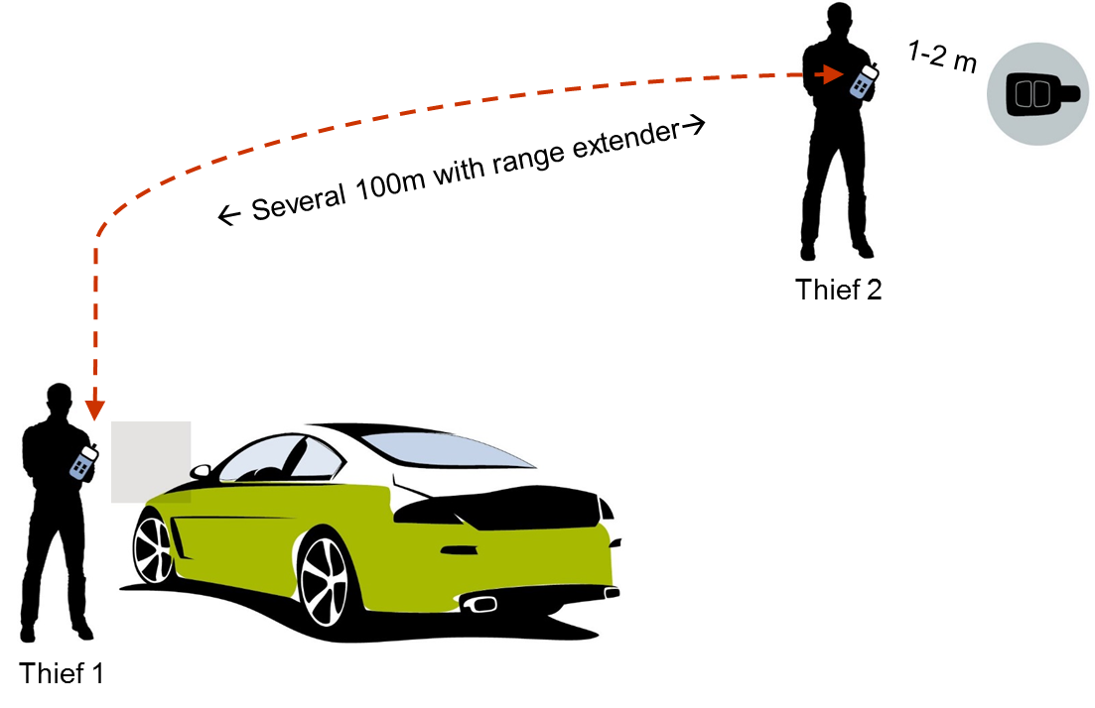
Data Protection and Cyber Security in Automated Driving
Functional Safety vs Cyber Security
Theft of Vehicles with Keyless Entry System
ADAC engineers managed to hack the keyless vehicles in a matter of seconds and to drive off, leaving no visible trace of a break-in or theft. Because of their obvious security flaws, comfort keys are worryingly
easy prey for thieves
Functional Safety of the keyless entry system is ok; but
lacking cyber security leads to theft

Slide 9
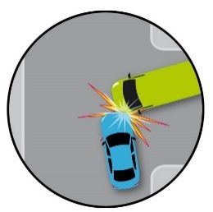
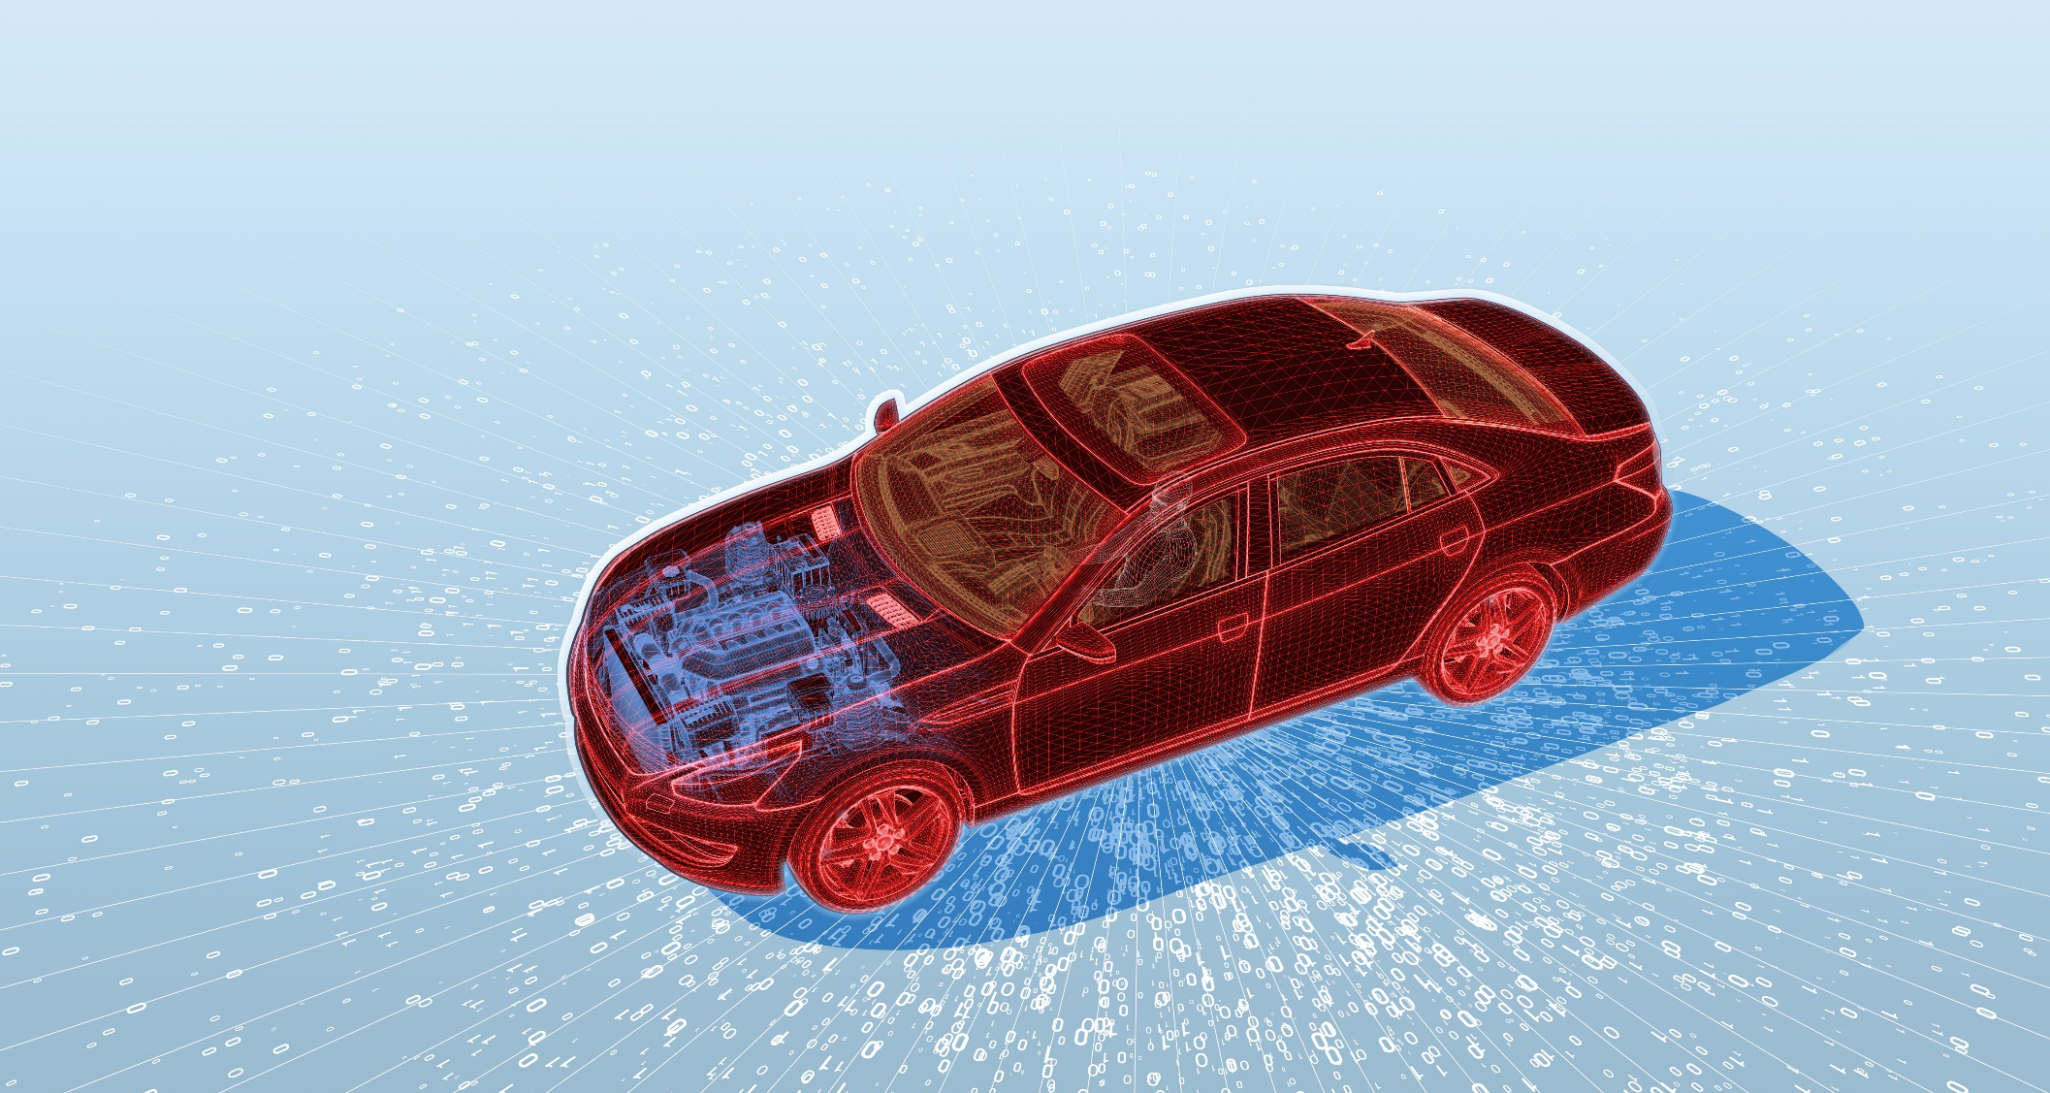
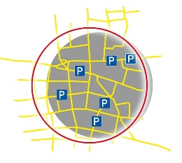

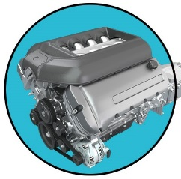



Data Protection and Cyber Security in Automated Driving
Cyber Security in Vehicles
OVERVIEW
OTA
V2I
OTA
V2V
OTA
Music
Radio
In-Vehicle-Network
+ Over The Air (OTA)
OTA
RDS
Prognostics
OTA
Keyless Entry

Slide 10
Data Privacy and Cyber Security in Automated Driving
Cyber Security in Vehicles
Cyber security starts with the technical design of a vehicle
Type approval authorities must be able to check the security of a new vehicle against a protection profile
During the lifetime of the vehicle, PTI stations must check, if the proper software is installed
Event based measures must close loopholes, once uncovered
End of support must be defined

Slide 11
Data Privacy and Cyber Security in Automated Driving
Cyber Security in Vehicles
A general risk analysis e.g. failure mode and effects analysis (FMEA) including all risks inherent to end-to-end connections such as backend or car-to-X, third party interfaces such as telephone, smartphone, OBD or radio should be performed (1)
Technology neutrality is a general requirement of technical regulations (2)
Verifiability / certifiability of type approval (3)
e.g. White box-principle: software screening by third parties based on internationally recognised protocols
Stage 1: general risk analysis
Stage 2: actually installed technical systems red

Slide 12
Data Privacy and Cyber Security in Automated Driving
Cyber Security in Vehicles
During the vehicle life time
Manufacturers are responsible for “approved software” in the vehicle
During mandatory vehicle inspections the use of such “approved software” should be checked e.g. PTI (4).
Proactive verification of certificate validity (state of the art) by third parties e.g. through reassessment as to whether or not un-changed products still meet the certification target in view of old and new attacks. This would be equivalent to repeated type approval for security aspects and could be implemented through market / field studies or simply according to a fixed schedule by third parties (5)
Manufacturers are required to close security loopholes on an ongoing basis.
Define change management as IT standard/process (6)

Slide 13
Data Privacy and Cyber Security in Automated Driving
Cyber Security in Vehicles
Scheduled updates by manufacturers
Amended rules of the road, map updates for navigation devices (7)
Phased out manufacturer support
Car manufacturers provide no more updates; this only affects assistance systems such as ACC (8)
While points 1, 2, 3, 4, 7 and 8 can be scheduled, points 5 and 6 are event-based and only occur after manipulation was uncovered

Slide 14
Data Privacy and Cyber Security in Automated Driving
Cyber Security in Vehicles
G7 determined, that cyber security and data protection is a growing concern from consumers perspective; therefore all stakeholders have a responsibility to design appropriate regulation to ensure trust in new technology and automated vehicles
The type approval authority or a national accredited body must check the cyber security of the vehicle against a protection profile
The vehicle manufacturer must meet this protection profile by his own proprietary measures against cyber attacks
Workshops and PTI Stations must be able to check during inspections, if the vehicle systems have been hacked or if any illegal software was installed, e.g by checking current hard- and software versions with informations from vehicle manufacturers
The protection profile should be updated regularly
Notes:
UN Rule No 2 of the 1997 agreement on road worthiness testing should be upgraded with provisions on mileage registration at PTI, similar as Regulation (EU) 45/2014.

Slide 15

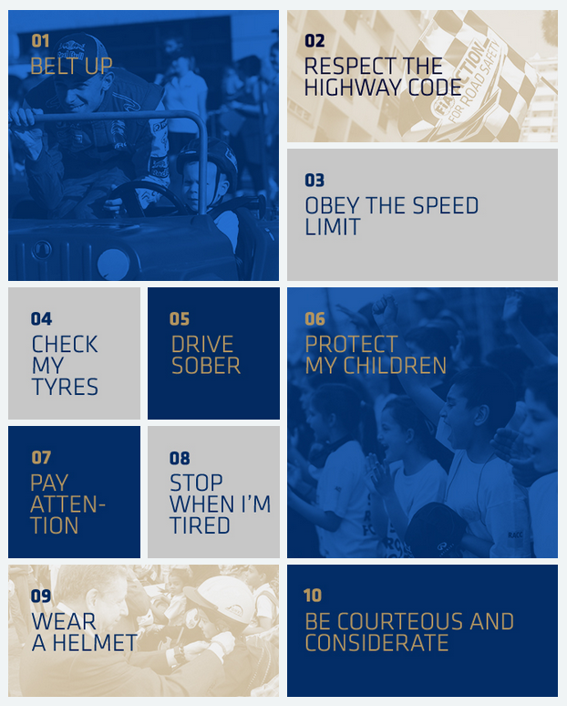

Thank you for your attention

