Slide 1
Overview of Electric Vehicle Market Issues in the U.S.
Jeff Alson
U.S. Environmental Protection Agency
EVE Informal Working Group Meeting #2
September 13, 2012

Slide 2
Contents
Current status of plug-in electric vehicles (EVs) and plug-in hybrid electric vehicles (PHEVs) in the U.S. market
U.S. regulatory landscape
U.S. government incentives
Market drivers
Market barriers
Conclusions

Slide 3
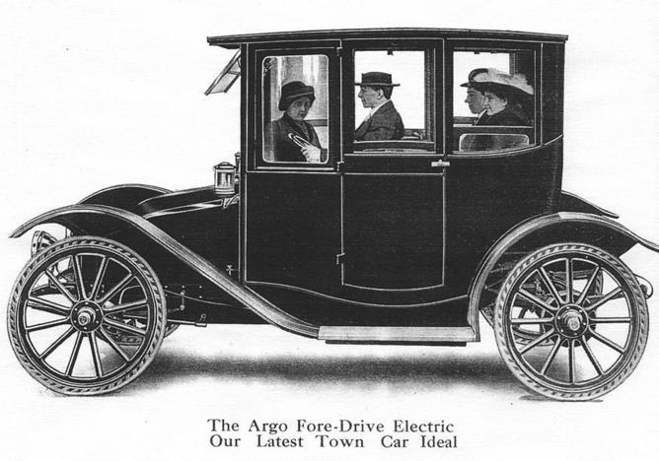
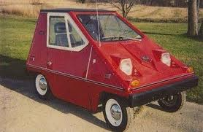
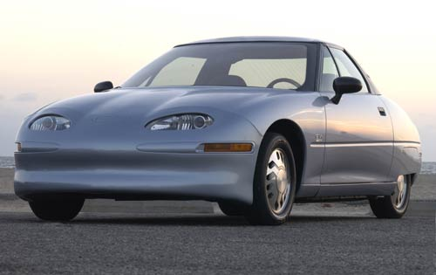
History of EVs in the U.S.
EVs held at least 30% of the market in 1900
  EVs disappeared as gasoline became more available and less expensive and gasoline vehicles improved in power, reliability, and cost.
Small revival during energy crisis in 1970s
Another revival after initial CA ZEV mandate in early 1990s
  GM EV1
  Toyota RAV4 EV

Slide 4
Current U.S. Market Status

Slide 5
EVs and PHEVs in U.S. Market
Many new vehicle models entering market
  2011
    Two major introductions: Nissan Leaf EV and Chevrolet Volt PHEV
    Also Tesla Roadster, BMW ActiveE EV and Smart fortwo EV
  2012
    Mitsubishi i EV, Ford Focus EV, Tesla Model S EV, Toyota Prius PHEV, and Fisker Karma PHEV
  2013
    Honda Fit EV, Toyota RAV4 EV, Ford C-Max Energi PHEV, …
Total sales remain relatively small
  0.1% of overall sales in 2011, 0.2-0.3% of sales in 2012

Slide 6
U.S. Refueling Infrastructure
Home charging
  Nationwide, 50-60% of all U.S. households have garages
  61% of new vehicle buying households in California have access to an electrical outlet within 50 feet of parking location
  Level 1 (120 v) systems can work for PHEVs
  Level 2 (240 v) are best for EVs
    GE WattStation sold to consumers for $1,000 plus installation
Public charging stations
  About 4500 public charging stations in U.S.
  Mostly Level 2 (240 v) systems, a few Level 3 (480 v) systems

Slide 7
Utility Programs in U.S.
Promoting consumer interest
  Offering new pricing options
    Lower rates for nighttime charging
    Dedicated meters with lower rates for home charging
    Fixed monthly price for unlimited EV charging at public stations
  Free or reduced price Level 2 charging stations and home installation
Evaluating potential impacts on electric grid
  distribution infrastructure (e.g., transformers)
  “smart charging” and vehicle-to-grid technology
Operating EV/PHEV fleets for research purposes
Collaborating with cities, local governments, and other stakeholders on plug-in vehicle readiness planning

Slide 8
Lifecycle GHG Emissions Performance
(Real world, based on EPA eGRID2012)

Slide 9
U.S. Regulatory Landscape

Slide 10
U.S. Health-Related Emissions Standards
U.S. (EPA and the California Air Resources Board) was the global pioneer in reducing automotive health-related pollution in the 1970s and 1980s
EPA “Tier 2” standards now in effect represent 98-99% reductions, relative to 1970, for hydrocarbons, carbon monoxide, and oxides of nitrogen emissions
  Technologies such as fuel injection and on-board electronic controls have led to cars that are not only cleaner, but better performing and more reliable and durable as well
EPA considering future “Tier 3” standards that could tighten both vehicle and fuel standards
Unlikely to have major effect on future EV market

Slide 11
U.S. National Program GHG/CAFE Standards
(www.epa.gov/otaq/climate/regulations.htm)
 | MY 2010 Baseline | MY 2016 Standards | MY 2025 Standards
GHG emissions | 351 g/mi (218 g/km) | 250 g/mi (155 g/km) | 163 g/mi (101 g/km)
Fuel economy | 25.3 mpg (9.3 L/100 km) | 34.1 mpg (6.9 L/100 km) | 49.6 mpg (4.7 L/100 km)

Slide 12
U.S. National Program
GHG Compliance Incentives for EV/PHEVs
Timeframe | GHG Emissions Compliance Treatment for Grid Electricity | Compliance Multiplier
2012-2016 | Below sales limit: 0 grams/mile Above sales limit: Net upstream | None
2017-2021 | 0 grams/mile | EV: 2.0 … 1.5 PHEV: 1.6 … 1.3
2022-2025 | Below sales limit: 0 grams/mile Above sales limit: Net upstream | None

Slide 13
U.S. National Program
Net Upstream GHG Approach for EVs
Measure vehicle electricity consumption over EPA city and highway test cycles in watt-hours/mile
Divide value by 0.935 to reflect transmission losses to reflect electricity needed at the electric powerplant
Multiply value by 0.534 grams/watt-hour to reflect EPA projection of overall electricity upstream GHG emissions (both powerplant and feedstock) associated with extra electricity demand for EVs/PHEVs in 2030
Subtract the upstream GHG emissions of a gasoline vehicle with the same footprint meeting its CO₂ target

Slide 14
CAFE Treatment for EVs
Based on “petroleum equivalency factor” per DOE regulations, reflecting that little or no oil is used in U.S. electricity generation
CAFE rating = 82,049 Wh/gal divided by electricity consumption in Wh/mile over EPA tests
  Nissan Leaf uses 238 Wh/mile, so CAFE = 347 miles/gallon

Slide 15
California ZEV Program
(www.arb.ca.gov)
Originally established in 1990 to require a fraction of sales of advanced technology vehicles with zero or near-zero health-related emissions
  Mostly met by ultra-low emissions gasoline and hybrid cars
  Smaller number of EVs, often “Neighborhood EVs”
Evolving to greater focus on vehicles that use fuels with “zero emission” tailpipe GHG emissions
  Grid electricity and hydrogen
Compliance based on credit system reflecting technology, EV range, hydrogen fuel cell storage pressure, etc.
EPA currently reviewing “waiver” for 2018-2025 that could be met by, for example, 13% EV 100 and 4% PHEV
  Or fewer fuel cell vehicles, or EVs with longer range

Slide 16
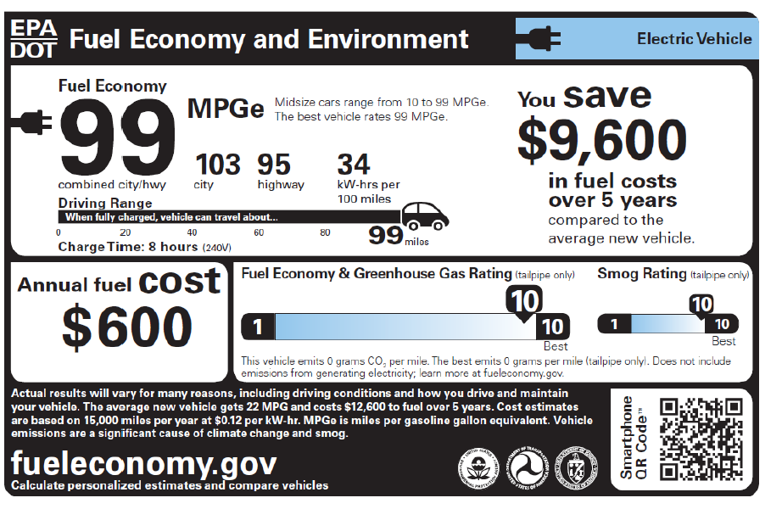
U.S. Fuel Economy & Environment Label
Starting with model year 2013, all new passenger cars and trucks sold in the United States are required to have the revised fuel economy & environment label
  The label’s metrics and design enable consumers to compare across technologies (gas, diesel, EV, PHEV, FCV, CNG)
Both MPGe & kW-hrs per 100 miles
Highlights how much consumers can save (or spend) in fuel costs compared to average vehicle
Range &
Charge Time
Tailpipe
CO₂
More information, including upstream GHG emissions estimates, are available on joint DOE-EPA website

Slide 17
U.S. Government Incentives

Slide 18
U.S. DOE Funding to support EVs/PHEVs
American Recovery and Reinvestment Act of 2009
  $2 billion in grants for advanced battery manufacturing and recycling & electric drive component manufacturing
  $400 million for transportation electrification program to install charging infrastructure and purchase EVs/PHEVs for demonstrations—The EV Project
    20+ cities
    Over 8000 Evs and PHEVs
    14,000 Level 2 chargers and 300 Level 3 chargers
    Data at http://avt.inl.gov/evproject.shtml
Recent Research & Development programs
  EV Everywhere Grand Challenge, announced March, 2012
    Goal to enable US companies to develop an EV that is cost competitive with conventional vehicles (payback < 5 years) and has a range that meet s average Americans’ needs by 2022
    Working with industry, academia, state and local governments, and other stakeholders
  $4 million to develop a wireless charging system for EVs, announced April 2012
  $43 million for breakthrough energy storage technologies for electric vehicles and the grid
    through the DOE’s Advanced Research Projects Agency-Energy , announced Aug 2012
Advanced Technology Vehicles Manufacturing Loan Program
  Loans help fund domestic manufacturing facilities for EVs and batteries (as well as other advanced technology vehicles)
  $25 billion authorized, $8,4 billion spent so far

Slide 19
U.S. EV/PHEV Tax Credits
Primary economic incentive to promote consumer interest in EVs/PHEVs
Federal tax credit
  $2500 credit for EV/PHEV with battery capacity of 4 kWh
  Credit increases by $417 for every kWh in excess of 4 kWh
  Maximum credit of $7500 for battery capacity of 16+ kWh
  Credit begins to phase down after a manufacturer’s cumulative EV/PHEV sales reaches 200,000 units
Some individual states also offer EV/PHEV tax credits
  Highest credit is $5000 in Georgia
  California state incentive ended June 30, 2012

Slide 20
HOV Lane Access in U.S.
Primary non-economic incentive to promote consumer interest in EVs/PHEVs
High-occupancy vehicle (HOV) lanes are normally restricted to vehicles carrying a certain minimum number of passengers to encourage car-pooling
11 states allow EV and PHEV drivers to use HOV lanes
  Including California, New York, New Jersey, Florida, Illinois, Virginia, and Maryland
In some areas, this can be a very powerful incentive

Slide 21
Fuel Road Taxes in U.S.
U.S. fuel taxes
  Federal: 18.4 cents per gallon
  State: vary, but typically average about 30 cents per gallon
Vehicles that use electricity generally pay no fuel taxes
  One state, Washington state, has a $100 annual EV tax
This yields an annual benefit of about $250 relative to a gasoline car that pays fuel taxes, or $2500 over a 10-year period

Slide 22
U.S. Market Drivers and Barriers for EVs

Slide 23
U.S. Market Drivers
Direct benefits to vehicle owner
  Fuel prices
    Much lower
    Much more predictable
  Refueling
    Can do so at home and avoid gasoline stations
  Reduce personal oil use and carbon emissions
  No tailpipe/noise may be perceived as more “elegant”
Collective societal benefits
  Large carbon savings, especially if electric grid is transformed to low-carbon feedstocks
  Large oil savings can also reduce oil prices, reduce trade deficit, and keep more dollars in local economies

Slide 24
U. S. Market Barriers
Much higher vehicle cost, due primarily to batteries
Vehicle range
  Lower
  More variable due to climate and driving behavior
Inconvenience and flexibility
  Loss of peak vehicle utility
  Longer refueling time
  Greater need for household planning for vehicle use
Lack of widespread public charging infrastructure
Consumer reluctance to try very different car technology
Cost and challenge of transforming electric grid to low-carbon feedstocks

Slide 25
Perspective
EVs are a “bigger change” than any other alternative vehicle technology option for the U.S. market
U.S. gov’t has done more to promote EV/PHEVs than other advanced technologies, but sales remain low so far
It is impossible to predict whether EVs will be successful
  Plausible that EVs will gain only a very small market share, e.g., as a second or third “city car” for high-income families
  Plausible that EVs will become a mainstream competitor and the “technology of choice” for those consumers who want to nearly zero out their oil and carbon footprints
Major determinants of future EV success in U.S.
  Oil prices
  Battery innovation and cost
  Ability to transform U.S. electric grid to low-carbon feedstocks
  Cultural attitudes toward oil and carbon

Slide 26
Thank You
Jeff Alson
U.S. Environmental Protection Agency
alson.jeff@epa.gov

