Slide 1
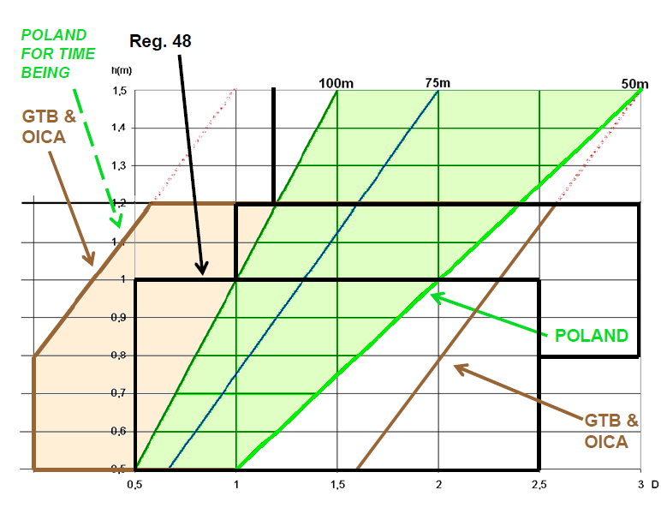
Other proposals for the right limit by the IWG VGL 5th session

Slide 2
Other proposals for the right limit during the IWG VGL 5th session
0

Slide 3
Consensus at the IWG VGL 5th session
0,85%

