Slide 1
Study on Drive Trace Index of Electrified Vehicles
Prepared by JAPAN
10 JAN 2017
WLTP 17th IWG

Slide 2
BACKGROUND
Overview of previous study
 | Normalization | Drive Index
ICE | study by EC → SOC correction was adopted | study by Japan → Require to submit each index value of each test
NOVC-HEV | study by Japan → Normalization doesn’t work for some of performance parameter. | study by Japan → Report during 17th IWG
OVC-HEV
PEV
WLTP IWG Decision | Premature to adopt “Normalization” except SOC correction | TBD
Today’s Topics

Slide 3
SUMMARY_1
It is observed that some of Drive Trace Indexes are able to detect the smooth/rough driving technique of electrified vehicles.
Test results have macro correlation with Drive Trace Indexes, however, it is difficult to normalize by using the drive indexes from the view points of accuracy and practical lab. operation

Slide 4
SUMMARY_2 (candidate indexes)
Vehicle category | ICE | NOVC-HEV OVC-HEV(CS) | OVC-HEV(CD) |  |  |  | PEV
parameter | CO₂ |  |  | EC | EAER | RCDA AER | EC | PER
ER | × |  | 〇 |  | 〇 | × | 〇
DR |  |  | × |  | × |  | ×
EER |  |  | 〇 |  | 〇 |  | 〇
ASCR | 〇
IWR
RMSSE |  |  |  |  |  | 〇

Slide 5
NEXT ACTIONS
2017/Jan Mar Jun Oct 2018/Jan
18th 19th 20th 21st
Final Decision
Initial Proposal
candidate index
Threshold
(by Japan)
Consolidated Proposal
candidate index
Threshold
(by Japan)
Feedbacks
Comments
Counter-proposals
(by WLTP IWG member)

Slide 6
Appendix
6

Slide 7
Drive Trace Indexes (SAE J2951)
Energy Rating (ER)
  is defined as the percent difference between the total driven and target cycle energy.
Distance Rating (DR)
  is defined as the percent difference between the total driven and scheduled distance.
Energy Economy Rating (EER)
  is defined as the percentage difference between the distance per unit cycle energy for the driven and target traces. Since fuel economy is a measure of the distance traveled per unit of fuel consumed, the effect of distance driven must also be considered in an assessment of a drive quality that is intended to correlate with fuel economy.
Absolute Speed Change Rating (ASCR)
  is defined as the percentage difference between the ASC for the driven and target traces. It provides an indicator of the "smoothness" of the driven trace relative to the scheduled trace. A driven trace that is "smoother" will have a lower ASC than the scheduled trace and so will result in a negative ASCR.
Inertial Work Rating (IWR)
  is defined as the percentage difference between the inertial work for the driven and target traces. It can indicate when the drive style might substantially impact the overall efficiency of the engine, such that a metric based strictly on cycle energy might not fully characterize observed deviations from expected emission rates.
Root Mean Squared Speed Error (RMSSE)
  provides the driver’s performance in meeting the schedule speed trace throughout the test cycle in terms of the Root Mean Squared Speed Error. The value is always a positive number with lower values (closer to zero) indicating better performance. RMSSE has units of kilometer per hour (km/h) in this study.
7
7

Slide 8
Overview of Test
The study of the driving trace index of Electrified vehicles
  Purpose: Check the influence of driving style and Consider the appropriate criteria
  Test vehicles： 1 EV and 1 OVC-HEV
  Test cycle: WLTC 4-phase
  Driving style:
    Normal (trace target speed as much as possible)
    Smooth (Smooth acceleration and Smooth deceleration)
    Rough (Aggressive acceleration, Rough behavior and High deceleration)
(note) All test are within drive trace tolerance
Smooth driving
Rough driving
Smooth
Fluctuate
Low deceleration
High deceleration
Low acceleration
High acceleration
8
8

Slide 9
Test sequence for OVC-HEVs CD～CS Test
day 1
day 2 （Normal）
Pre-con.
Charge
CD test
Soak
CS
Charge
Charging
day 3~ （Smooth/Rough）
CD test
Soak
CS
Charge
9
9

Slide 10
Test sequence for EVs
apply Shortened test procedure
PER_{est} is the estimated pure electric range of the considered PEV, km
d_{DS1} is the length of dynamic segment 1, km
d_{DS2} is the length of dynamic segment 2, km
d_{CSSE} is the length of constant speed segment CSS_{E}, km
10

Slide 11
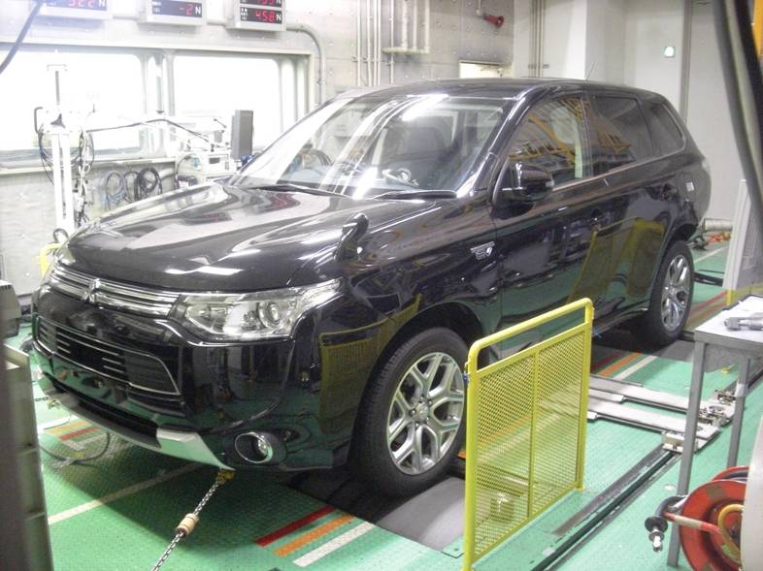
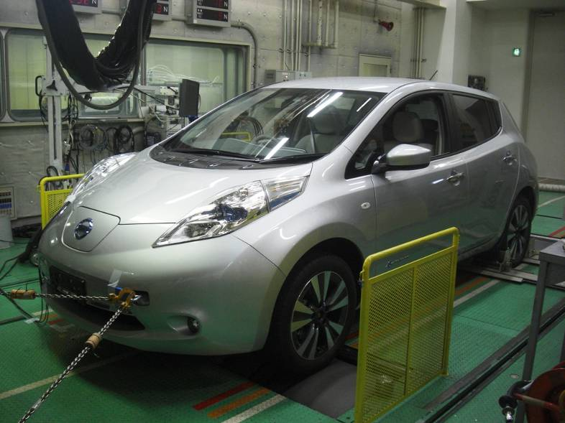
Vehicle specification
OVC-HEV (4WD)
EV
11
11

Slide 12
12
12
Test results of OVC-HEVs

Slide 13
Number of driving cycles under CD condition
# of CD cycles did not change when driving style was changed on test vehicle.
（CD-4 = confirmation cycle）
13
13

Slide 14
Drive Trace Indexes
Energy Rating [ER]
Absolute Speed Change Rating [ASCR]
Distance Rating [DR]
Root Mean Squared Speed Error [RMSSE]
Energy Economy Rating [EER]
Inertia Work Rating [IWR]
Drive trace indexes are varied according to driving style.
14
14

Slide 15
Influence on CO₂
Compared to Average CO₂ of Normal driving
ER
DR
EER
ASCR
Smooth <- -> Rough
Smooth <- -> Rough
Smooth <- -> Rough
RMSSE
IWR
CO₂ has variability up to 20 g/km according to driving style.
Approx. 20 g/km
0.8
-2
+4
Smooth
Rough
Smooth <- -> Rough
15
15

Slide 16
The utility factor-weighted charge-depleting CO₂
ER
DR
EER
ASCR
[Average of CD 1-4]
[Average of CD 1-4]
[Average of CD 1-4]
[Average of CD 1-4]
RMSSE
IWR
Approx. 10 g/km
M_{CO2,CD} has variability up to 10 g/km according to driving style.
0.8
-2
+4
[Average of CD 1-4]
[Average of CD 1-4]
16
16

Slide 17
The utility factor-weighted mass emission of CO2
ER
DR
EER
ASCR
[Average of CD 1-4&CS]
[Average of CD 1-4&CS]
[Average of CD 1-4&CS]
[Average of CD 1-4&CS]
RMSSE
IWR
Approx. 10 g/km
M_{CO2,weighted} were changed approx. 10 g/km according to driving style.
0.8
-2
+4
[Average of CD 1-4&CS]
[Average of CD 1-4&CS]
17
17

Slide 18
All-electric range (AER)
ER
DR
EER
ASCR
RMSSE
IWR
Approx. 16 km
AER were changed approx. 16 km according to driving style.
Large reduction was observed when rough driving was operated.
AER of Smooth driving and Normal driving were almost same.
0.8
-2
+4
18
18

Slide 19
Engine start timing in 1st cycle (AER)
Normal-1
Smooth-1
Normal-2
Smooth-2
Normal-3
Rough-1
Rough-2
19
19

Slide 20
Equivalent all-electric range (EAER)
ER
DR
EER
ASCR
[Average of CD 1-4]
[Average of CD 1-4]
[Average of CD 1-4]
[Average of CD 1-4]
RMSSE
IWR
Approx. 5 km
EAER has variability up to 5km according to driving style.
0.8
-2
+4
[Average of CD 1-4]
[Average of CD 1-4]
20
20

Slide 21
The actual charge-depleting range (R_{CDA})
ER
DR
EER
ASCR
[Average of CD 1-4]
[Average of CD 1-4]
[Average of CD 1-4]
[Average of CD 1-4]
RMSSE
IWR
Approx. 2 km
R_{CDA} has variability up to 2 km according to driving style.
Hard to detect driving style
0.8
-2
+4
[Average of CD 1-4]
[Average of CD 1-4]
21
21

Slide 22
The charge-depleting cycle range (R_{CDC})
ER
DR
EER
ASCR
[Average of CD 1-4]
[Average of CD 1-4]
[Average of CD 1-4]
[Average of CD 1-4]
RMSSE
IWR
R_{CDC} were not changed.
0.8
-2
+4
[Average of CD 1-4]
[Average of CD 1-4]
22
22

Slide 23
The electric energy consumption of the applicable WLTP test cycle based on the recharged electric energy from the mains and the equivalent all-electric range (EC)
ER
DR
EER
ASCR
[Average of CD 1-4]
[Average of CD 1-4]
[Average of CD 1-4]
[Average of CD 1-4]
RMSSE
IWR
Approx. 20 Wh/km
EC has variability up to 20 Wh/km according to driving style.
0.8
-2
+4
[Average of CD 1-4]
[Average of CD 1-4]
23
23

Slide 24
The utility factor-weighted charge-depleting electric energy consumption based on the recharged electric energy from the mains (EC_{AC,CD})
ER
DR
EER
ASCR
[Average of CD 1-4]
[Average of CD 1-4]
[Average of CD 1-4]
[Average of CD 1-4]
RMSSE
IWR
Approx. 10 Wh/km
EC_{AC,CD} has variability up to 10 Wh/km according to driving style.
0.8
-2
+4
[Average of CD 1-4]
[Average of CD 1-4]
24
24

Slide 25
The utility factor-weighted electric energy consumption(EC_{AC,weighted})
ER
DR
EER
ASCR
[Average of CD 1-4&CS]
[Average of CD 1-4&CS]
[Average of CD 1-4&CS]
[Average of CD 1-4]
[Average of CD 1-4&CS]
RMSSE
IWR
Approx. 6 Wh/km
EC_{AC,weighted} has variability up to 6 Wh/km according to driving style.
0.8
-2
+4
[Average of CD 1-4&CS]
[Average of CD 1-4&CS]
25
25

Slide 26
Comparison of vehicles on CO₂_CS
4 g/km
5 g/km
26
26

Slide 27
27
27
Test results of PEV

Slide 28
Drive Trace Index
Energy Rating [ER]
Absolute Speed Change Rating [ASCR]
Distance Rating [DR]
Root Mean Squared Speed Error [RMSSE]
Energy Economy Rating [EER]
Inertia Work Rating [IWR]
Drive trace indexes are varied according to driving style.
28
28

Slide 29
Electric energy Consumption (EC)
ER
DR
EER
ASCR
RMSSE
IWR
0.8
-2
+4
EC has variability (-2% ~ +8%) according to driving style.
29
29

Slide 30
Pure Electric Range (PER)
ER
DR
EER
ASCR
RMSSE
IWR
0.8
-2
+4
PER has variability (+2% ~ -8%) according to driving style.
30
30

Slide 31
31
31
< Previous study >
Test results of ICE and NOVC-HEV vehicles

Slide 32
Relationship between indexes and CO₂
ER, DR and EER is not appropriate to detect unexpected driving style.
ER
DR
EER
Not detected!!
Not detected!!
Not detected!!
32
32

Slide 33
Relationship between Indexes and CO₂
ASCR, IWR and RMSSE are able to detect unexpected driving style
ASCR
IWR
RMSSE
Rough
Rough
Rough
Smooth
Smooth
Smooth
33
33

