Slide 1
ASEP, a way to analyse methods
Louis-Ferdinand PARDO
FRANCE
2^{d} meeting of the Informal Working Group ASEP
13-15 february 2017

Slide 2
ASEP, Analysis
Usually, ASEP methods were analysis regarding real vehicle. By this way, concern vehicle are subject to doubt.
Criteria given for the determination of the term “vehicle of concern” could be analyse using a simulated test. It allows a better understanding of the behavior of the ASEP methods regarding abnormal behavior.

Slide 3
ASEP, Criteria given for the determination of the term “vehicle of concern”
From ECE/TRANS/WP.29/GRB/2010/9 :
Evidence of test beating and/or cycle detection.
Unexpected vehicle noise behaviour based on the individual vehicle’s technical capability.
Noise emission higher than absolute dB/r.p.m. slope, with different approaches for determining a reference point.

Slide 4
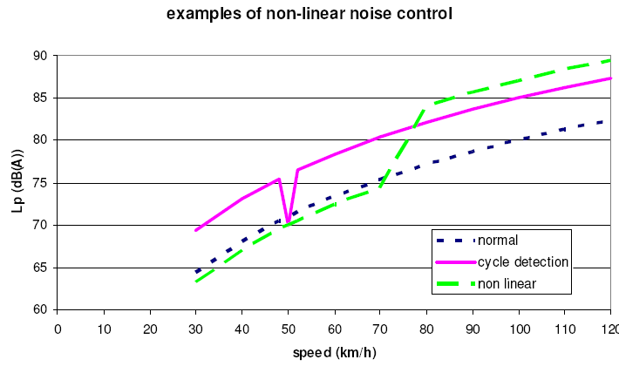
ASEP, Criteria given for the determination of the term “vehicle of concern”
Validation of normal or abnormal behaviour of the vehicle noise in a control range
Normal behaviour
Abnormal behaviour :
Evidence of test beating
and/or cycle detection
Abnormal behaviour :
Unexpected vehicle noise behaviour based on the individual vehicle’s technical capability.
Abnormal behaviour :
Noise emission higher
than absolute dB/r.p.m. slope

Slide 5
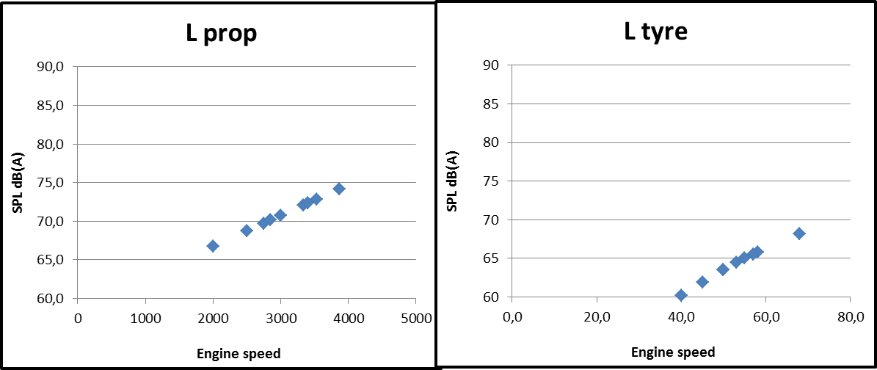
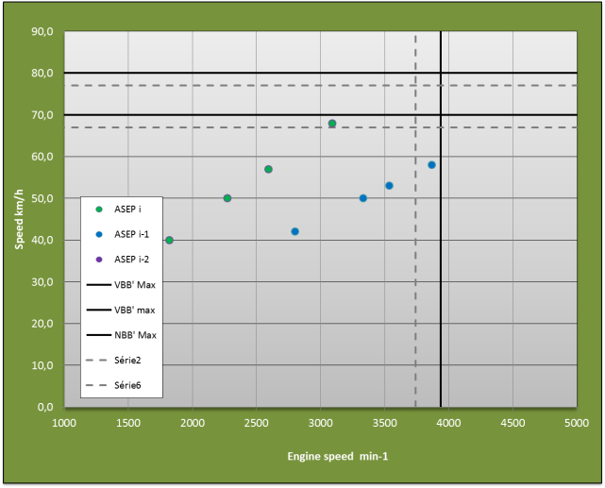
ASEP, Analysis
The basis vehicle used for simulation has the following characteristics :
The noise of the vehicle is described as the sum of the propulsion noise (Lprop) and the tyre noise ( Ltyre).
Vehicle dynamic is base on real vehicle.
Source contribution
Vehicle dynamic
ASEP point 1, 2, 3 and 4

Slide 6
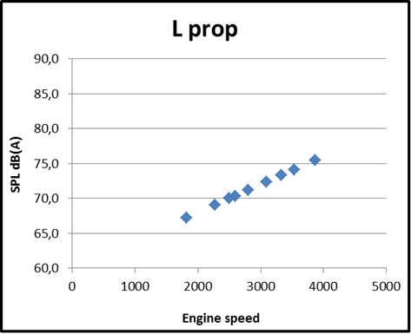
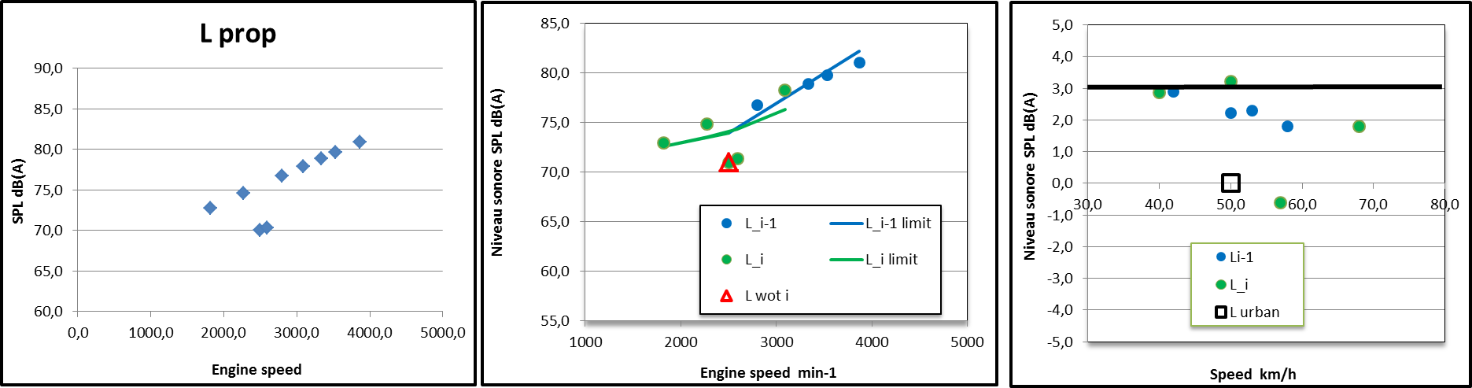
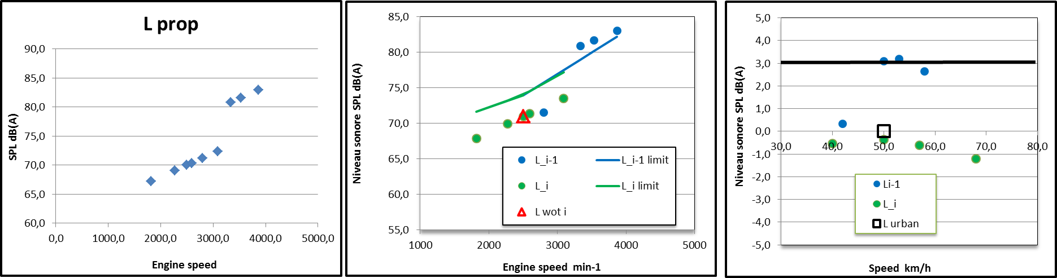
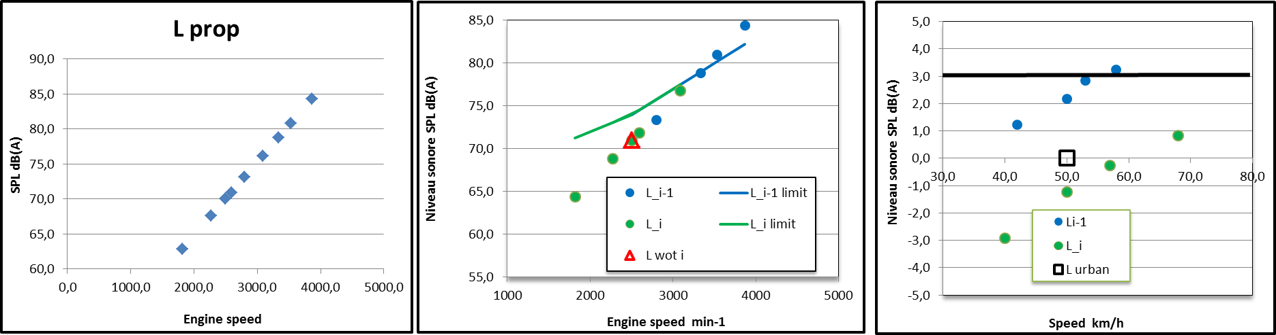
ASEP, Analysis
Normal behaviour is replaced by abnormal behaviour as following figures
Abnormal behaviour :
Unexpected vehicle noise behaviour based on the individual vehicle’s technical capability.
Abnormal behaviour :
Evidence of test beating
and/or cycle detection
Abnormal behaviour :
Noise emission higher
than absolute dB/r.p.m. slope
Normal behaviour
Assumptions :
Modification has no impact on anchor point and vehicle dynamic
Levels of engine abnormal noise are adjusted to provide non compliance to both Lurban and Slope methods

Slide 7
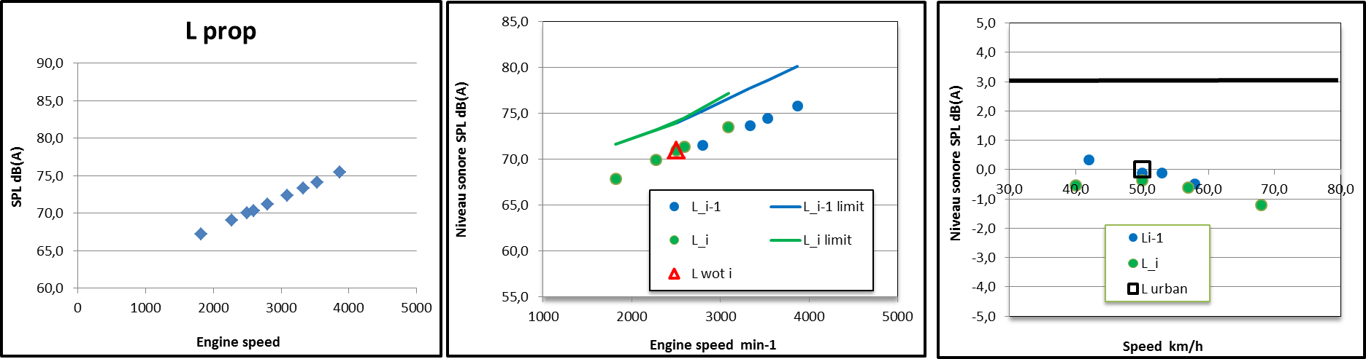
ASEP, Analysis
Evidence of test beating
and/or cycle detection.
Slope i = 4,4 dB/1000 rpm
Slope i-1 = 3,5 dB/1000 rpm
Slope = 4 dB/1000 rpm
Slope i = 3 dB/1000 rpm
Slope i-1 = 6,2 dB/1000 rpm
5,6 dB
5,5 dB

Slide 8
ASEP, Analysis
Unexpected vehicle noise behaviour based on the individual vehicle’s technical capability.
Slope i = 4,4 dB/1000 rpm
Slope i-1 = 3,5 dB/1000 rpm
Slope = 4 dB/1000 rpm
Slope i = 4,4dB/1000 rpm
Slope i-1 = 9,8 dB/1000 rpm
7,6 dB
7,5 dB

Slide 9
ASEP, Analysis
Noise emission higher
than absolute dB/r.p.m. slope
Slope i = 4,4 dB/1000 rpm
Slope i-1 = 3,5 dB/1000 rpm
Slope = 4 dB/1000 rpm
Slope i = 9,5 dB/1000 rpm
Slope i-1 = 9,7 dB/1000 rpm
Slope = 10,5 dB/1000 rpm
8,9 dB
8,9 dB

Slide 10
ASEP, Analysis
The linear and normal vehicle of the basic vehicle is doubtless with slopes lower than 5 dB / 1000min-1.
Current methods allow to detect the "abnormal" character of the sound emissions.
The slope-assesment’s method seems to be more sensitive than the L urban-assesment ‘s method.

Slide 11
Conclusions
Future method(s) shall allow to detect at least such "abnormal" character of the sound emissions :
  Evidence of test beating and/or cycle detection.
  Unexpected vehicle noise behaviour based on the individual vehicle’s technical capability.
  Noise emission higher than absolute dB/r.p.m. slope, with different approaches for determining a reference point.
However, although answering the concerns, sensitiveness and the limits of methods shall be considered

