Slide 1
HD ENGINE RAW PN MEASUREMENT
JRC, 15 MARCH, 2017
Hua Lu Karlsson

Slide 2
Background
PN should be measured via partial dilution or CVS system according to the current regulation
HD OEMs requested PMP program to evaluate direct PN measurement for HD application
Several OEMs have already measured raw PN emissions for development purpose for many years, experienced that the instrumentation and method are robust.

Slide 3
ACEA Round Robin Program PN measurement

Slide 4
Comparison between different PN measurement

Slide 5
Comparison between different PN measurement
APC at tailpipe with tailpipe kit at 150°C
APC at Smart Sampler (Qtot=1.35 g/s, r=0.05%)
Two hot WHTCs

Slide 6
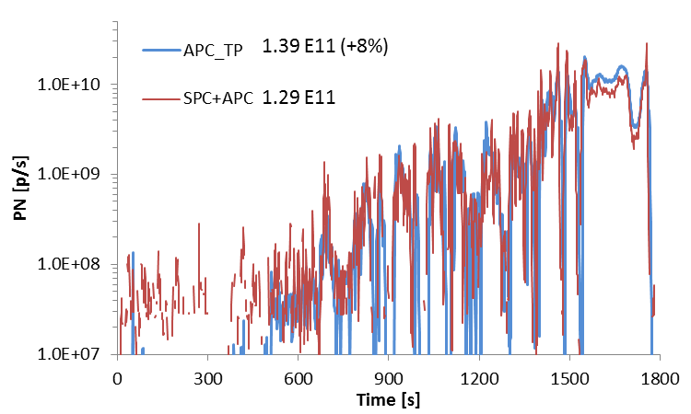
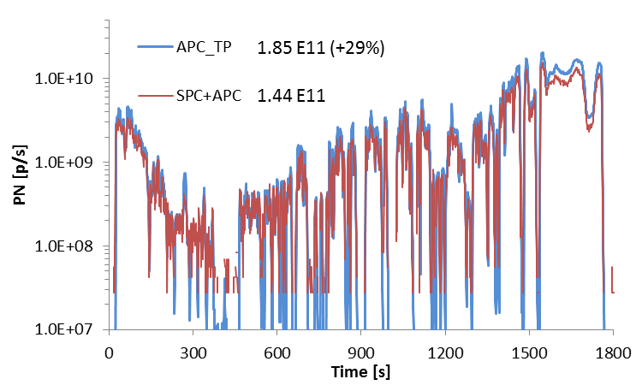
Texh start WHTC1=48°C
Texh start WHTC2=185°C
Differences 8-29% especially at the last part that need to be understood

Slide 7
Brief summary
The differences between diluted and raw PN measurements are similar to the data reported by JRC PEMS PN HD program. The differences are in similar magnitudes as the differences between CVS and particle flow PN sampling.
ACEA requests PMP program further investigates the differences between PN raw and PN diluted measurement and the feasibility to allow PN raw measurement for HD applications.

