Slide 1
43rd PMP-Meeting
Rosa Delgado
IDIADA
15/03/2017
15/03/2017

Slide 2
Contents
Scope of PEMs4Nano
Measurement system targets
Work package descriptions
Activities
Requirements & Assessment
Next steps

Slide 3
Scope of PEMs4Nano
We want to:
detect solid particles down to 10nm using CPC
develop robust and reliable measurement procedures based on empirical testing and model-guided application
so that:
new/cleaner engine technologies can be developed,
build a solid basis for new regulations.
Instruments:
Laboratory PN
PEMs PN
Robust and reliable measurement instruments
in order to ensure the definition of
measurement procedures down to 10 nm.
Consortium of leading experts
industry:
HORIBA, Bosch, TSI, IDIADA, CMCL
academia:
Univ. Cambridge
Univ. des Sciences et Technologie de Lille
expertise in:
measurement (procedures) and modelling
chemical/physical analysis of particles and particle formation
Timeline
October 2016 (kick-off) until September 2019 (final event).

Slide 4
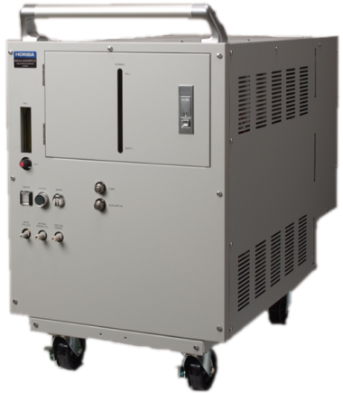
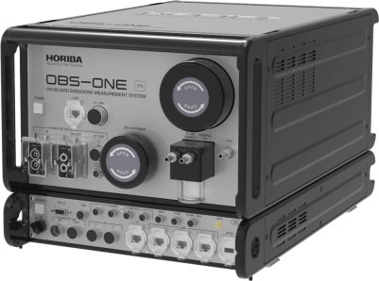
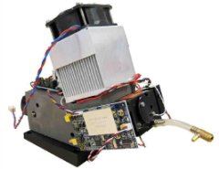
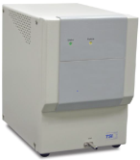
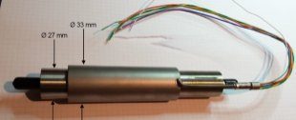
Measurement system targets
Development of measurement technology both for the lab and mobile applications
Particle loss optimization
Particle loss optimization
Model-guided application
Calibration procedures
Installation of a CPC with a D₅₀<10nm
Installation of a catalytic stripper and a CPC with a D₅₀<10nm
Robust & reliable testing at CVS, tailpipe and engine out
Correlation at CVS & tailpipe
Robust & reliable testing at CVS and tailpipe

Slide 5
Work Package descriptions 1
Work Package 1
starting block due to the interdisciplinary nature combining specialists from measurement technology, chemical engineering, internal combustion engines and software engineering
Work Package 2
(Measurement Technology) development of the measurement technology and the related calibration procedures (engine out, tailpipe, at the CVS) to support the understanding of particle characteristics and particle losses. Measurement results will be analyzed to provide data which can be used as an input for simulation work supporting a deeper understanding of the particles.
Work Package 3
(Measurement integration into system development) focuses on particle formation and dynamics, its impact on measurement technologies and procedures, and the integration of these into system development. A measurement procedure for application on an engine test bench is developed, physico-chemical model-guidance for particle characterization in engine or vehicle-in-the-loop configurations is provided.

Slide 6
Work Package descriptions 2
Work Package 4
Implementation of the calibration procedure. Definition of testing protocols. Testing activities according to regulations (NEDC, WLTC and future RDE) will be performed in two selected vehicles on the chassis dynamometer and/or real road. These tests will be used to validate the measurement procedure, and also to evaluate the robustness and verify the fulfillment of the behavior of the equipment.
Work Package 5
(Dissemination, communication and exploitation activities) aims to establish an appropriate and effective communication of the project results and to pave the way to exploitation of the project results.
Work Package 6
(Administrative, financial and contract management as well as Technical management) focuses on the efficient execution of the PEMs4Nano project, the maintenance of the consortium agreement and the protection of the Intellectual Property Rights of the consortium.

Slide 7
Activities
Since start
Website www.pems4nano.eu
Kick-off 18/19 Oct, Renningen DE
Executive board meetings Biweekly
WP1 kick-off 13 Dec, Cambridge UK
Current
PMP 42nd session 15/16 Mar, Ispra IT
Upcoming
General Assembly 28/29 Mar, Oberursel DE

Slide 8
Requirements & Assessment
Work-package 1 is a vital starting block for the project due to the strong interdisciplinary nature of the project combining specialists from measurement technology, chemical engineering, internal combustion engines and software engineering. Ambitious targets have been set that will be confirmed by all of the partners in the first step.
Establish specific requirements for each of the general working focus areas of the project team
Establish the criteria to be used in work-package 4 for assessing the impact of the project PEMs4Nano
Model Guided Application
Requirements Description
Measurement procedure and application
Requirements Description
Preparation of measurement and technology
Requirements Description

Slide 9
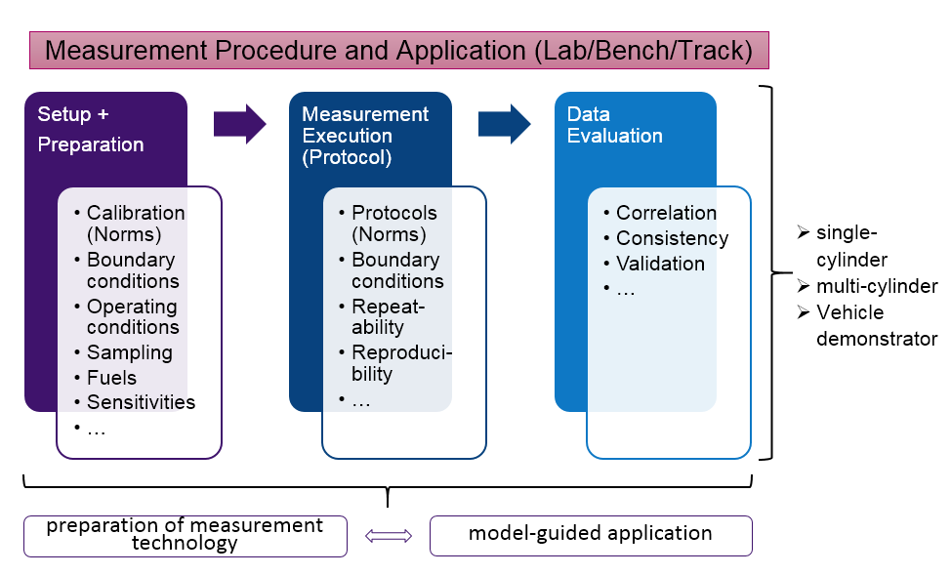
Requirements Approach

Slide 10
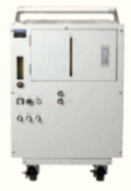
Assessment Criteria
Calibration
Lead time
Compatibility
Measurement
protocol
Sampling points
WLTC tests
Comparison among different measurement technologies
RDE tests
Robustness
Accuracy
Quality validation
New technology to measure:
PN 10nm
Precision (Repeatibility, Reproducibility)

Slide 11
Next Steps
Measurement technology
  Identify calibration procedure for 10nm CPC (late spring 2017)
  Integrate calibrated CPC into lab PN 10nm system (autumn 2017)
  Design system to minimize particle loss, optimize catalytic stripper (ongoing)
Catalytic stripper
  Redesign device so that for all semi-volatile organic compounds (by autumn 2017):
    (1) >99% is removed, (2) no downstream re-nucleation (saturation ratio = <1)
  Solid particle penetration (January 2018):
    (1) characterize penetration, (2) redesign stripper to maximize penetration
Simulation models (September 2017):
  Line-loss model needs extra data (in addition to particle number).
  Loss functions of PEMs system will be measured experimentally.
  Population balance model is extended to include inorganics.
Particle characterization at single cyl. engine
  Lab PN system: (1) identify operating points, (2) collect particle samples (start late spring 2017)
  Characterize chemical composition and morphology of particles (start late spring 2017)
  Characterize evolution of soot volume fraction along the tailpipe (start in summer 2017)
  Population balance model: inorganic particles implemented, to be extended (January 2018)

Slide 12


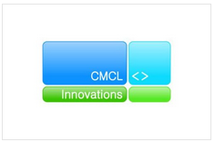






Acknowledgement:
This project has received funding from
the European Union’s Horizon 2020
research and innovation programme
under grant agreement No. 724145.

