Slide 1


HORIZON 2020
Call: H2020-GV-2016-2017
Technologies for low emission light duty powertrains
Action:
“Measuring automotive exhaust particles
down to 10 nanometres – DownToTen”
Project Overview
PMP Meeting March 2017

Slide 2












Project Partners
In collaboration with:
The University of California at Riverside,
National Traffic Safety and Environmental Lab (Japan)
and
National Metrology Institute (Japan)
PMP Meeting March 2017
2

Slide 3
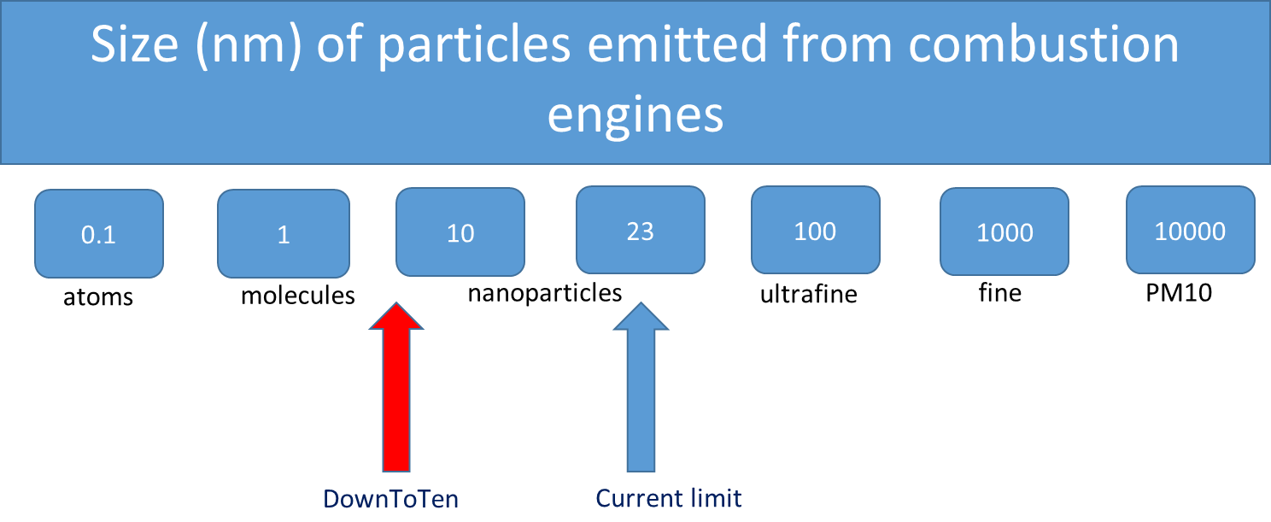
Aim of the project
To propose a robust approach for the measurement of particles from about 10 nm both for PMP and RDE, complementing and building upon regulation development activities and addressing topics not tackled so far
Objectives include development of both lab and PN-PEMS demonstrator equipment, optimised for the revised size range
PMP Meeting March 2017
3

Slide 4
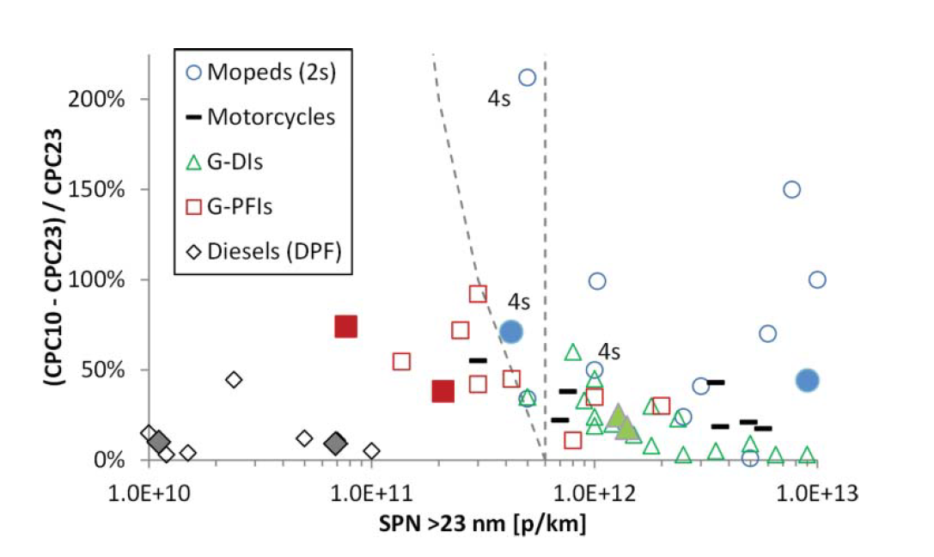
Why measure sub-23nm Particle Number?
<23nm particles detected on regulatory cycles; levels relatively low
Sub-23 nm fraction of solid particles
  estimated by differences between 10 nm & 23 nm CPCs
  Loss corrected (between x1.7 and x2)
Vertical dashed line
  6x10¹¹ p/km limit for particles >23 nm
  Other line indicates 6x10¹¹ p/km limit for particles >10 nm
All mopeds were 2-stroke unless otherwise specified in the figure
B. Giechaskiel, J. Vanhanen, M. Väkevä & G. Martini (2017): Investigation
of vehicle exhaust sub-23 nm particle emissions, Aerosol Science and Technology
PMP Meeting March 2017
4

Slide 5
Some interesting results: <23nm non-volatile PN from diesel fuel cuts and >23nm particles derived from urea-SCR
Driving events and ECT do produce <23nm particles: further investigation required
Light-duty (1.4L, 66kW) turbocharged diesel engine
Amanatidis et al. (2017) J Aerosol Sci
Amanatidis et al. (2014) ES&T
PMP Meeting March 2017
5

Slide 6
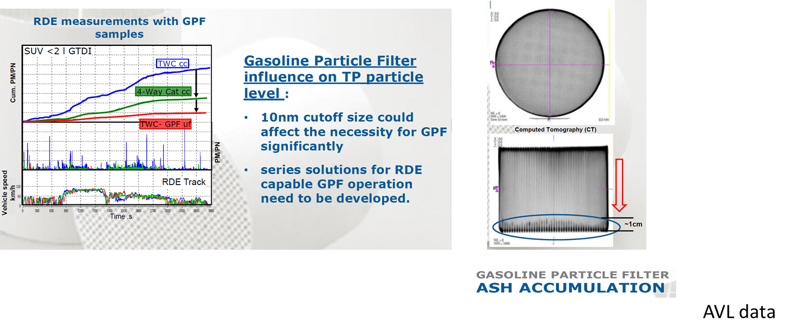
Data from GDIs
PMP Meeting March 2017
6

Slide 7
Questions to be answered within the new size range
What is the number fraction of exhaust particles below 23 nm?
What is the specific chemistry of the particles?
How to define the particle species: accumulation – nucleation mode, volatile – non-volatile, solid –liquid, Black Carbon – Elemental Carbon (BC-EC)
What fraction of exhaust particles corresponds to which species?
Which is the appropriate exhaust particle cut size?
How potentially un-regulated particles are linked to secondary aerosol formation
How to robustly correlate raw exhaust sampling suitable for both RDE engine development with dilution methods and sampling approaches employed during engine and vehicle type approval?
PMP Meeting March 2017
7

Slide 8
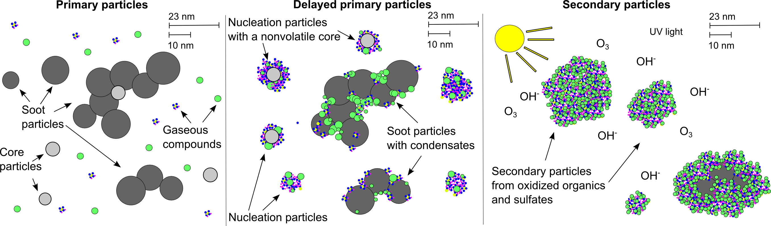
Exhaust emission related particle types
Manifold-out (ms) …
Tailpipe-out/dilution (s) …
Atmosphere (h)
PMP Meeting March 2017
8
Notes:
Time lag?

Slide 9
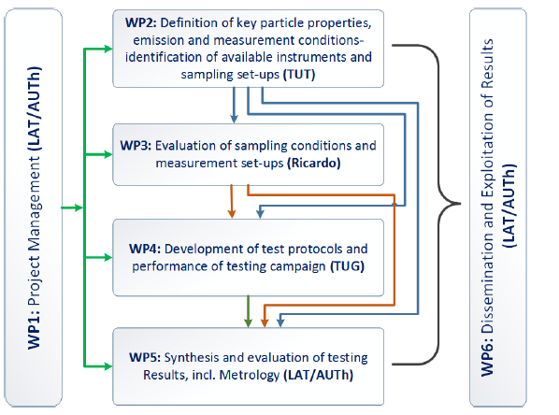
DownToTen structure and WP interaction
PMP Meeting March 2017
9

Slide 10
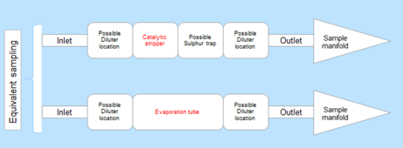
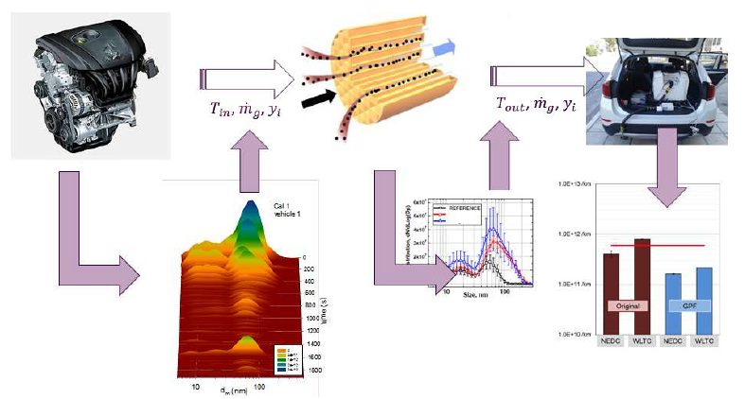
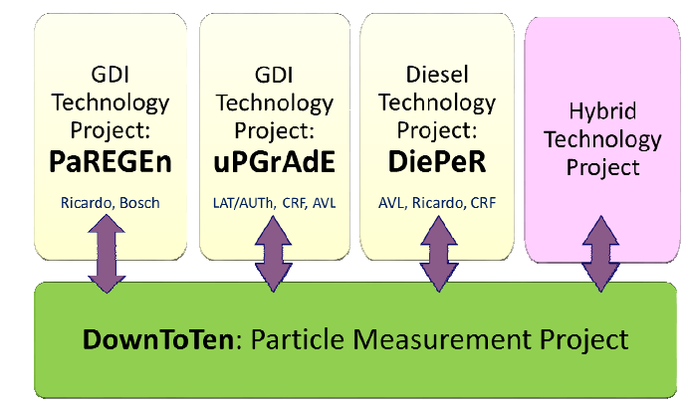
Concepts and approach
Equipment and sampling set-up (WP2 & WP3)
Modelling particle transformation (tailpipe-out to the inlet of the measurement equipment) (WP3)
Testing (emphasis on technologies that will be developed in the parallel projects (WP4)
Synthesis and evaluation of testing results, incl. metrology (WP5)
PMP Meeting March 2017
10

Slide 11
Vehicle class | Engines | Exhaust aftertreatment | Fuels | Cycles | Source of the test vehicles
Passenger cars | GDI & PFI | 3WC with and without GPF | Reference Petrol and biofuel admixtures | NEDC, WLTC, 3 RDE cycles; real PEMS trips | uPGrAdE, PaREGEn
 | SI-Hybrid | 3WC with and without GPF |  |  | A hybrid from GV-2-2016
 | Diesel | SCR and/ or NSC with DPF | Reference diesel and biofuel admixtures |  | DiePeR
 | CI-Hybrid | SCR/NSC with DPF |  |  | A hybrid from GV-2-2016
 | CNG | 3WC with and without GPF | Different qualities |  | GasON
HDV | Diesel | SCR and DPF | Reference diesel and biofuel admixtures | WHVC, standard CO2-vehicle test cycles; PEMS trips | To be decided
 | CNG | Not decided yet | Different qualities |  | To be decided
2-wheelers | >500ccm | 3WC | Reference Petrol and biofuel admixtures | WMTC, RDE cycles, PEMS test for >500ccm | Suggestions from the German programme
 | 50ccm | 3WC
AVL Research Networking Day 2017

Slide 12
Overview of key project results
WP | Exploitable knowledge | Exploitable product(s) or measure(s) | Sector(s) of application | Timetable for commercial use | Owner & other partners involved
WP2 | Proposal for system to generate laboratory-grade exhaust-type of aerosol | Device and method to generate aerosol (demonstrator in month 14) | Calibration institutes, users of aerosol instruments | 2020 | TUT, TUM
WP2 | Instrument benchmarking below 23 nm | Knowledge on instrument performance | Exhaust aerosol measurement labs | Not relevant | TUT, AVL, LAT/AUTh, RICARDO
WP3 | Understanding formation, properties and characteristics of PN <23 nm | PN <23 nm definition for regulatory purposes | Standardization and regulatory bodies | 2018 | Entire consortium
WP3 | PN <23 nm sampling configuration for laboratory testing and PEMS | Demonstrator (in month 17) | Exhaust aerosol measurement labs | 2020 | TUT, AVL, LAT/AUTh, RICARDO
WP3 | PN <23 nm measurement configuration | Instrumentation to be proposed | Exhaust aerosol measurement labs | Not relevant | Entire consortium
WP4 | DownToTen PN PEMS demonstrator unit | Device and Test protocol (demonstrator in month 22) | Exhaust aerosol measurement labs, regulatory authorities | 2020 | TUG, AVL, LAT/AUTh, RICARDO, TUT
WP4 | Evaluation procedures for RDE particle number | Software code and method (demonstrator in month 32) | Exhaust aerosol measurement labs, regulatory authorities | 2019 | TUG, AVL, LAT/AUTh, RICARDO, JRC
WP5 | Emission performance of late and forthcoming vehicle types | Emission factors to be used in models and estimates | Air quality research, policy making | 2019 | LAT/AUTH, TUG, TUT, TUM
WP5 | Calibration procedures for measuring PN<23 nm | Calibration test protocols | Standardization and regulatory bodies | 2020 | TUT, TUG, TUM, JRC
WP5 | Modelling of exhaust particle processes from emission to dilution | Simulation model | Researchers, manufacturers | 2021 | LAT/AUTH, TUT
Currently at Month 5

Slide 13
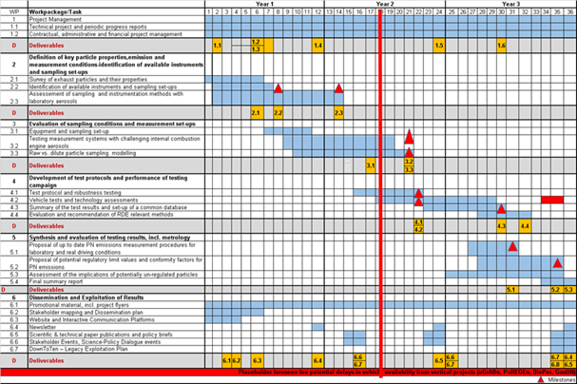
Planned progress per work task, including milestones and deliverables
Device and method to generate aerosol - November 2017
PN <23 nm sampling config. Feb. 2018
DownToTen PN PEMS
demonstrator unit - July 2018
Evaluation procedures for RDE PN May 2019
PMP Meeting March 2017
13

Slide 14
Progress in the first months of the project
PMP Meeting March 2017
14

Slide 15
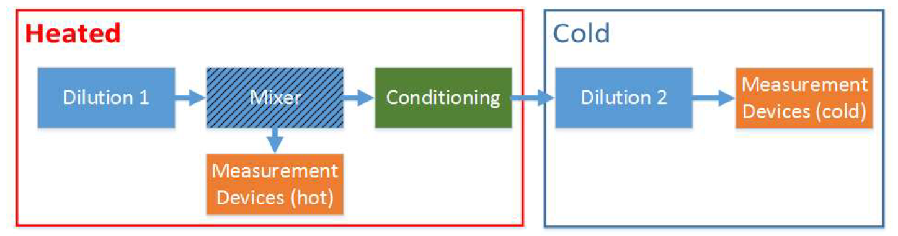
Sampling setup for testing in the synthetic aerosol laboratory
A setup was designed to maximize the penetration of non-volatile particles below 23 nm, while avoiding the creation of gaseous artefacts
Important factors like robustness against artefacts (re-nucleation, growth of sub-cut particles), losses of (solid) particles, storage/release effects of gas phase compounds are being assessed in detail
PMP Meeting March 2017
15

Slide 16
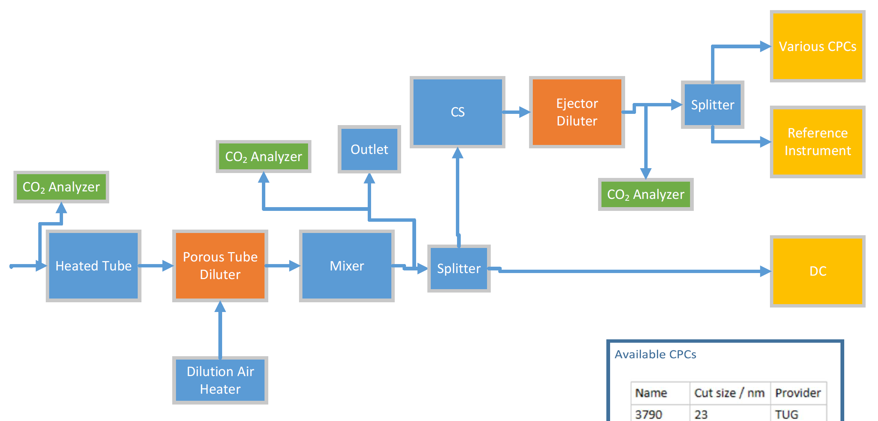
Sampling setup for testing in the synthetic aerosol laboratory
The selection of the setup’s components (primary and secondary dilution stage, conditioning system, mixing elements, measurement devices) are based on experimental and theoretical data
PMP Meeting March 2017
16
Notes:
PTD description required; WP3 AVL will look at the system after the pre-study and provide guidelines on manufacture for the partners. AVL will also look at diluter and losses and help robustness of design and ease of duplication.

Slide 17
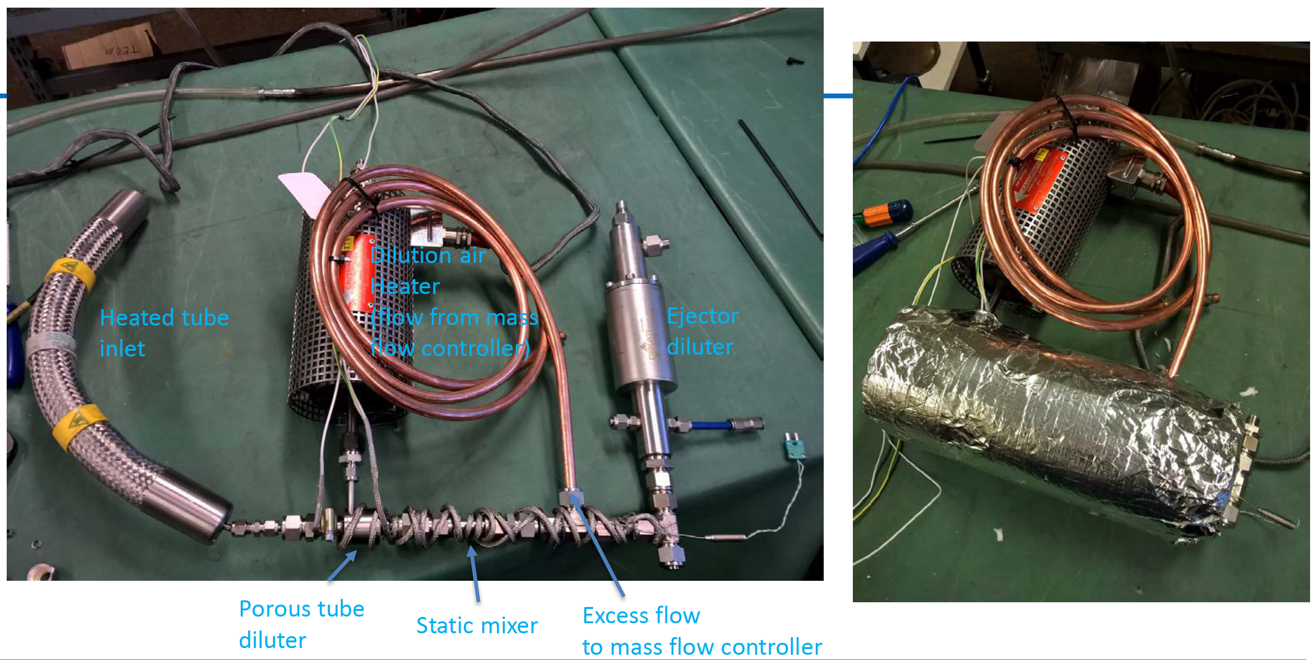
Preliminary sampling setup for testing in the synthetic aerosol laboratory
PMP Meeting March 2017
17

Slide 18
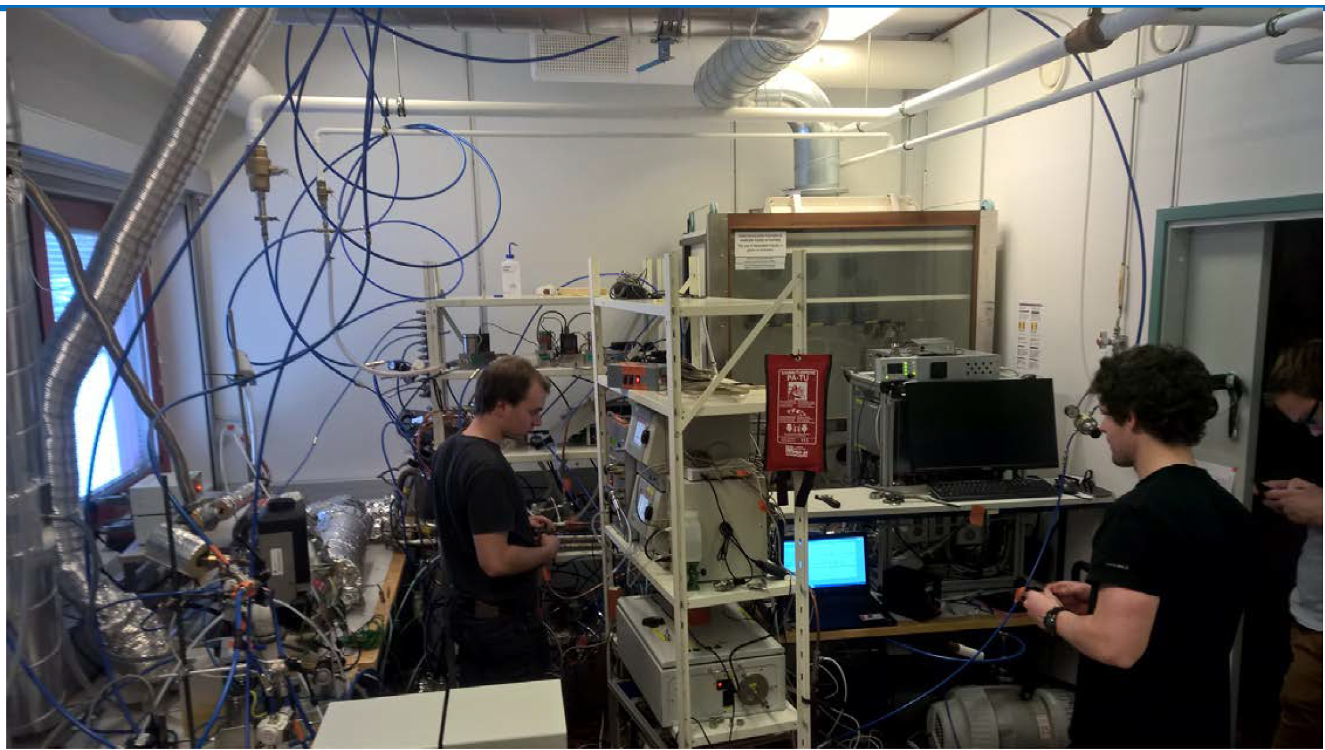
Testing in the synthetic aerosol laboratory
Tampere Technical University, February 2017
PMP Meeting March 2017
18

Slide 19
Raw vs Dilute Particle Sampling Modelling
AIM: To understand the relationship between the final quantification of raw-sampled “regulated particles” and dilute sampled one
To understand and quantify the effect of physicochemical processes during the transport of exhaust to the CVS tunnel
  Critical for fundamental understanding and determining influence of measurement approach on conformity factors
Overall approach would be to combine aerosol dynamics modeling with a CFD commercial code, similar to partner TUT work (Olin et al. 2015)
PMP Meeting March 2017
19

Slide 20
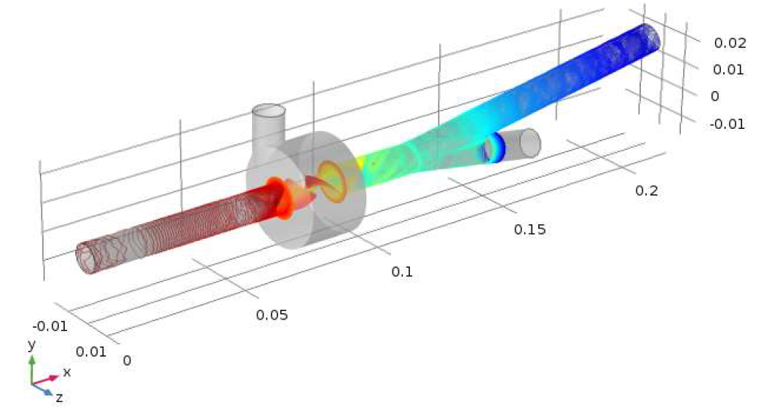
Basic CFD analysis of Porous Tube Dilutor
Critical components will be identified, in which to perform CFD. For example, flow and mixing unsteady 3D CFD simulations are performed for the PTD and mixer shown below by TU Graz.
Evaluate pressure fluctuation effects on dilution – no particle impacts assessed yet; work on-going
PMP Meeting March 2017
20

Slide 21
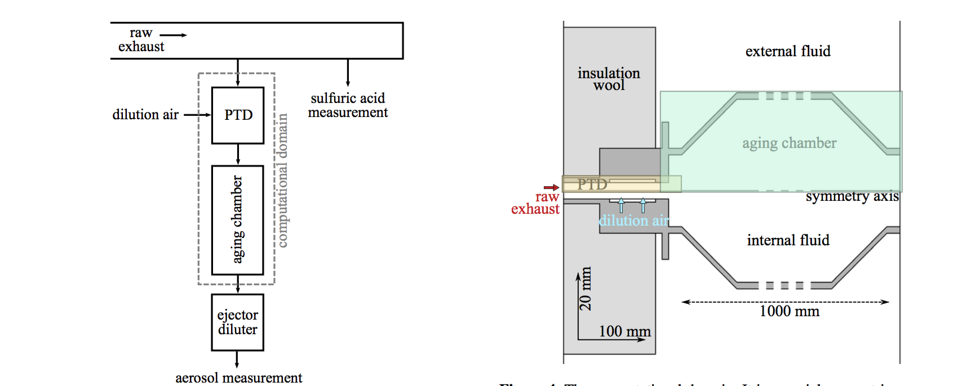
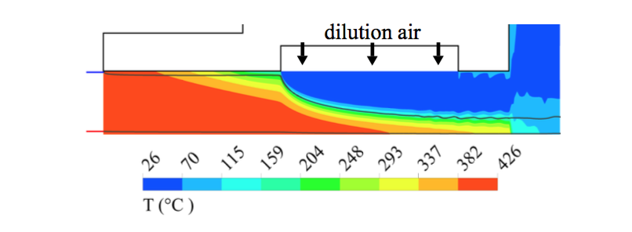
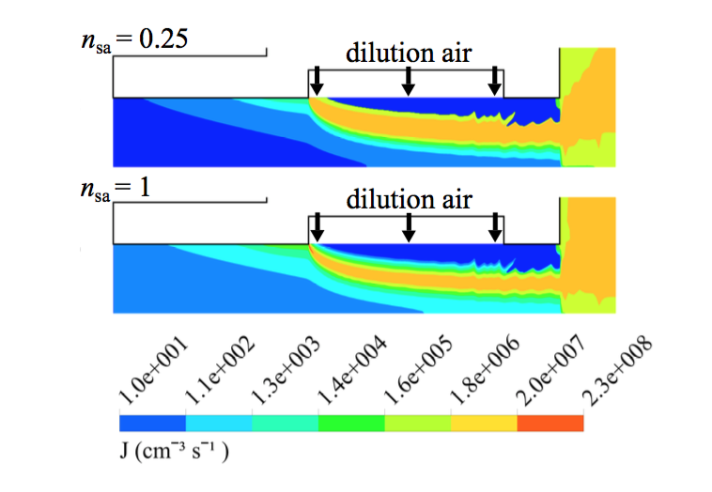
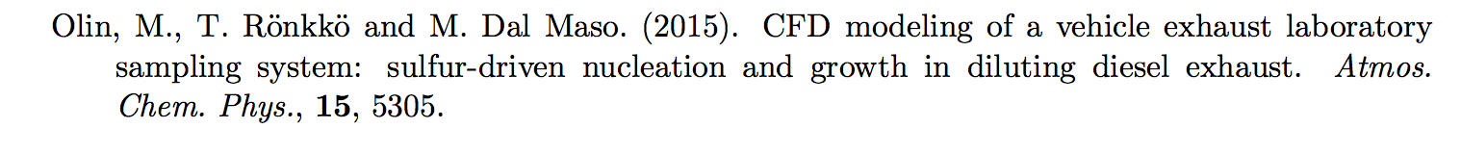
Modeling delayed primary: aerosol formation in the exhaust (CFD model)
Modelling of particle formation rates in exhaust requires determining the spatial profiles of temperature, humidity, vapours and particles.
In work by TUT, an in-house model CFD-TUTEAM, was developed and applied to a PTD dilution system with FLUENT.
PMP Meeting March 2017
21

Slide 22
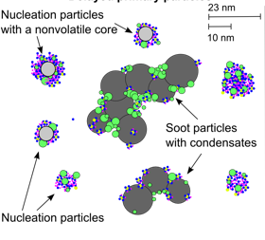
Any questions?

