Slide 1
43rd UNEC IWG PMP meeting
Ispra, 16th March 2017
LOWBRASYS Brake Emission Test Cycle
Speaker name: Marcel Mathissen¹
Team input: Jarek Grochowicz¹, Tomasz Grabiec¹, Ferdinand Farwick zum Hagen¹,
Vlastimil Matejka², Guido Perricone², Jens Wahlström³, Marcus Morbach⁴, Francesco Riccobono⁵
¹Ford, ²Brembo, ³KTH, ⁴Federal Mogul, ⁵JRC

Slide 2
Agenda
What is Lowbrasys?
Summary of Cycle Discussion in Lowbrasys.
How the current “Lowbrasys cycle” was derived.
Additional considerations
Summary & Outlook

Slide 3

LOWBRASYS: a LOW environment impact BRAke SYStem
GA 636592 - MG-3.1-2014: Technologies for low emission powertrains
10 members from 6 European countries
Total costs: 9.5 million €
Project Start: 01. September, 2015 (Project duration: 36 month)
www.lowbrasys.eu
Project goals:
1. | To demonstrate a novel and low environmental impact brake system that will reduce micro and nanoparticles emissions by at least 50%;
2. | To improve the measurement and understanding of micrometre-sized and ultrafine particles and their effects on health and the environment;
3. | Recommendations to policy makers.

Slide 4
Lowbrasys – Need for a test cycle
  Situation in Lowbrasys in 2016:
  Quick alignment on brake test cycle was needed to allow ranking of different solutions (pad/disc combinations) with regards to particle emissions.
  Considerations:
  Cycle needs to represent real-driving characteristics (decelerations, etc.)
  Cycle needs to be readily available.

Slide 5
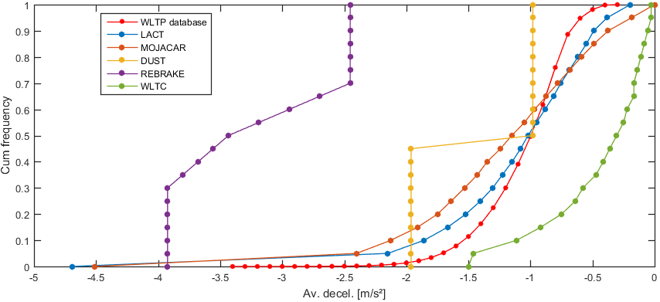
Lowbrasys – Cycle comparison
  Different cycles were analyzed and compared to the WLTP database (decelerations, brake durations, initial velocity, v x a_{neg},)
  No cycle matched all characteristics of the WLTP database.
  The Ford LACT procedure showed the most reasonable agreement with the WLTP database.
  It was agreed to adapt the Ford LACT procedure for further testing.
  Example: Decelerations

Slide 6
Ford -LACT
LACT Cycle overview, 3542 Stops
  Problem: Cycle is too long for particle measurements. How to select sub-cycle?

Slide 7
LACT Sub-cycle selection
Select sample from statistical population:
Option 1: select stops randomly
Option 2: select sequence of stops
Option 1 is most representative.
However, order of brake stops is important and gets lost with Option 1.
Option 2 was finally chosen.

Slide 8
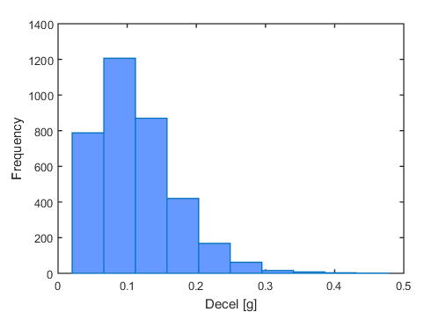
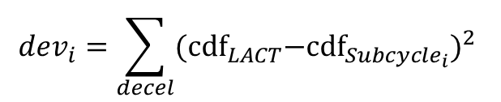
Sequence Sub-cycle - Algorithm
1. Start at stop 1. Add Stops until time restriction is met (e.g. 2h). Repeat for each remaining stop in LACT.
…
…
Sequence 1
Sequence 1480
Sequence 2500
2. Calculate probability distributions; cummulative distributions
3. Compare deviation between sub-cycle and full LACT based on „least squares“
$${dev}_{i}=\sum_{decel}{{{\text{(}\text{cdf}}_{LACT}−{\text{cdf}}_{{Subcycle}_{i}})}^{2} }$$
“Best Sub-cycle”= min(dev)
dev₁₄₈₀ << dev₂₅₀₀

Slide 9
Sequence Sub-cycle – Total deviation
Problem: Deceleration is not the only factor that should be met
Additional parameters needs to be preserved as well, e.g. Initial Velocity, Final velocity, Time between stops.
It is very likely, that a sub-cycle with minimum deviation for decelerations is not the best overall sub-cycle.
-> Define Total Deviation as sum of all deviations (normalized):
Deviation_{Total}= Dev_{decel} + Dev_{InitVel} + Dev_{FinalVel} + Dev_{TimeBetweenStops}
Best Sub-cycle= min(Deviation_{Total})

Slide 10
Sequence Subcycle – 2h duration
Best Sub-cycle:Deviation_{Total}=0.008
Worst Sub-cycle: Deviation_{Total}=0.027

Slide 11
Sequence Subcycle –duration influence
Total deviation decreases for increasing sub-cycle duration.
However, even for low durations a representative sub-cycle can be found.
More important:
Duration long enough for gravimetric PM mass estimation.
Meet time constraints for testing
Finally, a 3h sub-cycle of the LACT was chosen as comparison cycle within Lowbrasys.

Slide 12

Lowbrasys cycle – Run-in procedure
  Particle generation varies in magnitude during first runs of the procedure
  Proper run-in of friction couple is needed.
  No accelerated bedding cycle. Run-in is based on actual particle testing procedure to avoid unrepresentative wear behavior.
  Currently, 6 repetitions of the 3 h procedure are being performed for each disc/pad combination.
  Decay of particle generation is part of the investigation/assessment.

Slide 13
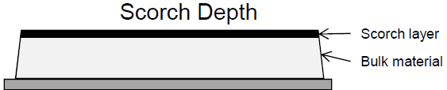
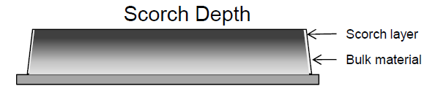
Lowbrasys cycle – Additional considerations
  Temperatures are expected to influence particle generation (especially particle number).
  Cooling behavior of brake dynamometer setups is very different.
    -> Tests are being performed temperature controlled (sliding thermocouple)
  Different scorching procedures for different pads (IR vs. Hot Plate).
  Particle generation from bulk material is from interest
  -> All pads are rectified, i.e. 2 mm of the pads are grinded/removed.
IR
Hot Plate
Federal Mogul

Slide 14
Summary
LOWBRASYS team needed a readily available, close to real-world brake cycle for comparing different hard solutions (disc/pad combinations).
The WLTP database was used as a reference database for normal driving conditions.
A sub-cycle of the Ford LACT procedure was chosen.
It was possible to reduce the original cycle length while keeping its characteristics (decelerations, initial Velocity, etc.)
The cycle duration is 3 h, with 6 repetitions, performed temperature controlled with grinded pads.

Slide 15
Outlook
Comparison study between results obtained from two different dyno setups is planned.
Experience with the procedure and potential flaws/pitfalls will be collected and summarized
Further on-going dissemination from Lowbrasys results to PMP group is intended
Final recommendation at the end of the project

