Slide 1
Informal Document - ACSF-12-04
Detecting Range to the Rear
by ACSF system of Category C
Korea Automobile Testing & Research Institute

Slide 2
A detecting range to the rear by ACSF Cat. C based on TTC
S rear(m) = (TTC ⅹ Vsd) + Smin
where :
TTC(sec) = time to collision
Vsd = Speed Difference = Vsmax - Vsmin
Vsmax = the maximum speed up to which an ACSF is designed to operate
Vsmin = the minimum speed down to which an ACSF is designed to operate
Smin(m)= The length of main view mirror(=device) ~ the trailing edge of
ACSF vehicle

Slide 3
A detecting range to the rear by ACSF Cat. C based on TTC
<Option A>
S rear(m) = (3.5 ⅹ Vsd) + Smin
<Option B>
S rear(m) = (2.5 ⅹ Vsd) + Smin

Slide 4
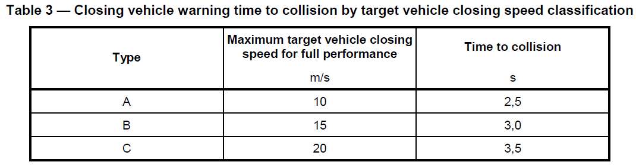
Factor background for the formula to the rear detecting(1)
S rear(m) = (TTC ⅹ Vsd) + Smin
where :
TTC(sec) = 3.5* or 2.5**
* TTC of the highest performance(Type C) of types by target vehicle closing speed
classification
** a half completed time of L.C as we are agreed(ACSF-11-03-Rev.2 para. 5.6.4.1.6),
whatever is lower
- M1, N1 : 5sec, M2, M3, N2, N2 : 10sec
[ ISO 17387 Lane change decision aid systems(LCDAS)-Performance Requirement and test procedures ]

Slide 5
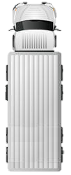
Factor background for the formula to the rear detecting(2)
Vsd(=Vsmax – Vsmin) : speed range specified by the vehicle manufacturer
of Cat. C. That is, the monitoring range should also be increased if operating speed range increases
Smin(m)= The length of main view mirror(=device) ~ the trailing edge of
ACSF vehicle*
TTC*Vsd
Smin
VUT

Slide 6

Calculation example
■ TTC = 3.5/2.5sec, Vsd = 70km/h(operating speed range)
☞ Condition
* In case of Germany, the recommended max. speed limit = 130km/h, the min. speed limit = 60km/h on highway
** if the length of Main view mirror ~ the trailing edge of ACSF vehicle : M1 = 3.2m(Chrysler
300c), N3 = 10.8m(Volvo FM cargo), Smin(m) = 3.2m(M1), 10.8m(N3)
130km/h(200km/h)
If TTC = 3.5sec, Srear = 71.3m(M1), Srear = 78.9m(N3)
If TTC = 2.5sec, Srear = 51.8m(M1), Srear = 59.4m(N3)
VUT
60km/h(130km/h)

Slide 7
Detecting Range(m) by Speed difference(operating range)
TTC 3.5(N3)
TTC 3.5(M1)
TTC 2.5(N3)
TTC 2.5(M1)

Slide 8
A detecting range to the rear by ACSF Cat. C based on TTC ?
Option A ? Option B ?

