Slide 1
Transmitted by the expert from GTB | GRE IWG “Simplification of the UN Lighting and Light-Signalling Regulations” (SLR) Document: SLR-15-01 Date: 2017-01-20
Application of the Unique Identifier (UI)
and the UN secure internet database in accordance with Schedule 5 of the 1958 Agreement - Revision 3
Input from IWG-DETA received 16 November 2016
and comment from 14th GRE-IWG-SLR meeting – 05 December 2016
Note: Input from IWG-DETA is based upon Informal Document No. GRE-76-24 Rev.1
(76th GRE, 25-28 October 2016 - agenda item 4)

Slide 2
Response from IWG-DETA - 16 November 2016
From: Guiting, Tim [mailto:TGuiting@rdw.nl]
Sent: 16 November 2016 12:54
To: 'GTB-Geoff Draper‘
Cc: 'Sven.Paeslack@kba.de'; 'Michel Loccufier'; 'Konstantin Glukhenkiy'; 'GTB Secretary - Davide Puglisi'; Rovers, Derwin; RYUZO OSHITA (ryuzo_oshita@mail.toyota.co.jp); 'Margarida.TELES-ROMAO@ec.europa.eu'
Subject: Info for GTB on DETA and Unique Identifier
Dear Geoff,
Herewith an update on last week’s DETA session:
First of all, at this moment we are very uncertain when DETA will become available or when it can deliver a Unique Identifier.
We discussed how to apply the UI, for example as a marking. Some of this could not be confirmed by the DETA meeting or by the subgroup 58 Agreement session. Especially we are not sure whether it shall be allowed to obligate the UI marking. The intention has always been that a manufacturer may choose to use the UI marking instead of the ECE markings. We will confirm this during next subgroup 58 Agreement session of 10 March 2017.
The report of the DETA meeting: https://www2.unece.org/wiki/download/attachments/40829198/DETA-28-02e%20rev1.doc?api=v2
The answers from IWG DETA and SG58 to the GTB understanding of the UI: https://www2.unece.org/wiki/download/attachments/35356721/GRE-76-24e_IWG%20DETA.pdf?api=v2
The first draft for guidelines on the application of the UI (will be further discussed and confirmed next session):
https://www2.unece.org/wiki/download/attachments/35356721/SG58-22-XX%20revised.docx?api=v2
Then about the third bullet point of page 3 of doc GRE-76-24 where it reads that CP’s have the freedom to choose to adopt, or not to adopt, particular devices within the UN lighting Regulation: This is not part on the DETA scope so we didn’t discuss it in detail but anyway comments had been received. There is real doubt whether this is a possibility within the 1958 Agreement. In the subgroup 58 Agreement we are already investigating other approaches. Last week we discussed OICA’s suggestion for an “attestation concept”. Several CP’s indicated being reluctant to accept such a concept. This is just for your information.
And finally about your proposal to incorporate the UI into R6:
(https://www2.unece.org/wiki/download/attachments/35356721/DETA-27-03e.pdf?api=v2).
Like mentioned we are not sure whether it shall be allowed to obligate the UI marking. This should maybe be introduced just as an alternative (especially until DETA is ready). Also we are not sure yet whether all UN Regulations should specify all details (e.g. definition) about the UI marking as this is already part of the 1958 Agreement Revision 3. We have to confirm this during the SG58 session on 10 March 2017.
(Other DETA docs: https://www2.unece.org/wiki/display/trans/DETA+27th+session).
Just let me know in case you have any more questions or remarks.
Met vriendelijke groet / Kind regards
Tim Guiting
Secretary DETA

Slide 3
Response from IWG-DETA - 16 November 2016
Text of Revision 3 of the 1958 Agreement - Schedule 5
Circulation of approval documentation
Where an approval authority is required to or is requested to provide a copy of an approval and its attachments, it shall send the documents as paper copies, or by e-mail in electronic format, or by utilizing the secure internet database established by the United Nations Economic Commission for Europe.
GTB Understanding | IWG-DETA Response
The UN secure internet database will be in operation by January 2019 and in time for the entry into force of the simplified Regulations | It can not be guaranteed when the internet database will be in operation nor if it will be in time for the entry into force of the simplified Regulations.

Slide 4
Response from IWG-DETA - 16 November 2016
Text of Revision 3 of the 1958 Agreement - Schedule 5
Circulation of approval documentation
Documents stored on the UN secure internet database shall consist of at least the documents specified in each UN Regulation. These shall include documentation communicating to Contracting Parties notice of approval, of extension, of refusal or withdrawal of approval or where production is definitely discontinued of a type of wheeled vehicles, equipment or parts pursuant to the UN Regulation.
GTB Understanding | IWG-DETA Response
All the documents specified in the new simplified regulations will be stored in the UN secure internet database. These will be the ”usual” documents that are currently required in the existing regulations. | There is no obligation to store documents on the internet database unless the UN Regulation stipulates otherwise. If the documents are stored it must be the 'usual' documents.

Slide 5
Response from IWG-DETA - 16 November 2016
Text of Revision 3 of the 1958 Agreement - Schedule 5
Circulation of approval documentation
If the type approvals applicable to a wheeled vehicles, equipment or parts are stored on the secure internet database, then the approval markings required by UN Regulations may be replaced by a Unique Identifier (UI) preceded by the symbol UI, unless specified otherwise in the UN Regulations. Such unique identifier shall be generated by the database automatically.
GTB Understanding | IWG-DETA Response
GRE can decide that the Unique Identifier shall be used in place of the normal approval markings | IWG-DETA and SG-58: the UI may be used as an alternative and there is no obligation to use the UI. During next SG-58 session (10/03/17) it will be confirmed whether it is allowed for a UN Regulation to obligate the UI marking.
The Unique Identifier will give access to the “usual” documents and it will only change for the same reasons that a new approval marking would be required, i.e. an extension to an approval would not trigger a change to the Unique Identifier. | access: yes, to the 'usual' documents (depending on the access rights); change: depends, see Annex I to the draft guidelines (SG58-22-XX revised).

Slide 6
Response from IWG-DETA - 16 November 2016
Text of Revision 3 of the 1958 Agreement - Schedule 5
Circulation of approval documentation
All Contracting Parties applying a UN Regulation shall have access to the information for that UN Regulation contained in the database by using the Unique Identifier and this will provide access to the relevant information relating to the specific approvals
GTB Understanding | IWG-DETA Response
Access rights will be defined for certain other users of the UN secure internet database in addition to the Contracting Parties. | the access rights are under discussion. It is considered to give (limited) access also to 'other users'. E.g. information on the approval numbers as part of a UI may be made public. (No final decisions are made yet).

Slide 7
Response from IWG-DETA - 16 November 2016
Text of Revision 3 of the 1958 Agreement - Schedule 5
Circulation of approval documentation
UN Regulations annexed to the 1958 Agreement may require the circulation of type approvals by electronic copies utilizing the secure internet database, where necessary for the efficient operation of the approval process, subject to the access rights as defined by the Contracting Parties.
GTB Understanding | IWG-DETA Response
As the secure internet database will be necessary for the efficient operation of the Simplified Regulations GRE can decide that the Unique Identifier shall be used in place of the normal approval markings. It is necessary to verify the GTB understanding of the operation of Schedule 5 in the context of the Regulations for which GRE is responsible | IWG-DETA and SG-58: see 3a.

Slide 8
Text of ECE/TRANS/WP.29/2017/53 – PAGE 12
VIII. Circulation of type-approval documentation, use of the secure internet database and use of a Unique Identifier
50. When drafting a new UN Regulation or an amendment of a UN Regulation, the subsidiary bodies of WP.29 shall bear in mind the general principle that the distribution of type-approval documentation can be performed by using the secure internet database established by UNECE and that, in principle, the approval marking may be replaced by a Unique Identifier, generated by that database application. The subsidiary bodies shall make a reference to Schedule 5 of Revision 3 of the 1958 Agreement and may specify:
(a) that the circulation of type-approval documentation has to be performed by using the secure internet database and / or
(b) that the approval marking may not be replaced by a Unique Identifier.
51. In the absence of such specification, and where the approval documentation is stored on the secure internet database, the approval markings required by UN Regulations may be replaced by the Unique Identifier.

Slide 9
GRE IWG-SLR Comments
Although the IWG-SLR strongly preferred to mandate the use of the UI instead of the conventional type approval markings in the three new simplified lighting and light-signalling regulations it remains unclear whether the approval markings can be replaced by the Unique Identifier.
According to text of ECE/TRANS/WP.29/2017/53 – PAGE 12 (see page 8 of this document), a subsidiary body (GRE in this case) can specify that the circulation of type-approval documentation has to be performed by using the secure internet database BUT the approval marking may not be replaced by a Unique Identifier. However in the first part of paragraph 50 it states that “in principle, the approval marking may be replaced by a Unique Identifier”
We remain concerned over the complications of maintaining the requirements for the conventional type approval markings in the new regulations that incorporate a multitude of devices having differing levels of amendment. However, we have found a way to draft these new regulations to continue to require the conventional approach to type approval marking without the need for the database and the UI.
We have also concluded that we should “future proof” these new regulations by introducing the use of the UI for when it may become operational.

Slide 10
GRE IWG-SLR Comments
It seems that our original understanding that the use of the UI could be mandated at the recommendation of one of the WP29 subsidiary parties (e.g. GRE for Lighting and Signalling) was not correct.
This means that the original objective of being able to replace the currently type approval markings with the UI will not be realised and the problem of accommodating all the homologation makings for lighting and signalling devices will not be resolved.

Slide 11
GRE IWG-SLR Comments
Whilst we have concluded that it is necessary to follow a pragmatic approach, as outlined above, the original requirement to simplify the markings remains due to the growing complexity of the markings.
Please refer to the following examples

Slide 12
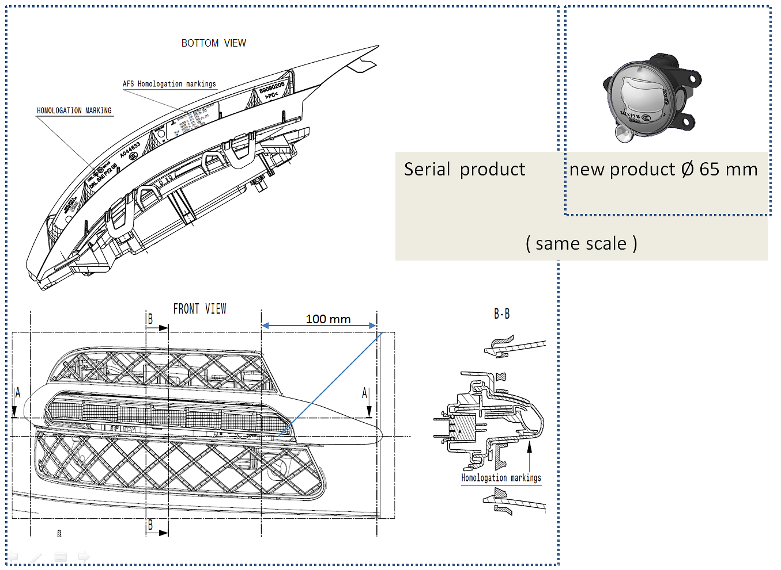
GRE IWG-SLR Comments
This headlamp is part of an AFS system and is required to carry all these AFS markings. In this example the only place to accommodate all the markings is under the bottom edge of the lens (markings visible when installed on the vehicle).
If this new device is installed as a part of the AFS system it is also required to carry all the AFS markings as shown on the left. In this case the only possibility is to position the approval markings on the front optical surface with the risk of detracting from the optical performance.
Example of the marking problem

Slide 13
GRE IWG-SLR Comments
Example of the marking problem
Disturbance of the optical surfaces and resulting photometric performance is unavoidable
Note: Both devices and AFS approval marking are shown at the same scale

Slide 14
GRE IWG-SLR Comments
Issues to be addressed
The text of ECE/TRANS/WP.29/2017/53 – PAGE 12 (see page 8 of this document) is unclear regarding the question of mandating the use of the UI as a replacement for the approval markings.
Despite all the discussions in the DETA group the original motivation to simplify the type approval markings remains (See TRANS-WP29-GRE-2004-24e). It should also be noted as technology has become more complex and lighting and signalling devices have become smaller the problem of physically accommodating all the markings has become more demanding.
The requirements of the enforcement authorities regarding markings and their accessibility should be reviewed and clarified.
What is meant by the requirement for markings to be indelible? Would a modern permanent adhesive label be acceptable as an alternative to engraving tools or laser etching products?
The “ideal” solution would be to remove all type approval markings and replace them with the secure electronic database with controlled access rights via the use of the Unique Identifier.
Could enforcement authorities have access rights to the electronic database through the UI? If so would the GTB proposal (DETA-25-09e) form the basis for a suitable approach to realise simplification of markings whilst still providing the necessary information for enforcement?

