Slide 1
Submitted by the expert of France and the Secretary
Informal Document - ACSF-13-01
13th meeting
Informal Working Group ACSF
in Paris (F)
12. – 14. June 2017

Slide 2
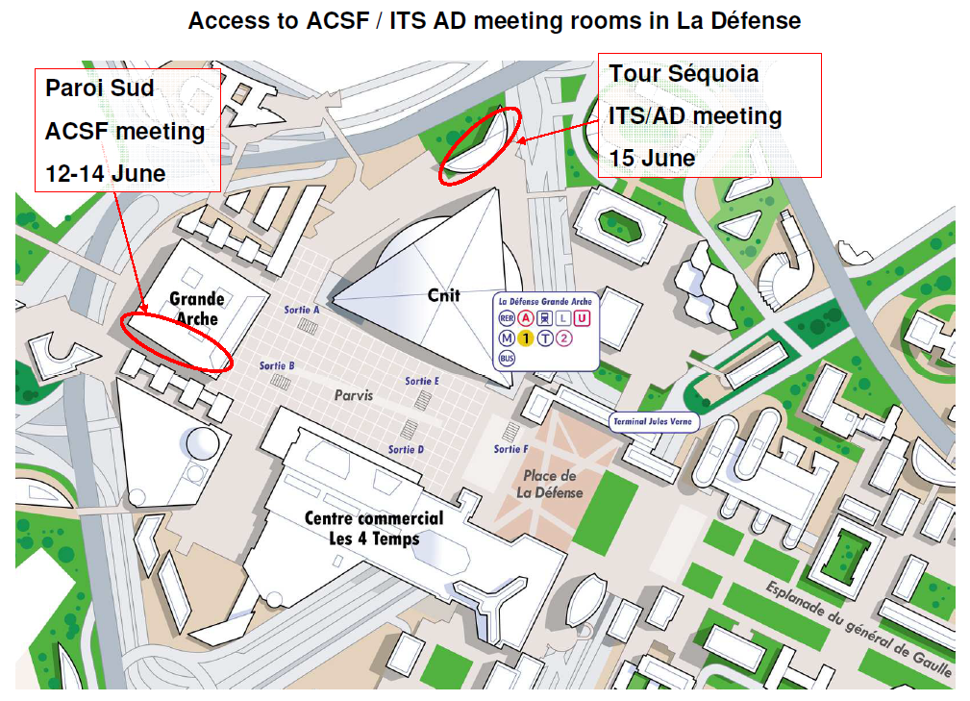

Slide 3
Access to ACSF meeting rooms in La Défense
To La Grande Arche, Paroi sud, room Passy 03S30, ACSF meeting :
From the RER or metro station, take exit A or B dome and 2 escalators take
you outside on the forecourt of La Défense.
You are facing the Grande Arche.
The reception is at the top of the monumental staircase, on your left.
Access to the Grande Arche possible for Persons with Disabilities is done
under the Arche (access exit A), a panoramic lift or escalators will take you
to the reception level.

