Slide 1
Submitted by the experts of OICA and CLEPA
Informal Document: ACSF-13-15
ACSF CAT C1
Sensor performance requirements and testing

Slide 2
Facts:
The technology to promptly detect that the specified range of a single (e.g. radar) sensor can been met is not available
Motorbikes have an extreme variation in the reflection behavior of a radar beam

Slide 3
Proposal:
Test the sensor range at Type Approval under „good“ conditions (no ageing- and environmental impact)
Release the CAT C1 system only if the system has positively tested the sensor range at ignition/system on

Slide 4
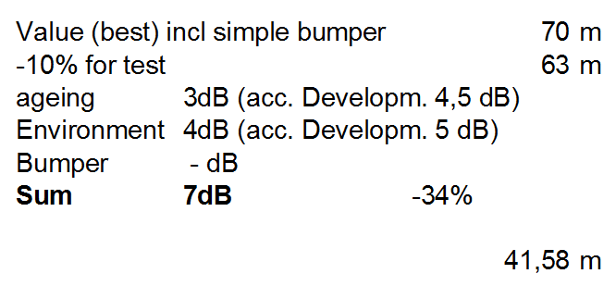
Sensor range
Discussion in Amsterdam
(proposal for L3 test vehicles)
Not concluded!

Slide 5
Sensor range
Proposal: System activation
Basis: 41m
Asumption: Difference in detection range
L3 vs. M1 is 15%
Sensor range for system „release“:
41m + 15% = 48m
C1-system can be activated if an object (e.g. M1 vehicle) is detected in a sensor range of > 48m

Slide 6
Sensor range
Proposal: Type Approval
Basis: 63m, but for M1 vehicles!
Asumption: Difference in detection range
L3 vs. M1 is 15%
Calculated Sensor range for L3 vehicle:
63m - 15% = 54m
C1-system can be approved, if an object (e.g. M1 vehicle) is detected in a sensor range of > 63m

Slide 7
Conclusion:
Due to big differences in the radar reflection of motorbikes, industry proposes:
To approve the C1 system if, at the time of Type Approval, an object (e.g. M1 vehicle) is detected in a distance > 63m
To release the system function of C1, once per ignition cycle, if an object (e.g. M1 vehicle) is detected in a distance > 48m

