Slide 1
FIA MOBILITY & TOURISM
Gerd Preuss,
FIA Representative at
UNECE, WP 29
FIA Definitions on
Data Protection and Authorisation
ITS-AD Task Force CS and OTA
2017-05-10
Submitted by FIA Document No. TFCS-05-11

Slide 2
FIA Definitions on
Data Protection and Authorisation
Summary
FIA Definitions on Data Protection and Data Privacy
FIA Definitions for Authorisation
Cyber Security in Vehicles

Slide 3
FIA Definitions on
Data Protection and Authorisation
Summary
FIA proposes definitions for data protection and authorisation
Using defined terms eases the common understanding and ensures transparency for all stakeholders.
We use UNECE definitions or adapted definitions from standards or the internet (Wikipedia)
FIA amends its definitions by justifications
Our justifications are based on consumer principles that derive from 12.000 customer polls in european countries
Cyber Security in Vehicles
Cyber security is a prerequisite for automated vehicles. Cyber security must not be misused for the purpose of a single stakeholder. The vehicle owner/driver must be able to decide, with whom he shares or does not share his vehicle related data and from who he obtains data related services

Slide 4



FIA Definitions on
Data Protection and Authorisation
Basic Principles for Data Protection
Transparency
Vehicle owners and/or operators are entitled to know what data is collected, transmitted, stored and received in their vehicles
Data minimization and earmarking
The principles of data minimization and earmarking data for specific uses should be mandatory requirements in the development of the applications
Freedom of Choice
The vehicle owner/driver must be able to decide, with whom he shares or does not share his vehicle related data and from who he obtains data related services

Slide 5
FIA Definitions on
Data Protection and Authorisation
Definitions for Data Protection
Definition | Justification
"Data Protection" means a natural person’s right to respect for his or her private and family life, home and communications with regard to the processing of personal data. All in-vehicle-data combined with VIN are personalized data | FIA supports the definition of ITS-AD that was presented in the march 2017 session of WP 29 Source: ECE/TRANS/WP.29/2017/46- (Informal Working Group on Intelligent Transport Systems / Automated Driving) Proposal for draft guidelines on cyber security and data protection

Slide 6
FIA Definitions on
Data Protection and Authorisation
Definitions for Data Subject
Definition | Justification
"Data Subject" means an individual who is the subject of personal data (e.g. vehicle owners or drivers). | FIA sees the right to use, to deliver, to receive vehicle data in the hands of the vehicle owner/driver. The rights of the “data subject” should also include the right to stop any data transfer from/to the vehicle, unless those functions that are legally mandated, e.g. eCall. Source: ECE/TRANS/WP.29/2017/46- (Informal Working Group on Intelligent Transport Systems / Automated Driving) Proposal for draft guidelines on cyber security and data protection

Slide 7
FIA Definitions on
Data Protection and Authorisation
Definitions for Data Privacy and Data Breach
Definition | Justification
“Data privacy” means ensuring protection against data breach. “Data breach” means a breach of security leading to the accidental or unlawful destruction, loss, alteration, unauthorised disclosure of, or access to, personal data transmitted, stored or otherwise processed. | The term ‘Data privacy’ is not defined in ECE/TRANS/WP.29/2017/46 The definition of ‘data breach’ is laid down in Article 4(12) of Regulation (EU) 2016/679 (referred to as the GDPR)

Slide 8
FIA Definitions on
Data Protection and Authorisation
Definitions for Data Protection by Default and Data Protection by Design
Definition | Justification
"Data Protection by Default" means a controller’s obligation to implement technical and organizational measures, which ensure that, by default, only personal data which are necessary for each specific purpose of the processing are processed. "Data Protection by Design" means a controller’s obligation to implement technical and organizational measures appropriate to the controller’s processing activity which are designed to implement data protection principles with the aim of protecting the rights of data subjects by reducing the likelihood and severity of the risk to his or her private and family life, home and communications. | Data Protection by Default and Data Protection by Design are basic requirements to ensure transparency and security. Any vehicle data in combination with VIN and/or personal data are personalized data and they have to be encrypted with the measures defined under “Data Protection by Design” and “Data Protection by Default”

Slide 9
FIA Definitions on
Data Protection and Authorisation
Definitions for Authorised Access (1/4)
Definition | Justification
“Authorised Access” means to access in-vehicle-data with approval and to use such access to read in-vehicle-data, information and functions or to alter software. The authorised access is either legally mandated or accepted by business-to-business contracts. The authorisation ensures that only the granted levels of data, information, functions or software are accessible. | From technical point of view, an access is authorised or not. We prefer therefore to define authorised access, only. Authorised User Groups are either legally mandated oder accepted by B2B contracts. The access can be limited by time, according to the contracts. In principle, the vehicle owner can select / unselect any authorised service provider(s).

Slide 10
FIA Definitions on
Data Protection and Authorisation
Definitions for Authorised Access (2/4)
Definition | Justification
“Authorised Access” …. | The level of access to in-vehicle-data and functions is differentiated between “Reading” and “Writing” Furthermore there are three categories of data and functions (A, B and C) A) All data and functions that are necessary for the operation of the vehicle (Highest IT - Security) B) Theft relevant data and functions, e.g. Anti-Theft Systems or Keyless Entry (High IT-Security)

Slide 11
FIA Definitions on
Data Protection and Authorisation
Definitions for Authorised Access (3/4)
Definition | Justification
“Authorised Access” …. | C) Comfort related data and functions e.g. radio stations or messenger services that do not influence the operation of the vehicle or provoke the distraction of the driver (low IT Security) The european legislation grants the authorisation to in-vehicle-data e.g. for workshops, repairers or automobile clubs. The european legislation grants also the access to eCall data for public service answering points. Furthermore, an authorised access can be granted by B2B contracts between vehicle manufacturers and 3rd party service providers, like insurance companies or IT service providers.

Slide 12
FIA Definitions on
Data Protection and Authorisation
Definitions for Authorised Access (4/4)
Definition | Justification
“Authorised Access” … | While “reading data” is possible in all driving conditions, the “writing” of data should be limited to stationary vehicles. Any vehicle data in combination with VIN and/or personal data are personalized data and they have to be encrypted with the measures defined under “Data Protection by Design” and “Data Protection by Default”

Slide 13
FIA Definitions on
Data Protection and Authorisation
Definition for Authentication
Definition | Justification
“Authentication” is the act of confirming the truth of an identification. | Authentication is the process of actually confirming an authorised identity. It might involve confirming the identity of a person by validating their identity documents or verifying the authenticity of a website with a digital certificate. Authentication involves verifying the validity of at least one form of identification. Adapted from https://en.wikipedia.org/wiki/Authentication

Slide 14
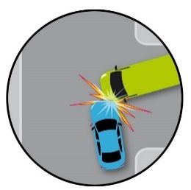
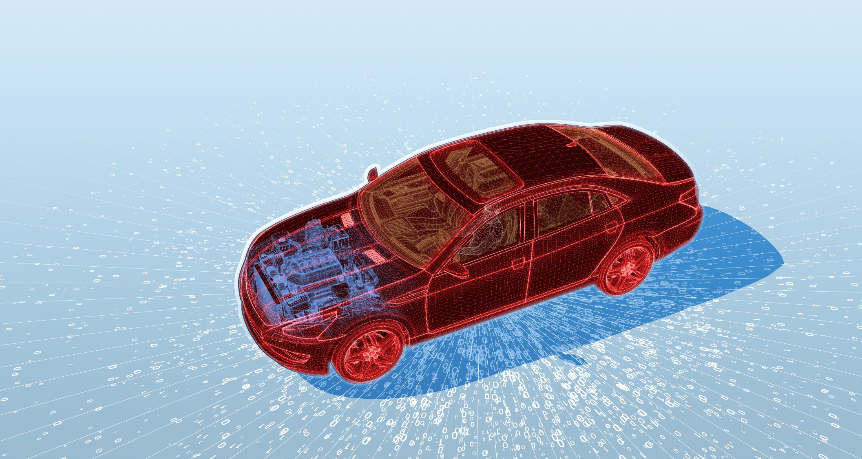
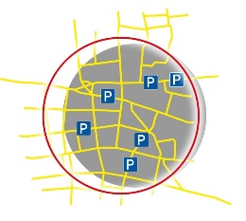

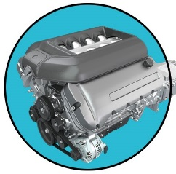



FIA Definitions on
Data Protection and Authorisation
Cyber Security in Vehicles
OVERVIEW
OTA
V2I
OTA
V2V
OTA
Music
Radio
In-Vehicle-Network
+ Over The Air (OTA)
OTA
RDS
Prognostics
OTA
Keyless Entry

Slide 15
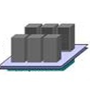





FIA Definitions on
Data Protection and Authorisation
Cyber Security in Vehicles
A-GW
Admin
Insurance
OEM
ITS
3rd
DIC
RCDLR
Radio
IPC
HVAC
A-GW
TDM
ECM
TCM
SDM
EBCM
Driver Domain
Safety Domain
Security Module

Slide 16
FIA Definitions on
Data Protection and Authorisation
Cyber Security in Vehicles
Cyber security starts with the technical design of a vehicle
Type approval authorities must be able to check the security of a new vehicle against a protection profile
During the lifetime of the vehicle, PTI stations must check, if the proper software is installed
Event based measures must close loopholes, once uncovered
End of support must be defined

Slide 17
FIA Definitions on
Data Protection and Authorisation
Cyber Security in Vehicles
A general risk analysis e.g. failure mode and effects analysis (FMEA) including all risks inherent to end-to-end connections such as backend or car-to-X, third party interfaces such as telephone, smartphone, OBD or radio should be performed (1)
Technology neutrality is a general requirement of technical regulations (2)
Verifiability / certifiability of type approval (3)
e.g. White box-principle: software screening by third parties based on internationally recognised protocols
Stage 1: general risk analysis
Stage 2: actually installed technical systems

Slide 18
FIA Definitions on
Data Protection and Authorisation
Cyber Security in Vehicles
During the vehicle life time
Manufacturers are responsible for “approved software” in the vehicle
During mandatory vehicle inspections the use of such “approved software” should be checked e.g. PTI (4).
Proactive verification of certificate validity (state of the art) by third parties e.g. through reassessment as to whether or not un-changed products still meet the certification target in view of old and new attacks. This would be equivalent to repeated type approval for security aspects and could be implemented through market / field studies or simply according to a fixed schedule by third parties (5)
Manufacturers are required to close security loopholes on an ongoing basis.
Define change management as IT standard/process (6)

Slide 19
FIA Definitions on
Data Protection and Authorisation
Cyber Security in Vehicles
Scheduled updates by manufacturers
Amended rules of the road, map updates for navigation devices (7)
Phased out manufacturer support
Car manufacturers provide no more updates; this only affects assistance systems such as ACC (8)
While points 1, 2, 3, 4, 7 and 8 can be scheduled, points 5 and 6 are event-based and only occur after manipulation was uncovered

Slide 20

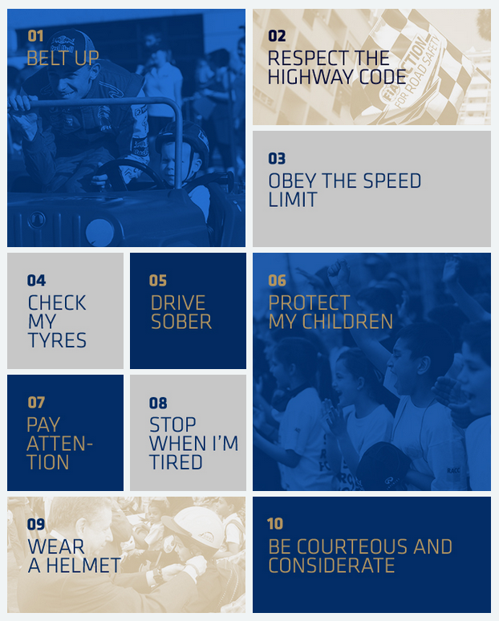

Thank you for your attention

