Slide 1
Reference Architecture Model Automotive (RAMA)

Slide 2
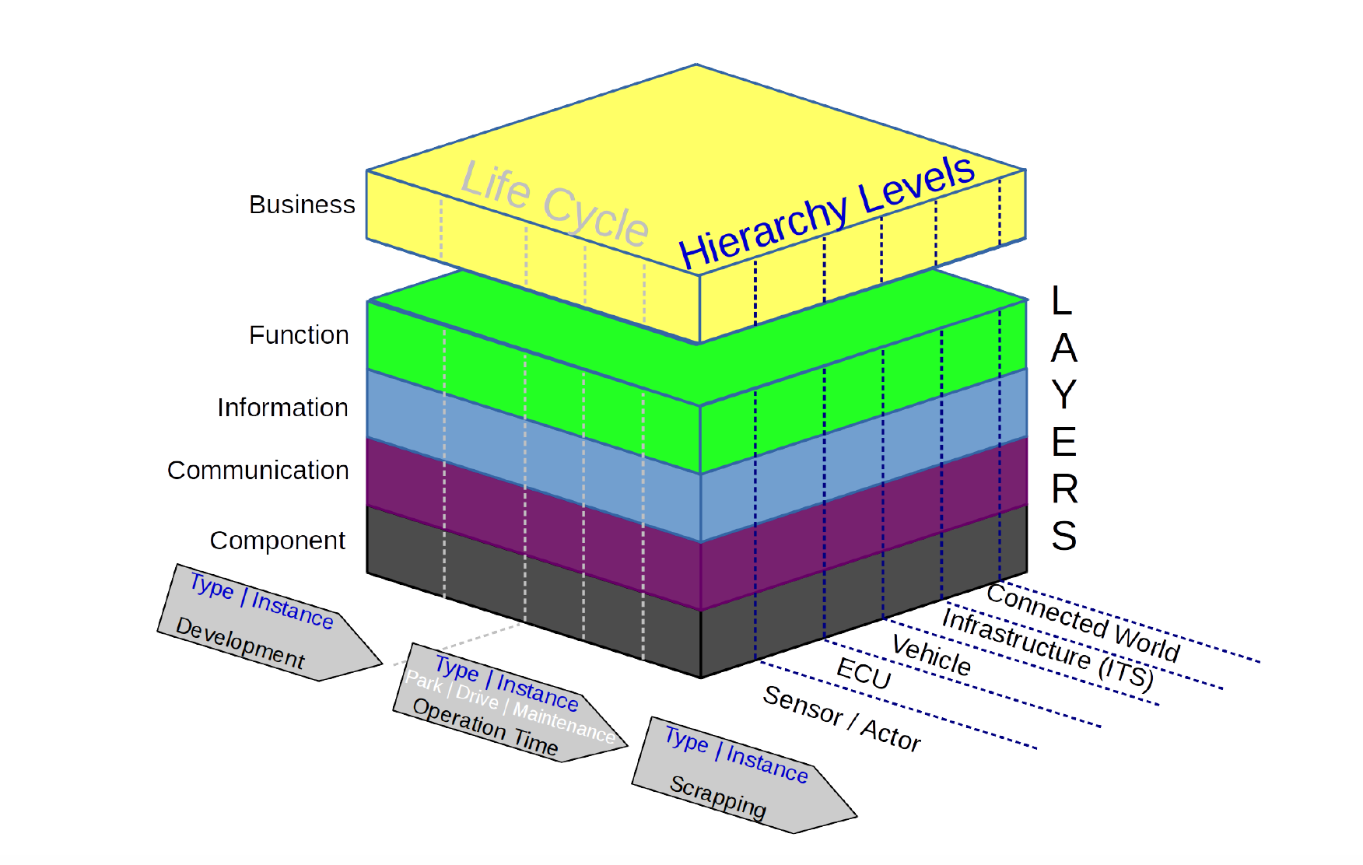

Slide 3
Layers:
• Business: Organization and business processes
• Function: Elementary function and composition of functions including functional dependencies (e.g., Electronic Stability Control (ESC), Adaptive Cruise Control (ACC))
• Information: Data (internal - and external vehicle data, e.g., from the backend)
• Communication: Communication channels and data flow
• Component: Physical components plus firmware

Slide 4
Life cycle:
• Development: Design and production including type-approval
• Operational time: Usage of vehicle
• Scrapping: End of live cycle. Scrapping can have different characteristics: Scrapping of a physical component of a vehicle, scrapping of the whole vehicle or only scrapping of vehicular data due to a selling of a vehicle.

Slide 5
Hierarchy Levels:
• Sensor / Actor: This level refers to a individual sensor or actor or a collection of sensors
and/or actors of a vehicle.
• ECU: Individual ECU or collection of ECUs.
• Vehicle: This refers to the complete IT of a vehicle including sensors, actors, ECUs, the
internal networks and internal/external communication units.
• Infrastructure: A vehicle may interact locally with external components of the road side or
maintenance infrastructure (or other vehicles), so this level covers all types of vehicle-to-X
communication, e.g., at a garage.
• Connected world: This level covers all types of communication via internet including
connections to the OEM backend or other services (maps, traffic info, etc.)

