Slide 1
Outcome TFCS-05 // 10-11 May 2017 @ OICA, Paris
ISO/SAE update on their activities on cyber security
Overview presented by OICA/CLEPA (see TFCS-05-12)
4 project groups working on different fields
Main targets:
    uniform definitions
    min. requirements on security engineering process, activities and criteria for assessment
    describe state-of-the-art of automotive security engineering for E/E development
- 1st draft (WD) aimed for vote in February 2018
- Publication of ISO/SAE 21434 expected by October 2019
OICA/CLEPA will update TF-CS/OTA on regular basis in order to
ensure coodination of groups

Slide 2
Outcome TFCS-05 // 10-11 May 2017 @ OICA, Paris
Definitions
FIA presentation (TFCS-05-11) on definitions for data
protection, data privacy, authorized access and more.
ITU offered to contribute to definitions
(see TFCS-05-17)
Definitions to be reviewed once used for the working document on respective topics

Slide 3
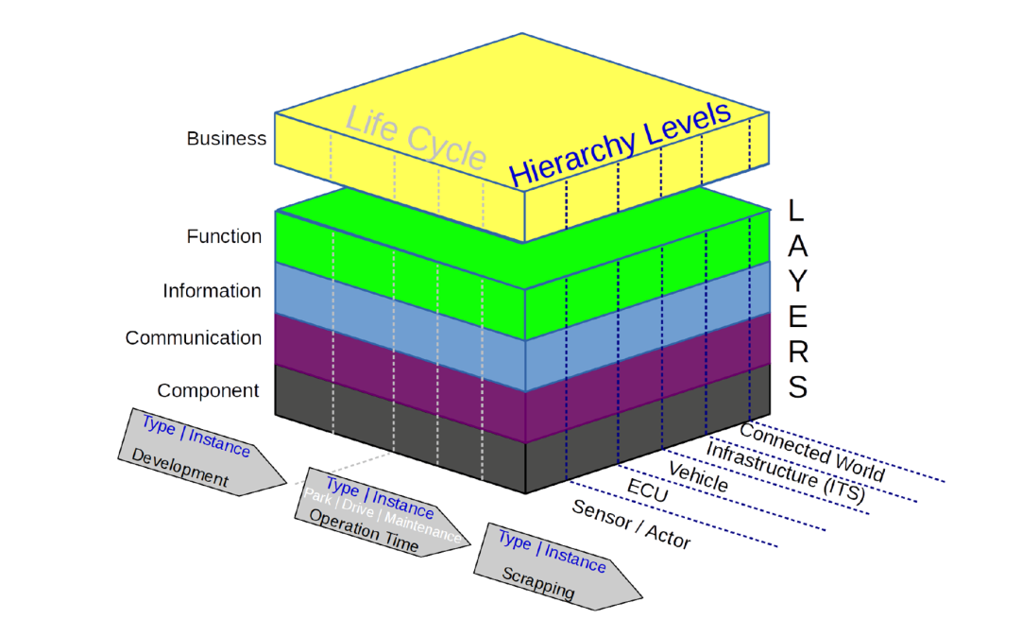
Outcome TFCS-05 // 10-11 May 2017 @ OICA, Paris
Reference Model regarding Cyber Security
TFCS-05 agreed to add “lifecycle” and the “information flow” to the reference model
Presentation by Germany (TFCS-05-13) on a “Reference Architecture Model Automotive”

Slide 4
Outcome TFCS-05 // 10-11 May 2017 @ OICA, Paris
Cyber security threat analysis:
  Table of threats modified to clarify spoofing to include the example of GPS messages (request by France)
  The group noted that the scope of the threats identified is wider than just connected/automated vehicles (=> ITS/AD guideline)
  The format and content of the table was agreed. The table will now be used as basis for the future work on mitigations (TFCS-05-05-Rev1)

Slide 5
Outcome TFCS-05 // 10-11 May 2017 @ OICA, Paris
Mitigations:
  Based on the Japanese proposal the group agreed to consider:
          Pre attack (prevention)
          During attack (detection)
          Post attack (response)
  OICA will apply an „extended CIA“ approach for mitigations to the threats listed in the table (TFCS-05-05-Rev1),
  Note: CIA = Confidentiality, Integrity, Availability
  Japan will consider mitigations for individual threats and reference these to the UNECE Cyber Security guideline principles and UK DfT principles
  ITU agreed to consider software aspects more
  => Target is to identify a way forward to define mitigations

Slide 6
Outcome TFCS-05 // 10-11 May 2017 @ OICA, Paris
Mitigations (continued):
  Reference documents identified were:
    ENISA report „Cyber Security and Resilience of Smart Cars” TFCS-03-09
    UK DfT Cyber Security principles TFCS-03-07
    NHTSA Cyber Security Guideline TFCS-03-08
    IPA “Approaches for Vehicle Information Security” (Japan) TFCS-04-05
    UNECE Cyber security guideline (ITS/AD) WP.29/2017/46
    SAE J 3061
    ISO 26262
    US Auto ISAC (report by Booz Allen Hamilton) https://www.automotiveisac.com/best-practices/
- Any other relevant documents shall be shared/identified
within the group (depending on copyright restrictions)

Slide 7
Outcome TFCS-05 // 10-11 May 2017 @ OICA, Paris
        Software updates:
  Presentation by Japan (TFCS-05-06): Proposal that TF-CS/OTA should focus for post-registration S/W updates on technical issues, rather than mandatory administrative provisions
  OICA/CLEPA presentation on S/W updates (TFCS-05-08), related to software configuration control and approval process
  FIA input on a process for software updates (TFCS-05-11)
  The group agreed to use the OICA/CLEPA presentation as its basis for further work
  => Participants to provide comments/input on TFCS-05-08

Slide 8
Outcome TFCS-05 // 10-11 May 2017 @ OICA, Paris
        Software updates (continued):
  The group agreed that systems with „deep learning/self learning“ is currently out of scope
  It was noted that an electronic CoC/DoC may be needed
  Consideration should be given to the work on the so called „ACSF TAN“ (see UNECE GRRF IWG ACSF: document ACSF-08-10) as a possibility to address software approval/ software version identification
  Furthermore, the task force shall give considerations to safety aspects and security of software updates and may review ITU recommendation X.1373 (Secure software update capability for ITS communication devices)

Slide 9
Outcome TFCS-05 // 10-11 May 2017 @ OICA, Paris
        Action items for next session:
          Cyber security (mitigations):
            Japan to provide table of threats adding mitigations as proposed on slide 9 of TFCS-05-07
            OICA/CLEPA to prepare table of threats with „extended CIA“ approach for identification of mitigations
            ITU will consider software mitigations further
            Other additional thoughts are welcome
            All to share additional references to be considered for mitigations
          Software updates:
            Japan to update the group on their considerations

Slide 10
Outcome TFCS-05 // 10-11 May 2017 @ OICA, Paris
        Action items for next session (continued):
          Software updates:
            All participants to provide feedback on approval process and configuration control in order to develop more detailed proposals
        Input shall be sent to:
        darren.handley@dft.gsi.gov.uk; niikuni@ntsel.go.jp; jschenkenberger@hyundai-europe.com
        and, if OICA/CLEPA documents concerned, in copy kai.zastrow@mpsa.com; mpoulson@ford.com

Slide 11
Outcome TFCS-05 // 10-11 May 2017 @ OICA, Paris
Next meetings:
TFCS-06 13-14 June 2017 Washington DC area @ TIA
(Arlington, VA)
TFCS-07 30-31 August 2017 Europe (NL/UK/F ?)
date confirmed venue tbd
TFCS-08 11-12 October 2017 Tokyo
date confirmed exact place (building) tbd

