Slide 1
Proposal for Next Actions
- Based on Threats Table Approach -
Japan
(Security TF of ITS/AD
13-14. June 2017 @TIA / Arlington)

Slide 2
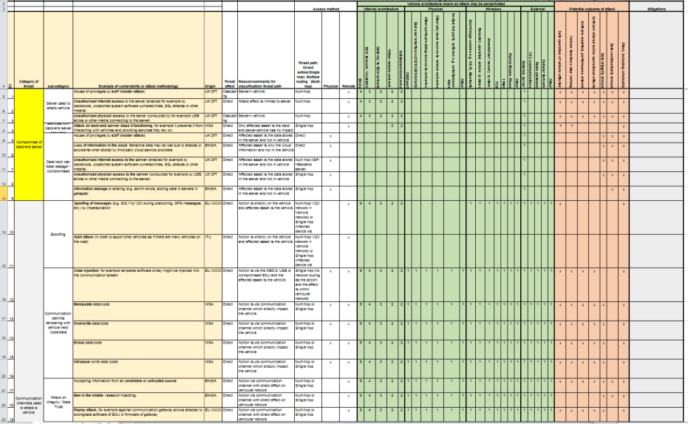
Background
Source: Outcome TFCS-05 // 10-11 May 2017 @ OICA, Paris (TFCS-05-19)
The format and content of the table was agreed.
The table will now be used as basis for the future work on
mitigations (TFCS-05-05-Rev1)
Action items for next session:
OICA/CLEPA and Japan
to provide example or
working approach for mitigations

Slide 3
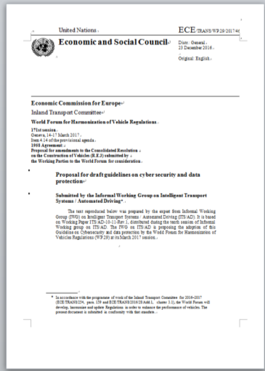
Process of Matching between the threats and the principles
Japan worked on matching between the threats and the existing principles.
The point of matching was that the “principles” can mitigate the “threats” on the table.
Then, matched/unmatched items were identified.
26 items
Threats
Principles
86 items
+ 8 items by UK DfT

Slide 4
Proposal of next actions
Items listed on the threat analysis table (TFCS-05-05-Rev1) - Total 86 items - | Conditions of existing principles (ITS/AD, UK DfT) | Proposed Next Actions
62 items | Existing principles are applicable. (UK DfT could cover more.) | Review the matching / Modification of principles (If necessary)
24 items | Existing principles are NOT applicable. | Reference/Development of principles (Mitigations to justify the principles are necessary)
0(Zero) items | 12 principles are unmatched (1 principle by UK DfT is unmatched.) | Reasoning for these principles (Principles for data protection will be majority. Responses in post attack should be considered.)
The count is ITS/AD guideline basis.

Slide 5
Conclusion
The existing principles are useful.
Many existing principles can be justified by the mitigations which OICA/CLEPA carried out with extended CIA approach.
Even so, some existing principles should be modified.
New items of threats which are not covered by existing principles should be discussed to create “additional principles”.
Items of principles which are not mentioned on the “threats table” may be reasoned to be connected with other threats.

