Slide 1
Analysis of threats table
With regards DfT cyber principles (sub-principles)

Slide 2
Methodology
Considered sub-principles
  Versus the high level threat categories
  Versus the threat examples (the analysis has concentrated on this)
Identified in the table those sub-principles which could be used to in part, or collectively to mitigate the attack or vulnerability, or reduce its impact.
Analysis only applied to the threat categories that present cyber attacks or vulnerabilities
Not included:
  For simplicity specific mitigations that could be applied have not been included.
  The ranking of specific mitigations is not considered, although it is accepted that some will be more impactful.
  How the sub-principles are applied is not considered. This will vary depending on the threats, the design of the system and other factors.

Slide 3
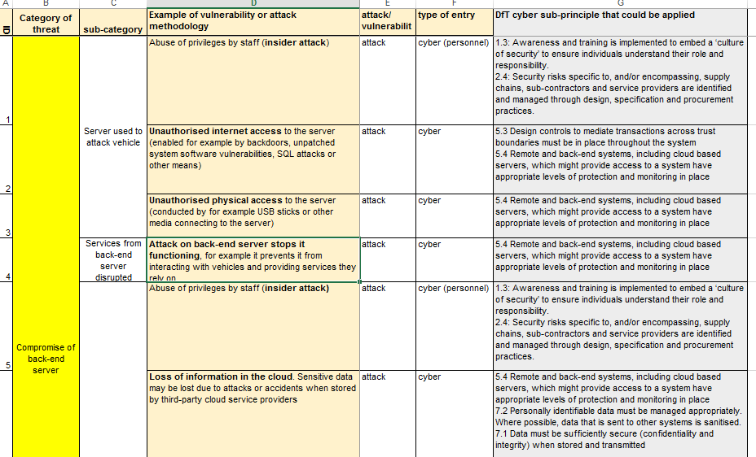
Results – what the table looks like

Slide 4
Top hits

Slide 5
Top hits by threat category

Slide 6
Conclusions
Application of all of the DfT principles might help mitigate the breadth of attacks and vulnerabilities identified. The sub-principles are also widely applicable, with some more applicable to specific threats or vulnerabilities. Those not highlighted are important to managing data, processes and sensors.
The most frequent sub-principles (based on top two per threat category) are:
  2.4: Security risks specific to supply chains are identified and managed through design, specification and procurement practices.
  3.1: Organisations plan for how to maintain security over the lifetime of their systems.
  3.3: There is an active programme in place to identify critical vulnerabilities and mitigations
  5.2: The security architecture applies defence-in-depth & segmented techniques
  5.3: Design controls to mediate transactions across trust boundaries must be in place.
  5.4: Remote and back-end systems have appropriate levels of protection and monitoring
  6.1: Organisations adopt secure coding practices including systems to audit and test code.
  6.2: It must be possible to ascertain the status of all software, firmware and their configuration
  6.3: It is possible to safely and securely update software and return it to a known good state.
  8.1: The system must be able to withstand receiving corrupt, invalid or malicious data or commands. This includes sensor jamming or spoofing.

