Slide 1
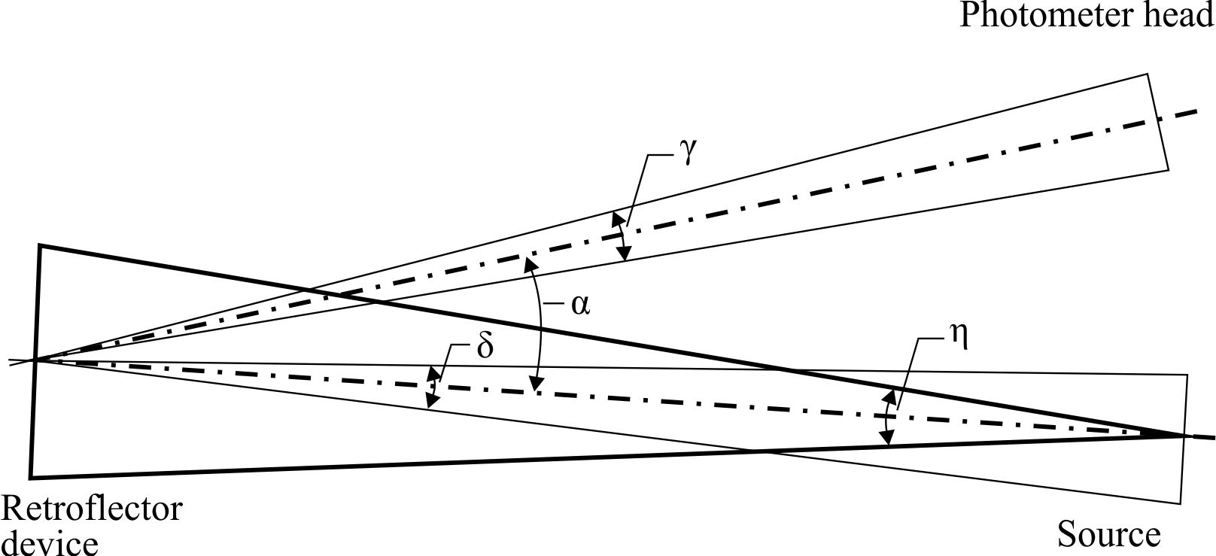
SLR-16-08

Slide 2
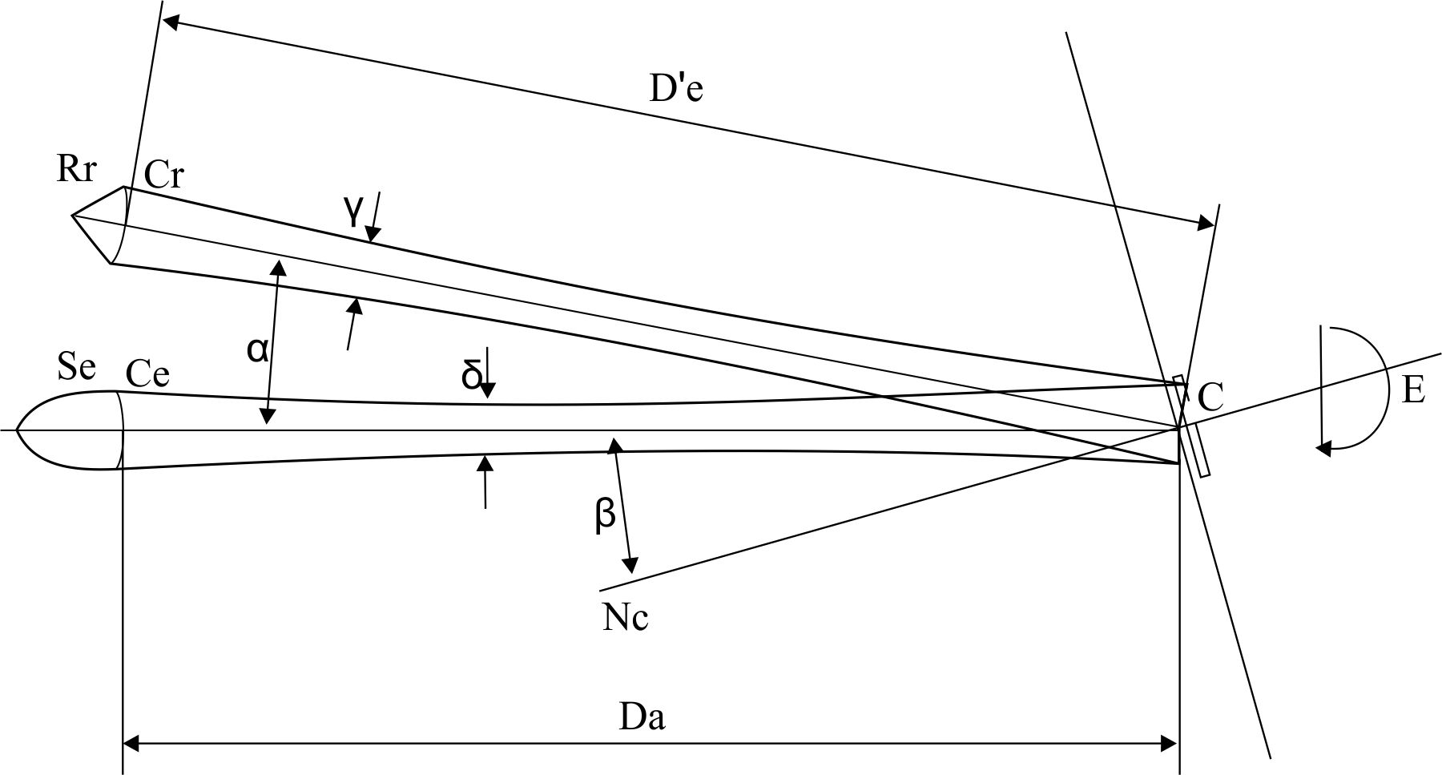

Slide 4


Slide 6
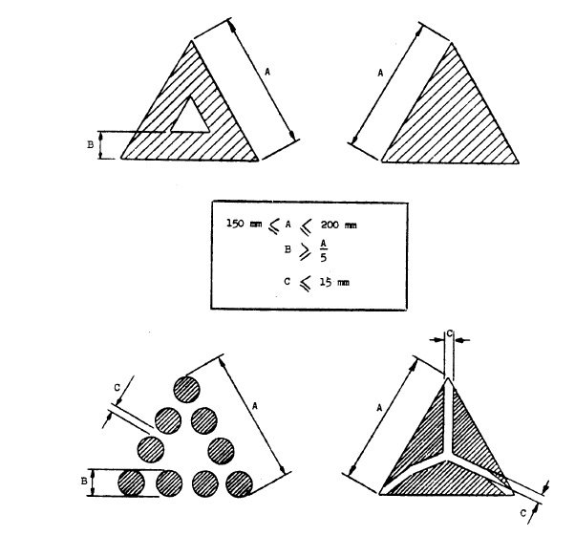

Slide 14
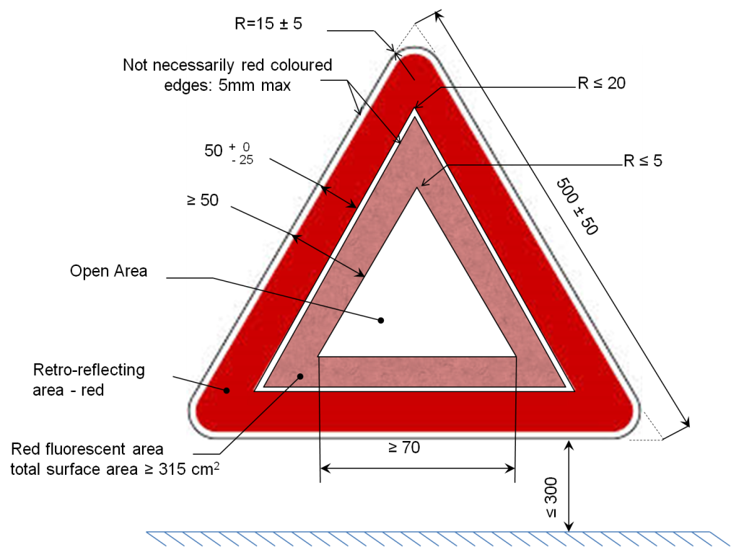


Slide 16
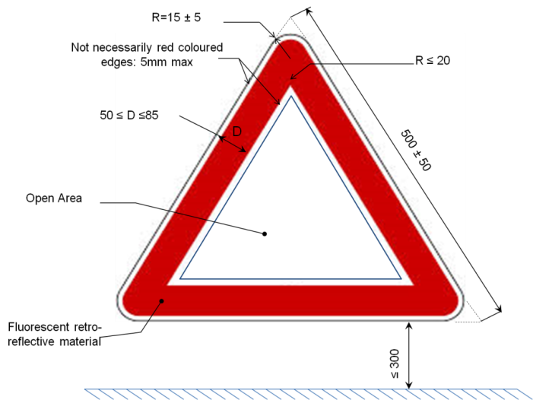

Slide 18
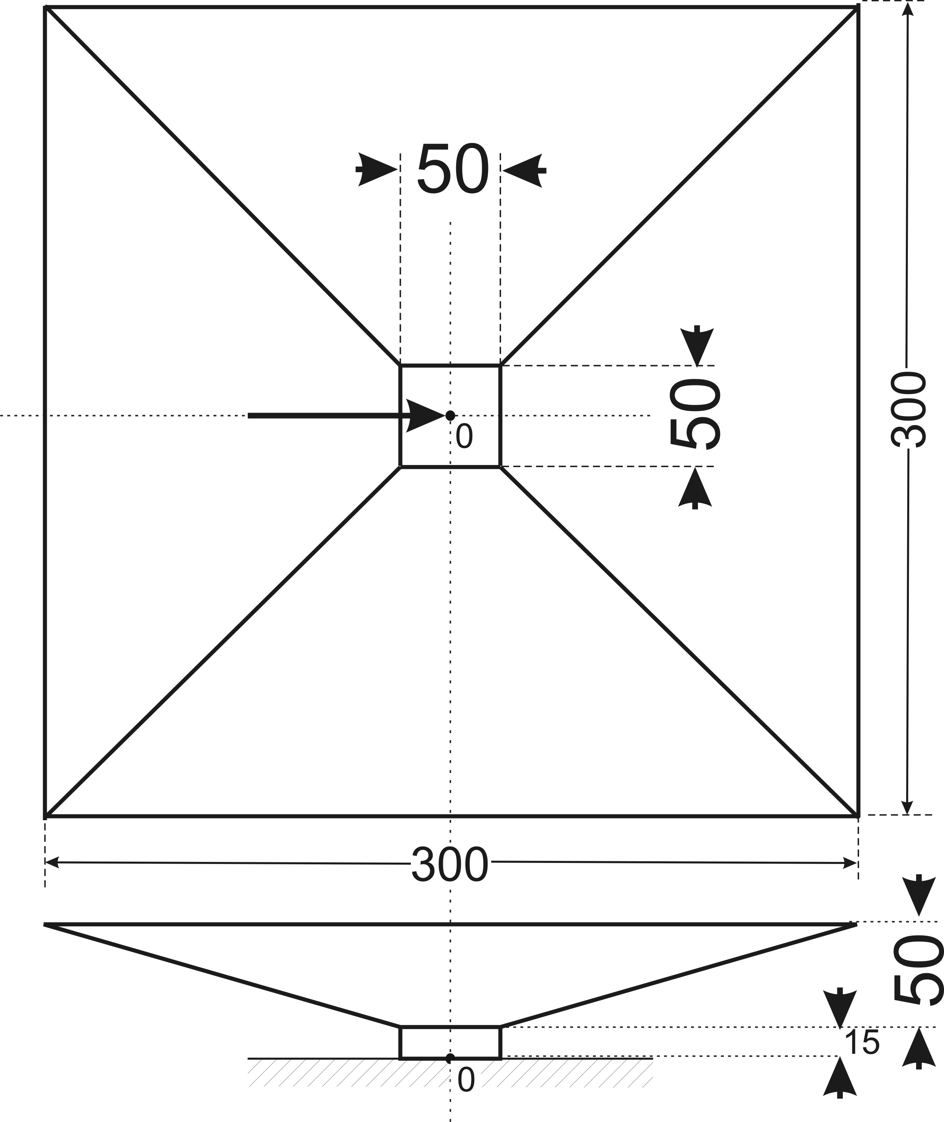

Slide 19
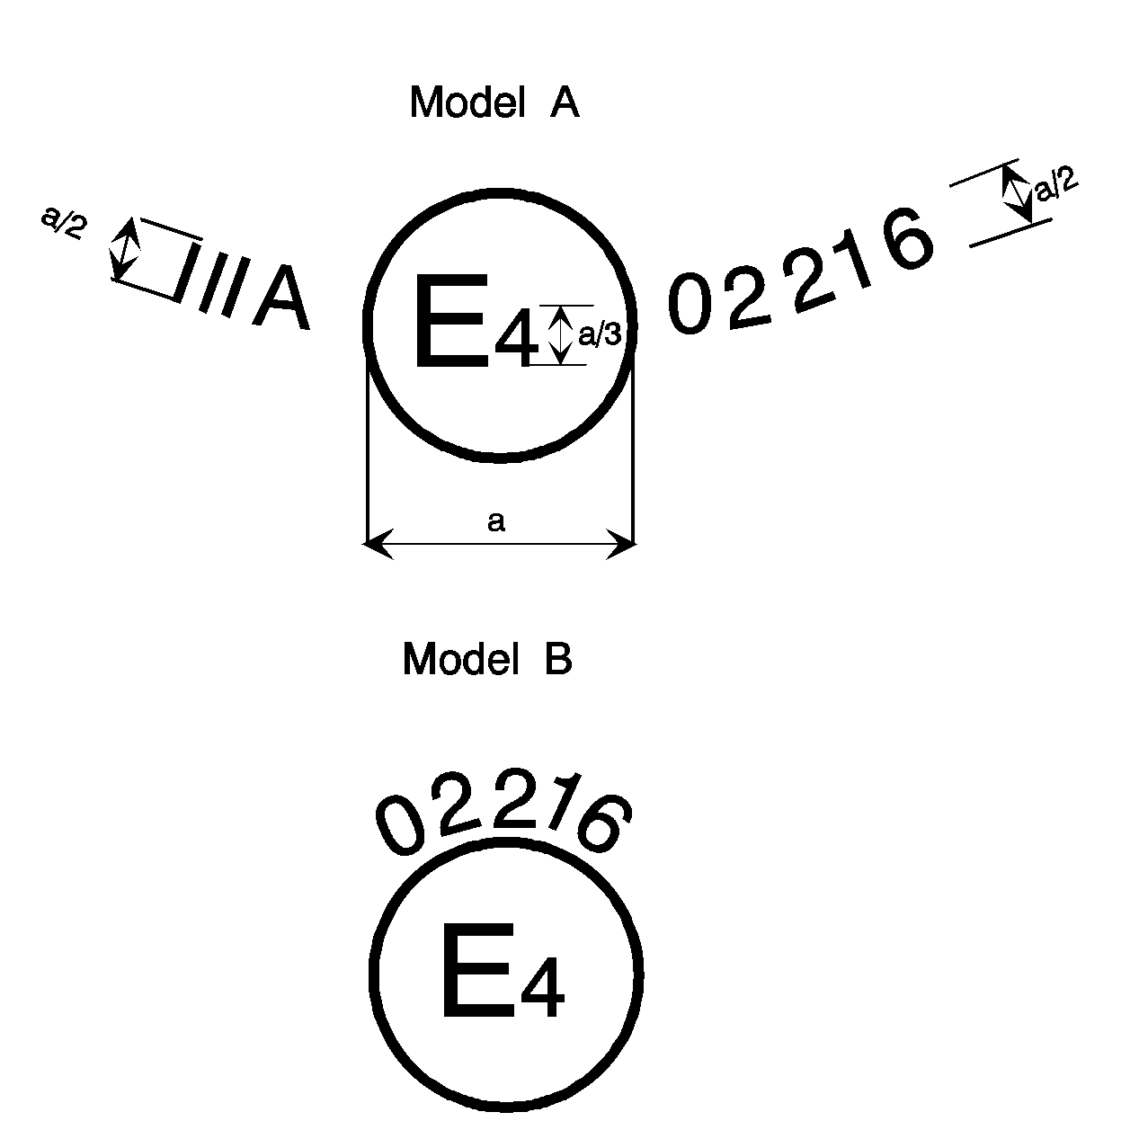
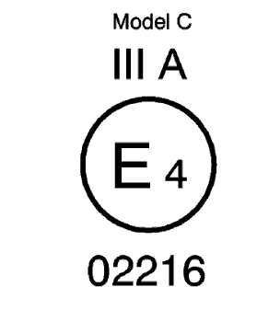

Slide 20
Model A
III A
0 2 2 1 6
E
4
002216
Model B
02216
Model C
E
III A
4
E
4
002216

Slide 21
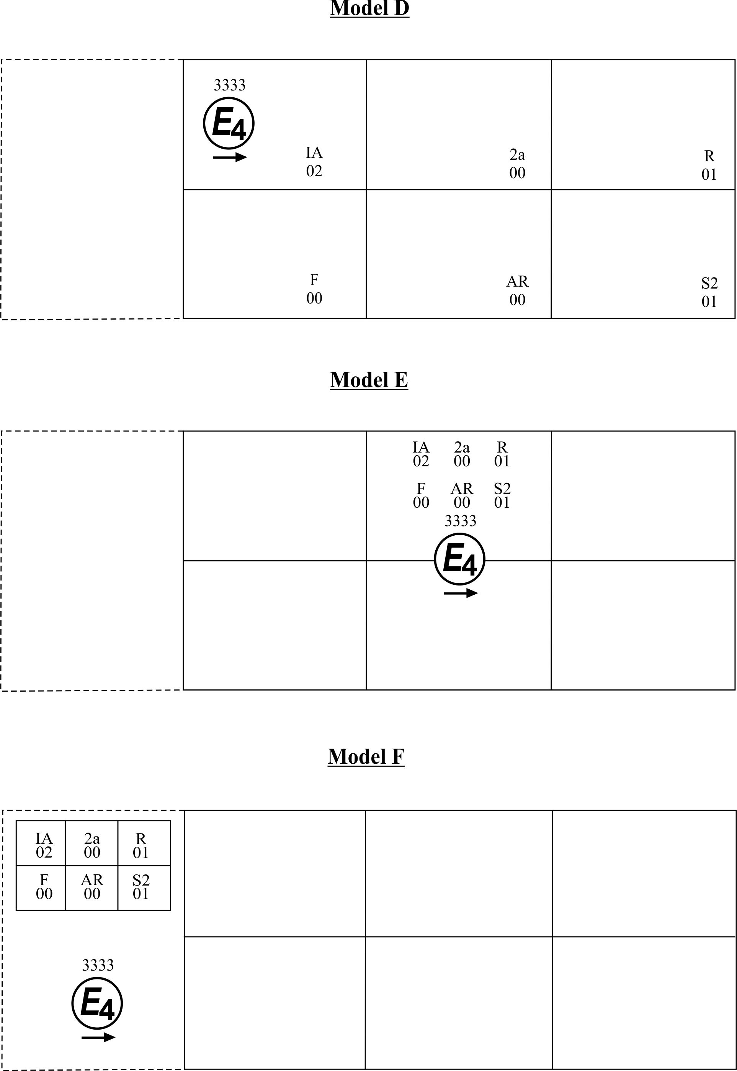

Slide 22
3333
E
4
IA
02
2a
00
R
01
F
00
AR
00
S2
01
IA
02
2a
00
R
01
F
00
AR
00
S2
01
3333
E
4
IA
02
2a
00
R
01
F
00
AR
00
S2
01
3333
E
4

