Slide 1
Off-cycles principles
3d IWG ASEP
FRANCE

Slide 2
General principles
A “laboratory” based test cycle reflects world-wide on-road vehicle operation. The wide variety of real world driving conditions cannot be fully incorporated within.
Off-cycle aims to check a wide variety of operating conditions (e.g. starts, stops, accelerations, decelerations, steady cruises) and/or varying ambient conditions (e.g. temperature, humidity and barometric pressure).
There is currently 2 possibility for off-cycle evaluation : Model base or Not-to Exceed

Slide 3
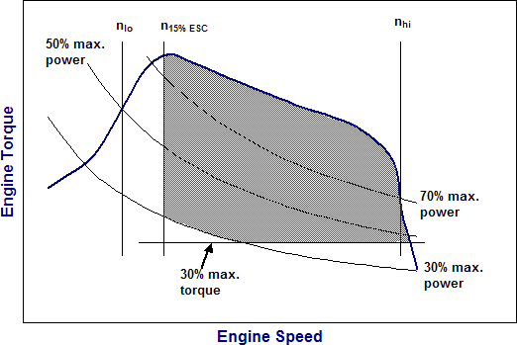
Some off-cycles principles
Emissions from US EPA (HDV):
Any type of driving conditions that could occur within the bounds of the NTE control area, including operation under steady-state or transient conditions and under varying ambient conditions.
Not-To-Exceed

Slide 4
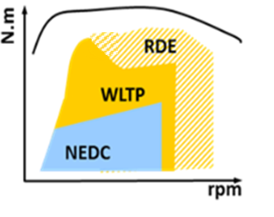
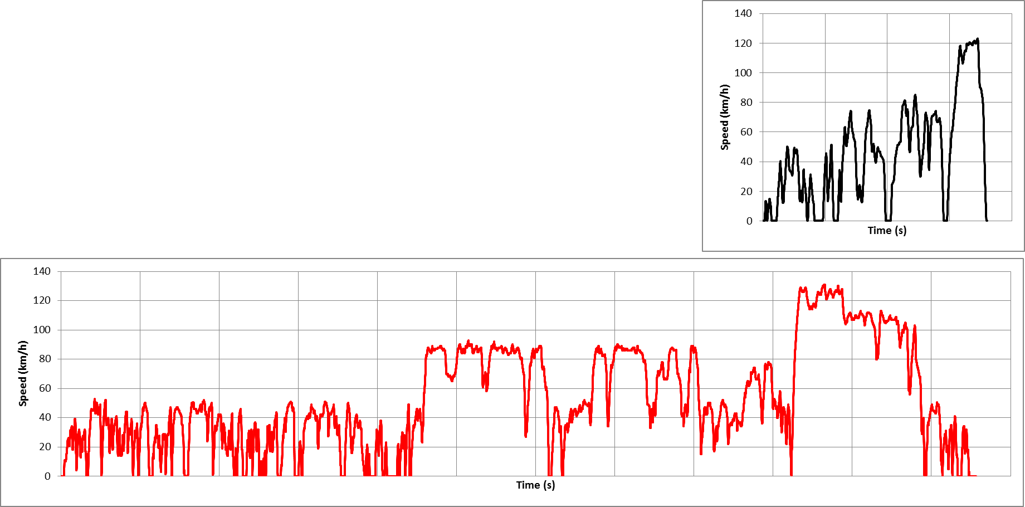
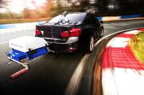
Some off-cycles principles
Real Driving emissions :
Not-To-Exceed
  WLTC (Cycle on bench
  RDE (Off Cycle on real road

Slide 5
Some off-cycles principles
ASEP UN ECE R51 Slope method & UN ECE R41
Model base
L ASEP
Limit
x
L anchor
L wot ASEP - Gear k
N anchor
Engine speed

Slide 6
Some off-cycles principles
ASEP UN ECE R51 L urban method
Not-to-Exceed ?
L ASEP
Limit
x
L anchor
L wot ASEP - Gear k
L crs ASEP - Gear k
L urban ASEP - Gear k
V anchor
Vehicle Speed

Slide 7
From previous ASEP IWG
Proposals used for limits establishment :
a simplified model for the noise generation of a vehicle for limit concept (using an anchor point) and/or
a margin and/or
a bonus for « silent » vehicle
→ L_{limit ASEP} = L_{vehicle,expected} (n, v, a) + margin + bonus

Slide 8
From previous ASEP IWG
Some models of expected noise behavior :
L_{vehicle,expected} (v) =L_{ref} + c₁*(v – v_{ref} )
L_{vehicle,expected} (n) =L_{ref} + c₁ *(n – n_{ref} )
L_{vehicle,expected} (n,v) =10*log (10^{(Lengine(n)/10)} +10^{(Ltyre(v)/10)})
Where L_{tyre} = L_{tyre}(v_{ref}) + c₁ *log(v/v_{ref}), and
L_{engine} = L_{engine}(n_{ref}) + c₂ *(n-n_{ref})
L_{vehicle,expected} (v,a) =L_{ref} + c₁*(v*a – v_{ref} *a_{ref})
L_{vehicle,expected} (v,a) =L_{ref} + c₁*v + c₂*a
L_{vehicle,expected} (v,a) =L_{ref} + c₁*(v – v_{ref}) + c₂*(a – va_{ref})
L_{vehicle,expected} (v,a) =L_{ref} + c₁*log(v/v_{ref}) + c₂*a
…

Slide 9
From previous ASEP IWG
Some anchor points :
L _{ref} = L _{wot i} and n_{ref} = n_{wot i} and v_{ref} = v_{wot i} k<i
L _{ref} = L _{urban limit} - k_{p *} L _{crs})/(1-k_{p})
and n_{ref i}= n_{urban} = S*1,65*PMR^{-0,32} and v_{ref} = 50 km/h
L _{ref}= L _{wot i} - max(0 , L_{wot,i}(n_{ref}) – L_{wot,k}(n_{ref}) and n_{ref} = n_{wot i}
L_{ref_k} = 10 * log(10^{(Lwoti/10)} - 10^{(Lcrsi/10)} + 10((32*log(gear_ratio_k/gear_ratio_i)+Lcrsi)/10))
with k = gear to be measured (n_{wot i}, v_{wot i})
…

Slide 10
From previous ASEP IWG
Some bonus :
∆ (L_{annex3} – L _{limit Annex3}) = L _{urban limit} - L _{urban}
∆ (L_{annex3} – L _{limit Annex3}) = MAX(2 dB(A) ; L_{ref} – L_{crs,50})
…
Other ideas :
Engine and vehicle speed are reported where Lmax occurs (need continuous measuring equipment)
Replace limited slope by a Not-To-Exceed level
…

Slide 11
Conclusions and perspectives
In a first step :
Advantages and disadvantages for model base and Not-to-exceed should be discussed.
In all case (model base or NTE), control range and test conditions (e.g. partial throttle) shall be defined.
For Model base, IWG for ASEP should try to define better model(s) of expected noise behavior to be apply to all cases.
IWG for ASEP should validate model(s) by comparison with measurement for “normal” car.
Validation criteria should be defined.
For Not-to-Exceed, IWG for ASEP should define general principle for the limit’s establishment.

