Slide 1
CLEPA Input for 3rd IWG ASEP meeting
Brussels, 2017-05-10

Slide 2
Feedback on current procedure
Overview
Does the flow chart (figure 3) capture all cases?
Application of electronically controlled technologies
  Application of variable exhaust system valve
  Application of sound box
  Conclusion

Slide 3
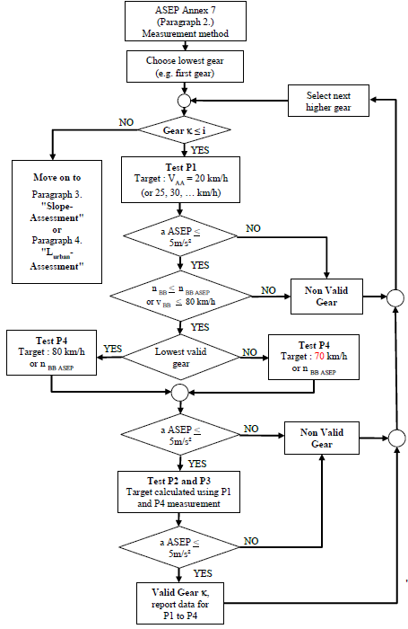
Feedback on current procedure
Flow chart (1 of 2)
  Does the Flow chart capture all cases?
for P1 test
If one of both criteria "nBB <= nBB_ASEP or vBB <= 80 km/h“ is fullfilled, while the other one is not, the gear is valid.
-> Proposal to split both requirements.
for P4 test
Some cases may not be covered if it’s the lowest gear:
nbb_ASEP is not reached in locked transmission: Target=70km/h
nbb_ASEP is reached in locked transmission: Target=80km/h
-> Proposal to include nbb_ASEP criteria.
-> Proposal to include non-locked transmission cases
Target=80km/h
Source: Figure 3 of ECE/TRANS/WP.29/GRB/2017/2

Slide 4
Feedback on current procedure
Flow chart (2 of 2)
  Does the Flow chart capture all cases?
for P1 test
If one of both criteria "nBB < nBB_ASEP or vBB < 80 km/h“ is fullfilled, while the other one not, the gear would be valid?
-> Proposal to split both requirements.
for P4 test
Some cases may not be covered if it’s the lowest gear:
nbb_ASEP is not reached in locked transmission: Target=70km/h
nbb_ASEP is reached in locked transmission: Target=80km/h
-> Proposal to include nbb_ASEP criteria.
-> Proposal to include non-locked transmission cases
Target=80km/h
Source: Figure 3 of ECE/TRANS/WP.29/GRB/2017/2

Slide 5
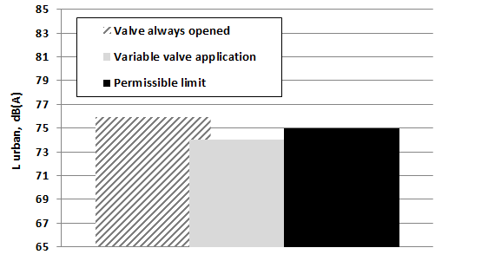
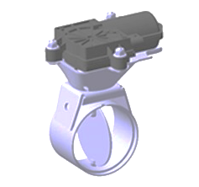
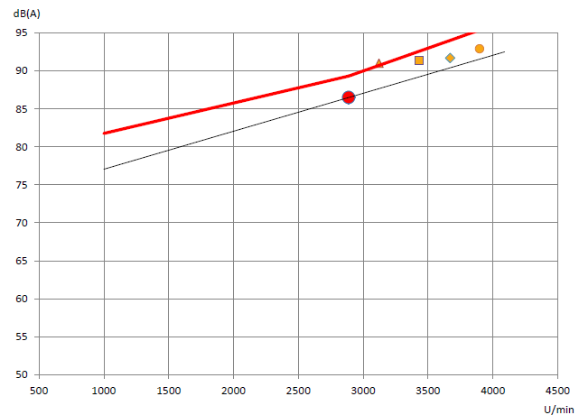
Feedback on current procedure
Application of electronically controlled technologies (1 of 3)
  Application of variable exhaust system valve
    Example: Vehicle with PMR>160kW/t with by-pass valve (worst case)
Variable exhaust system valves help to comply with Annex 3
while retaining compliant according to Annex 7.
Slope assessment for lowest valid gear

Slide 6
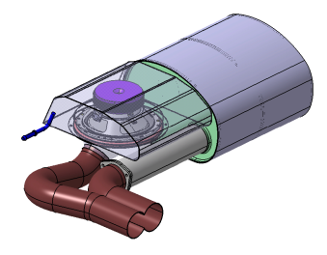
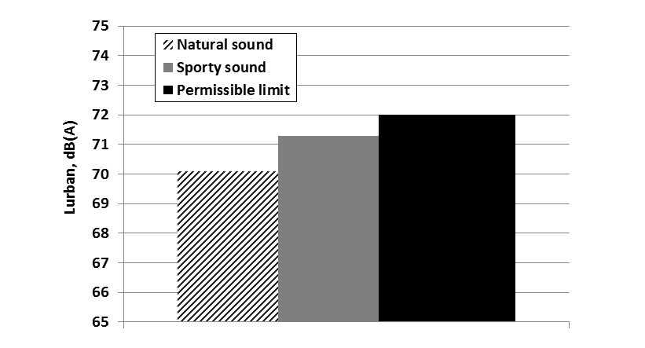

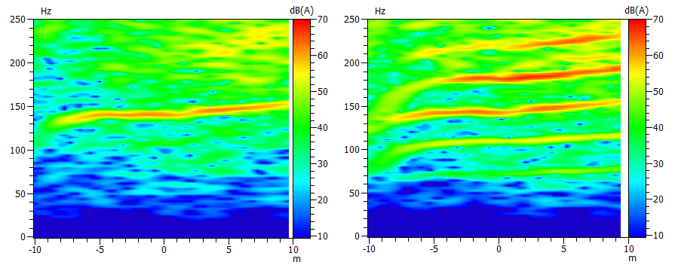
Feedback on current procedure
Application of electronically controlled technologies (2 of 3)
  Application of sound box
    Example: Vehicle with PMR<120kW/t with sound box
A proper sound box application does not significantly increase the emitted noise (Annex 3) nor does it affect the linearity of noise emission (Annex 7).
-> Sound box systems may also be used for cancellation (upcoming phases).
Sound box off Sound box on
->Linear addition of sound

Slide 7
Feedback on current procedure
Application of electronically controlled technologies (3 of 3)
Application of electronically controlled technologies helps to achieve compliance with Annex 3 while retaining compliant with Annex 7.
Electronically controlled technologies (sound box for noise cancellation and electrical valves) are important products to reduce the noise emission and ensure compliance in the future.
However, a clear definition of the „modes“ to be tested (e.g. solution 2 in proposal by „ASEP-02-09“) may be required.

Slide 8
Thank you for
your Attention.

