Slide 1
<Discussion point>
How the position of CSTF’s recommendation can be given in WP29?
Japan
(Security TF of ITS/AD
30-31, August 2017 Den Hague, Netherlands)

Slide 2
Remind:Outcome TFCS-06 @ TIA, Arlington/VA (USA)
Mitigations:
  OICA/CLEPA introduced proposal for “extended CIA” approach with corresponding mitigations defined (see document TFCS-06-11:
  > mitigations based on threats identified in the table
  > 18 mitigations identified
  Based on comments from ITU/NICT the 18 mitigations in combination with the UK DfT principles had been reviewed
  The group reviewed the threat table accordingly and cross checked the 18 mitigations with the ITS/AD guideline principles in order to identify necessary amendments/additions

Slide 3
Remind:Outcome TFCS-06 @ TIA, Arlington/VA (USA)
Mitigations (continued):
  The group agree to clarify the terms „Software“, „Data“, „Messages“, „Configuration“ and „Information“
  Reference document added: ISO 19790 „Security requirements for cryptographic modules“
  An ad hoc meeting „Mitigations“ was agreed (mid/end July – doodle poll) to review the table of threats with mitigations by OICA, ITS/AD principles, UK DfT Principles and NL comments on the OICA/CLEPA mitigations in order to conclude on the mitigations
  > CS/OTA ad hoc "Mitigations„ Web meeting
  (3rd, Aug. 2017), 31 of threats were reviewed and modified

Slide 4
Toward finalizing CSTF’s work
How can we appeal the recommendation to public through the system of WP29?
For example, “Guideline on cybersecurity and data protection” by ITS/AD was combined to “Consolidated Resolution on the Construction of Vehicles (R.E.3) ” 11, July 2017.
R.E.3 is an official document of WP29 and is accessible for everyone (includes manufacturer).

Slide 5
Contents of ITS/AD’s guideline and CSTF’s recommendation
 | The security guideline by ITS/AD (Annex 6 to Resolution 6) | The recommendation(mitigation) by CSTF
Reference model | Not covered | Covered
Possible attack, threats to the systems | Not covered | Covered
Mitigations, Security controls | Not covered | Covered
Principles | Covered | Covered
Similar in many parts

Slide 6
Possible instruction for ITS/AD on the recommendation document
To replace the recommendation to Annex 6 of Resolution 6.
Resolution 6 (administrated by GRSG?)
 |  |  |  |  | Annex 6 Security guideline by ITS/AD
Remind: steps for the amendment of annex 6
Proposal by CSTF to ITS/AD
Adoption by ITS/AD, proposal by ITS/AD to WP29
Adoption by WP29, request by WP29 to GRSG(? administration body of Resolution 6)
This plan depends on ITS/AD’s decision.

Slide 7
Schedule(TBD)
2017 |  |  |  |  |  |  |  |  |  |  | 2018
F 2 | M 3 | A 4 | M 5 | J 6 | J 7 | A 8 | Sep. (9) | Oct. (10) | Nov. (11) | Dec. (12) | Jan. (1) | Feb. (2) | Mar. (3)
★2/16-17 TF#3@Paris
★5/10-11 TF#5@Paris
★8/30-31
TF#7@NL
★11/9-10
TF#9@Europe?
★3/13-14 TF#4@Geneva
★6/13-14 TF#6@Washington
★10/11-12
TF#8@Tokyo
★12/x
TF#10 @xx
Drafting recommendation
☆11/16
ITS/AD #13
☆March
ITS/AD #14
The CSTF’s document will be reviewed in March(2018) and its position will be given in later sessions.

Slide 8
Proposal of interim approach
The position of CSTF’s document (e.g. endorsement as a formal document) depends on ITS/AD’s decision.
Until its position is clarified, the CSTF’s document could be posted as a “referable document” on the WP29’s website. (Proposal)
As an interim approach, CSTF may ask ITS/AD to store the CSTF’s document in a dedicated stationary folder which everyone can access to.

Slide 9
Proposal of interim approach
Advantage:
People can refer the CSTF’s document soon.
The CSTF’s document can be modified flexibly when its position is fixed.
No need to compromise with the ITS/AD’s guideline
Disadvantage:
Some task will be left after CSTF is closed.
e.g. To modify the CSTF’s recommendation as a guideline or to amend the ITS/AD’s guideline.

Slide 10
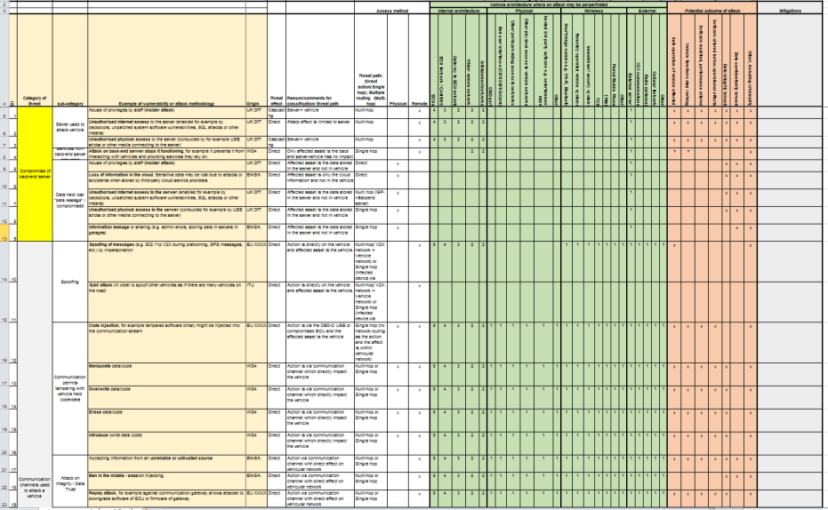
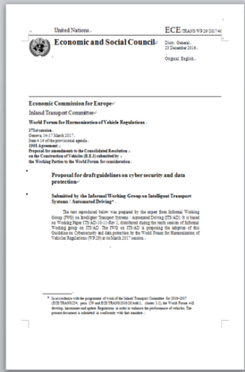
Reminder:
Process of Matching between the threats and the principles
Japan worked on matching between the threats and the existing principles.
The point of matching was that the “principles” can mitigate the “threats” on the table.
Then, matched/unmatched items were identified.
26 items
Threats
Principles
86 items
+ 8 items by UK DfT

Slide 11
Reminder:
Proposal of next actions
Items listed on the threat analysis table (TFCS-05-05-Rev1) - Total 86 items - | Conditions of existing principles (ITS/AD, UK DfT) | Proposed Next Actions
62 items | Existing principles are applicable. (UK DfT could cover more.) | Review the matching / Modification of principles (If necessary)
24 items | Existing principles are NOT applicable. | Reference/Development of principles (Mitigations to justify the principles are necessary)
0(Zero) items | 12 principles are unmatched (1 principle by UK DfT is unmatched.) | Reasoning for these principles (Principles for data protection will be majority. Responses in post attack should be considered.)
The count is ITS/AD guideline basis.

Slide 12
Recommended contents of “Recommendation”
 | The security guideline by ITS/AD (Annex 6 to Resolution 6) | The recommendation(mitigation) by CSTF
Reference model | Not covered | Covered
Possible attack, threats to the systems | Not covered | Covered
Mitigations, Security controls | Not covered | Covered
Principles | Covered | Covered
Similar in many parts
Japan recommends this area to be reflected on the “Recommendation” .
The “Mitigations” provide concrete security control to follow “Principles”.
We should take care that “Mitigations” are recommended security controls and are NOT regulations. (The “Mitigations” are providing flexibilities on vehicle design.)

Slide 13
In addition, Japan needs time to peer at “Mitigations” until #8 session of CSTF because “Mitigations” will be the most major output in the recommendation.

Slide 14
Threat:
Spoofing of messages (e.g. 802.11p V2X during platooning, GPS messages, etc.) by impersonation
Principle:
(ITSAD) 2.4.4 Online Services for remote access into connected vehicles and vehicles with ADT should have a strong mutual authentication of messages and assure secure communication (confidential and integrity protected) between the involved entities.
Mitigation:
Messages processed by a receiving vehicle shall be Authenticated and Integrity protected.
Controls may include:
o Message authentication for all messages received.
o Encryption for communications containing sensitive data.
o Techniques to prevent replay attacks, such as timestamping and use of freshness values
o Use of techniques for integrity checking, such as hashing, secure protocols and packet filtering.
o Session management policies to avoid session hijacking
o consitency checks using other vehicle sensors (e.g. temperature, radar…)

