Slide 1


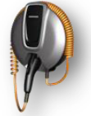
VEHICLE TECHNOLOGIES PROGRAM
EV Safety Lessons Learned from Vehicle Evaluations
Lee Slezak
Team Lead, Vehicle Systems Analysis & Testing
Lee.Slezak@ee.doe.gov
EV Safety Conference – Bonn – 22 October, 2012

Slide 2
Outline
  Vehicle Technologies Program Structure
Vehicle Evaluations
    Background
      Lab & Field Evaluations
      AVTA Testing Experience
      Industry Awards Demo Sites
      Vehicle Data Collection
      EVSE Data Collection
      Information Management
    Thermal Runaway
      Dynamics of Reactions
      Thermal Runaway Events
      Lessons Learned
        Thermal Runaway Event Details
          Passenger battery electric bus
          Conversion company conversion of a HEV sedan to a PHEV
          Conversion company conversion of a HEV SUV to a PHEV
          Original equipment manufacturer (OEM) preproduction PHEV
Backup Slides
  Vehicle Systems Overview
  Industry Awards Demonstration Projects

Slide 3
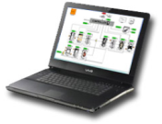
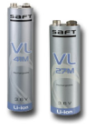
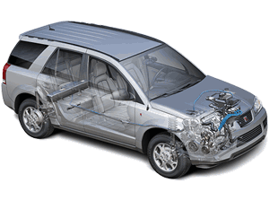
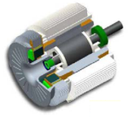
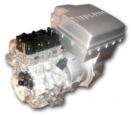
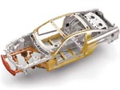
Office of Vehicle Technologies Program Structure
OVT/PHEV
Program Mgmt.
Industry/Gov’t
Collaboration
Technology
Assessment
Research &
Development
Testing &
Validation
Deployment
Issues
Benchmarking
Analytical Studies
Risk Assessment
Energy Storage
Standard Procedures
Lab Testing and Validation
Field Reliability Testing and Validation
Field Testing and Demonstration
Grid Interactions
Automotive-Utility Industry Interactions
Incentives
Education and Learning Demonstration
Codes & Standards
Power Electronics &
Electric Motors
Engines and Fuels
Vehicle Efficiency
Technologies

Slide 4
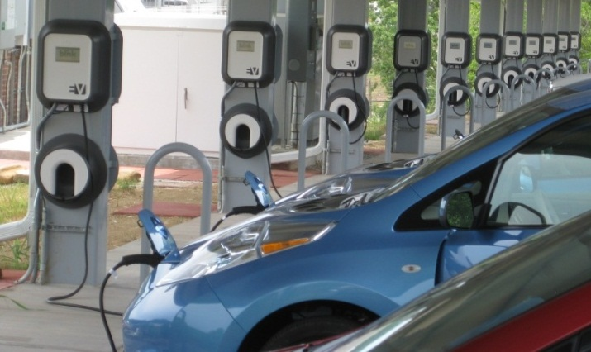
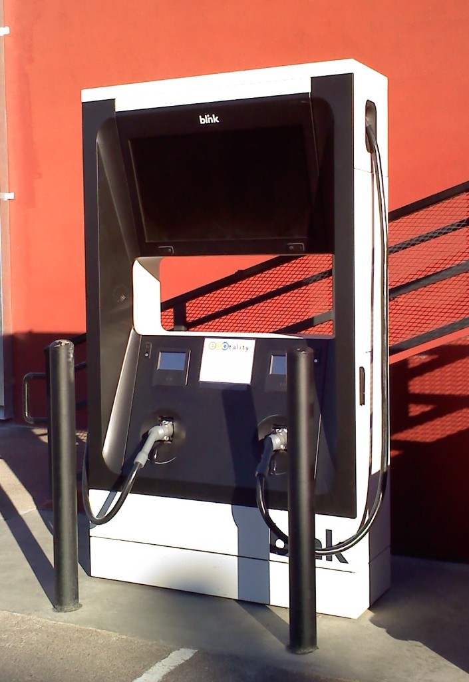
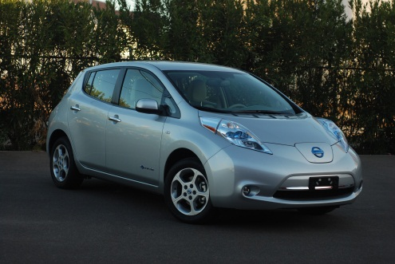
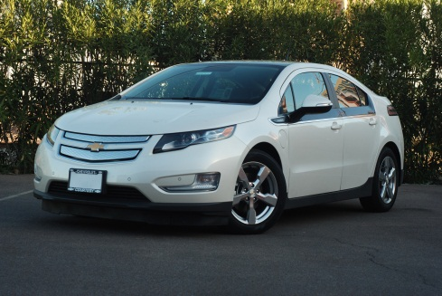
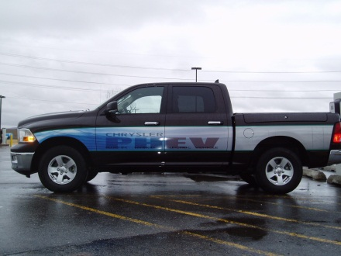
Lab & Field Evaluations
Structured, repeatable testing methods and real-world usage
  Advanced Vehicle Testing & Evaluation (AVTE) in-use data collection
  Advanced Powertrain Research Facility (APRF) vehicle test and test development
  Medium duty drive cycle analysis and route optimization
  Truck cab environmental control optimization (Cool cab) and evaluation
  EDV Charging Infrastructure Evaluations
  ~ 75 Testing partners in the U.S. and Canada,
    Utilities
    State & local governments
    Universities and colleges
    Private companies/advocacy organizations
    Canadian provinces
    U.S. military organizations
    OEMs & conversion companies

Slide 5
Advanced Vehicle Testing Activity (AVTA)
Light Duty & EVSE Testing Experience
DOE’s Advanced Vehicle Testing Activity is DOE’s field, lab and track benchmarking program for advanced technology electric drive vehicles. Conducted by the Idaho National Laboratory (INL) and ECOtality North America
Total to date: 61 million test miles accumulated on 9,100 electric drive vehicles representing 116 models, and 10,830 EVSE
Currently: 17,000 light-duty vehicles and EVSE providing 125,000 miles and 5,200 charging events of daily data to the AVTA
EV Project: 5,631 Leafs, Volts and Smart EVs, 7,630 EVSE, 41.6 million test miles
PHEVs: 14 models, 430 PHEVs, 5.1 million test miles
EREVs: 1 model, 150 EREVs, 1.2 million test miles
HEVs: 21 models, 52 HEVs, 6.4 million test miles
Micro hybrid (stop/start) vehicles: 3 models, 7 MHVs, 580,000 test miles
NEVs: 25 models, 373 NEVs, 200,000 test miles
BEVs: 47 models, 2,000 BEVs, 5 million test miles
UEVs: 3 models, 460 UEVs, 1 million test miles
Other testing includes hydrogen ICE vehicle and infrastructure testing

Slide 6
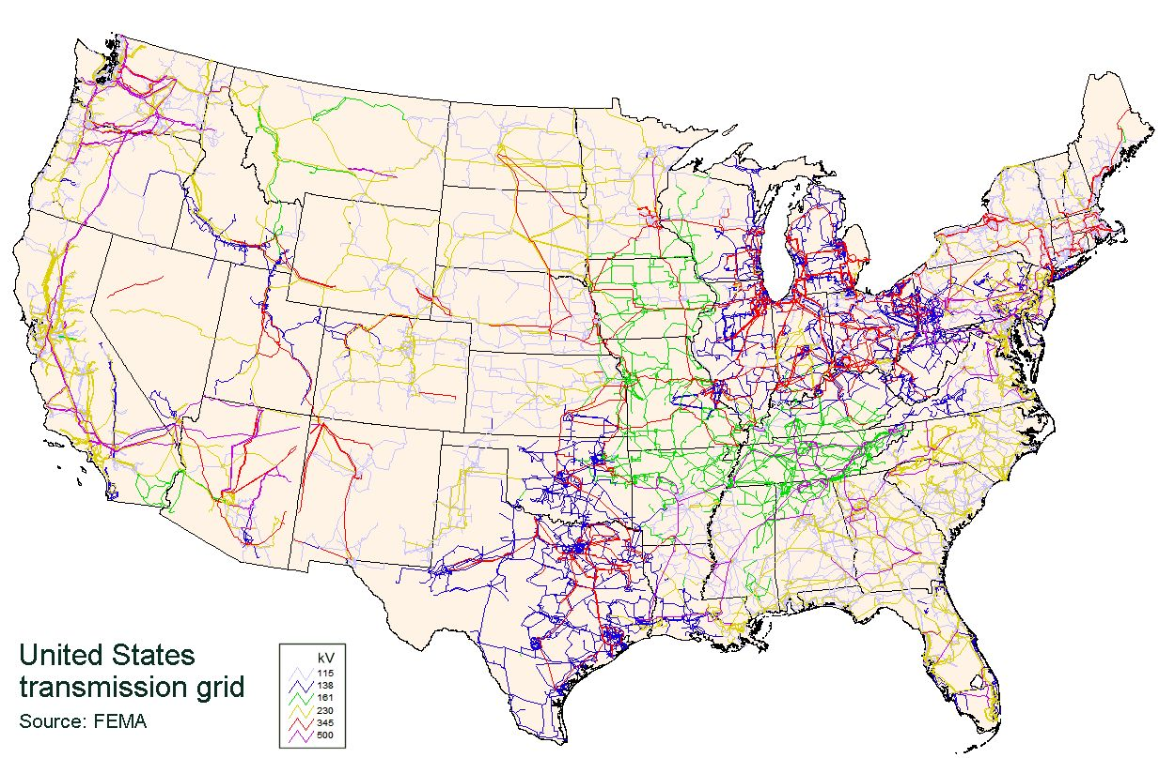









Industry Awards - Transportation Electrification plus Vehicle Demo Sites
Seattle
Portland
Detroit
Sacramento
New York
San Francisco
Washington, DC
Los Angeles
Nashville
Knoxville
San Diego
Phoenix
Chattanooga
Tucson
Dallas/Fort Worth
Austin
Orlando
*
Houston
*
* tbd
US transmission grid; Source: FEMA

Slide 7
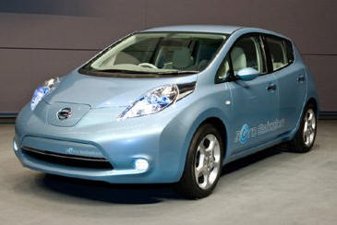
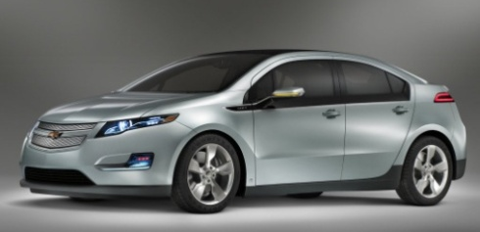
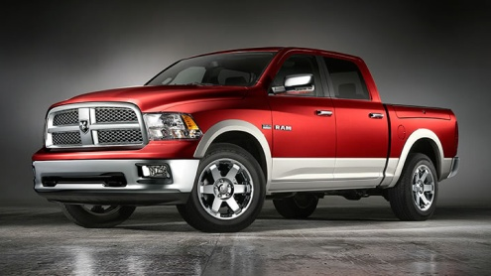
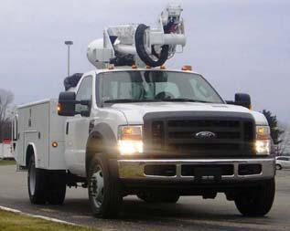
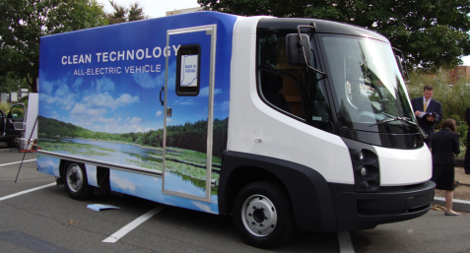

Vehicle Evaluations - Vehicle Data Collection
Data collected for each driving event:
  Data recorded for each key on/key off event
  Event Type (key on/off), date/time stamp
  Vehicle ID, Odometer, GPS location
  Battery SOC, Liquid Fuel consumption
Vehicle data submitted:
  ECOtality: 5,600 Nissan Leafs, Chevy Volts, & Smart EVs
  GM: 150 Chevy Volts
  FORD: 22 Escape SUVs
  Chrysler: 163 PHEV pickups & vans
  SCAQMD: 200 pickups, vans, & SUV PHEVs
  Smith: EV 187 BEV Delivery trucks
  Navistar: 110 BEV Delivery trucks

Slide 8
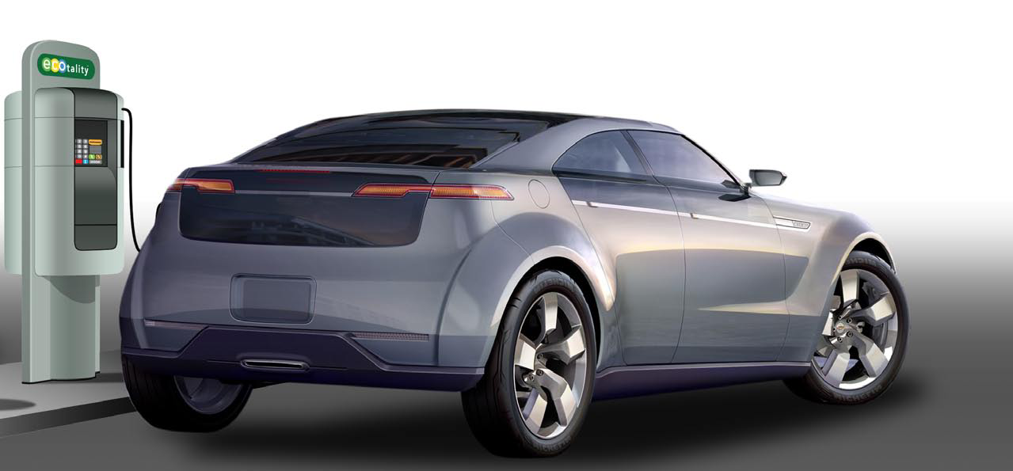
Vehicle Evaluations - EVSE Data Collection
Data collected for each charging event:
  Connect, start charge, end charge and disconnect times
  Average power (kW), max. peak power (kW), total energy (kWh) and rolling 15 min. average peak power (kW)
  Charger ID, event ID and date/time stamp
EVSE providers submit data weekly:
  ECOtality: 7,600 AC Level 2 EVSE; 40 DC fast chargers
  Coulomb: 3,100 AC Level 2 and Levels 2 and 1 Combo EVSE
  Eaton & Aerovironment: 150 AC Level 2 public
Additional demonstration data:
  Testing of efficiencies and standby power: Aerovironment, Blink, ChargePoint, Clipper Creek, Eaton, Leviton, SPX, Voltec

Slide 9
Vehicle Evaluations - Information Management
Data Collection
  INL collects and manages light duty vehicle and charger data
  NREL collects and manages medium duty vehicle data
Data Analysis and Reporting
  Vehicle and charger performance, efficiency and utilization
  Drivers’ charging patterns and public charging use
  Impact of various rate structures on charging habits
  Impact of vehicle charging on electric grid
Report Dissemination
  Web-based per NETL, DOE and ARRA requirements
  Fact Sheet reporting began Q2 FY 2011
  Utilization and impacts reports are published annually

Slide 10
Vehicle Evaluations -Thermal Runaway Events
The AVTA supports the development and introduction of new technology electric drive vehicles by benchmarking DOE investments in advanced technology components, energy storage devices, and vehicle systems, as well as advanced charging infrastructure
AVTA test vehicles have included preproduction vehicles from OEMs and conversion companies
The AVTA has never experienced a thermal event with an OEM production vehicle
AVTA’s direct experience with thermal events includes
  Passenger battery electric bus
  Conversion company conversion of a HEV sedan to a PHEV
  Conversion company conversion of a HEV SUV to a PHEV
  Original equipment manufacturer (OEM) preproduction PHEV

Slide 11
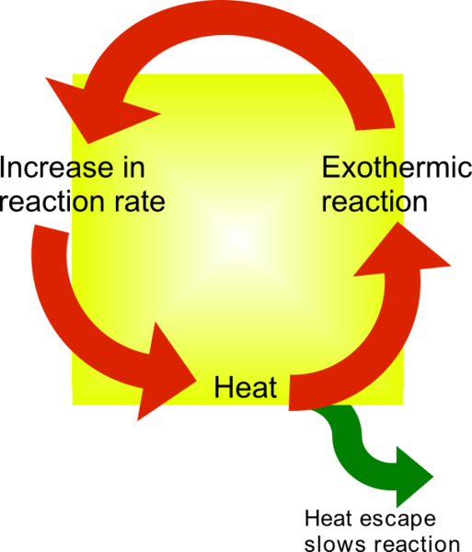
Vehicle Evaluations –
Dynamics of Thermal Runaway Reactions
Stable exothermic chemical reactions
  Heat produced = Heat removed
  Product of Pressure and Volume are constant
  Constant temperature at steady state
  Constant reaction rate at steady state
  Heat production rate is constant at steady state
Thermal Runaway is an unstable exothermic chemical reaction
  Heat produced > Heat removed
  Pressure and Temperature Increases
  Reaction rate increases
  Heat production rate increases
  Mutually reinforcing cyclic reaction is unstable
  Unchecked it may result in boiling of the reaction mass, explosion, and/or secondary fire
Exothermic reaction
Heat
Heat transfers out
ΔH = ΔE + Δ(PV)
ΔE = q - Δ(PV)
ΔH = q - Δ(PV) + Δ(PV)
- Δ(PV) + Δ(PV) = 0
ΔH = q
Change in enthalpy equals heat transfer out
Image Source: http://pysystems.ca/blog/2011/06/20/what-is-thermal-runaway/

Slide 12
Vehicle Evaluations -
Thermal Runaway Lessons Learned
Unintended battery discharging and resulting thermal events have not occurred in any production vehicle the AVTA has tested during 61 million test miles, with 9,100 electric drive vehicles
Full battery thermal events can be suppressed or “finished” by:
  Disassembling the pack (thus discharging) and applying water to cool the pack to avoid in-pack and in-vehicle combustible materials from burning
  Allowing the event to continue unsuppressed and ensuring personnel and facility safety, and an exhaust stream, will ultimately result in all combustible materials burned and vehicle destroyed (but the fire will be out!)
  Using trained electrical safety worker to discharge the pack while applying cooling (water) will stop combustible materials from burning (INL’s recent experience)
    However, this should only be undertaken by electric safety trained workers with large battery pack safety and equipment experience
    May take hours or days depending on vehicle location

Slide 13
Vehicle Evaluations - Thermal Runaway Events Passenger Battery Electric Bus
The AVTA provided assistance investigating bus battery melting events at the Grand Canyon
3 packs per bus, 108 total NiCad modules per bus
Approximately 60 modules melted
Causes included:
  A battery module was installed incorrectly by the bus manufacturer to repair prior minor module damage from battery arcing as a result of an inadequately tightened terminal,
  Ignition resulting from electrolyte tracking in the watering system
  Ignition due to defective construction resulting from arcing under load

Slide 14
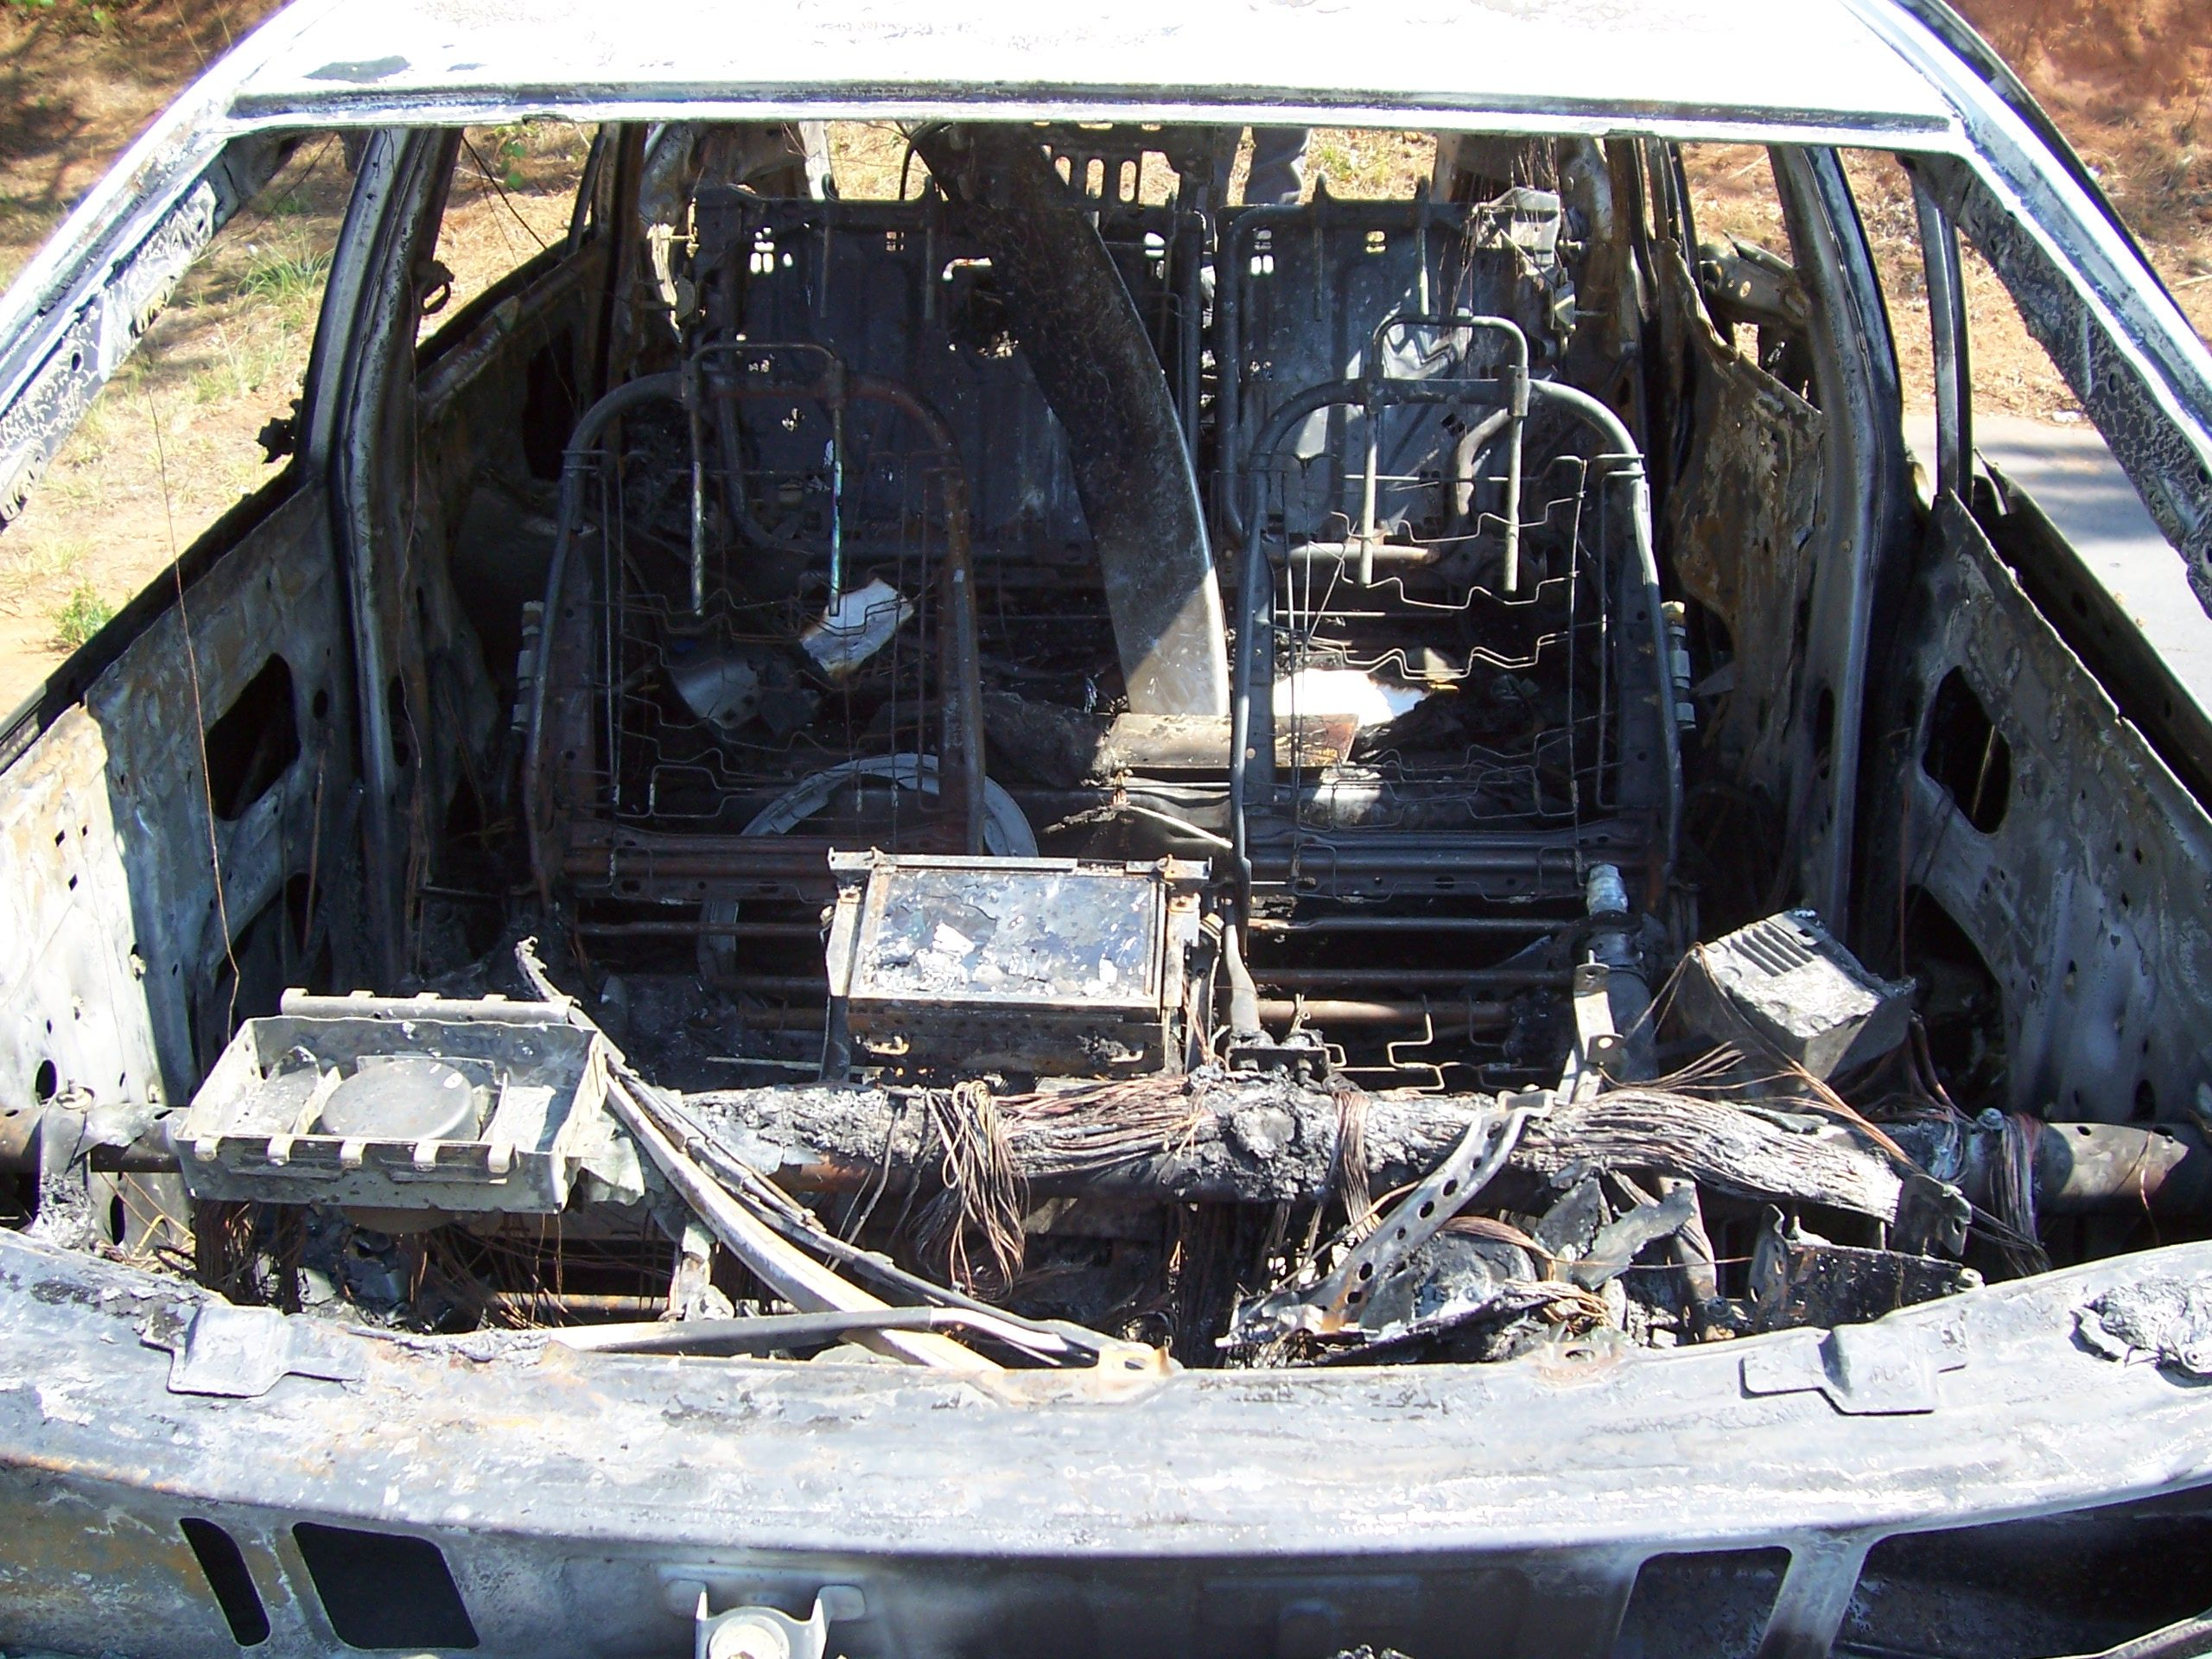
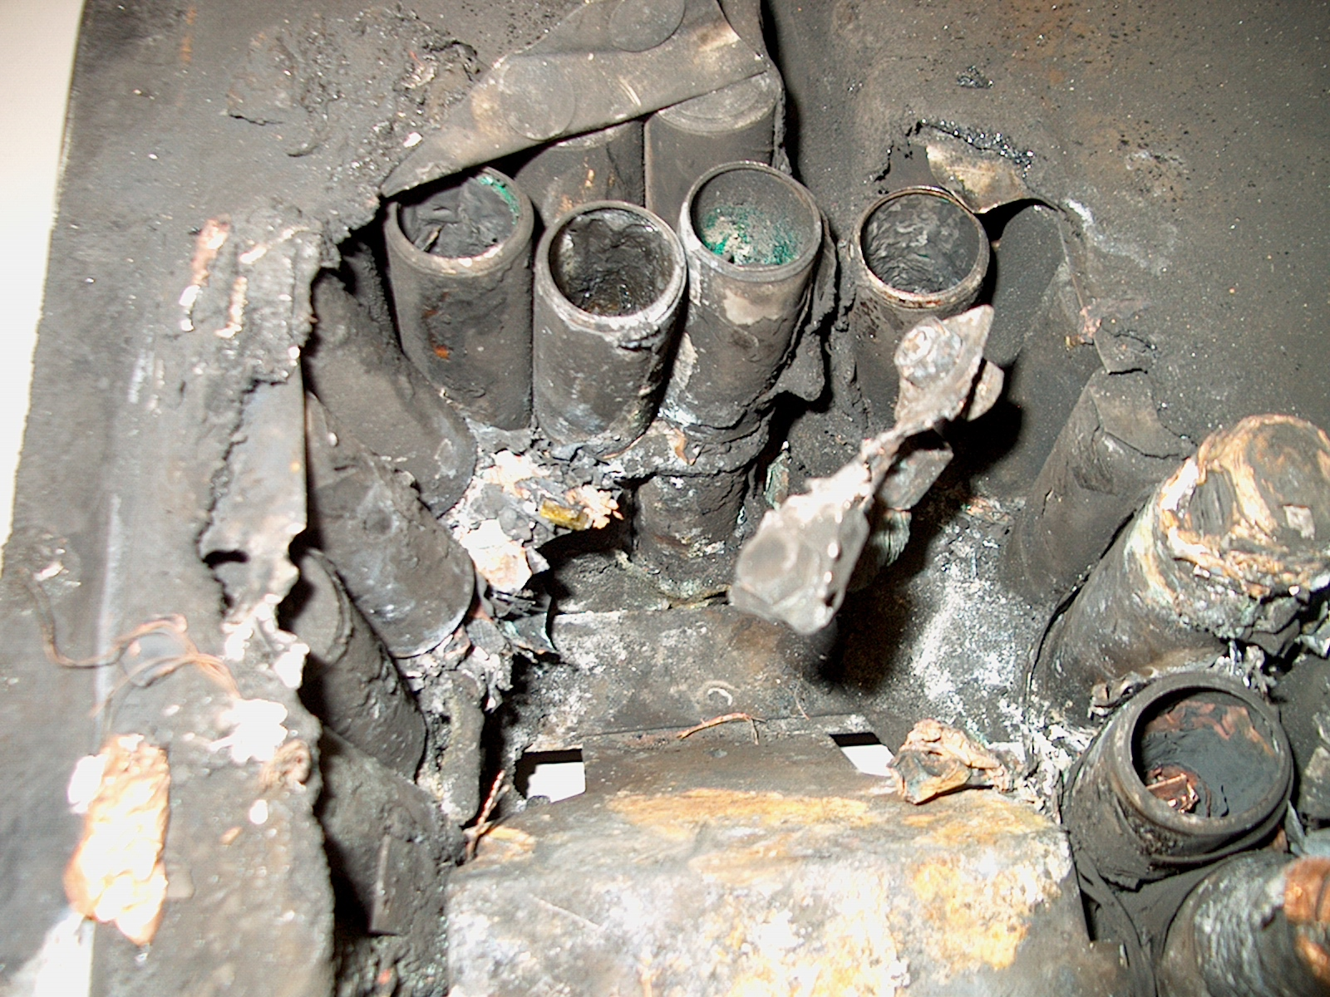
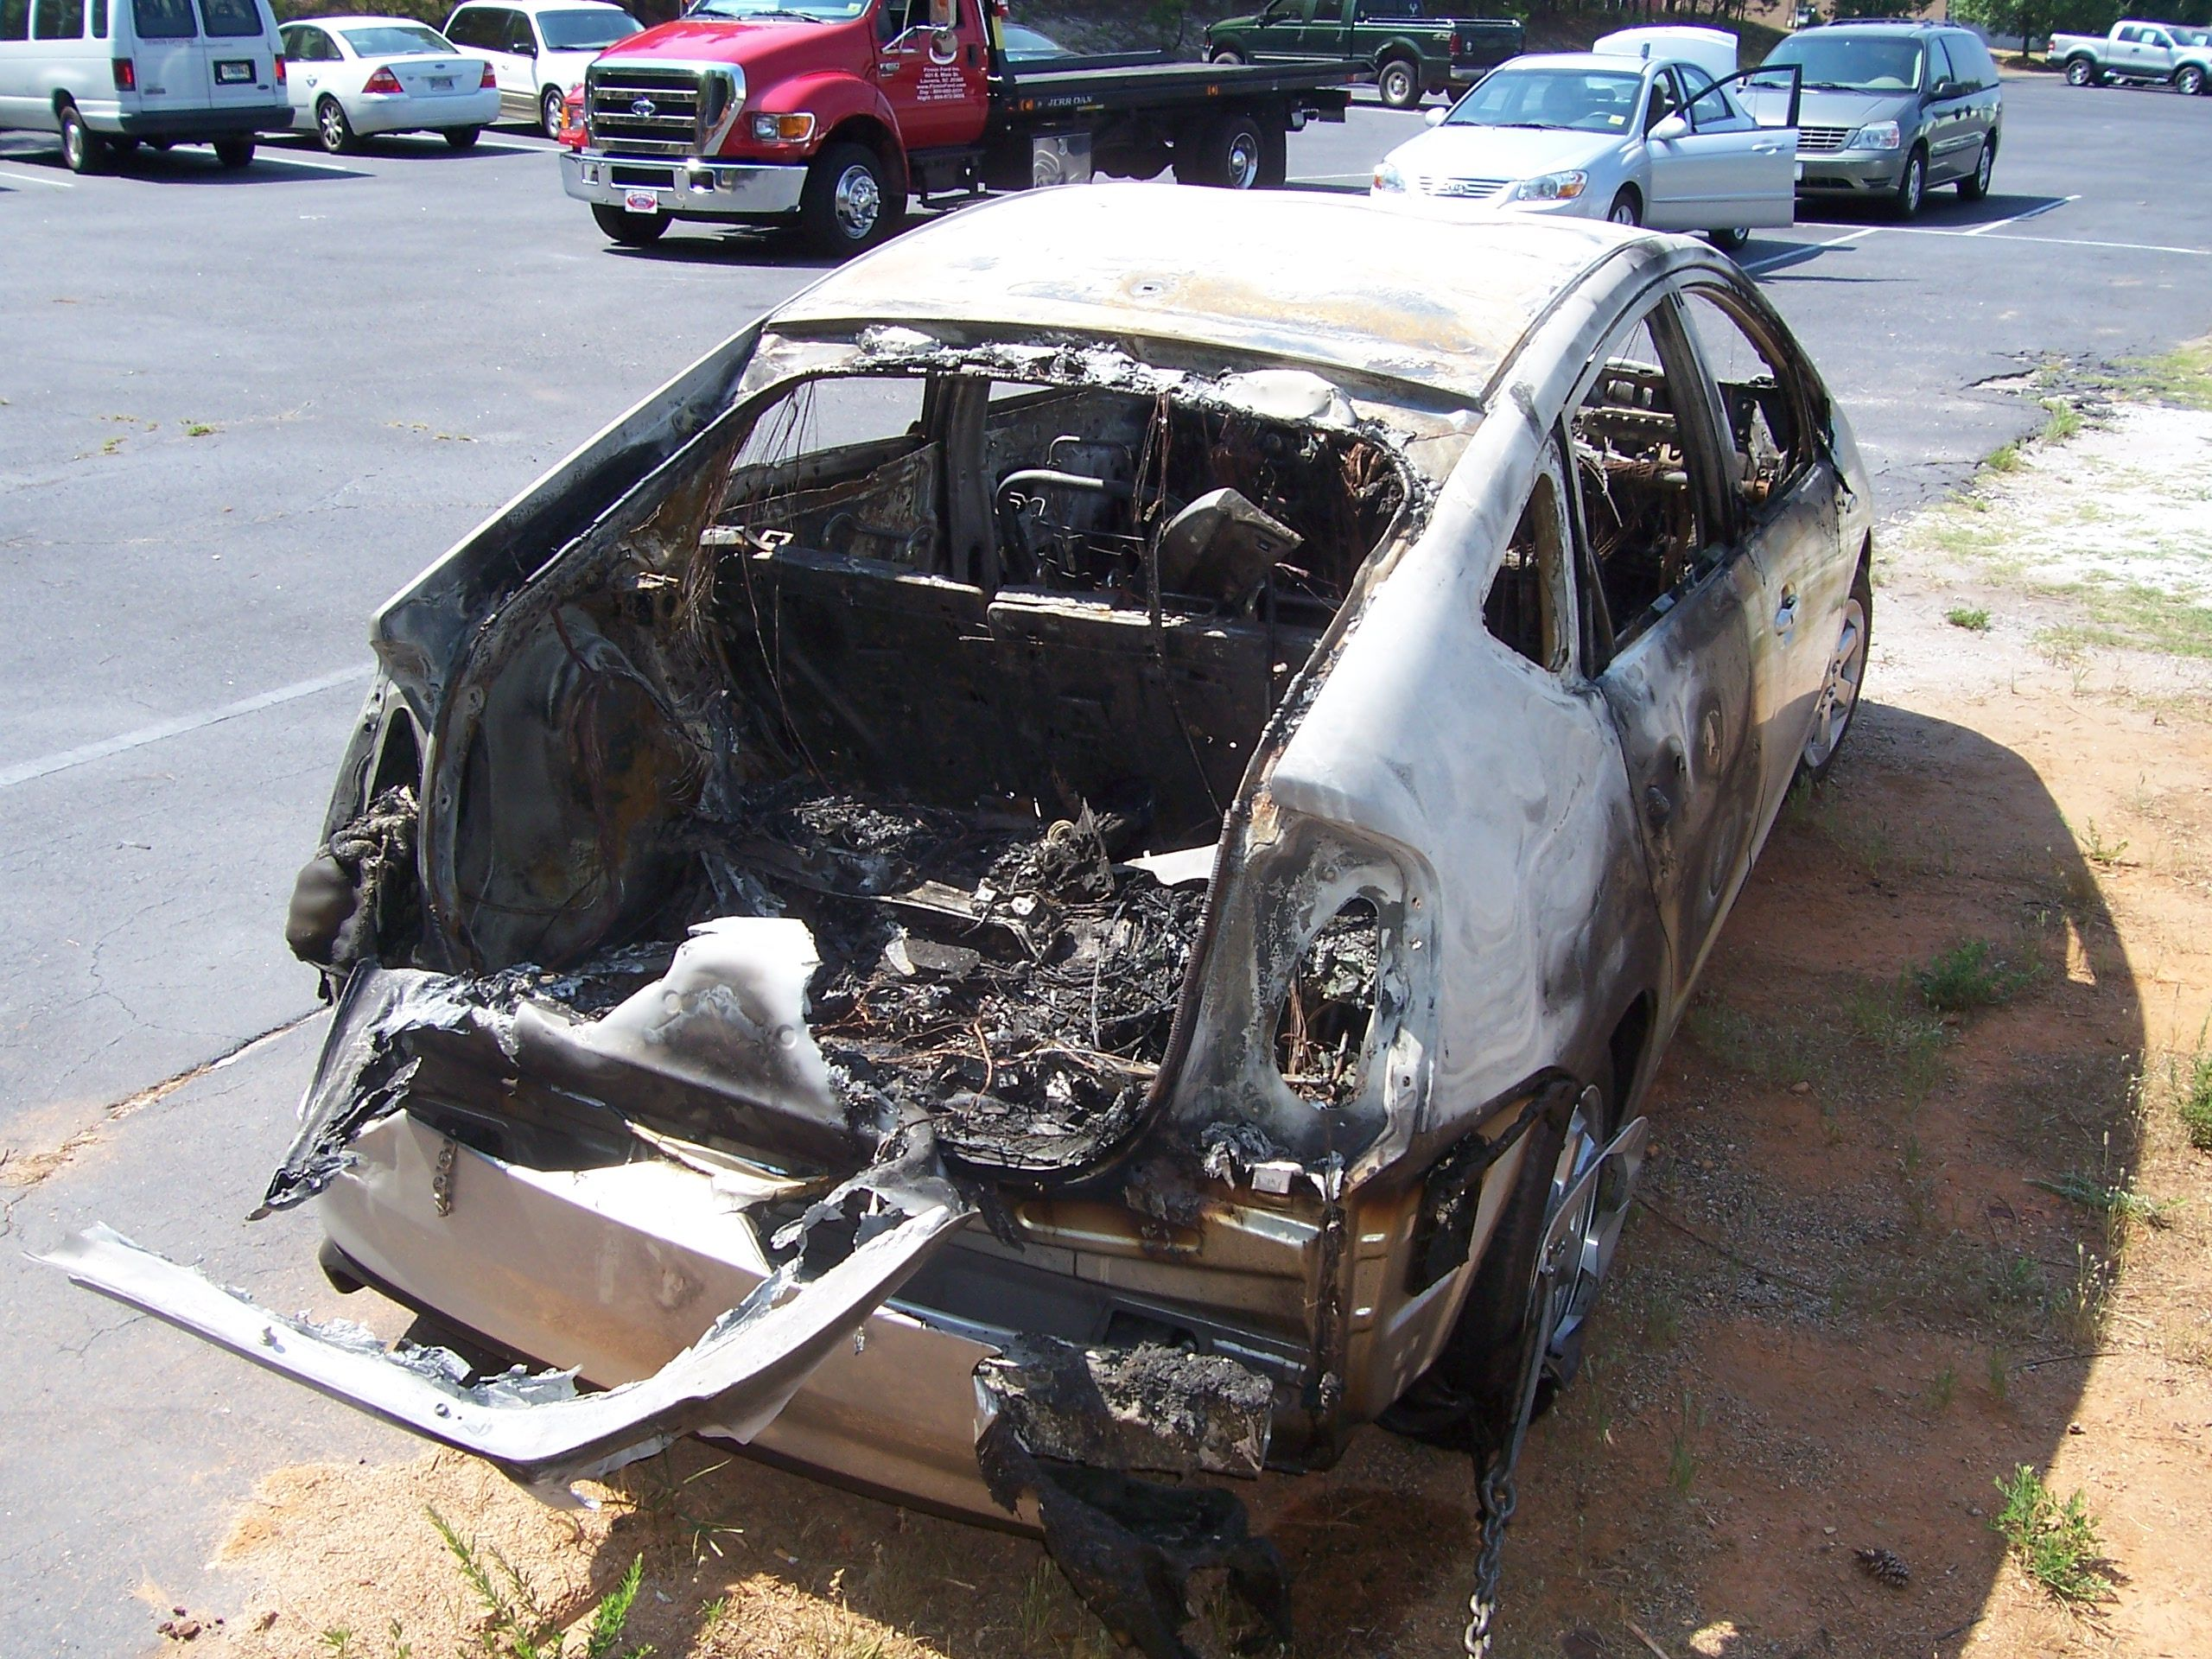
Vehicle Evaluations - Thermal Runaway Events Conversion of an HEV Sedan to a PHEV
The AVTA was benchmarking the performance, use and charging profiles of a conversion PHEV in the South Eastern U.S.
In this case, the conversion company used a HEV sedan as the base vehicle and converted it into a PHEV-15 by adding a lithium ion battery
Note that the conversion company did not follow the battery manufacturer’s guidelines
Smoke filled the vehicle cabin while the vehicle was being driven and the driver pulled over and noted fire in the right side of the rear cargo compartment, and the vehicle was consumed
Event occurred in a rural area and there was no fire suppression
Likely cause was a loose high voltage connection within the battery enclosure
At autopsy, high voltage was still present in the damaged battery

Slide 15
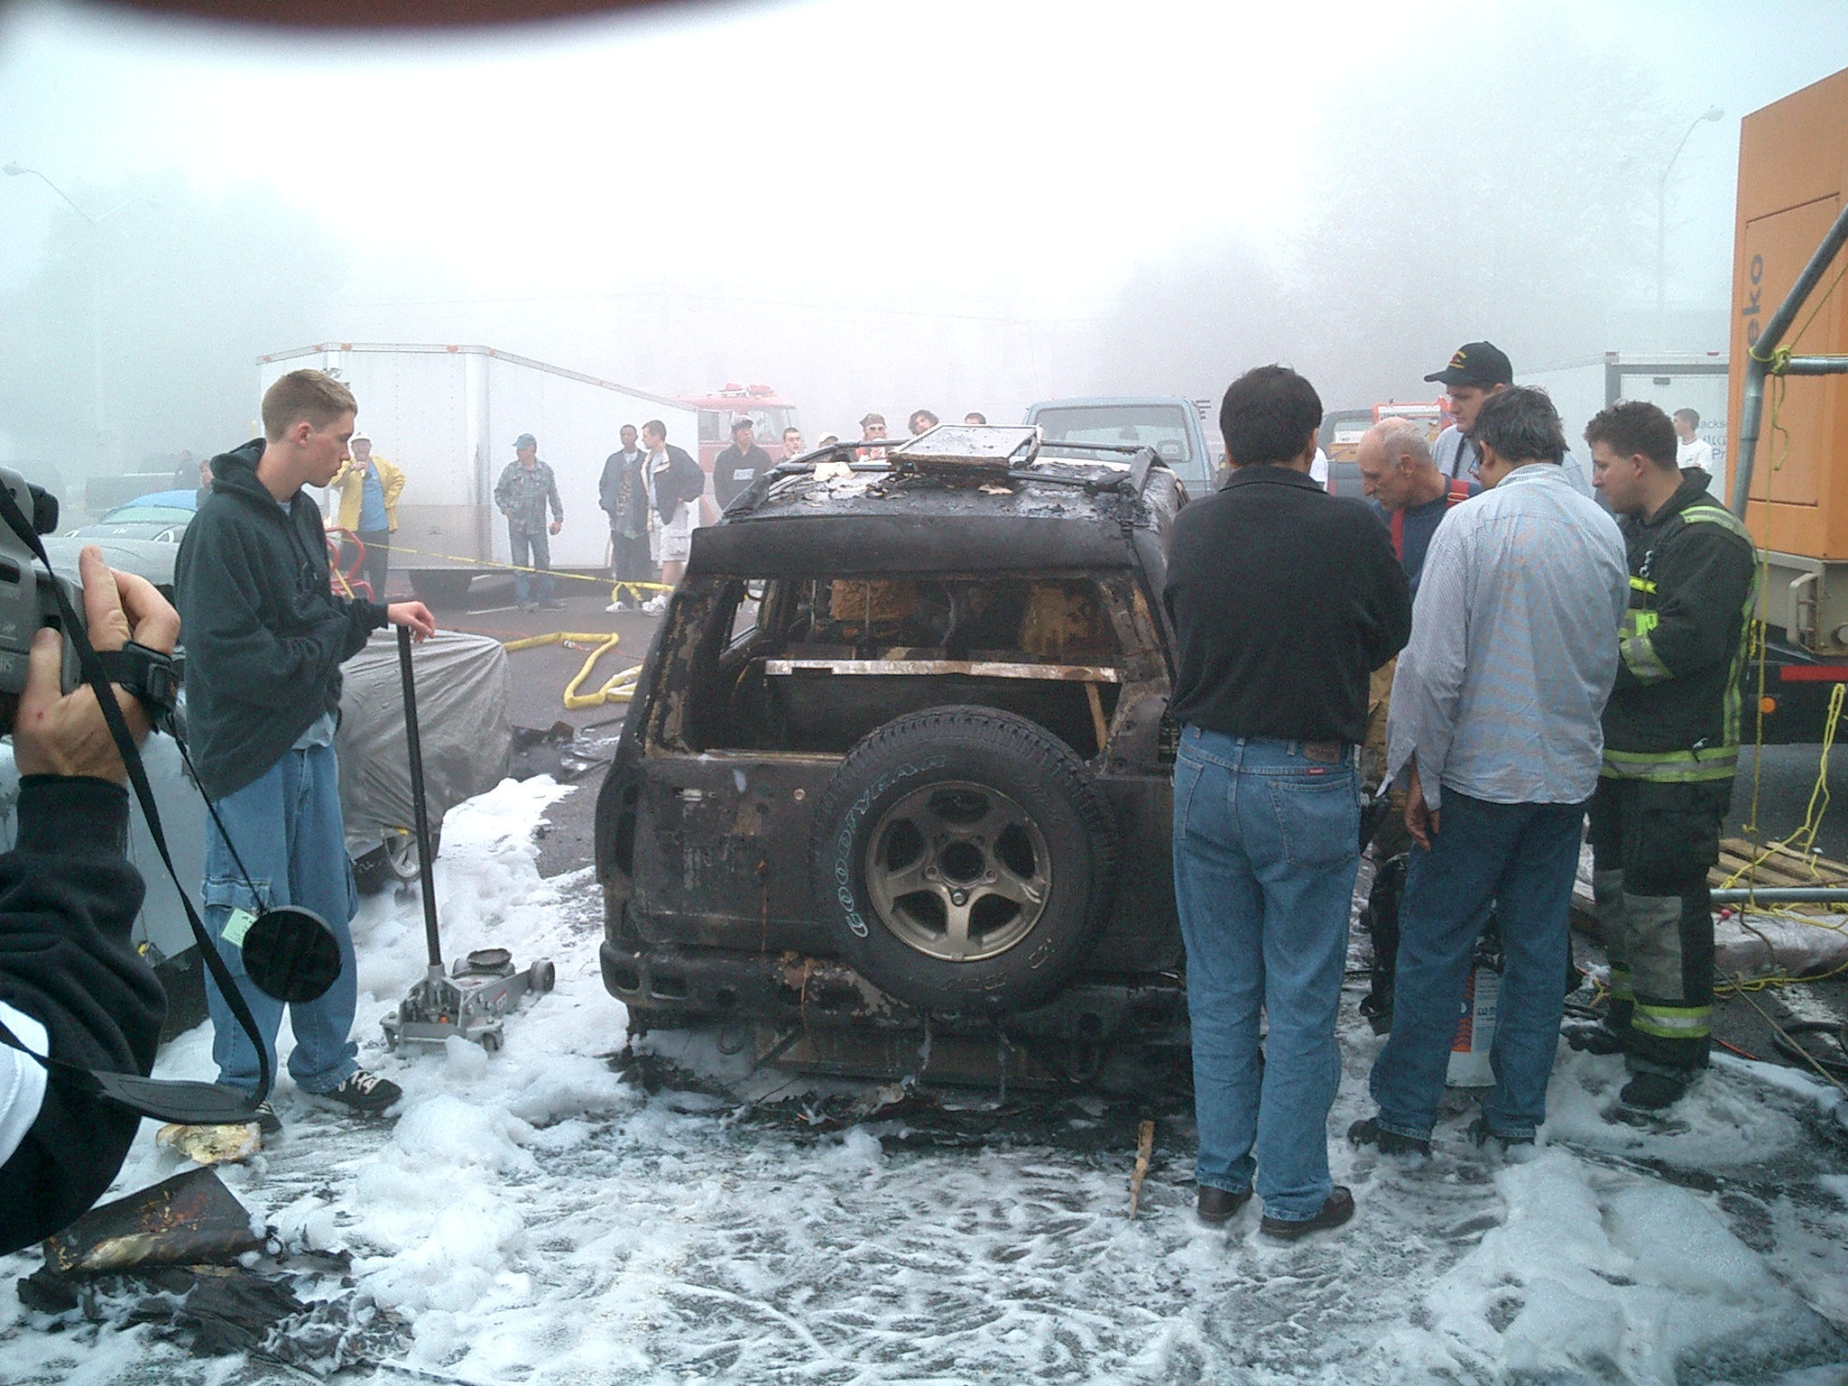
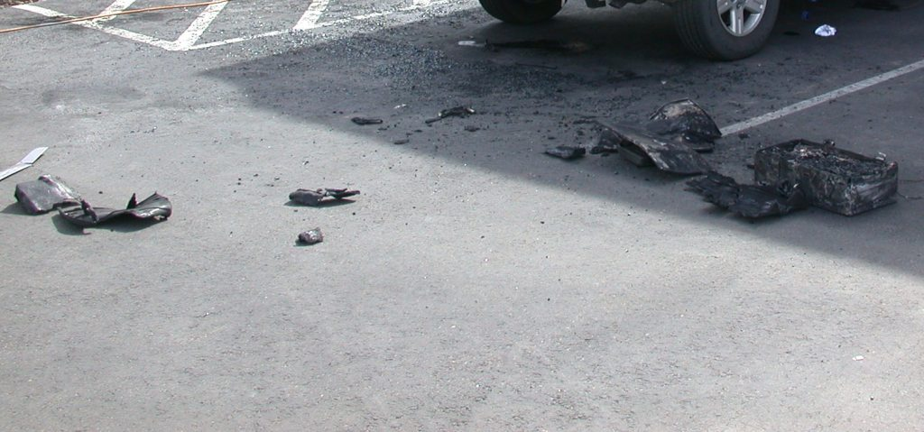
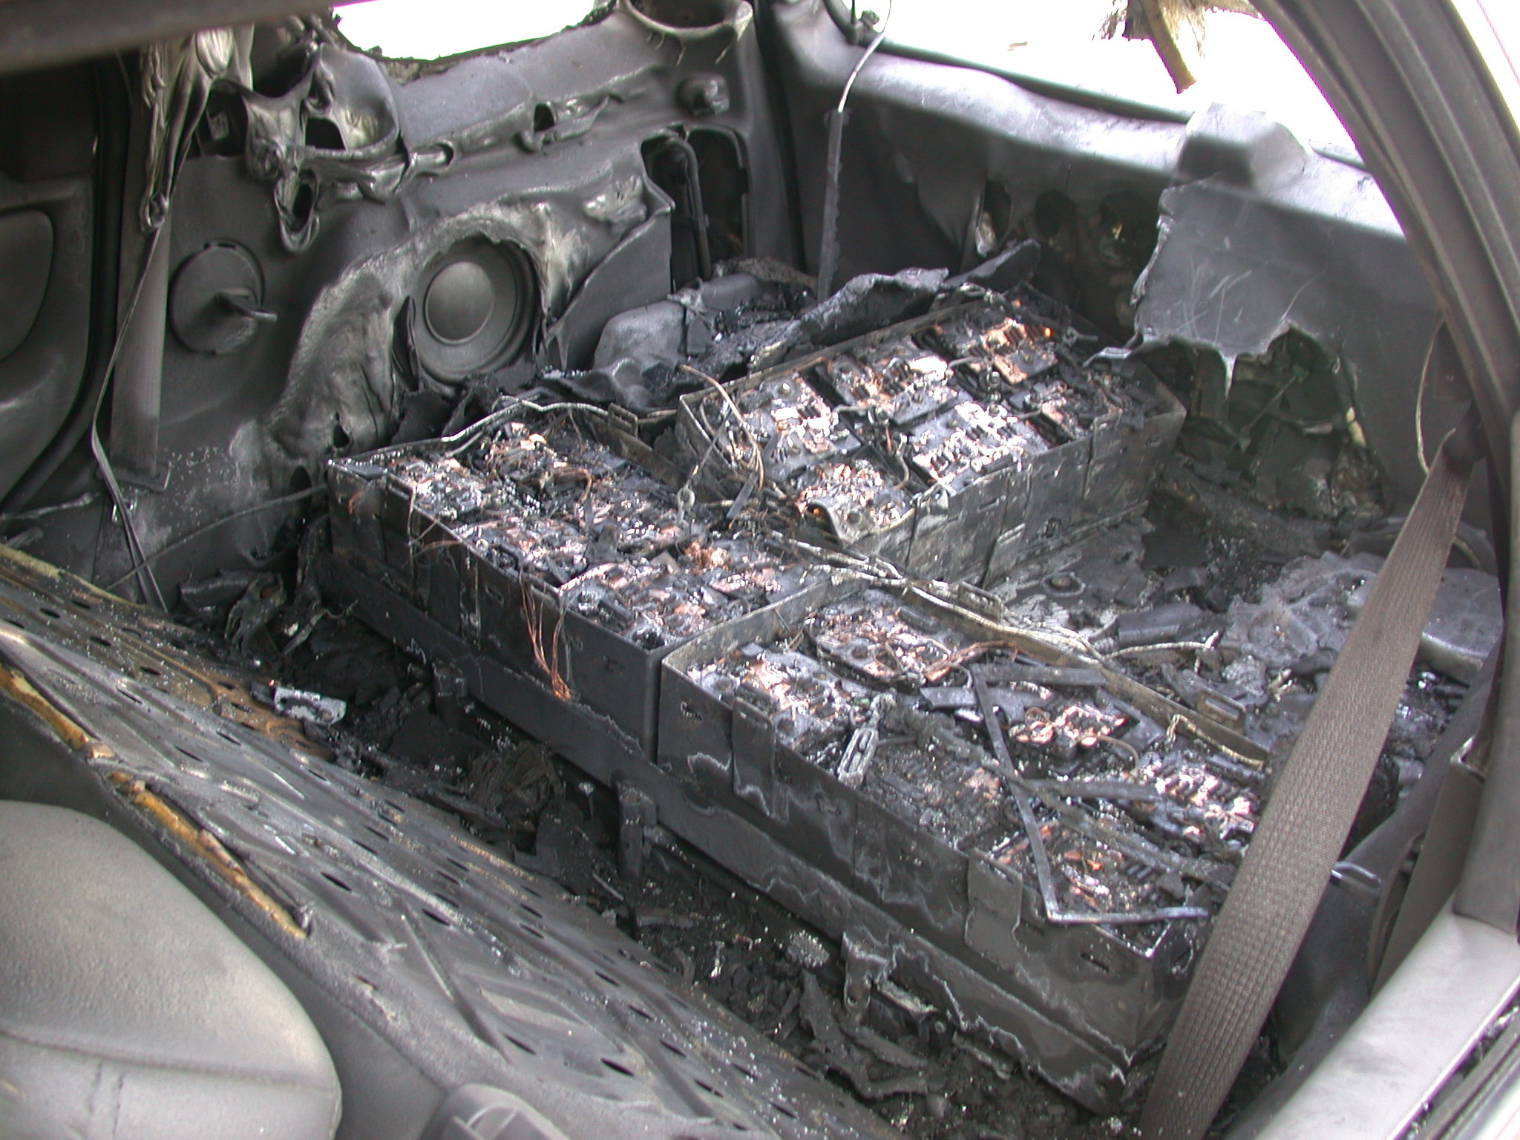
Vehicle Evaluations - Thermal Runaway Events Conversion of an HEV SUV to a PHEV
The AVTA was benchmarking the performance, use and charging profiles of this conversion PHEV. The conversion company used a HEV SUV as the base vehicle and converted it into a PHEV with their own 12 Kwh lithium ion battery
Vehicle was parked overnight and security guard called the fire department when smoke was observed at approximately 2 a.m.
Cause was several over-charge events, likely caused by onboard battery charger or BMS failure. Cells overheated
Vehicle did not catch fire but suffered heat and smoke damage
It is believed high voltage was still present in the damaged battery
Fire department forcibly removed part of the pack and applied water
Event damage and partial pack removal stopped overcharging and internal shorting, while water cooled the pack
Bottom left is an earlier vehicle from the same converter at a student competition

Slide 16
Vehicle Evaluations - Thermal Runaway Events OEM Pre-Production PHEV
The AVTA was benchmarking the performance, use and charging profiles of an OEM’s prototype PHEV that used a battery supplier’s 12 Kwh lithium ion battery.
Three events with this design, with one occurring at the INL
During the first day, during a short drive, the vehicle shutdown twice. After 30 seconds of key cycling, the vehicle restarted. Returned to outside INL parking lot and connected to EVSE
  Manufacturer called and directed disconnecting from EVSE
  While discounting the vehicle from the EVSE, smoke was observed coming from the closed cabin
  Smoke source was the PHEV pack
  Fire department (FD) disconnected 12 Volt battery, removed PHEV battery lid, and 250 gallons of water applied over two hours
  When water was interrupted, smoke would reappear
  After two hours, the FD left and a garden hose was used to continue the water stream into the PHEV battery with the lid off
  Three times over six hours, the water was turned off and smoke resumed. It was decided to leave the water running into the pack all night

Slide 17
Vehicle Evaluations - Thermal Runaway Events OEM Pre-Production PHEV (continued)
It should be noted that a conscience decision was made to preserve the battery pack for autopsy if staff safety was not jeopardized. Immediately putting out the fire by disassembling the pack across the parking lot was not the preferred course of action
The second day saw a series of water removal, pack warming, and the resumption of smoke coming from the pack
  In the afternoon, the vehicle and battery manufacturers arrived
  Water was removed and again the pack heated and smoke reappeared
  With high temperatures below freezing, with full electrical safety gear, INL battery technicians measured the voltage across each of the four modules: 0.9, 87.5, 3.1 and 14.3 V
  Using a thermal imager, pack temperatures were: 8 a.m. -1C, 8:15 a.m. 15C and 10 a.m. 40C
  It was agreed that the 87.5 V module had to be safely discharged before the vehicle could be safely shipped

Slide 18
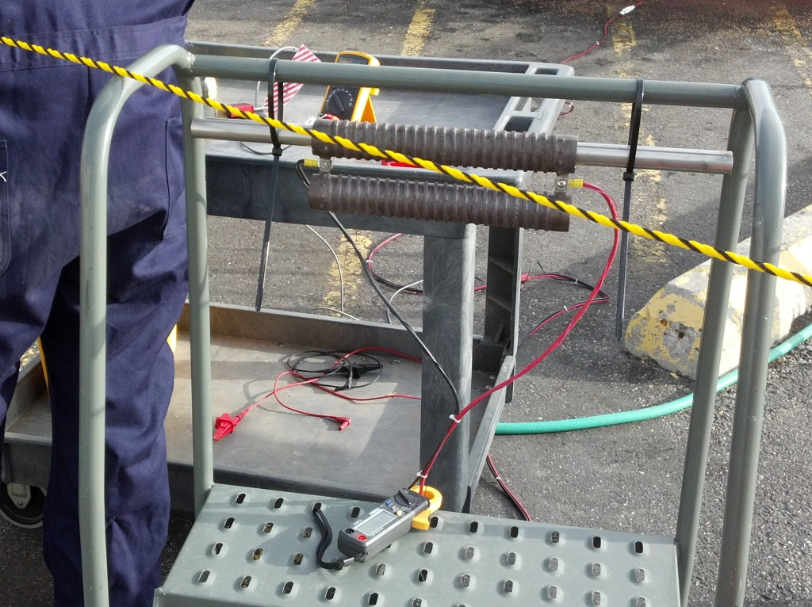
Vehicle Evaluations - Thermal Runaway Events OEM Pre-Production PHEV (continued)
The third day, again with full electrical safety gear, power resistor bank was used to discharge the 87.5 V module for about 2.5 hours
  In the same module order as previously, the modules voltages were now 0.0, 9.0, 0.8 and 8.99 V
  While the pack was believed to be stable, running water was again placed on the pack overnight
After removing water the morning of the fourth day, the pack was stable, no temperature rise and no smoke present
  Vehicle was shipped off site for autopsy with vermiculite on top of the pack as a further safety step
INL’s and the other two events likely resulted from the battery manufacturing process
  Not properly insulating wires used for diagnostics after they where cut when installing them into the vehicles
  High and low voltage wires rubbing together from vibration and high voltage flowing to low voltage pack diagnostics, and ultimately, the cells
Power resistor bank

Slide 19
Vehicle Evaluations -
Thermal Runaway Lessons Learned
U.S. Departments of Energy and Transportation (NHTSA), and the National Fire Protection Association (NFPA), via DOE’s INL, are developing a vehicle fire suppression program
  OEMs, through the Alliance of Automobile Manufacturers, are also participants and will be contributing full size lithium ion plug-in electric and pure electric vehicle traction battery packs
  Packs will be used to demonstrate suppressed and non-suppressed outcomes via the NFPA fire trainer vehicle
  Target audience is first responders
  Film will be part of the education and training materials
Diagnostics tools that identify battery cell conditions, as measured by high and low voltage on a per cell basis can be predictors of:
  Internal soft shorts
  Accelerated cell aging
When one cell self discharges (lower voltage) faster than pack cells, it may be predictor

Slide 20
Appendix
Backup Slides
  Vehicle Systems Overview
  Industry Awards Demonstration Projects

Slide 21
Vehicle & Systems Simulation & Testing Missions
Focus Area activities provide direct and indirect support for evolution of high efficiency vehicles as real world product offerings
Focus Areas engage stakeholders & partners to provide enablers & remove barriers
Component & Systems Evaluation
Validate performance of advanced components in a systems context via R&D activities in Virtual Vehicle Environment
Lab & Fleet Vehicle Evaluation
Benchmarking of real-world performance for advanced vehicle technologies
Validate vehicle modeling/simulation tools
Collection of 112M miles of on-road operational vehicle test data by 2015
Stakeholders & Partners
Grant Recipients
OEMs
Utilities
Consumers
Fleet Owners
VTP Programs
DOE Programs
Policy Makers
Modeling & Simulation
Develop & use modeling tools to support development and analysis of vehicle components & systems
Focus & accelerate R&D activities on technologies of greatest potential for petroleum displacement
Vehicle Systems Optimization
Reduce auxiliary and parasitic loads that significantly affect vehicle efficiency
Speed introduction of wireless and other charging solutions
Codes & Standards Development
Development standards for grid-connected vehicle infrastructure, communication, testing, safety, etc.
Eliminate barriers & smooth transition of advanced technologies
Notes:
Focus areas interact with each other by …….. (yellow arrows)
Focus Area activities provide direct and indirect support for evolution of high efficiency vehicles as real world product offerings
Done through analytic evaluation tools and providing results to Key Stakeholders
Products fed to consumers & OEMs

Slide 22
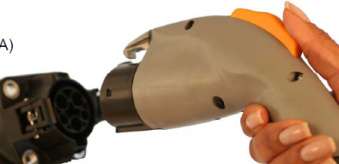
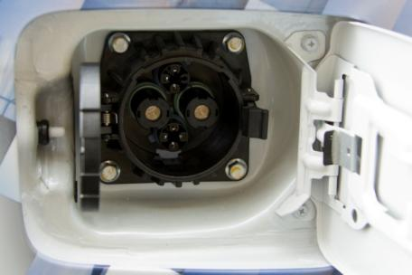
Codes and Standards
Recommended Practices for Plug-in Vehicles, Charging Equipment
and Grid Connectivity
SAE standards committees participation
Development and validation of standards
Technology development
National Recommended Practices for permitting and installation of charging equipment (streamlined/automated process) turned over to Clean Cities.
Notes:
List shows standards that are currently under development.
22

Slide 23
Industry Awards - Transportation Electrification
American Recovery and Reinvestment Act (ARRA)
Drivers
  Transportation accounts for 2/3 of US oil use, 1/3 GHGs and is the second largest expense for most American families
Objectives
  Development, demonstration, evaluation and education projects to accelerate the market introduction and penetration of electric drive vehicles … to substantially reduce petroleum consumption
  Create US-based jobs and support the goal of 1M plug-in hybrid or electric vehicles (PEVs) on the road by 2015
$2.4B ARRA grants awarded by Vehicle Technologies
  $400M Vehicle/Infrastructure Learning Demonstration Program
    8 projects; Approximately 13,000 PEVs and 20,000 chargers (aka Electric Vehicle Supply Equipment, or EVSE)

Slide 24
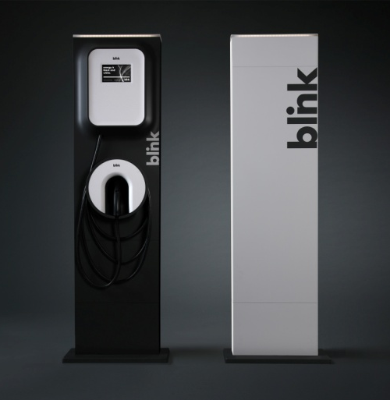
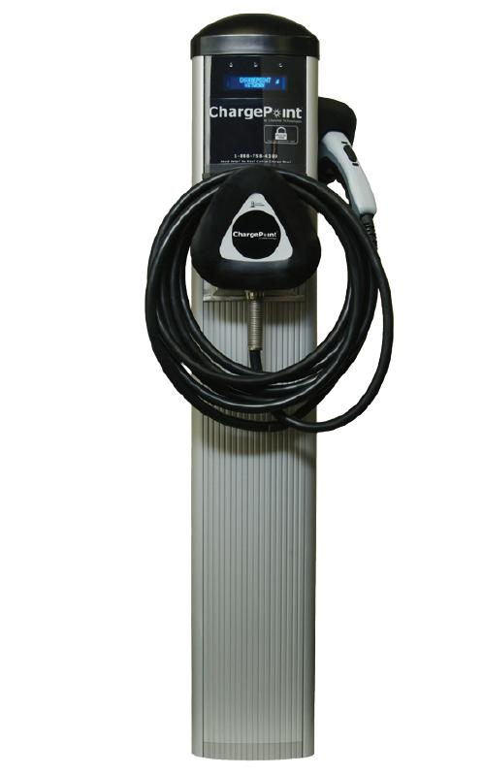
Industry Awards - Transportation Electrification
EVSE/Infrastructure Installers
ECOtality - $114.8 M
~14,850 AC L2 and 200 DC L2 EVSEs
Coordinated with sale/lease of ~5,700 Nissan Leaf EVs and ~2,600 Chevy Volt E-REVs (aka PEVs)
Instrumented vehicles and EVSEs
Deployment scheduled to be complete Dec. 2011
Coulomb Technologies - $15 M
~4,600 public and private EVSEs
Locations coordinated with deployment of 2,600 PEVs from GM (Chevrolet Volt), Ford (Transit Connect EV) and Smart USA
Deployment is scheduled to complete in June 2011

Slide 25
Industry Awards - Transportation Electrification PEV Suppliers – Light Duty
General Motors - $30.5 M
125 Chevy Volt E-REVs through electric utility fleets
~650 EVSEs in home, workplace, and public
Deployment began 2010
Data collected through GM OnStar
Chrysler - $48 M
140 PHEV Dodge Ram pickups
11 partner fleets … to refine PHEV requirements
Built off of the existing Dodge Ram Hybrid platform,
deployment scheduled to begin mid-2011

Slide 26
Industry Awards - Transportation Electrification PEV Suppliers – Medium Duty
Navistar - $39.2 M
950 electric delivery trucks (12,100 lbs GVWR)
Deployment scheduled to be complete in 2011
Smith Electric - $32 M
500 electric delivery trucks
20 launch partners; commercial and public sector
Deployment scheduled to be complete in 2011

