Slide 1
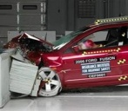






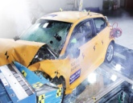


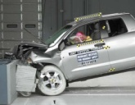

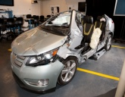
NHTSA Office of Applied Vehicle Safety Research
Crashworthiness Division
Li-ion Based
Rechargeable Energy Storage System (RESS)
Safety Research Programs

Slide 2
RESS Research Program Projects & Process Flow
Failure Modes and Effects Analysis (FMEA)
Test Procedures Development
Analytical Methods for Control System Safety Performance
Diagnostics, Prognostics,
and Operator Indicators/Messages
Data Generation
(with Sandia National Labs)
Control System Functional Safety
Inoperative Vehicle
RESS Diagnostics and
Common/Standardized
Discharge Process(s)
Comparable Safety Metrics with Data for
Li-ion RESS
NHTSA Policy and Rulemaking

Slide 3
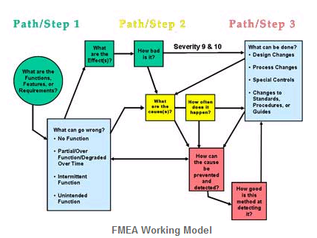
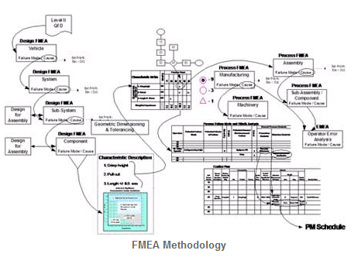
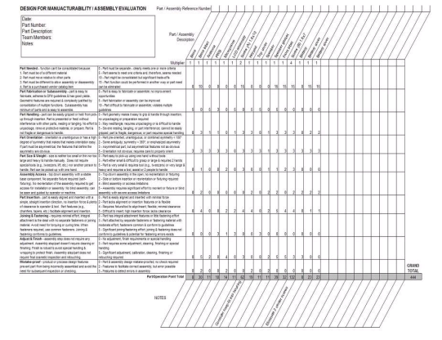
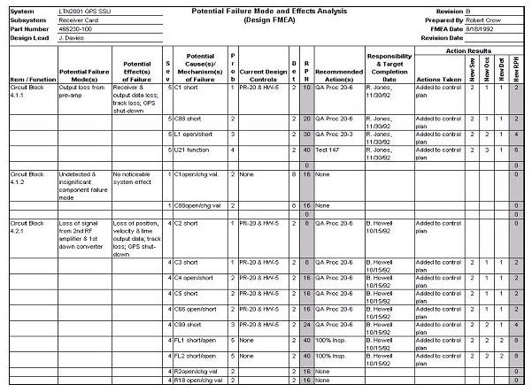
Failure Modes and Effects Analysis
An FMEA is an analytical tool which identifies, lists, and ranks all potential failures and their corresponding effects of the product or process under investigation, in this case Li-ion based RESS Safety Performance
  Battelle Memorial Institute, Columbus, OH
  The results of this FMEA will be used to perform a gap analysis to existing standards and test procedures for thoroughness.
  … (including the Test Procedure Development work plans, Diagnostics and Discharge Process Development, and Control System Safety of the NHTSA research program).
  Draft Report Under Further Development
  First quarter 2013
  Industry Review and Feedback
  Becomes Living Document for Other Safety Analysis

Slide 4








Test Procedure Development
Develop and document repeatable vehicle level safety performance tests procedures.
Addressing critical potential failure modes
Addressing all areas of operation Including: Charging, Normal Operation, Crash, and Post-Crash
Building upon the body of existing standards (SAE J2464, SAE J2929, ECE R100, Etc.)
Data generated from these test procedures will be used to accurately measure the effects of the failure modes generated by both normal and abnormal abuse conditions.
Repeatable, Quantifiable, Comparable, Directly associated to safety risks for accurate analysis
2 Contract Awards: October 2011 – October 2013
Independent testing at Sandia National Labs through January 2014

Slide 5
SAE International RESS Research Program
Safety Performance of Rechargeable Energy Storage Systems (RESS)
Project Objectives:
Develop Li-Ion RESS Safety Test Methods:
  Vehicle level testing when possible
  Component level testing when necessary
  With and without loss of the control system
  Identify and Document:
    Test Conditions
    Boundary Limitations
    Performance Criteria
Develop Performance Based Safety Metrics

Slide 6
SAE International RESS Research Program
Test scope and conditions will include consideration of the following but, are not limited to:
RESS enclosure integrity Electrical abuse & short circuits Electrical isolation Thermal Humidity Altitude Submergence Single and multi-level failure modes Charging states (including overcharge) Capacities and operational states Fire or flame Thermal runaway or propagation Corrosion | Storage / shipping Shock / drop Mounting / retention Vibration / fatigue Impact / penetration / crush Post crash environments Vapor / venting / emissions Leakage of hazardous substances Explosion Flow reversal Aging EMC/EMI and ESD effects Dielectric strength

Slide 7
SAE International RESS Research Program
RESS ancillary subsystem components to be considered for incorporation in the testing plan include:
Onboard Chargers,
Invertors and Convertors
Charging Inlet
Wiring and Connectors
Thermal Management Systems
RESS Packs, Modules & Cells
Voltage Interlocks & Disconnects
Monitoring & Control Interfaces
Protective Devices
Control Systems and Interface
Power Connection Interfaces
Serial Data Communication Bus

Slide 8
SAE International RESS Research Program
Project Timeline:
Single Level Failure Mode
Dual Level Failure Mode
Phase 1 – Develop Test Procedures
Oct 01, 2012 – June, 30 2012
July 01, 2012 – Nov 30, 2012
Phase 2 – Conduct Testing at OEM Labs
July 01, 2012 – Nov 30, 2012
Dec 01, 2012 – Mar 31, 2013
Phase 3 – Refine Procedures & Conduct Verification Tests
Oct 01, 2012 – Mar 31, 2013
Feb 01, 2013 – Jun 30, 2013
Phase 4 – Final Refinement & Documentation
Apr 01, 2013 – Aug 31, 2013
Apr 01, 2013 – Aug 31, 2013
* Project Completion Sept. 30, 2013

Slide 9
SAE International RESS Research Program
System FMEA Development
Recognized Failure Modes
Global Standards Review & Gap Analysis
Test Methodology Development
Test Standards Development
Test Assignment Matrix
Phase 2 – OEM Testing
Phase 1 Methodology - Draft, Preliminary Test Procedures:

Slide 10
SAE International RESS Research Program
OEM Laboratory Phase 2 - Single Level Failure Mode Tests 07/01/12 to 11/30/12
Vibration: Pack Test
Thermal Shock: Pack Test
External Short Circuit Protection: Pack Test
Overcharge Protection: Vehicle Test
Over Discharge Protection: Vehicle Test
Over Temperature Protection: Vehicle Test
Under Temperature Protection: Vehicle Test
Fire Resistance – Short Duration: Pack Test
Fire Resistance – Long Duration: Pack Level
Vehicle Crash Evaluations: Vehicle Test
Water Intrusion Test: Vehicle Test

Slide 11
SAE International RESS Research Program
Independent Laboratory Phase 2: Cell Level Abuse Tests 09/01/12 to 12/31/12
Cell Resilience to Thermal Propagation
Test Description:
Steel Nail Penetration
Ceramic Nail with Ni Contaminant
Ceramic Nail Penetration
Crush
Impact
Forced Internal Short Circuit of Cells
Data to be Collected:
Cell Surface Temperature(s)
Air Temperature
Cell Voltage
Current (if applicable)
Heat Output
Video
Video Thermal Imaging
Vent Gas Analysis

Slide 12
SAE International RESS Research Program
Dual Level Failure Mode
Potential 1st Level Causes Which May Result in Overcharge:
Power related causes
Communications related causes
Voltage Sensor related causes
Voltage detector circuit (ECU) related causes
Main contactor “Driver Circuit ON" failure
Welded contactors
Battery management system fails to initiate "charge stop" signal
Power control/ on-board charger module does not respond to "charge-stop" signal
Single cell overcharge resulting from imbalance
Failure of current sensors
Failure of self check
Assessment Parameters:
"Tell-Tale" detection capability?
Diagnostic code generated?
Can the vehicle be charged in this present state fault?
Is charging allowed during Regen
Functional Safety Tools
  Hazard Analysis & Fail Safe Strategies
  Diagnostic Strategies and Trouble Codes
  Software Strategies and Validation Requirements
  Hardware and System Reliability
  Validation

Slide 13
Ford RESS Research Program
Test development program
  Fault Tree Analysis
  Standards review and gap analysis
  Test procedure development
  In-house testing and analysis
  Test performance measures
  External testing at Sandia National Labs
  Test procedure refinement and documentation
Project Completion October 2013
Additional Sandia Testing through January 2014

Slide 14
Standardized Battery Assessment,
and Field Discharge Procedure
NHTSA and Argonne National labs are working to identify, develop, and demonstrate methods for the safe management and handling of RESS in post-crash and non-operational environments.
Areas of Focus:
Definition of common interface connector and location to support
  Diagnostic interface
  Diagnostic protocol
  Architectural requirements
  Standardized Discharge Port/Terminal
Project Timing :
October 2012 – August 2014
Detailed research plan and timing are currently under development

Slide 15
Analytical Tools Development
Control System Performance Modeling
Scope: Define required operator warning indicators for RESS safety critical criteria. Research prognostic conditions and warnings for for anticipated safety critical events.
Volpe National Transportation Research Center is leading this effort to:
Establish basic Fail-Safe Conditions, Diagnostic Codes and indicators, Data Recording/Storage (e.g., EDR), and Safety Prognostic Requirements
Utilize outputs from FMEA and Discharge projects
Timing: October 2012 – March 2014
Detailed research plan, timeline and deliverables expected January 2013

Slide 16
Cycling Testing to Evaluate Battery Health
Test procedure development for post-crash health and safety performance
  GM and SAE have teamed with Sandia National Labs
  Adapt USABC function cycle test for use in post crash assessment of batteries
  Recently initiated, timeline and test plans are under development

Slide 17
Questions?
Thank you

