Slide 1

Draft Global Technical Regulation
Electric Vehicle Safety
Outline of the OICA proposal
Volker Rothe, OICA
October 23, 2012

Slide 2
Scope of the draft GTR
  Applies to vehicles of Category 1-1 and 1-2, with a gross vehicle mass (GVM) of 4,536 kilograms or less
    Category 1-1 means vehicles with four or more wheels designed primarily for the carriage of persons (not more than eight seats plus driver´s seat)
    Category 1-2 means vehicles with four or more wheels designed primarily for the carriage of persons (more than eight seats plus driver´s seat)
  Applies to vehicles equipped with electric power train containing high voltage bus
  Vehicles permanently connected to the grid are excluded
  Vehicles whose unladed mass is not more than 400 kg and whose maximum continuous rated power is below 15 kW are excluded

Slide 3

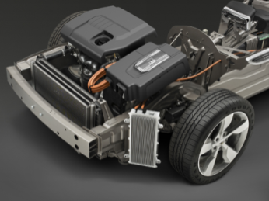
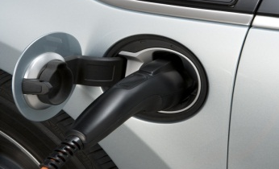
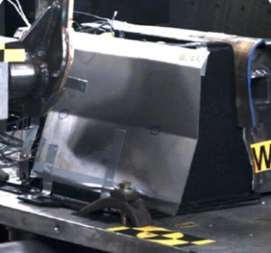
Technical Content of the draft GTR
  In use Requirements:
  Protection against Electric Shock:
    Electrical Protection Barriers, Insulation, Marking
    Isolation Resistance, Potential Equalization
  Functional Safety
    Indication of „Active Driving Possible“ Mode
    Prevent Vehicle Movement during Charging
  REESS
    Thermal Shock and Cycling, Vibration, Mechanical Impact
    Fire Resistance, Over-Temperature Protection
    External Short Circuit Protection
    Overcharge Protection, Over-Discharge Protection

Slide 4
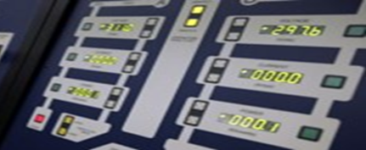

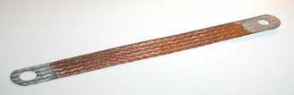
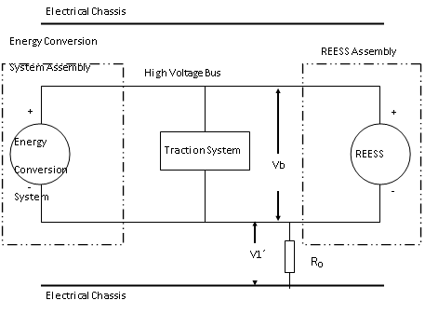
Technical Content of the draft GTR
  Post Crash - Protection against Electric Shock
  At least one of the “Four Criterias” shall be met:
    Absence of High Voltage (30 VAC or 60 VDC)
    Low Electrical Energy (0.2 Joules)
    Physical Protection:
      Protection against direct contact (IPXXB)
      Protection against indirect contact
      (potential equalization 0.1 Ω)
    Isolation resistance
      100 Ω/volt for DC buses
      500 Ω/volt for AC buses

Slide 5
Technical Content of the draft GTR
  REESS Post Crash Requirements
  Electrolyte leakage:
    No electrolyte leakage from REESS into the passenger compartment
    No more than 7 per cent by volume of the REESS electrolyte capacity spilled from the REESS to the outside of the passenger compartment
  REESS Retention
    REESS located inside the passenger compartment shall remain in the location in which they are installed
    No REESS that is located outside the passenger compartment shall enter the passenger compartment
  Fire hazard
    1 hour after the crash test, there shall be no fire of the REESS

Slide 6
Thank you !
OICA Draft
Global Technical Regulation
Electric Vehicle Safety

